Slide 1
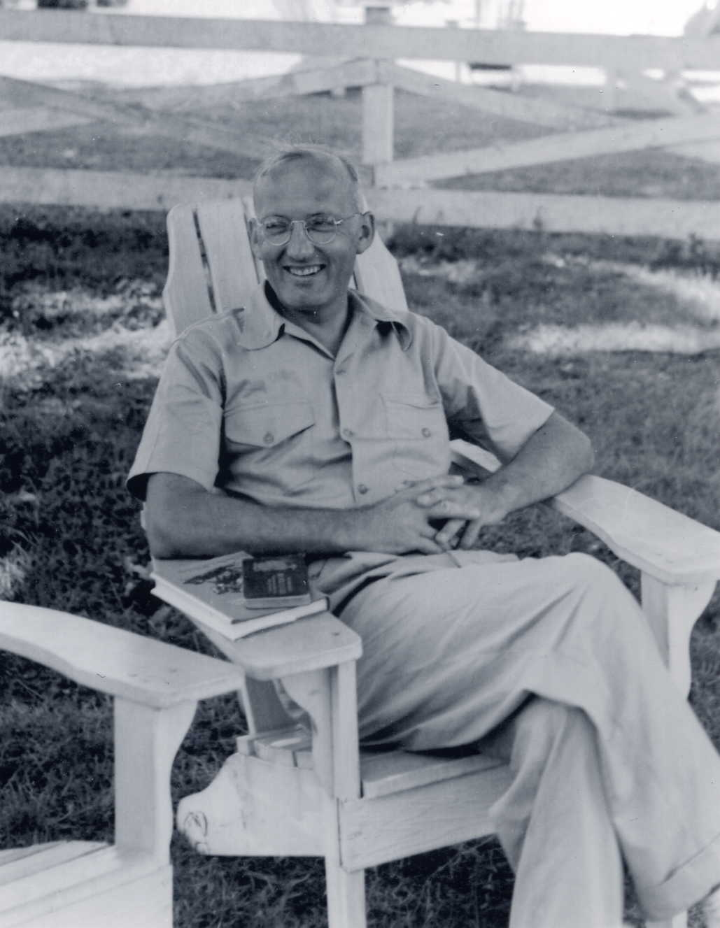
Against all odds: Jansky returns to star noise in 1937
Tony Tyson
UC Davis

Slide 2
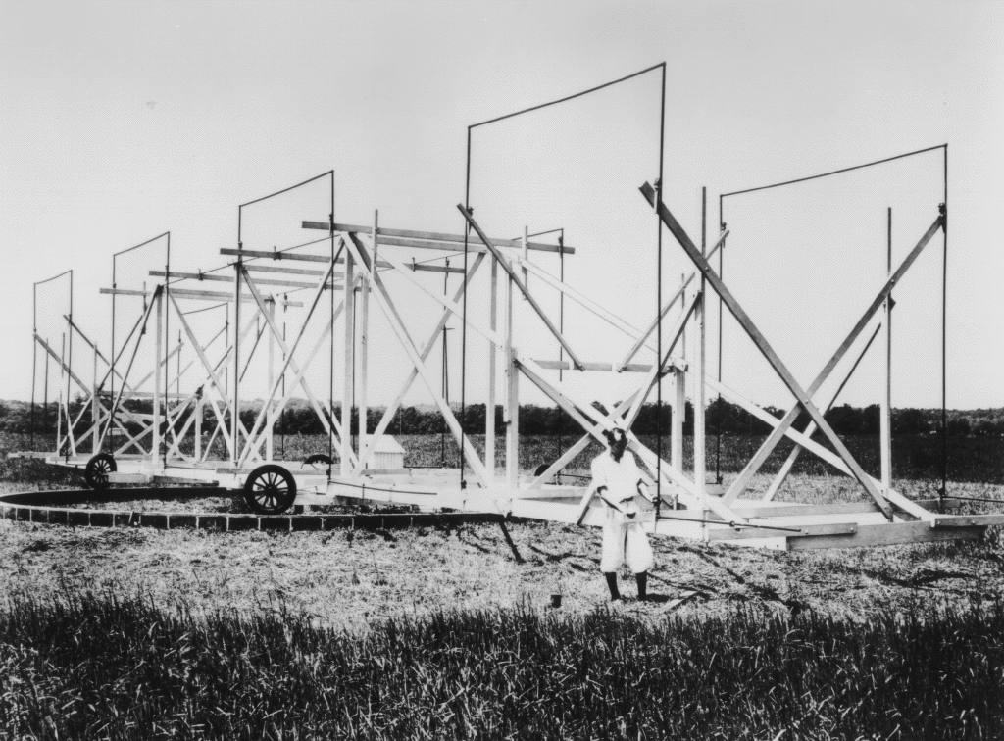
The Discovery of the Radio Sky 1932

Slide 4
Cycle 16

Slide 5
Challenges post 1934
Sunspot Cycle 17
Diathermy machines
Lack of interest by astronomers
AT&T focus on HF circuit fading
Resulting focus on MUSA
…but S/N becomes an issue in 1936
Use of “merry-go-round” for other antennas
Company layoffs

Slide 9
Both antennas 1936

Slide 10
Cycle 17

Slide 14
18MHz propagation January 1937

Slide 15
18MHz propagation January 1937

Slide 16
18MHz propagation January 1937

Slide 17
18MHz propagation January 1937

Slide 18
18MHz propagation January 1937

Slide 19
18MHz propagation January 1937

Slide 20
18MHz propagation January 1937

Slide 21
18MHz propagation January 1937

Slide 22
18MHz propagation January 1937

Slide 23
Diathermy interference p102 lab book 14897 2/2/37

Slide 24
NE rhombic 0630 EST Jan 4 1937

Slide 25
SW rhombic 0400 EST Dec 24 1936

Slide 26
"Minimum noise levels obtained on short-wave radio receiving systems”
Karl G. Jansky
Proc. IRE, Volume 25, December 1937
pp 1517-1530

Slide 29
Jansky Monument 1998

Slide 30
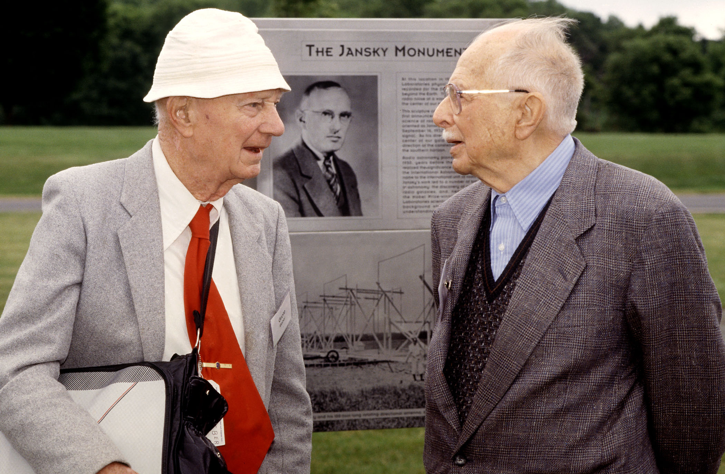
Grote Reber and Jesse Greenstein

Slide 31
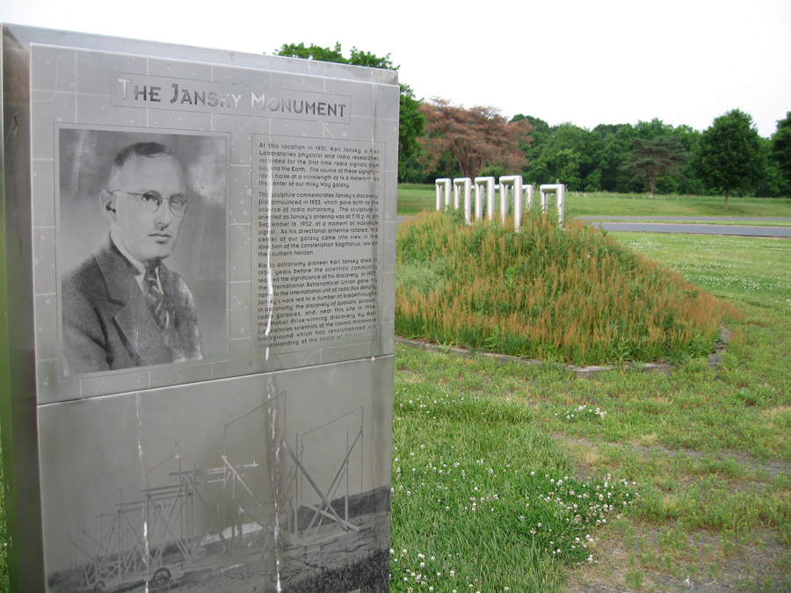

Slide 32
update 2015-
Property bought by Somerset Development
Refurbished main building as community
See http://bell.works
They want to celebrate science heritage
Bell.Works science advisory committee
Restoring Jansky monument

