Slide 1
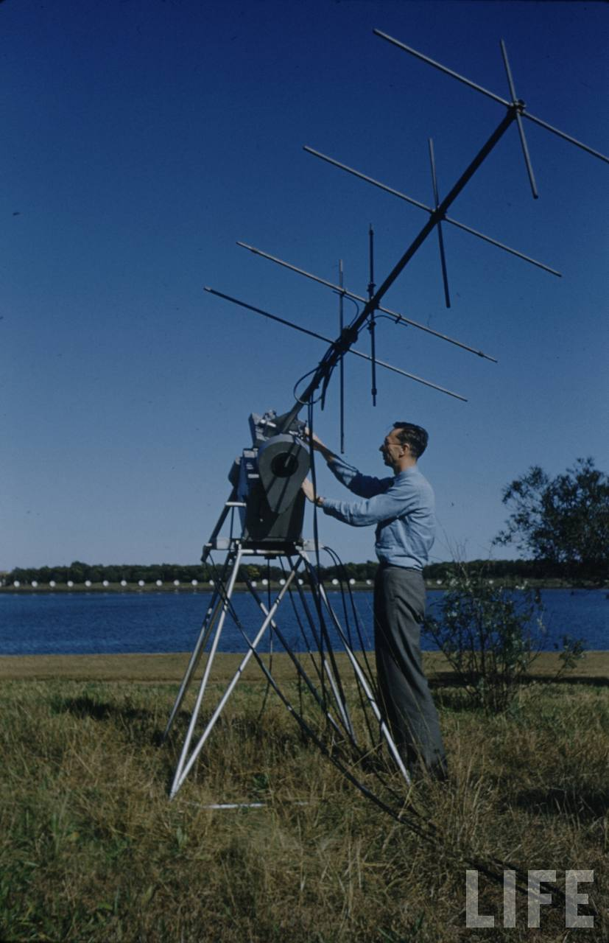
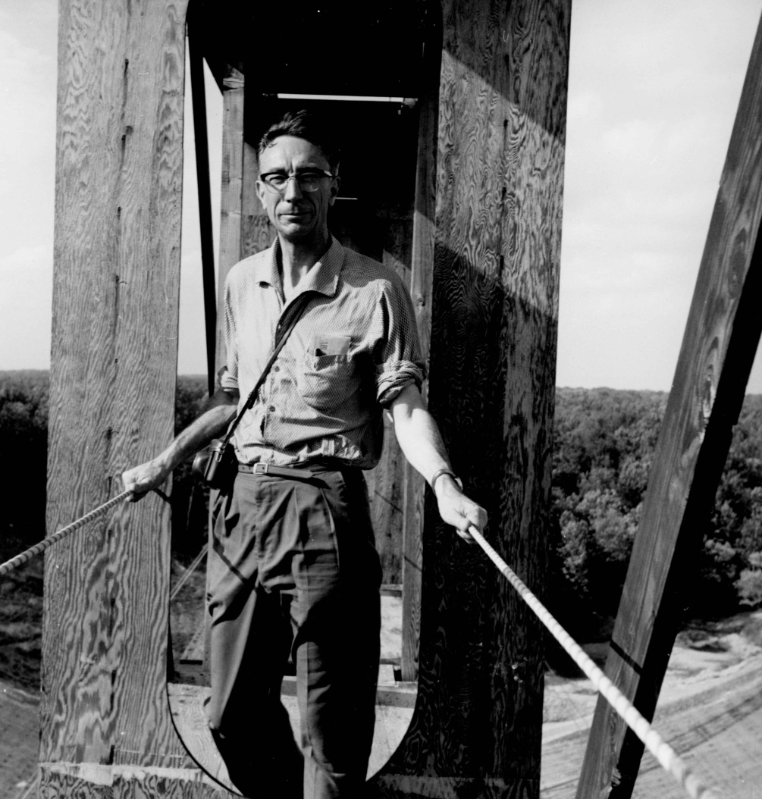
First Solar Noise Observations in Sydney, October 1945: Radio Discovery of the Million Degree Solar Corona- 2015 Discovery of Pawsey’s Original Data
Miller Goss, Ron Ekers, Helen Sim
NRAO, CSIRO-CASS, University of Sydney
WG History of Radio Astronomy
5 August 2015 IAU XXIX

Slide 2
Joseph Lade Pawsey Founder of Australian Radio Astronomy and the Second Director of NRAO 1962- Biography by Goss, Ekers and Hooker ~ 2017

Slide 3
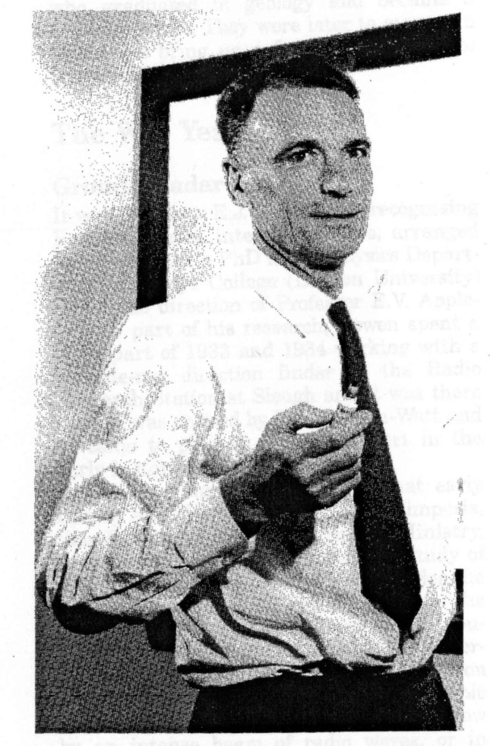
E. G. Bowen 1911-1991- the other major player in setting the course of post war Australian radio astronomy- one of the inventors of UK radar in the 1930’s- Father of the GRT – Giant Radio Telescope of 1961 – The Parkes Telescope

Slide 4
A summary of the talk
Finding the original records in July 2014 – Sally Atkinson (13 July 1914 -13 Nov 2012) – had worked at CSIRO since 1943. Later archivist and protector Bowen’s legacy. Jay and Ron Ekers picked up the material from her house organised by her remarkable neighbour and executor -Don Stevens- starting 16 May 2013; later pickup August 2013. Ron went through and did a preliminary classification. Goss discovered the 1945 original material July 2015 in Ron’s office- and also the smoking gun of the controversy Bracewell v Bowen of the Sept 1962 publications about Cen A polarisation. Cooper and Price and then Bracewell, Cooper and Cousins
What happened at Collaroy in Sydney in Oct 1945? Discovery of the radio HOT corona and the correlation of sunspots with bursts. This led the way for further radio astronomy at Dover Heights in 1946- first interferometry on Australia Day 1946 at Dover Heights and the proposal of aperture synthesis
Process of discovery that made this important discovery possible
J.S. (Stanley) Hey in 1973 “Evolution of Radio Astronomy: “ .. It was characteristic of Pawsey that he should be seeing the answer to a simple basic question, namely, what really was the base level of radio output from the Sun in its quiescent state?”
The radio emission is optically thick free-free emission- could get information on electron densities and temperatures

Slide 5
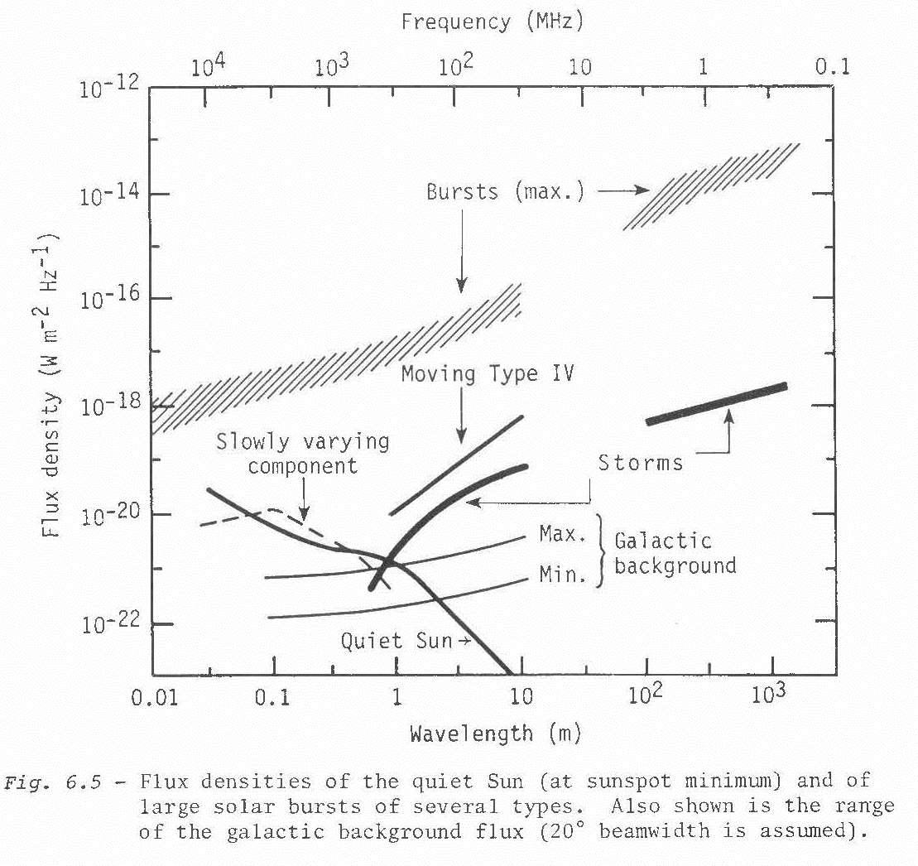
200 MHz – a sweet spot for Discrimination Quite Sun and Type I Bursts
1 sfu
10,000 Jy

Slide 6
Properties of the Radio Solar Corona
Quiet sun about 8 to 10 sfu at 200 MHz, and rise rates as high as 10⁴ sfu per sec can occur at 200 MHz

Slide 7
Sally Atkinson 1914 to 2012- Bowen’s personal assistant 1948 to 1971. Archivist 1972 to 1988

Slide 8
The Discovery after May and August 2013- 5 metres of material- in Ron Ekers’ office- July 2014

Slide 9
Field Stations of RPL

Slide 11
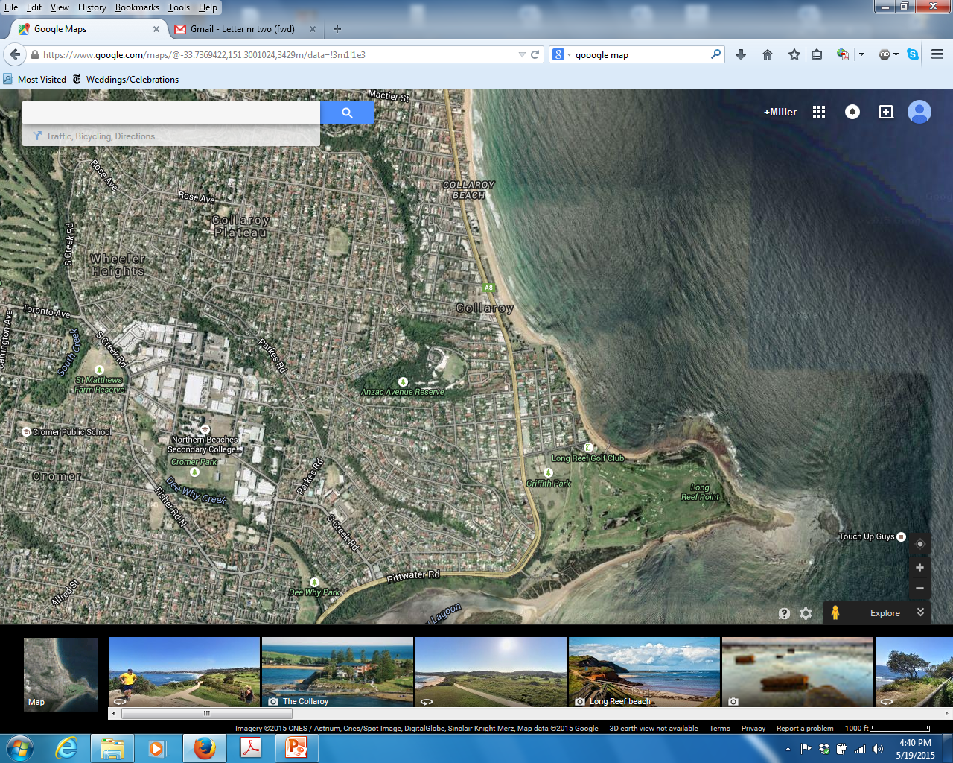
To left Plateau Park
I have checked the name of the parish priest from Lane Cove - it is Geoff
Plant. It will be lovely if the Pawseys remember him.

Slide 12
From Warringah Council- Rose Cullen Local Studies and Family History Librarian- May 2015. Likely Collaroy was more available to CSIR group 2 months after WWI ended. And could also observe sun at sunset – with difficulty

Slide 13
Collaray RAAF LW AW radar at end 1945. Too far from sea (800m) for sea cliff interferometry. Test X band radar from CSIR Div of Radiophysics for testing Height finding with nodding 6 foot dish
4 cm X band Height finding radar prototype

Slide 14
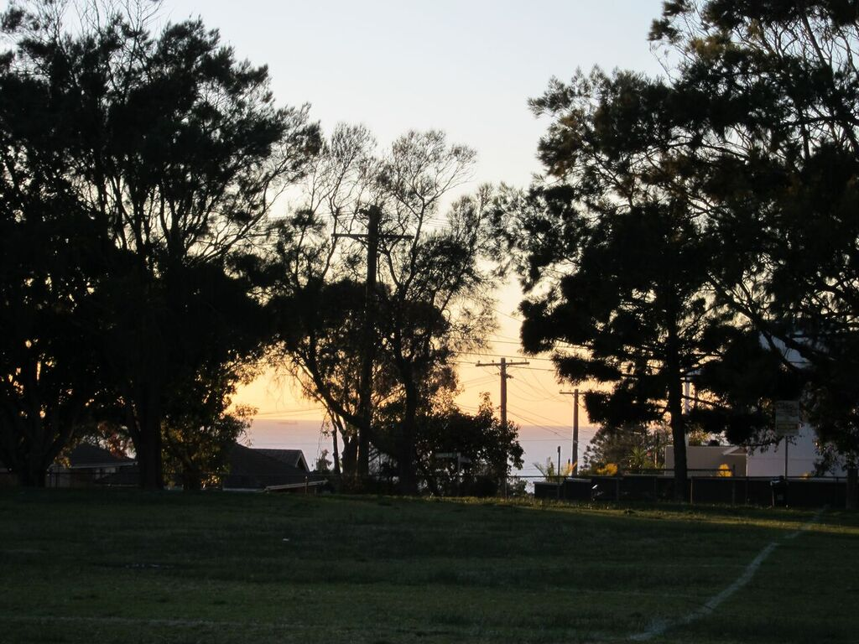
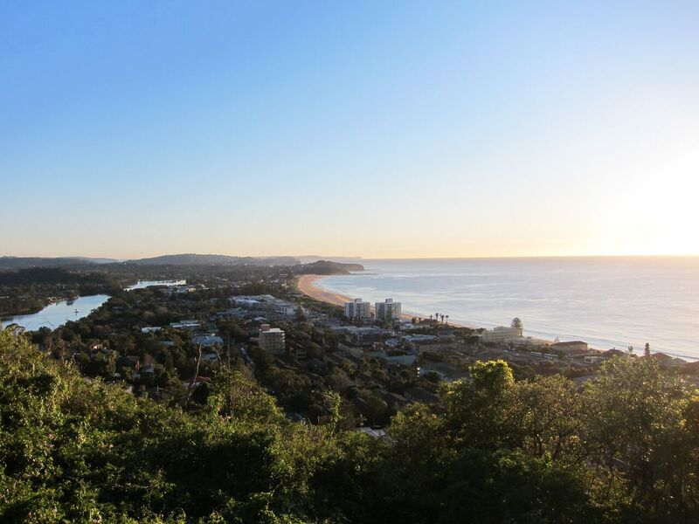
Chris Hales of NRAO was at Collaroy Plateau Park last week -70 years after the first solar observations
View to the east note ship
Cricket Pitch to the North
To north --Narrabeen

Slide 15
Communication with RAAF – 9 October 1946
“Radiophysics Laboratory and RAAF personnel have over the last few days, observed on the COL at Collaroy, a substantial increase of noise level, similar in effects to noise jamming, when the aerial points towards the sun as may at sunset or sunrise. We do not know the cause of this but suspect it to be an irregularly occurring phenomenon originating in the sun. … we would appreciate the cooperation of the personnel at 54 station in taking observations… We propose to continue observations for a period of one month…”

Slide 16
The important documents
Paul Wild knew about them in 1968
He suggested to send them to the archive of the Australian Academy of Science
Inquiries by Prof Peter Hall of the Univer of Melboune (R Payne-Scott’s son) in late 2014 indicate this did not happen. Evidence that they were recopied in 1977?
July 2015- Found the originals in Sydney – These had never been sent to any archive

Slide 17
Letter from Paul Wild 1968 – never carried out !

Slide 18
First results – correlation of solar bursts with Sunspot numbers from CW Allen at Mt Stromlo

Slide 19
How were the data reduced – observations period at sunrise only about 30 min

Slide 20
Work sheets- all Pawsey’s handwriting

Slide 21
Collaray data Oct to March 1945-46. Daily averages

Slide 23
Nature 2 November 1946

Slide 24
Ogive plots for Collaroy- x axis is intensity in db and y axis is percentage data at or below intensity plotted-

Slide 25
Ogive- cumulative histogram- eg the percentage of points less than or equal to the intensity (in db )- Note that with this method of plotting a normal distribution is a straight line – Collaroy RAAF aerial

Slide 26
Dover Heights data - Bigger antenna - Sh D antenna run by the Australian Army O db is 10,000 Jy 1 to 2 db increase in signal to noise Sum of two independently variable components: (1) An approximately normal distribution with wide dispersion – the Type I bursts (2) The other being either constant or of a small dispersion- Quiet Sun

Slide 27
Letter to Southworth – Bell Labs- Dec 1945- calculation of Ruby Payne-Scott

Slide 28
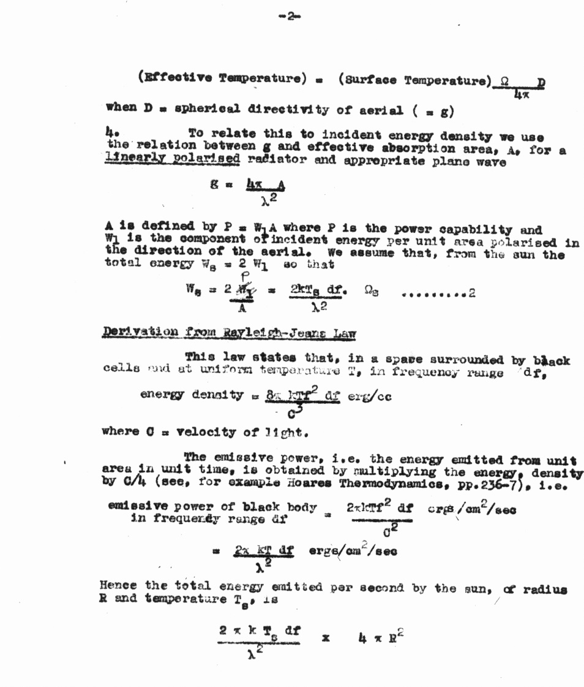

Slide 29
Early 1946- Australia Day 1946- 26 January 1946
Ruby Payne-Scott did the first interferometry at Dover Heights- 10⁹ K brightness of enhanced emission at 200 MHz from the large sunspot of early 1946- fringe spacing was 25 arc min (primary beam about 10 deg )
Principle of aperture synthesis proposed by this group in 1946: “It is possible in principle to determine the actual form of the distribution in a complex case by Fourier synthesis using information derived from a large number of components…”

Slide 30
Conclusions --
The great intensity of the solar bursts at first masked the presence of any contribution at metre wavelengths from the quiet, undisturbed sun
Radio results were not the first to establish the presence of a hot million degree corona. Previous data from Edlén’s ‘coronium’ lines of highly ionized metals (eg Fe) and the broad line widths as observed in eclipses optically. After radio detection coronal studies became routine. Also could study the properties of the corona at any time- an eclipse not required.
Pawsey clearly demonstrated that existence of a baselevel in the radio emission at 200 MHz (1.5m) below which the sun’s intensity did not fall. This intensity corresponds to an apparent temperature of 10⁶ K
Impact of Pawsey’s career- he decided to become a radio astronomer . The original term for the new discipline “Solar and Cosmic Noise “ research- This disappeared gradually after Pawsey invented a new term “Radio Astronomy” in January 1948- Ryle independently at about the same time.
But he did urge caution in August 1946- “The Sun takes impish delight in setting traps for young players.”

Slide 31
Conclusion - again
Pawsey and his group- why did they succeed: Luck, serendipity and they were prepared
Understood the physics of the ionosphere- a reasonable step to understand the free-free emission of the hot corona
They were lucky- solar cycle and the coincidence with the end of WWII
Suitable time constant (around a second) and frequency (200 MHz close to a sweet spot for corona and bursts)
Right people- with appropriate experience- that understood interferometry and calibration of radio telescopes – conversion of intensity to Tb etc
And the sensitivity of rms in the range about 10⁴ Jy was just ok
5 November 1945, Pawsey was proud of his results- he wrote to his thesis advisor from Cambridge Jack Ratcliffe: “… we get a fluctuating noise level [from the sun] of astonishingly high level, corresponding to black body radiation at a temperature of millions of degrees [describing the bursts]… [The bursts do not arise in our [earth’s] atmosphere .. I think we have something pretty important in interpretation. I presume the solar phenomenon is the same as Jansky’s ‘cosmic static’ originating in the stars.” [Later turned out to be not at all correct ,of course.]
Pawsey and Yabsley in June 1949: “The outstanding conclusion concerning the nature of the solar atmosphere which may be drawn from these observations if that they offer direct confirmation of the existence of kinetic temperatures of the order of a million degrees in the corona.”

