Slide 1
Cosmic Masers
by
Jim Moran
Harvard-Smithsonian Center for Astrophysics
The Golden Years of Radio Astronomy
IAU General Assembly, Honolulu
August 5, 2010

Slide 2
Charles H. Townes (1915-2015)* His Legacy in Cosmic Masers
1944
1946
1954
1959
1964
1969
Warned management at MIT Rad Lab that the 1.25 cm airborne radar developed for the South Pacific theater would not work (because of atmospheric H₂O). It failed.
Measured precise frequency of 1.35 cm H₂O line
Presented case for observing spectral lines of molecules via radio astronomy (Washington Conference on Radio Astronomy)
Measured precise frequency of ground state of OH, enabling his former student, Alan Barrett, to detect it
in ISM in 1963
Invented laboratory maser
Spinoffs essential for VLBI at 22 GHz:
Low-noise maser amplifier
Hydrogen maser frequency standard
Discovered cosmic H2O masers at Berkeley
(with Cheung, Rank, Thornton, and Welch)
*Academic tree: von Helmholtz (Berlin, 1843) Michelson (Berlin) Gale (Chicago)
Smythe (Chicago) Townes (Caltech) Barrett (Columbia) Moran (MIT)

Slide 3
I Should Have Followed Up on That . . .
PHYSICAL PROCESSES IN GASEOUS NEBULAE
ABSORPTION AND EMISSION OF RADIATION
DONALD H. MENZEL
Ap.J. 1937, 85, 330
The total radiation, absorbed in the transition n’– n, including the effect of the “stimulated emissions,” which must be counted as negative absorptions, is easily found to be . . . .
Outside of thermodynamic equilibrium, the condition may conceivably arise when the value of the integral [above] turns out to be negative. The physical significance of such a result is that energy is emitted rather than absorbed. This energy must be distinguished, however, from that arising in random emissions. The process merely puts energy back into the original beam, as if the atmosphere had a negative opacity. This extreme will probably never occur in practice.

Slide 4
Elementary Maser Pumping Scheme
waste pump photon
(must be able to escape)
pumping by radiation or collisions
microwave maser
photon
A saturated maser requires one
Pump photon per microwave maser
photon
“Spectacular” cosmic masers require population inversion AND high negative optical
depth, aka “gain”, e.g. as seen in OH, H2O, SiO and CH3OH

Slide 5
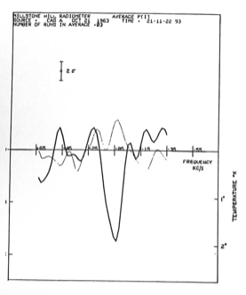
Discovery of OH at 18 cm in ISM in 1963
Cassaeopia A
Spectrum made with Weinreb’s digital autocorrelator built for his PhD thesis
Al Barrett Lit Meeks
Sandy Weinreb
John Henry
Antenna Temperature
Velocity (km/s)

Slide 8
Advised by:
Ed Lilley &
Sam Goldstein

Slide 9
Theory of Maser Emission
1966 (May) Perkins, Gold & Salpeter (UV)
1966(Oct) Litvak, McWorter, Meeks &
Zeiger (UV)
1973 Goldreich, Keeley & Kwan (IR)*
* Based on data showing correlation of IR and maser
Flux density in late type stars (Harvey et al., 1973)

Slide 10
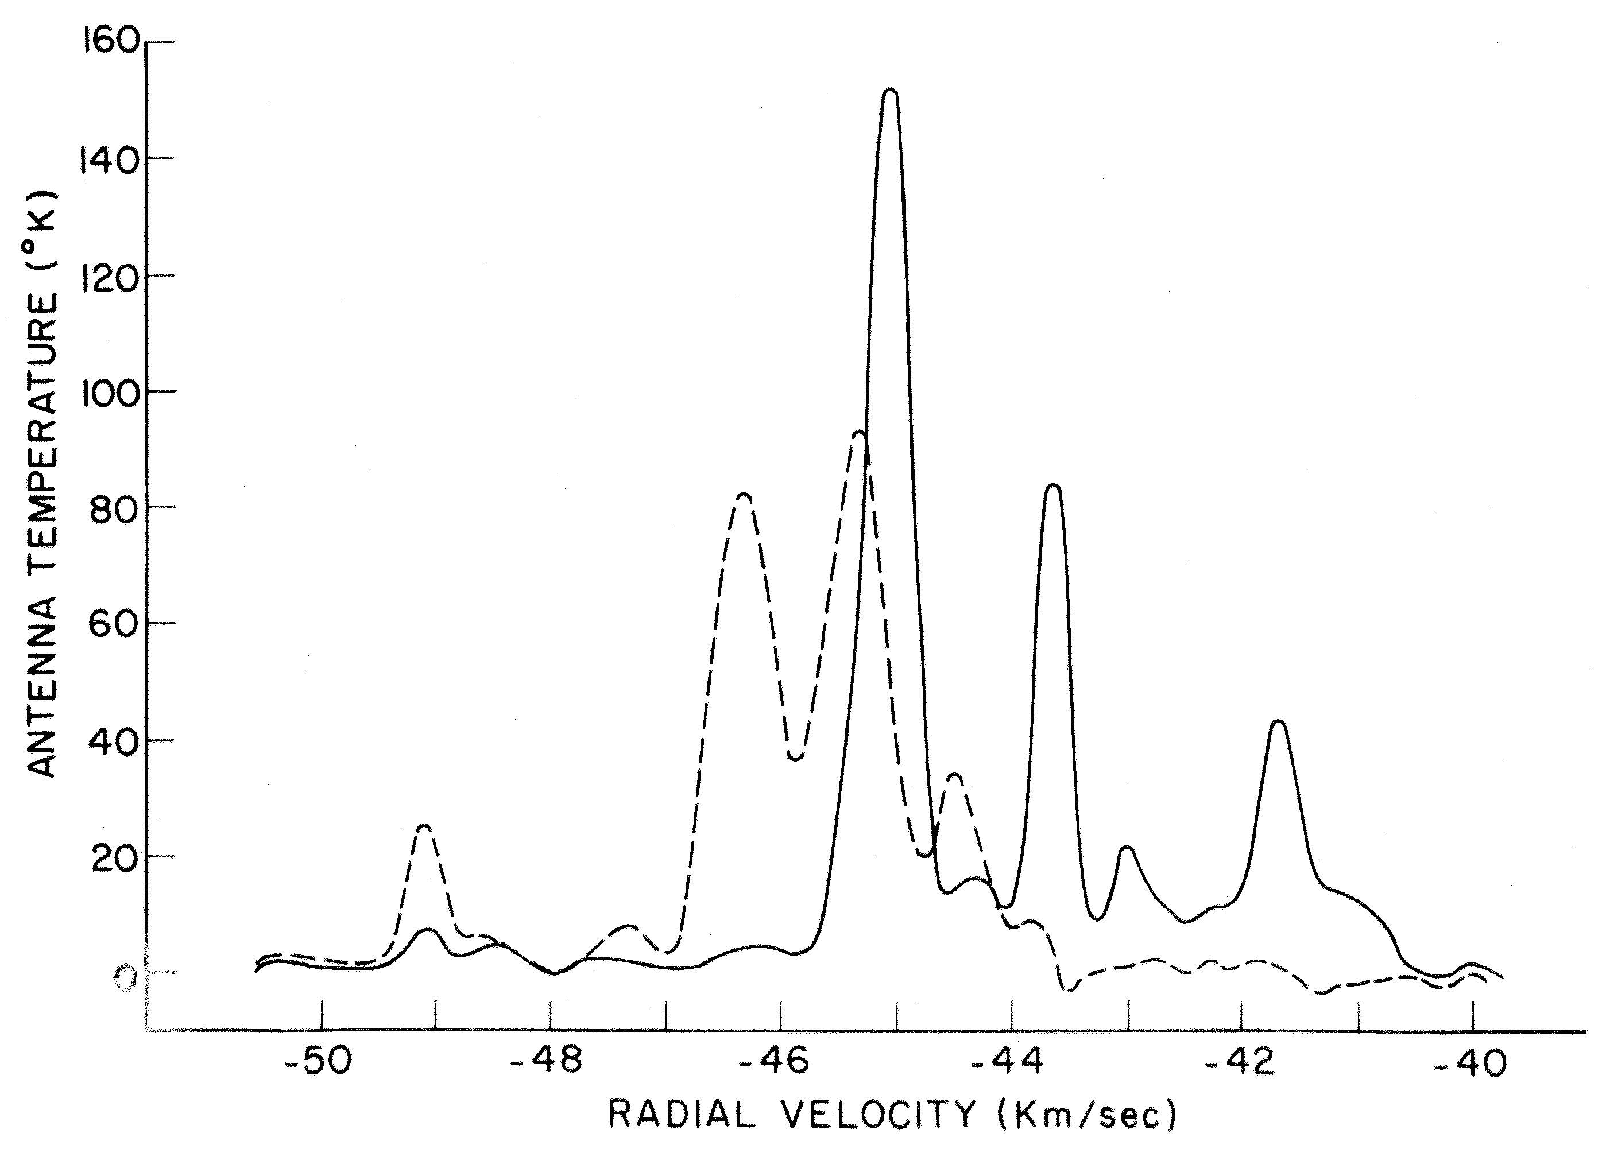
Spectrum Towards Westerhout 3 (aka W3),
a galactic HII Region(1966)
5 KHz window
18 cm wavelength
1665 MHz
RCP (solid line)
LCP (dashed line)
Rogers and Barrett, Nature, April 1966
Davies, de Jager, & Verschuur, Nature, March 1966

Slide 11
Groups Active in OH Maser Research
CSIRO (Parkes 210 ft)
Berkeley
Harvard
MIT
Jodrell Bank

Slide 12
Interferometry of OH Maser W3(OH) at 18 cm
Publication
date
1966 (Aug)
1966 (Aug)
1967 (Mar)
1967 (May)
1967 (Aug)
1968 (May)
1968
1971
1978
1980
1982
1992
Interferometer
OVRO
Haystack-Millstone
Jodrell Bank-Malvern
Millstone-Agassiz
Haystack-GB 140 ft.
Haystack-GB-Hat Creek
Haystack-GB-HC-Onsala
Jodrell Bank-Malvern
GB-NRL-ARO*
US NUG
Merlin
US NUG
Baseline
(km)
1.6
0.7
127
14
845
4030
7900
127
3100
4030
134
4030
Angular
size
<20”
<15”
<0.05”
<0.3”
<0.02”
<0.005”
0.0045”
Significance
Abs Position
Abs Position
Sep ~0.1”
First map (3)
First VLBI
Good map (7)
Size
Better map (16)
B fields
Excellent map (70) Multi-transitions
Proper motions &
B field distribution
Reference
(1st author)
Cudaback
Rogers
Davies
Moran
Moran
Moran
Moran
Cooper
Moran
Reid
Norris
Bloemhof
*5 cm

Slide 13
(Fall 1966)

Slide 14
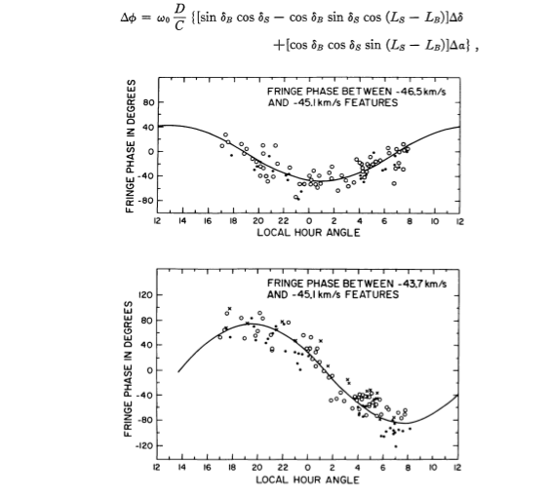
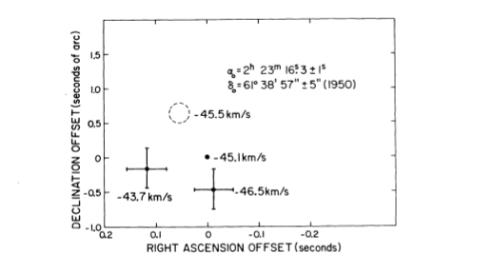
First Maser “Spot Map” Millstone-Agassiz Interferometer (1967): W3(OH)
Visibility Phase vs Hour Angle

Slide 16
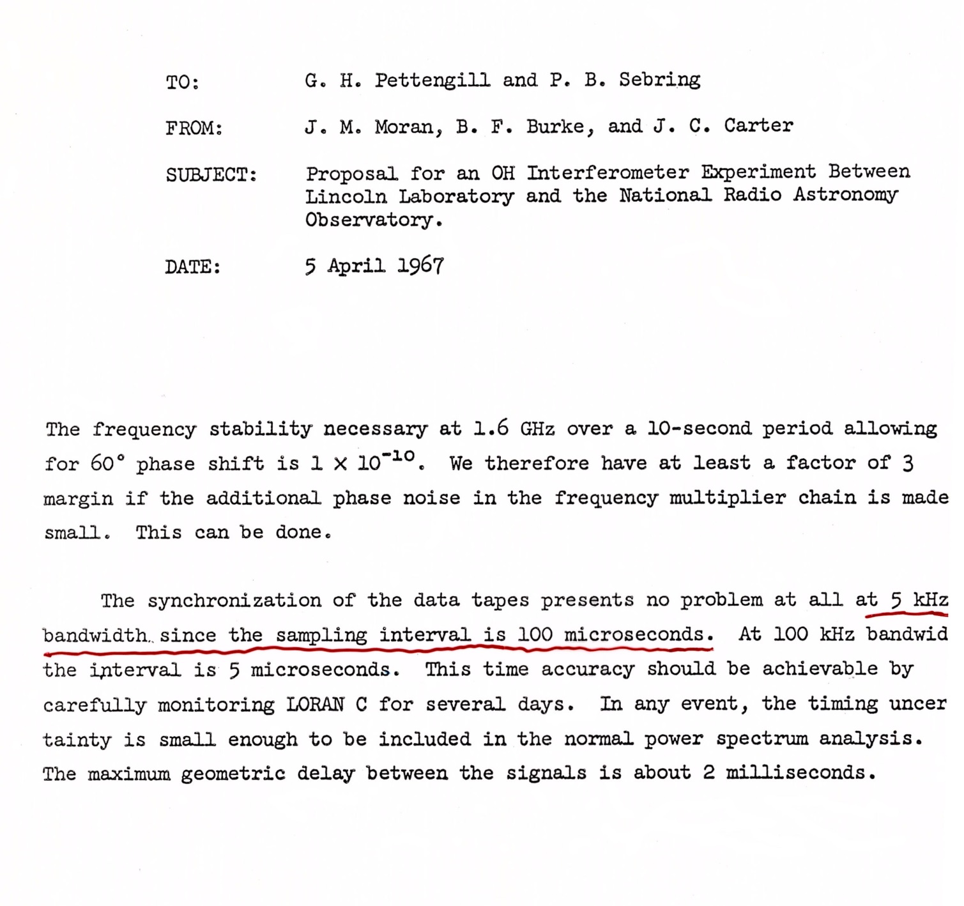

Slide 17
Hewlitt Packard Catalog cira 1967
HP 5100
Phase locked oscillator
0-50 MHz in steps of 0.01 Hz

Slide 18
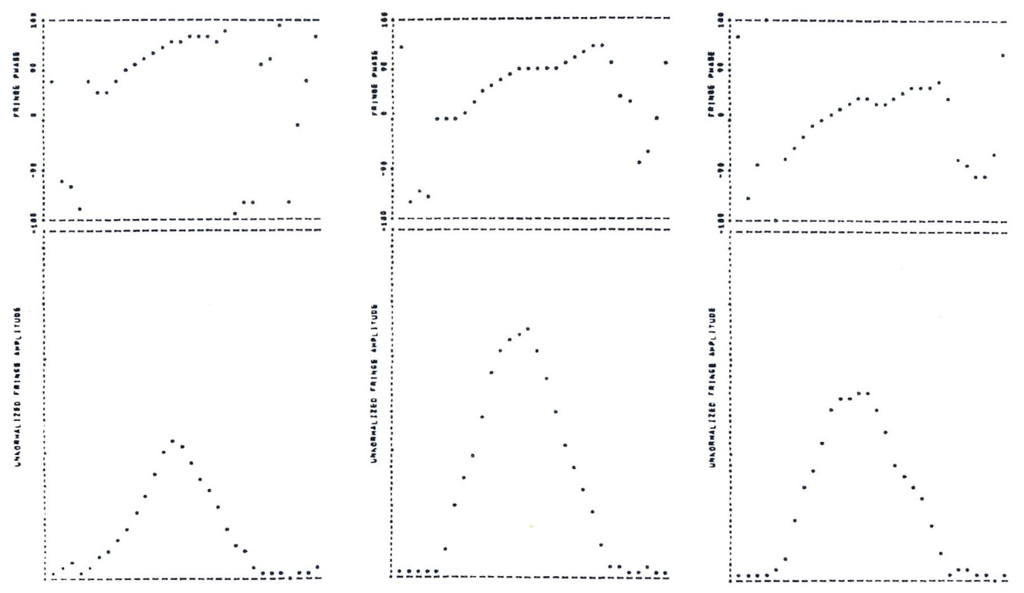
First VLBI Fringes on a Maser Source, June 1967
Haystack 37-m to NRAO 43-m (845 km baseline)
Phase
Amplitude
Frequency (5 KHz window)

Slide 19
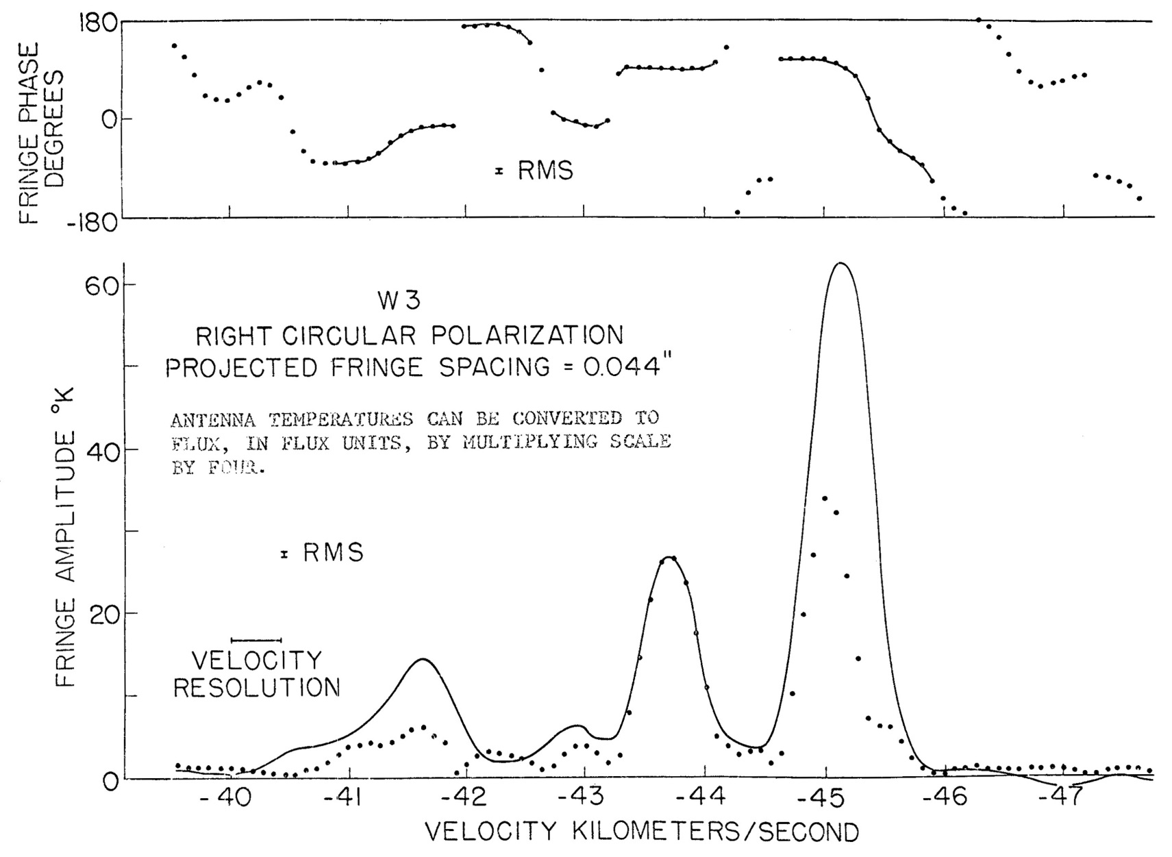
Interferometer Spectrum of W3 in 120 KHz band (June 1967)
Cross Power (solid)
Total Power (dotted)

Slide 20
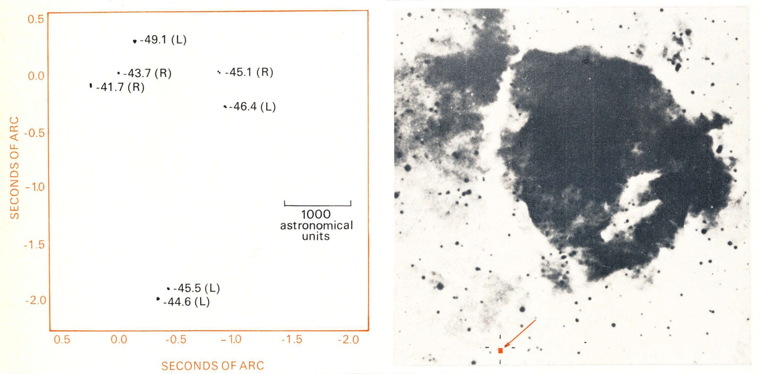
Polmar Sky Survey Image
of W3 HII Region
VLBI Image of W3 Maser

Slide 21
First Four Element
VLBI Array
Jan 1968
Onsala
Millstone Hill
Hat Creek
Green Bank

Slide 22
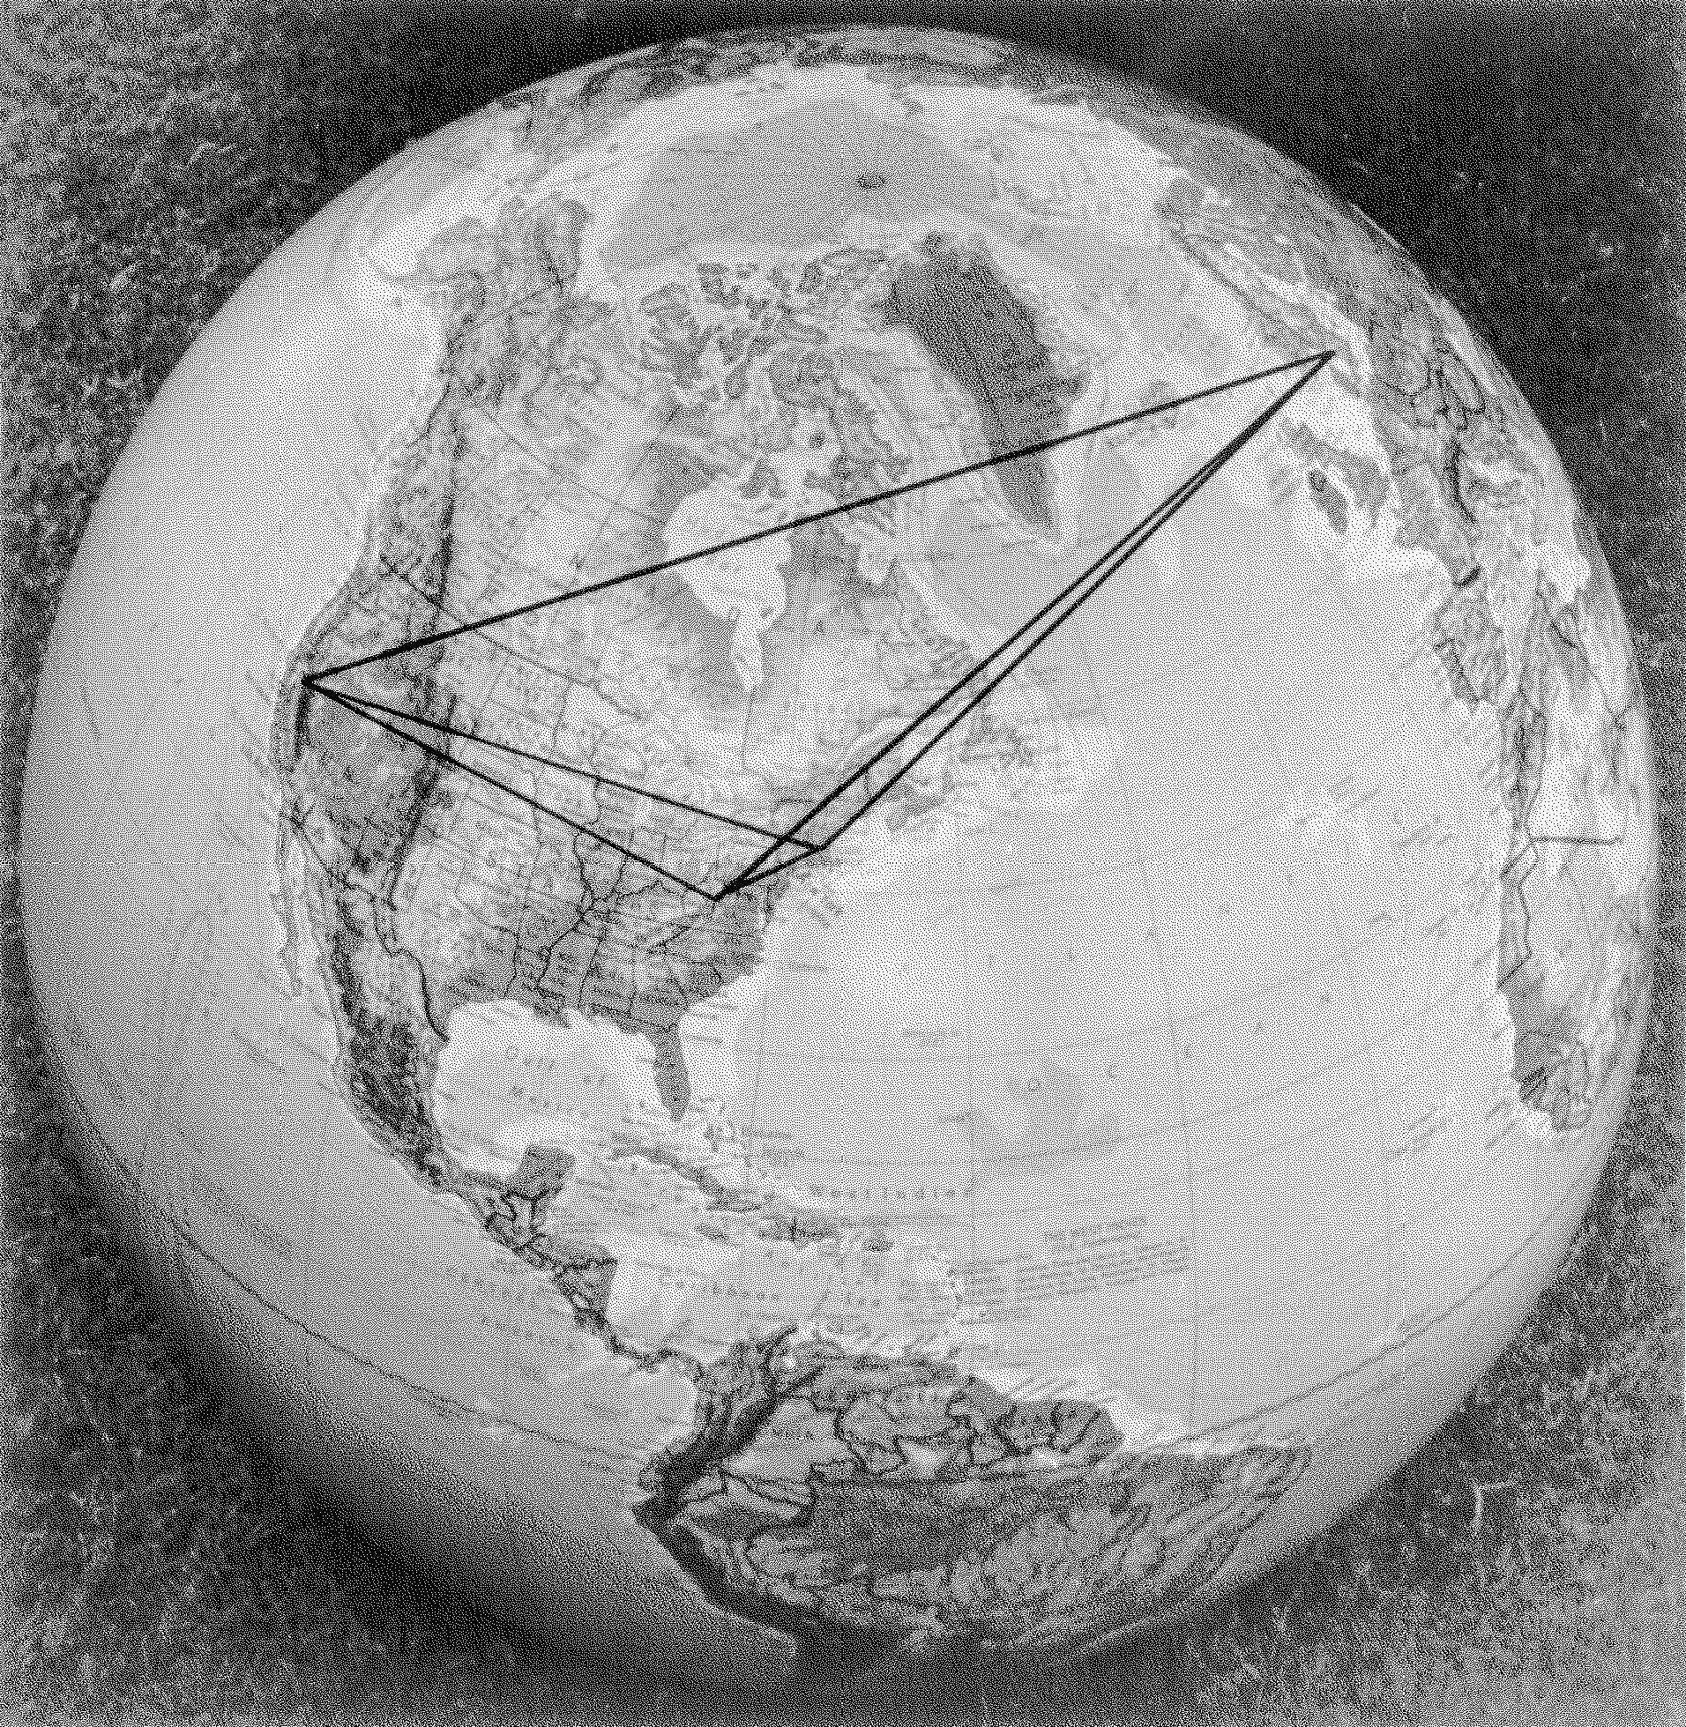
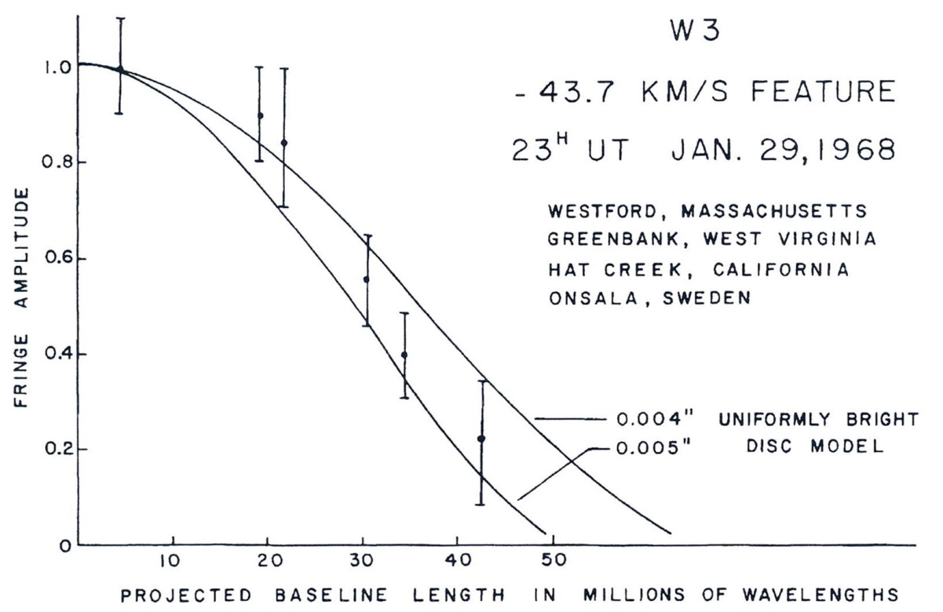
First Resolution of a Maser “Spot”

Slide 23
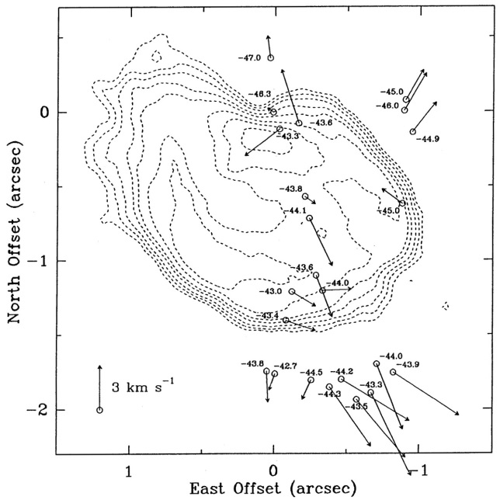
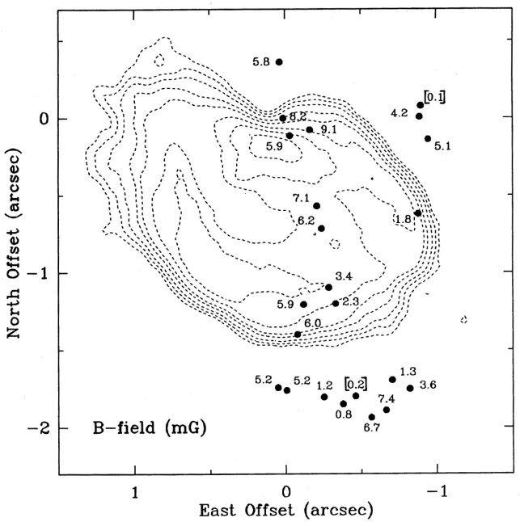
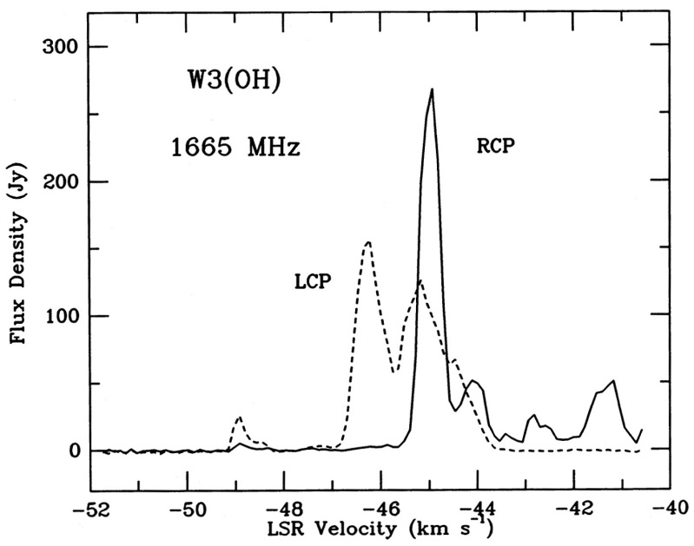
Proper Motions (left) and Magnetic Field Strength (right)
in W3 OH Maser (1986) with US VLBI Network (NUG)
Contours
Trace
UCUII
Region
W3(OH)

Slide 24
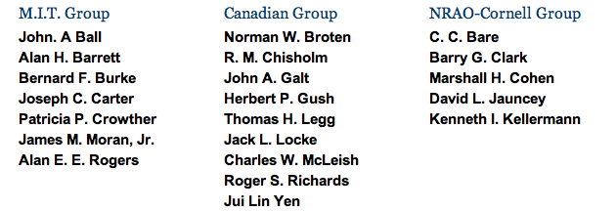
Rumford Prize Symposium, April 1971
NRAO-Cornell Group
Claude .C.Bare
Barry G. Clark
Marshall H. Cohen
David L. Jauncey
Kenneth I. Kellermann
MIT Group
John A. Ball
Alan H. Barrett
Bernard F. Burke
Joseph C. Carter
Patricia Crowley
James M. Moran
Alan E.E. Rogers
Canadian Group
Norman W. Broten Jack L. Locke
Richard M. Chisholm Charles W. McLeish
John A. Galt Roger S. Richards
Herbert P. Gush Jun Lin (Alan) Yen
Thomas H. Legg

