Slide 1
JODRELL BANK LONG BASELINE
INTERFEROMETRY IN THE SIXTIES
FROM “FIELD 80”
TO INTERNATIONAL POLITICS
Important part of radio astronomy’s “Golden Age”
Crucial to development of VLBI
  Beginning of MERLIN array
Laid ground for fundamental astronomical discoveries
from talk when JIVE ➔ European Research Infrastructure Consortium.
APOLOGIES TO THOSE WHO WERE THERE

Slide 2
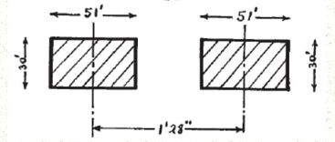
DEVELOPMENT OF
RADIO LINK INTERFEROMETRY AT JODRELL
PRELUDE
1953 Cygnus A Jennison & Das Gupta
  Radio link Intensity interferometer to 4km
<-- ~ 120 kpc -->
CYGNUS A IS DOUBLE AND HUGE!!
Notes:
It is difficult to imagine now the huge shock that must have been engendred in the conservative astronomical establishment in the 50s when radio galaxies were discovered by an upstart band of electrical engineers didn’t even know the meaning of magnitude!!
Colliding galaxy. Minkowski bet Baade In retrospect, both were partly right.

Slide 3
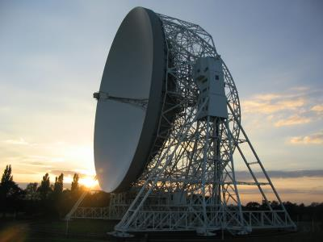
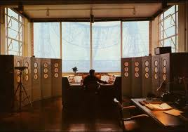
JODRELL BANK - CRADLE OF VLBI
Mark I Control Room
Long baseline
interferometer control room
1957 Completion of Mark I Telescope – later Lovell Telescope
  Largest telescope - 250 ft diameter- x3 larger than Dwingeloo radio telescope
1959 - 1968 Development of phase coherent radio link interferometry
  Only show in town

Slide 4
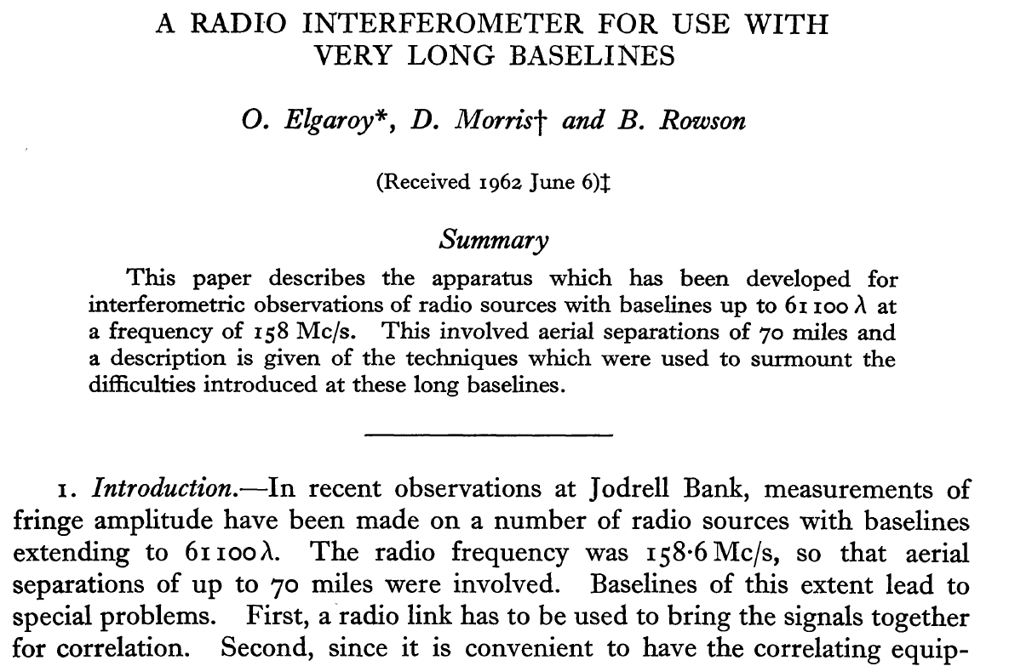

Slide 5
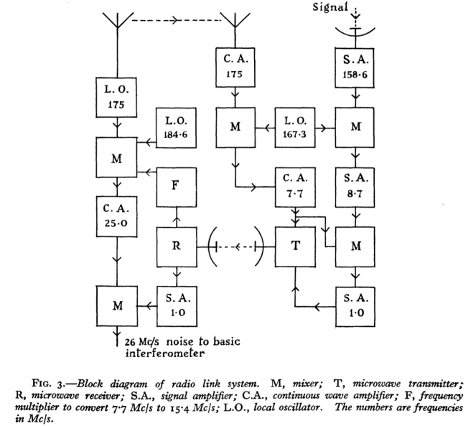
ELGAROY, MORRIS, ROWSON MNRAS, 124, 395 (1962)
A radio interferometer for use with very long baselines
RADIO LINK

Slide 6
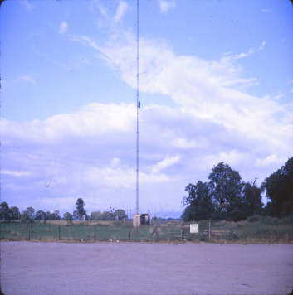
ELGAROY, MORRIS, ROWSON MNRAS, 124, 395 (1962)
A radio interferometer for use with very long baselines
“FIELD 80”

Slide 7
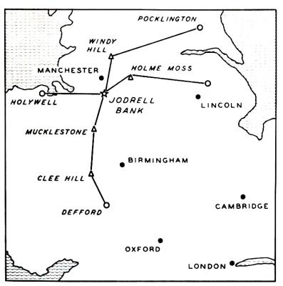
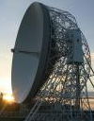
DEVELOPMENT OF RADIO LINK INTERFEROMETRY
1959 – 1962 158 MHz with Yagi Remote Antennas
Lincoln
115 km 61000λ
Holywell
60 km 32000λ
1966 Malvern (Defford) 5000.0 127 2,100,000 940 (Mark II)

Slide 8
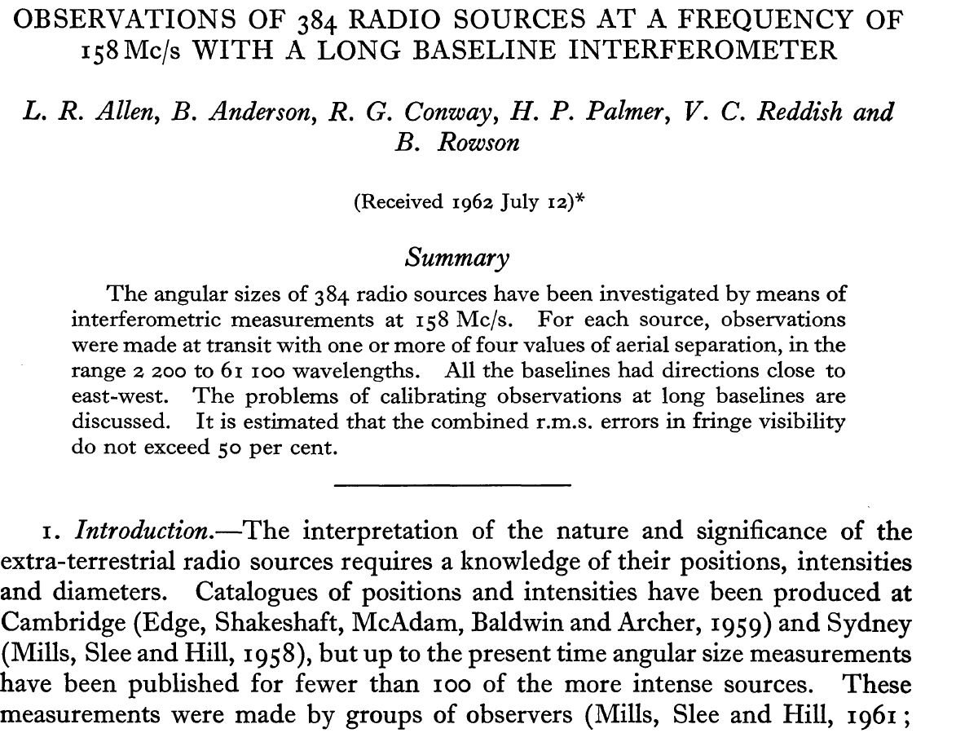

Slide 9
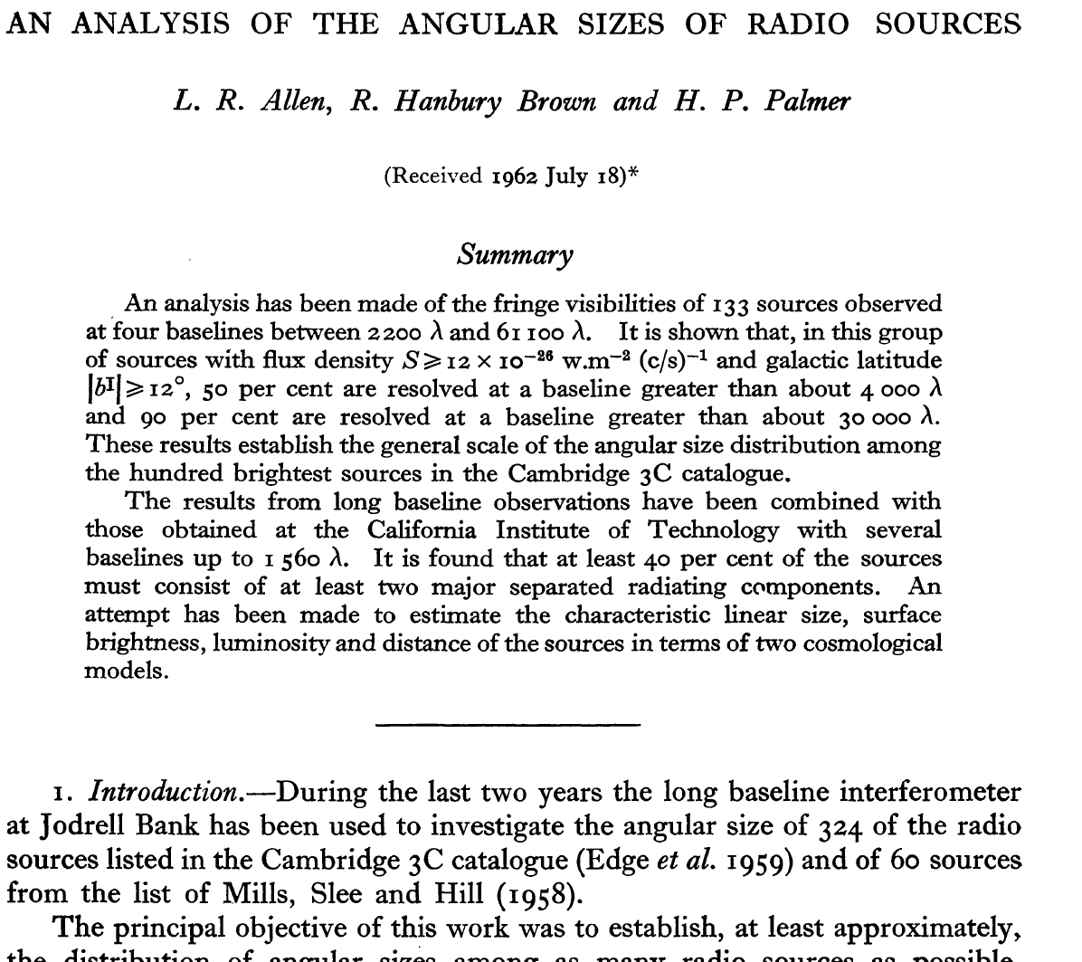

Slide 10
DEVELOPMENT OF RADIO LINK INTERFEROMETRY
1959 – 1962 158 MHz with Yagi Remote Antennas
Lincoln
115 km 61000λ
Holywell
60 km 32000λ
  133 sources to 115 km at 158 MHz
  Allen, Anderson, Conway, Palmer, Reddish, & Rowson, 1962, MNRAS, 124,477
  Allen, Hanbury Brown and Palmer 1962, MNRAS., 125, 57. (combined with Moffet & Maltby Caltech)
    AT LEAST 40% DOUBLE
    BUT ~10% UNRESOLVED ~ 1” !! > QUASARS
1966 Malvern (Defford) 5000.0 127 2,100,000 940 (Mark II)

Slide 11
DISCOVERY OF QUASARS Alan Sandage
Ann. Rev. Astron. Astrophys. 1999. 37: 445-486
“Particularly important for the quasar history was the long base-line interferometry made by the Jodrell Bank radio astronomers.
They performed interferometry with the Jodrell Bank 250-foot antenna, measuring the fringe visibilities of more than 350 3CR sources. With baselines ranging from 2200 to 61,100 wavelengths (Allen et al 1962, Rowson 1962), they compiled a list of unresolved 3C sources whose angular diameters were smaller than one arcsec, and therefore had "brightness temperatures" larger than 107 K, a telling indication of nonthermal radiation (Palmer 1961). Also from these data, Allen, Hanbury Brown, & Palmer (1962) surmised that many resolved 3CR sources were double, following the previous demonstration by Hanbury Brown & Das Gupta that Cygnus A is double.
The heroes of the quasar discoveries were clearly Palmer for his brilliant measurements with his Jodrell Bank colleagues of the radio angular diameters, Matthews for all aspects of the identification work and for the organization of the joint Owens Valley-Palomar collaboration, Hazard for the position of 3C 273, and Oke (1963), Schmidt (1963) for their joint discovery of the redshift of 3C 273”

Slide 12
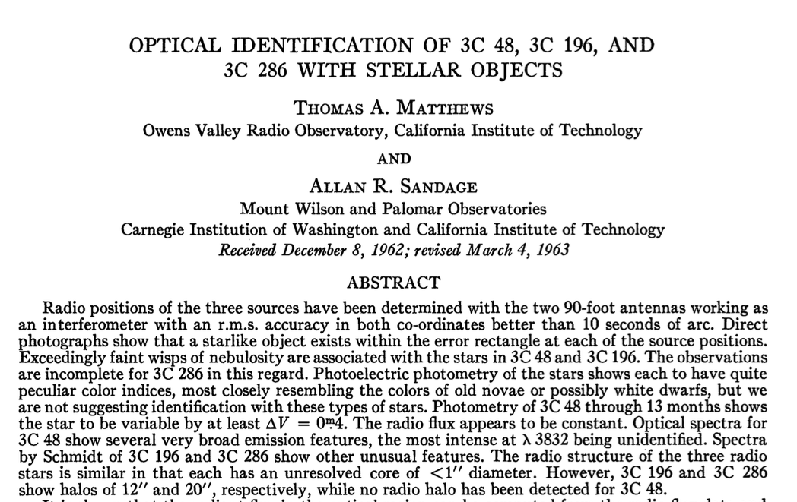
NOT ONLY 3C273!!!
QUASARS WAITING TO BE DISCOVERED

Slide 13
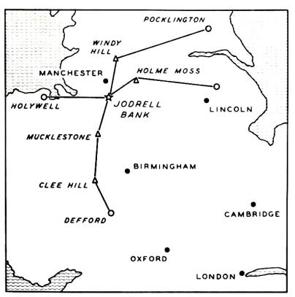
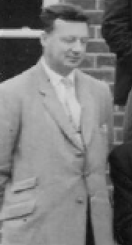
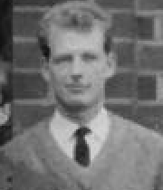

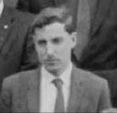
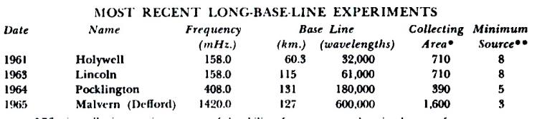
THE “HENRY PALMER” LONG BASELINE GROUP
ONLY LONG BASELINE INTERFEROMETRY 1959 - 68
JODRELL GROUP 1963 WHEN I JOINED
    Forgotten heroes of VLBI
HENRY
PALMER
BARRIE ROWSON
BRYAN ANDERSON
WILF DONALDSON
1963
1966 Malvern (Defford) 5000.0 127 2,100,000 940 (Mark II)

Slide 14

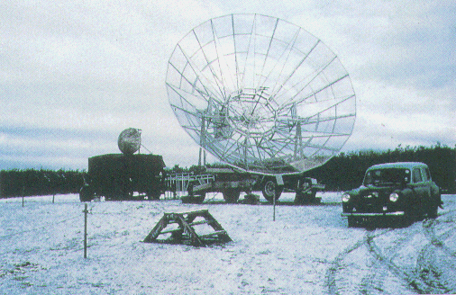
LONG BASELINE INTERFEROMETRY IN THE SIXTIES
QUEST FOR HIGHER AND HIGHER RESOLUTION
1964, 408 MHz
Wilf’s 8m diam. dish at Pocklington
Controlled remotely
Built by a PhD student
SEVERAL SOUCES STILL UNRESOVED
1963
1966 Malvern (Defford) 5000.0 127 2,100,000 940 (Mark II)

Slide 15
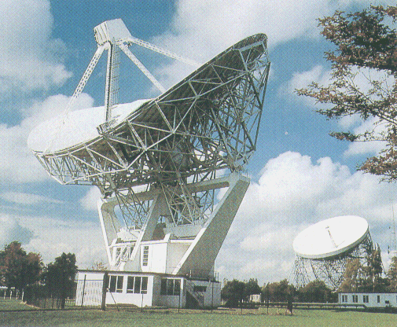
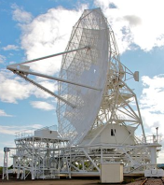
QUEST FOR BETTER AND BETTER RESOLUTION
VIA HIGHER FREQUENCIES AND RRE MALVERN (DEFFORD) e.g. Palmer et al. Nature, 213, 789, 1967
Several sources with unresolved structure < 0.05”
STILL LONGER BASELINES NEEDED
Defford 1965 – 67
1.4GHz, 5 GHz
1963
1966 Malvern (Defford) 5000.0 127 2,100,000 940 (Mark II)

Slide 16
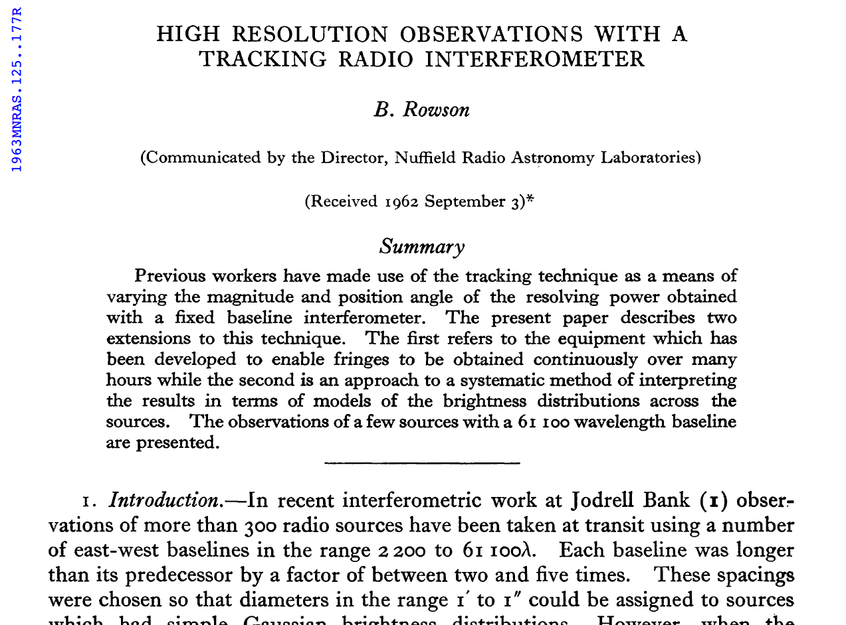

Slide 17

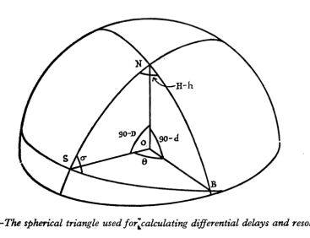
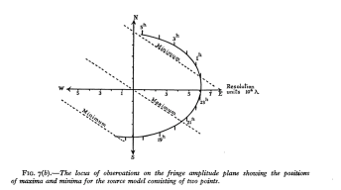
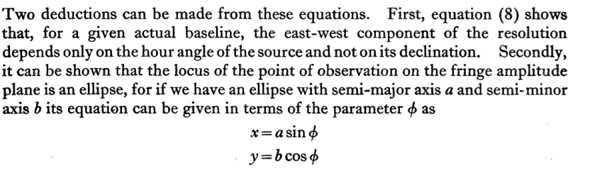
CLASSIC PAPER BY BARRIE ROWSON
MNRAS 125, 177 (1963)
“High resolution observations with a tracking interferometer”
1 THEORY OF THE “U-V” ELLIPSE

Slide 18

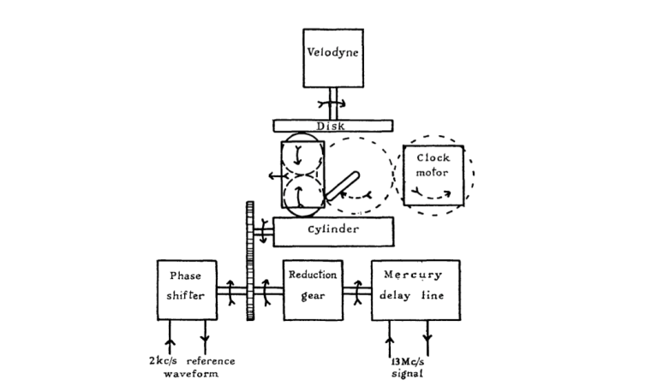

CLASSIC PAPER BY BARRIE ROWSON MNRAS 125, 177 (1963) “High resolution observations with a tracking interferometer“
2. PRACTISE - FRINGE FREQUENCY/ DELAY MACHINE Ingeneous analogue computer
Tracks fringe frequency and delay out to B >100 km
Fringe freq.
Speed ~ cos δ
Delay =
Meccano gears
1 revolution
in 24h
~ sin (H-h)
~ cos (H-h)

Slide 19
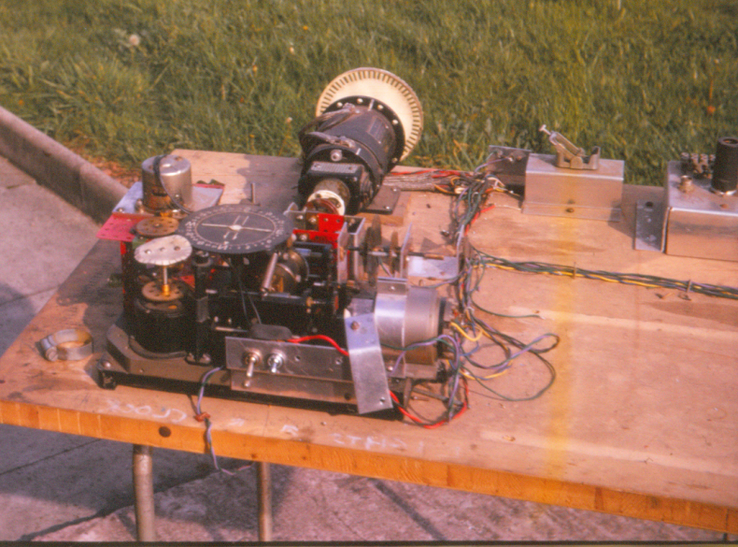
ROWSON FRINGE FREQUENCY/ DELAY MACHINE
ON TEST BENCH
Tracked fringe frequency and delay out to B >100 km
Delay =
Photo
courtesy
Barrie
Rowson
Fringe freq.

Slide 20
ROWSON FRINGE FREQUENCY/ DELAY MACHINE
Tracked fringe frequency and delay out to B >100 km
Fringe freq.
Delay =
Speed ~ cos δ
1 revolution in 24h
Meccano
~ sin (H-h)
Set initial delay
to calculated
delay for start HA
~ cos (H-h)
TURN ON MOTOR AT CORRECT TIME

Slide 21
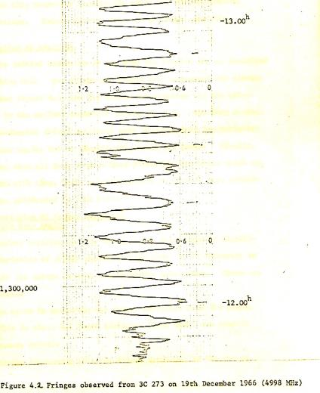
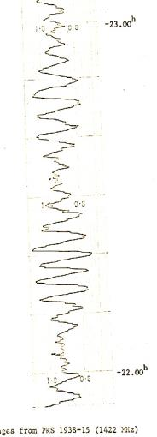
QUEST FOR HIGHER RESOLUTION - ARE THERE FRINGES?
Jodrell – Defford Baseline - 5 GHz 2 Mλ
3C273B YES!!!
UNRESOVED
1938-15 YES!!!
RESOLVED

Slide 22
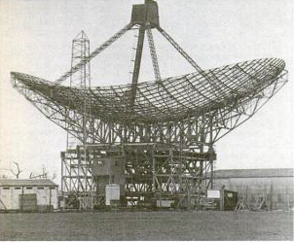
QUEST FOR MORE SENSITIVITY
THE MARK III TELESCOPE 1967
35m x 28m Increased sensitivity
  “Transportable”, but never transported

Slide 23
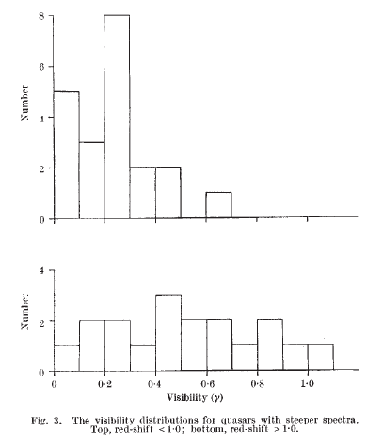

QUASAR ANGULAR SIZES DECREASE WITH REDSHIFT
GM Nature 218, 933 (1968)
STEEP-SPECTRUM QUASARS
SPECTRAL INDEX < -0.7
No.
z < 1
z > 1
Fringe Visibility
< Large
Small >

Slide 24
QUEST FOR HIGHER RESOLUTION
DEVELOPMENT OF TAPE RECORDING INTERFEROMETRY
AT JODRELL BANK
1963 Visit by Lovell to Crimea
  Discussions with Shlovsky and Matveyenko
    Crimea – Jodrell 42 cm 2200 km
  Memo by Palmer, Anderson, Rowson
    Impossible/ too expensive with linked interferometer
    Possibility of phase coherent tape recording interferometer
1965- 67 Development of tape recording interferometers
    Video tape recorders
    Atomic clocks
1967
  Canada. Broten et al (Algonquin-Penticton)
  US. NRAO – Cornell Kellermann, Cohen, Clark
  MIT Moran et al
1969
  Jodrell – Arecibo (too late – Jodrell lost the race)
VLBI = SCIENCE + SCIENCE DIPLOMACY IN COLD WAR

Slide 25
LONG BASELINE INTERFEROMETRY = SCIENCE + POLITICS
Attractiveness to policy makers and international organisations
  Building international scientific bridge between countries
    Europe, EVN, Radionet, JIVE
    Africa, AVN, SKA
    ERC Synergy Project “Event Horizon Telescope”
  Current role in development of Africa
  (technology and human capacity building)
    Africa, AVN, SKA-Africa
    Resolutions of European Parliament and African Union

Slide 26
BOTTOM LINE
Sixties – key decade for development of long-baseline interferometry
Jodrell Bank played crucial role
Long baseline interferometry has political dimension
  In addition to fundamental scientific rationale

