Slide 1
Discovering Cosmic Microwave Background Radiation
Robert W. Wilson
Harvard-Smithsonian Center for Astrophysics
Notes:
1
1
This is supposed to be a 20 min talk

Slide 2
Notes:
Just over 51 years ago, Arno Penzias and I made this measurement with the major pieces of a
precision radiometer we had been working on for more than a year. Our plan was to make a
series of precise measurements with the 20’ H-R.
At the time it was a disappointment, showing more than twice the amount of noise coming from
the antenna as expected.
In retrospect this messy looking record is the first evidence we had of theCMB.
.04dB ~= 2.5K
In this talk I will discus:
how we got to this point.
how the source of the "excess noise" was identified
some thoughts looking back
I would like to start this story in 1928, when Art Crawford and Karl Jansky were hired at Bell labs
For a time they roomed together. More about Art later.

Slide 3
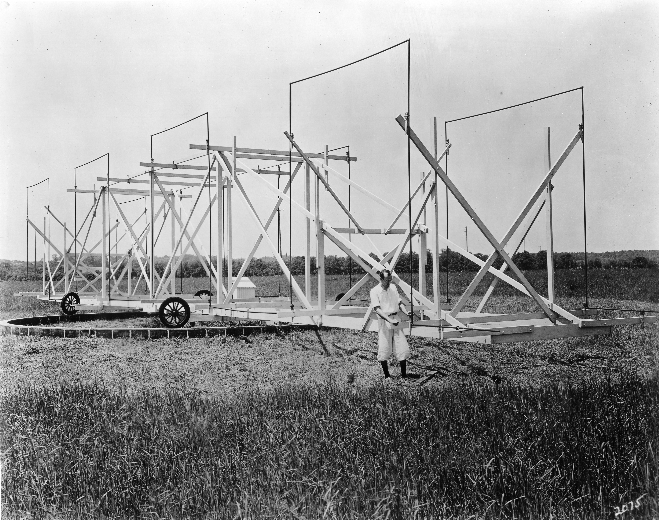
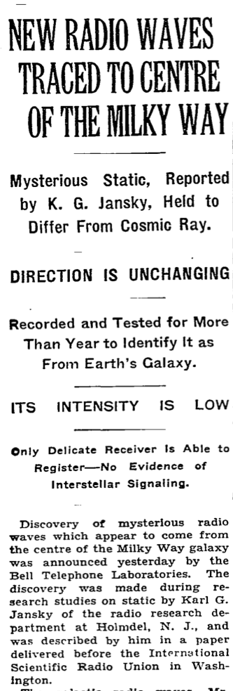
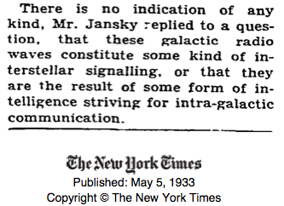
Notes:
Karl was tasked with understanding the sources of noise on proposed trans-Atlantic
short-wave radio-telephone connections
He built this large rotating directional antenna and a sensitive radio receiver and recorded its output
In addition to thunderstorms and man made noise, he found a hiss like noise which
came from the same direction at about the same time every day
In 1933 after several years of observation he and an astronomer friend identified it a
radio noise from the center of our Milky Way galaxy, starting the field of radio astronomy
Advance to NYT article
Not from alien civilization!
Unfortunately Karl died young from a chronic medical problem and did not live to see
radio astronomy become an important science
Jumping ahead

Slide 4
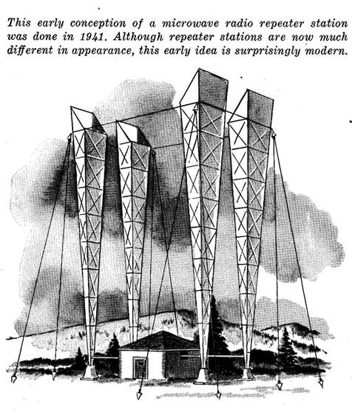
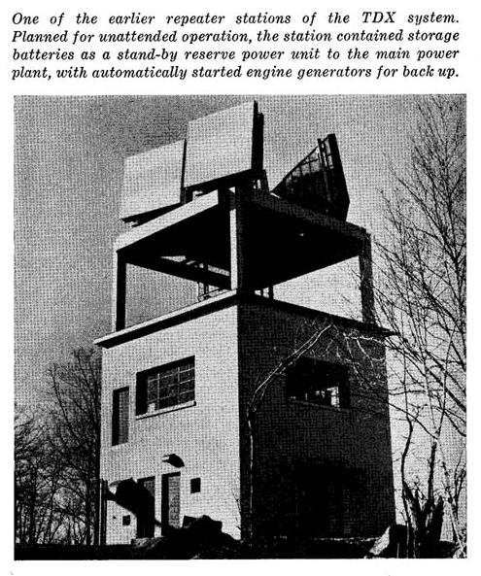
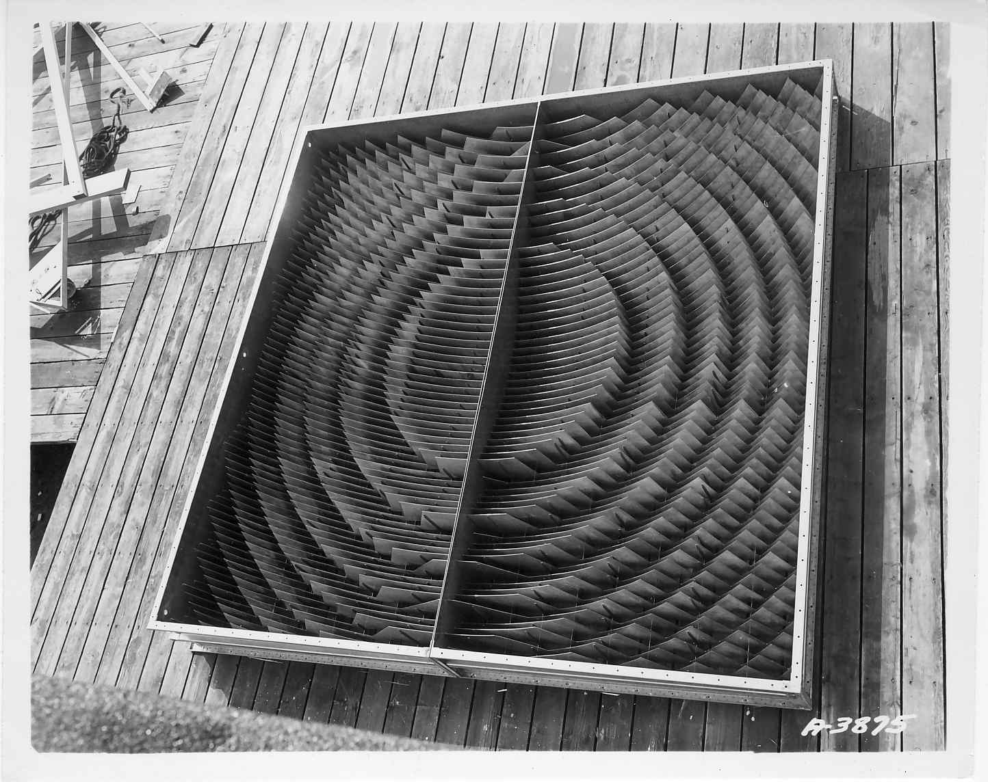
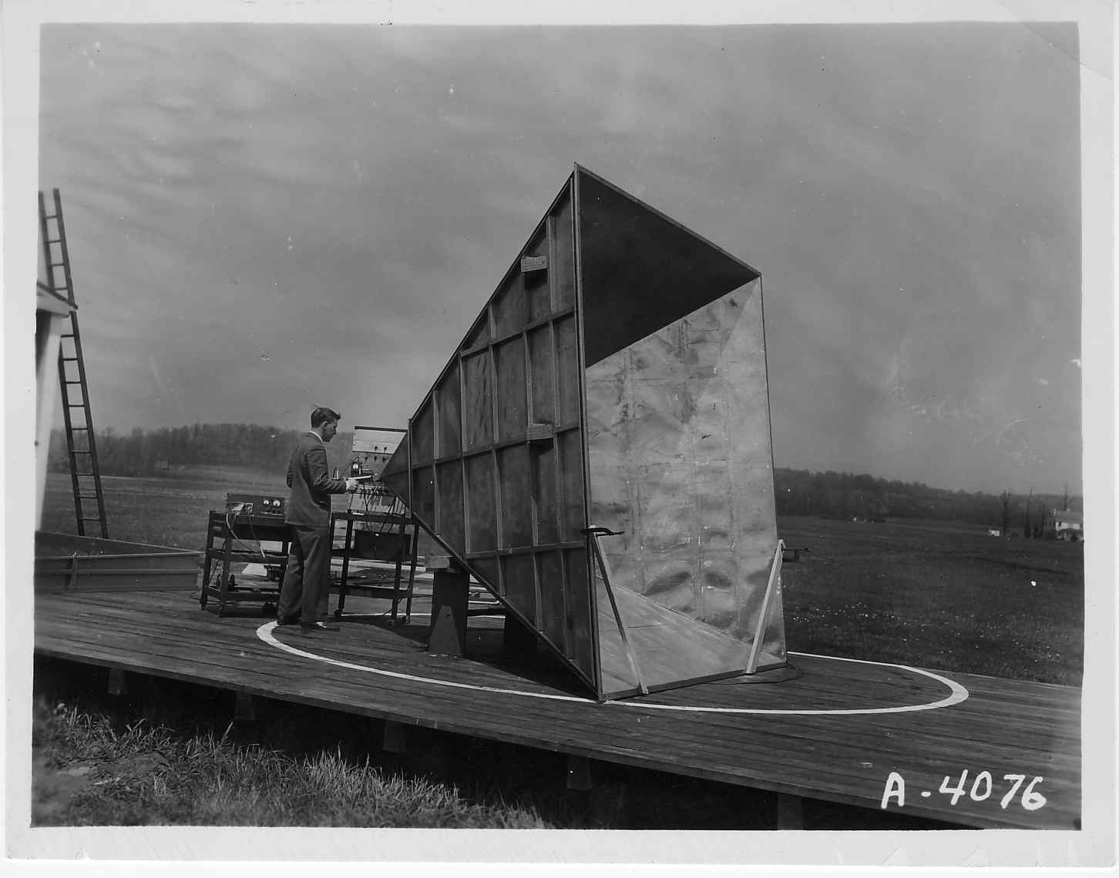
Notes:
The group started working on microwave relay
During WWII they worked on radar.
Microwave relay systems developed after WWII
How Al Beck invented the Horn-Reflector

Slide 5
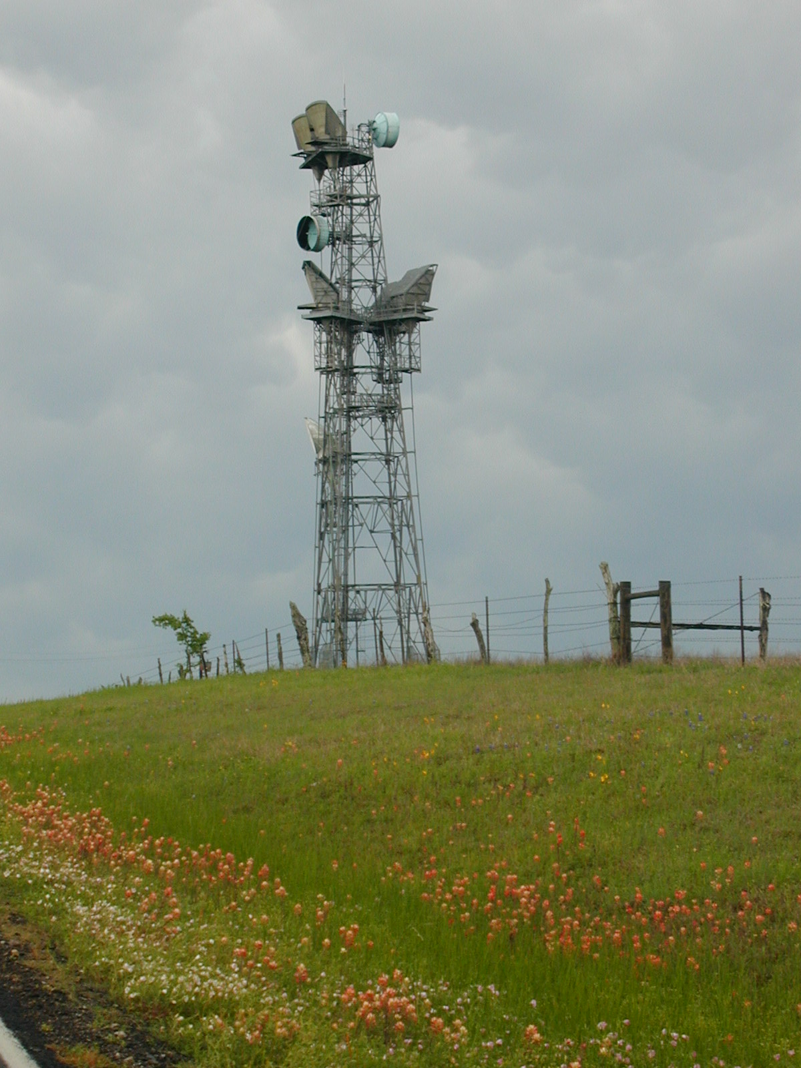

Slide 6
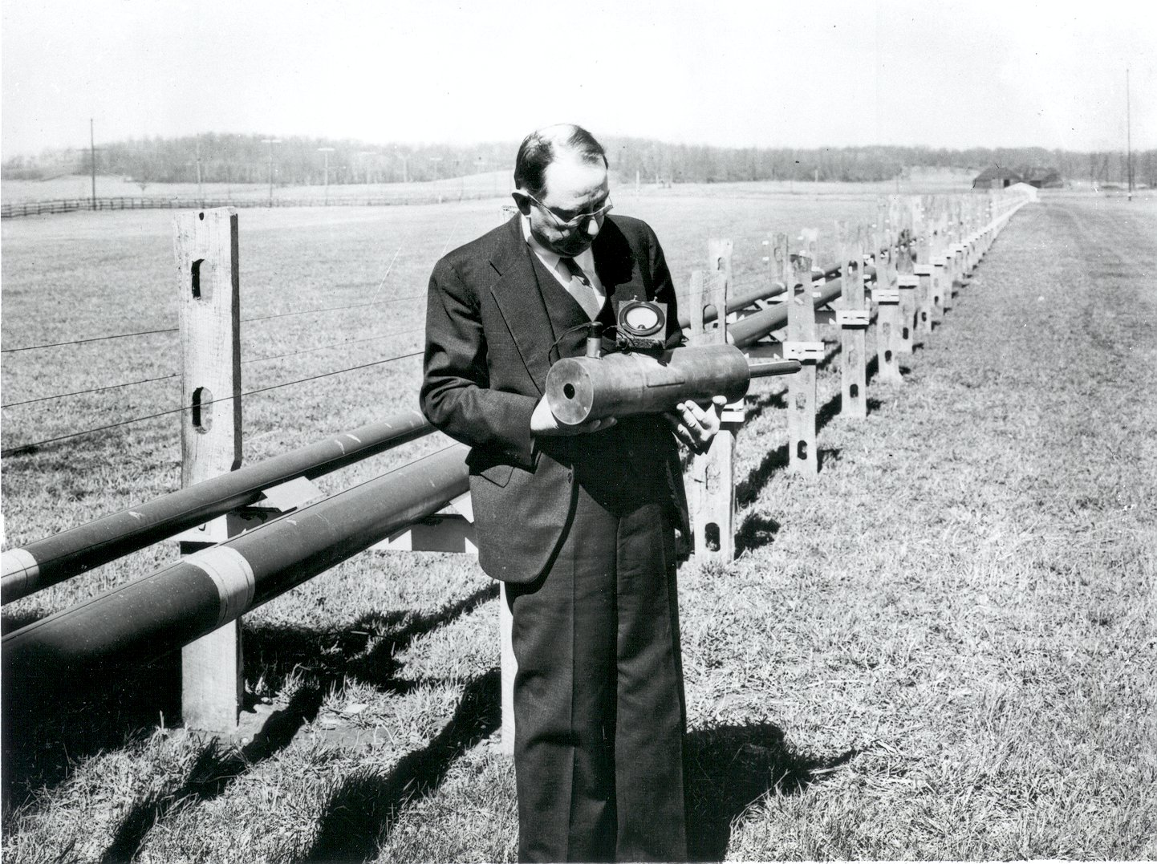
Notes:
The promise of wideband, low loss transmission of mm-waves through waveguide remained as a driving force at Holmdel, with interest increasing as the technology developed
When I joined Bell Labs at the newly completed Crawford Hill Lab in 1963 a mm-wave waveguide system was under intense development. It used 2” diameter waveguide which could propagate 38 to 120 GHz in the TE₀₁ mode
By 1975 a system was developed and coast to coast communication was shown to be possible, but not yet needed; the Crawford Hill group was working on optical communication (VLA)

Slide 7
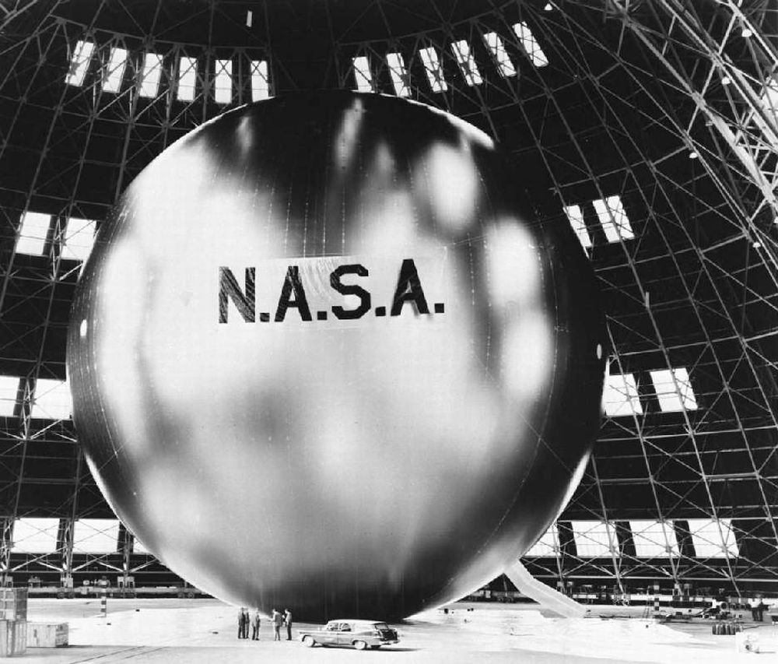
Notes:
John Pierce
Book on electron beam guns
communication theory
computer music
science fiction
In 1955 John Pierce published a paper in ‘Jet Propulsion’ titled “Orbital Radio Relays” he was apparently unaware of Arthur C. Clark’s “Extra-Terrestrial Relays” in WW 1945
In 1957 Sputnik was launched and then in 1958 NASA proposed launching the 100’ diameter Echo balloon made of , 0.0005” aluminized mylar to measure the forces in orbit.
Bell Labs proposed using Echo as a first communications satellite. (only useful as a precursor experiment)

Slide 8
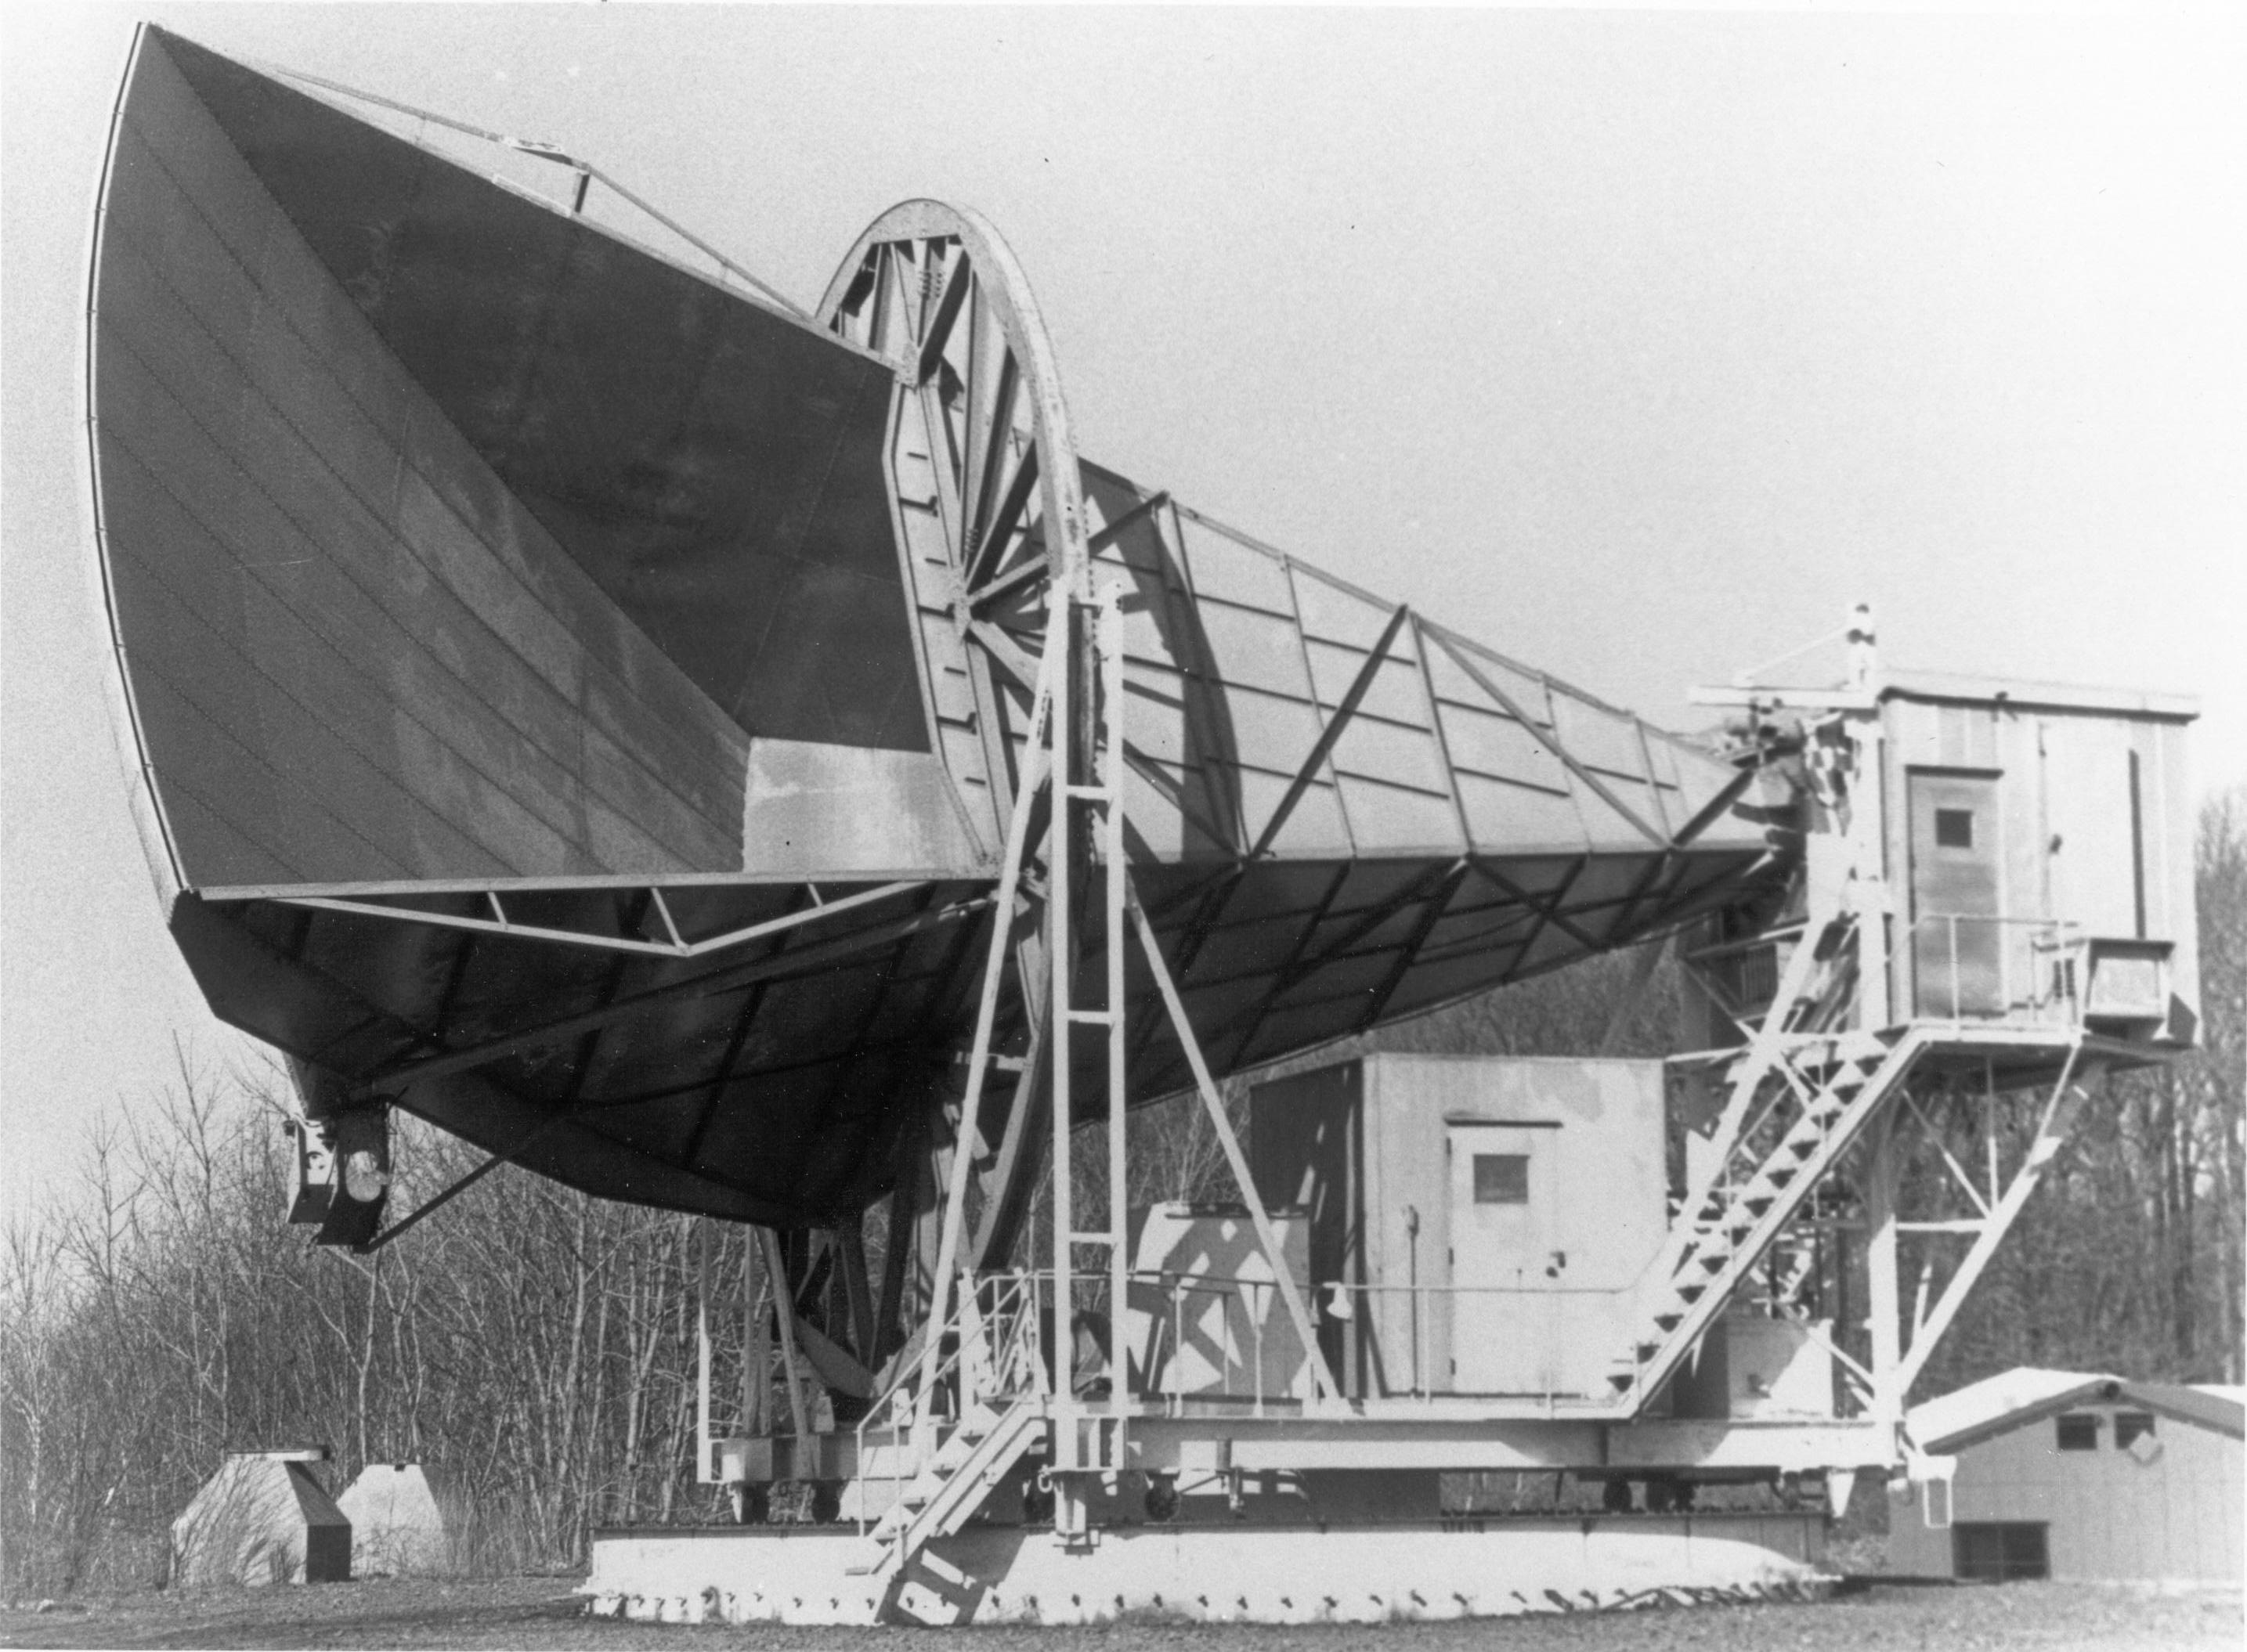
The 20 foot Horn-Reflector
Notes:
8
The return signal would be weak, so they would combine two Bell Labs inventions to form a low noise receiving system.
A ruby traveling wave MASER amplifier
A large horn-reflector antenna – very little pickup from the ground
Art Crawford led the construction
Echo was launched and used as a microwave relay in 1960. Eisenhower’s voice was transmitted by JPL and received at Crawford Hill

Slide 9
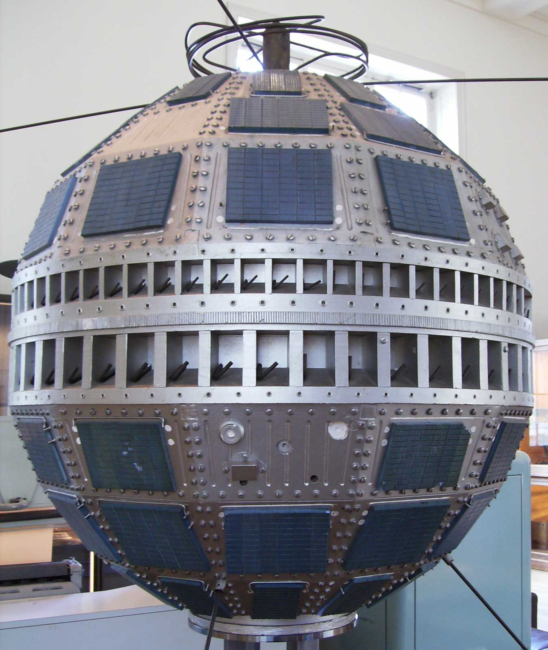
Notes:
Telstar was the first active communications satellite, launched in 1962
The 20’ H-R was fitted with a 4 GHz receiver and had a backup role

Slide 10
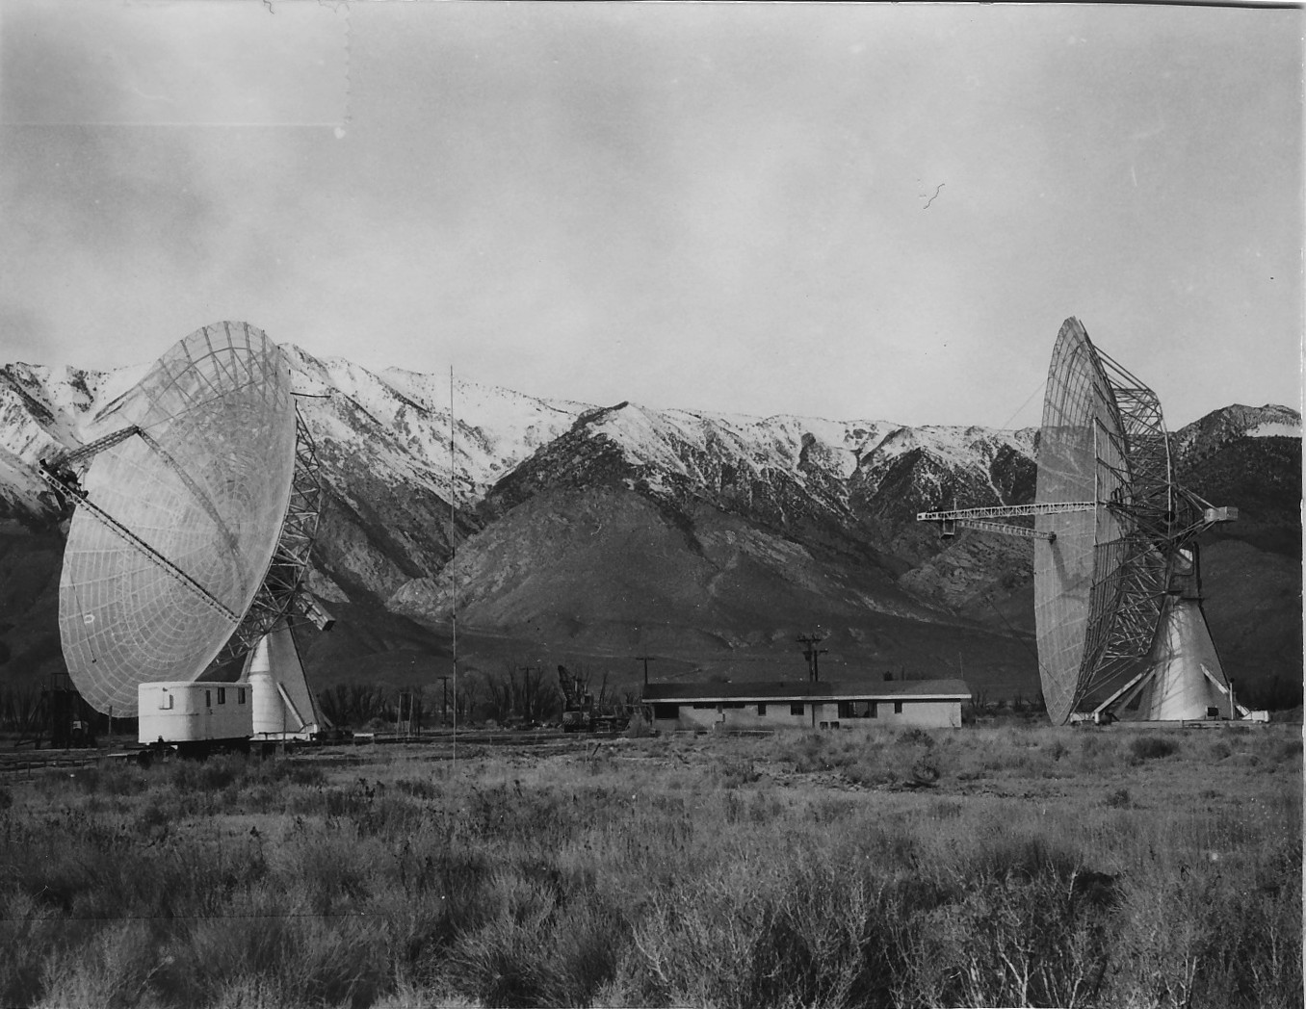
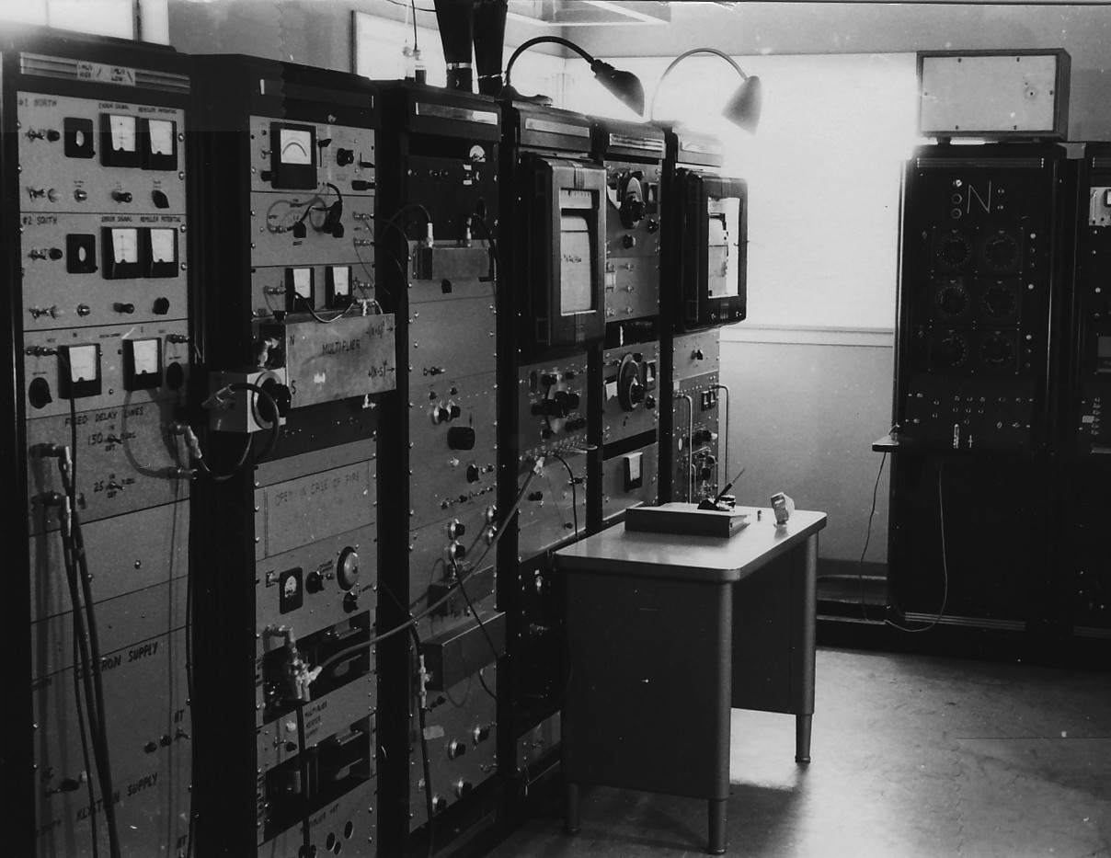
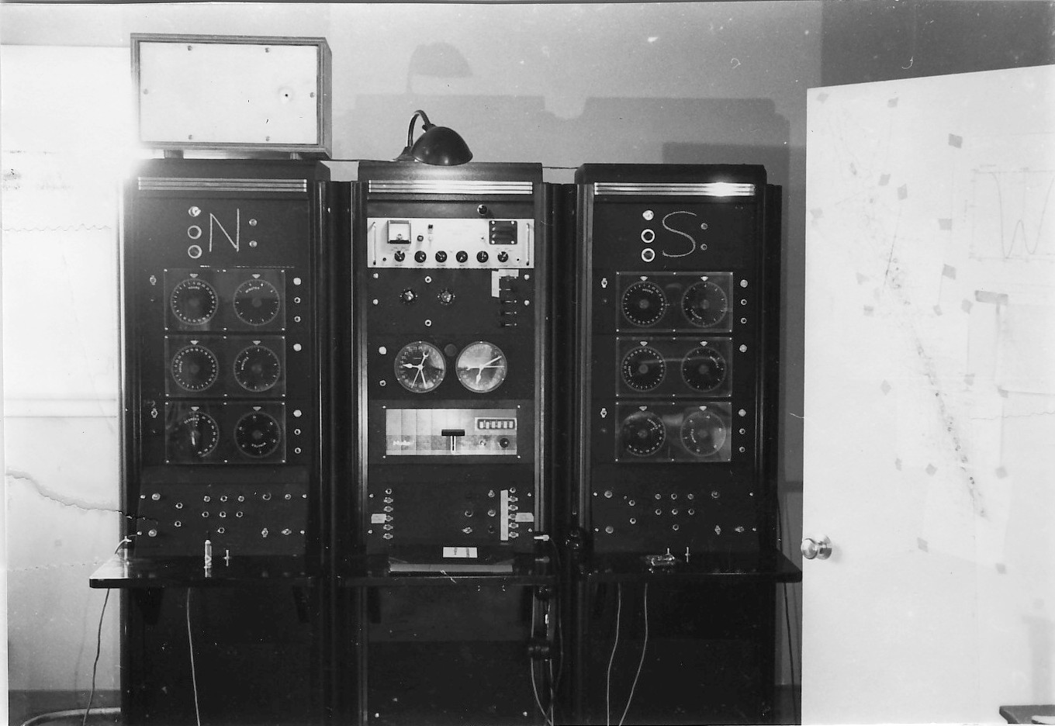
Notes:
In 1957 I went to Caltech for a PhD in Physics. Sputnik was launched that October.
I Joined the new Radio Astronomy group at Caltech. Engineering and science
My one cosmology course was taught by Sir Fred Hoyle and philosophically I liked the steady-state theory.
Measurement of the Hubble constant (age of universe) disagreed by factor of 2
In my thesis I used one of the 90’ dishes of the interferometer to map the brightness of the part of the Milky Way we could see from the Owens Valley.
A chapter about antennas Kevin Westfold

Slide 11
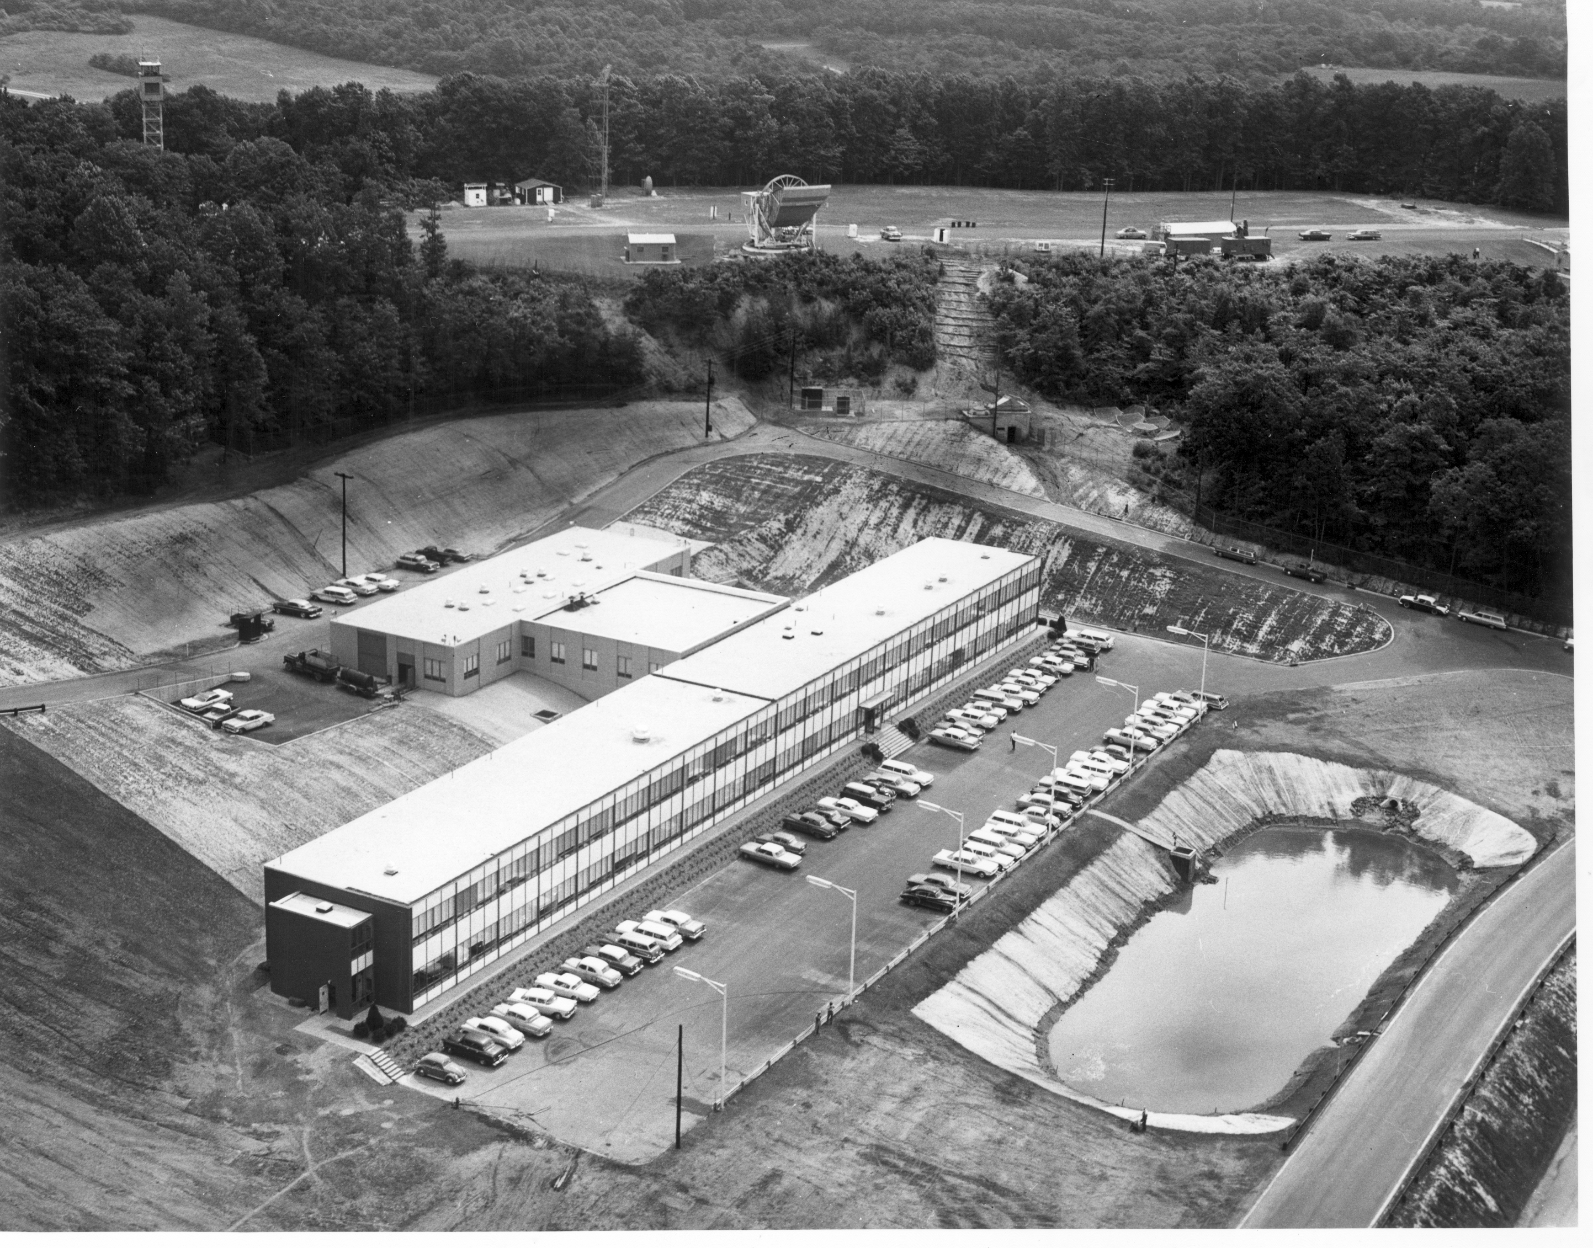
Notes:
After finishing my PhD and a one year post-doc I took a job at Bell Labs' Crawford Hill Lab in 1963.
Arno Penzias had been hired earlier after he finished a radio astronomy thesis at Columbia with Charlie Townes.
Why BTL hired 2 radio astronomers Art Crawford/Jansky
We knew that the 20-foot HR had unique properties
Small enough to measure gain, but sensitive
Very little pickup from the ground, could make absolute brightness measurement
11

Slide 12
Our Plans
Arno and I set out a series of measurements we wanted to make using the 20 foot horn-reflector. Among them were:
Measure the absolute strength of CasA at 4 GHz. This would be useful for astronomy and satellite systems.
Look for a halo of radiation around the Milky Way at 1.4 GHz and establish a zero level for Galactic radiation (fix up my thesis).
Make a much better search for atomic hydrogen in galactic clusters (fix up Arno's thesis).
Notes:
12
12
Eric Betzig’s title “Working where others aren’t”
By starting with the existing 4 GHz system, we could do the useful measurement of CasA and a control measurement for the galactic halo.
We built the best measuring system we could:
Arno made a liquid helium cooled reference noise source.
I made an accurate switch for comparing the antenna to the reference and improved the stability of the measuring system.

Slide 13
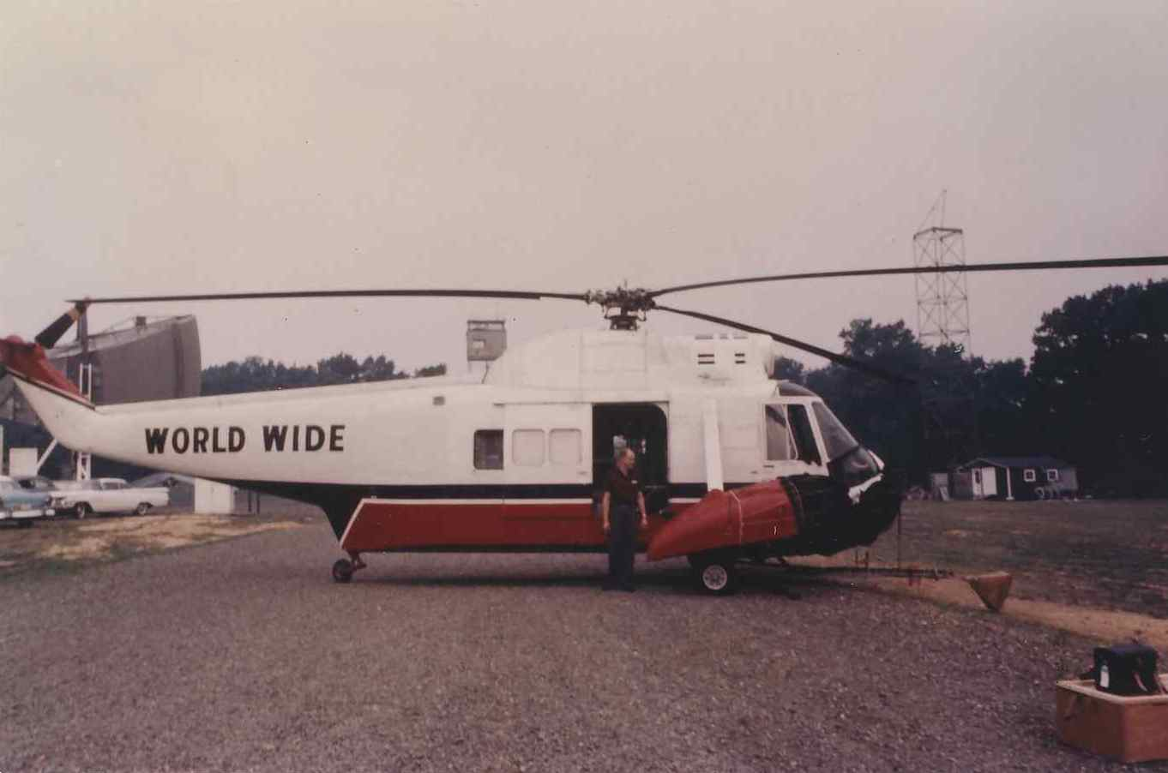
Notes:
Dave Hogg and I hired a helicopter for a day to fly a 4 GHz source in the far field of the 20’ H-R

Slide 14
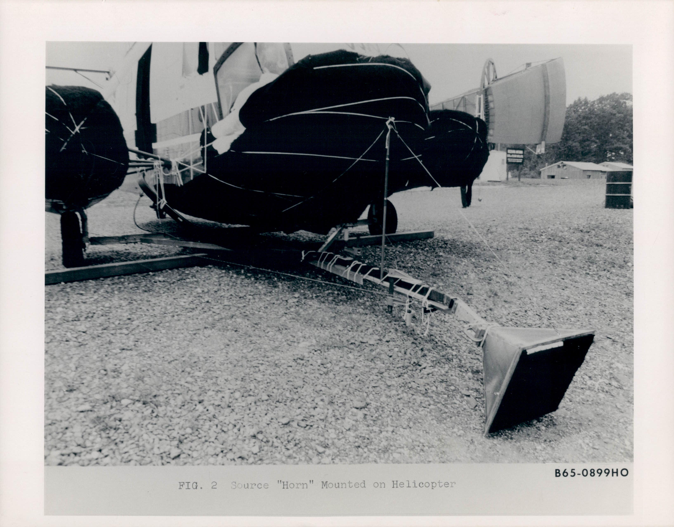

Slide 15
Notes:
After Arno and I got our radiometer together this was our 1st measurement. Disappointing
Point out antenna and cold load
Excess noise had been seen before at Bell Labs, but we could trace that excess directly to the antenna or sky
Since the accurate gain measurement had been made, we did not want to change anything on the antenna.
We spent 9 months improving our receiver, checking that several different ways of calibrating it gave consistent answers and accurately measuring the strength of several radio sources, including Cas A.
During that time the excess noise of 3.5K remained the same and we found no fault in our equipment or environment to explain it.
04dB ~= 2.5K

Slide 16
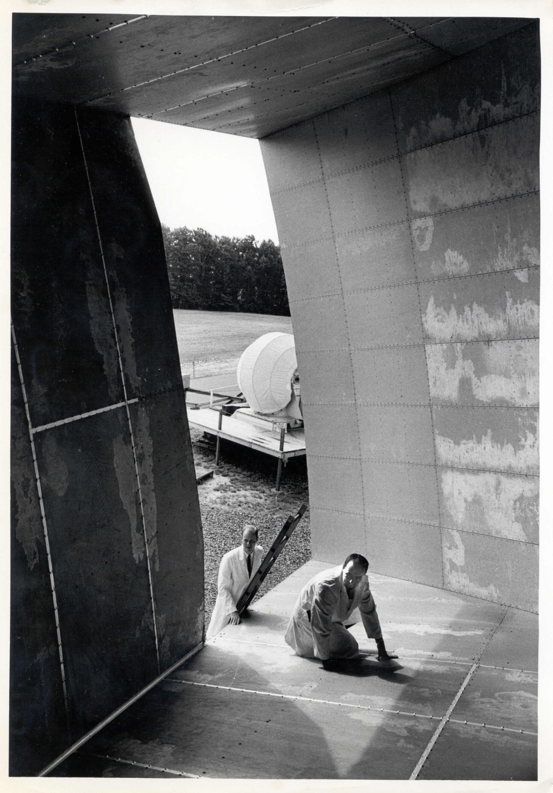
Notes:
After completing the CasA measurement we started cleaning up some parts of the antenna which we had not wanted to disturb earlier, including removing a pair of pigeons and their droppings and putting good conducting tape over the joints. This had little effect.

Slide 17
Sources Which We Ruled Out
Atmospheric radiation
Man made noise (NYC on our horizon)
Pigeon droppings in our antenna
Imperfect walls of the antenna
The Starfish high altitude nuclear bomb test
Unknown solar system source
The Milky Way galaxy
The combined effect of known discrete sources
Notes:
We had ruled out about everything we could think of when
One spring day in 1965 Arno called Bernie Burke
The Princeton Gravity Group’s plans
Arno called Bob Dicke at Princeton ...
Arno and I were happy to have any explanation.
We and Dicke's group wrote two separate papers
We made one final check and submitted our paper.

Slide 18
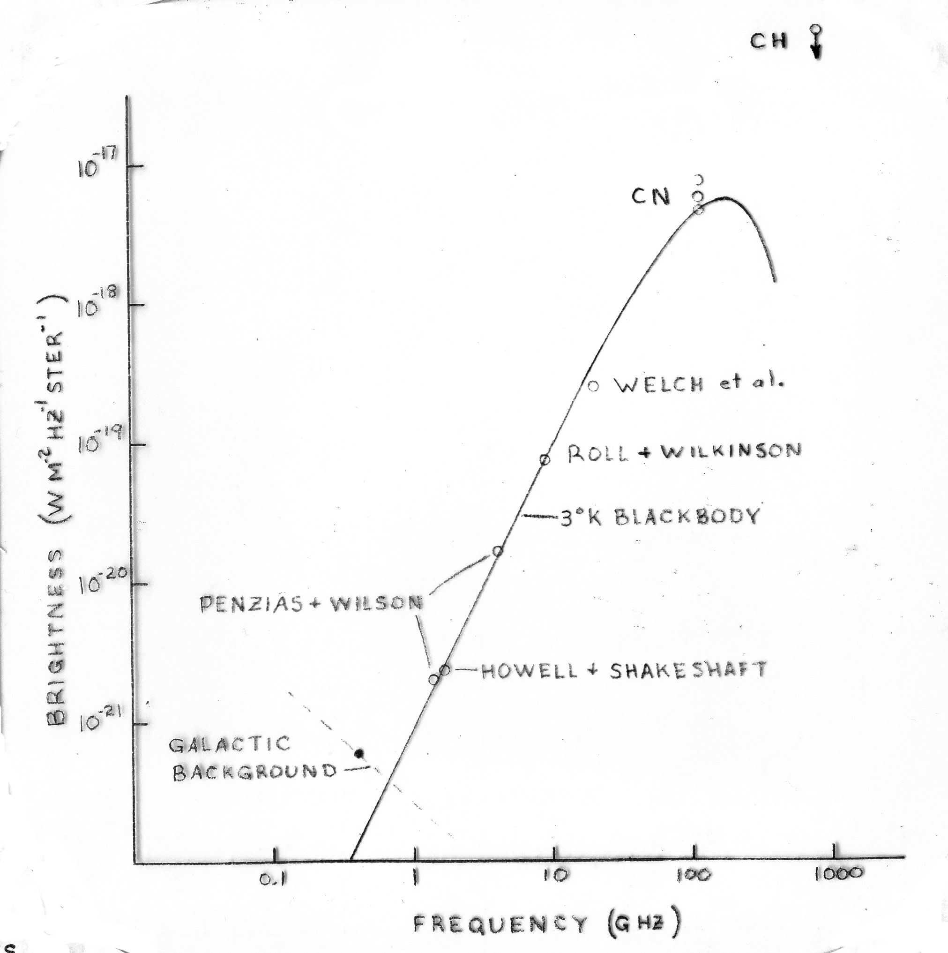
Measurements of the CMBR After a Year
Notes:
18
18
Soon 3 groups remembered that CN was seen in diffuse clouds absorbing starlight and the first rotationally excited state was also seen
By the end of the year Wilkinson and Roll had made a measurement at 3 cm wavelength which agreed with ours.
So after a year, the Raleigh-Jeans part of the spectrum was rather well defined.
We also soon learned that, working with Gamow, Alpher and Hermann had thought about thermal radiation from the big bang in the late 40’s.

Slide 19
COBE Science Working Group
Notes:
19
19
Original presented at the AAS meeting Jan. 1990 Washington, DC by John Mather

Slide 20
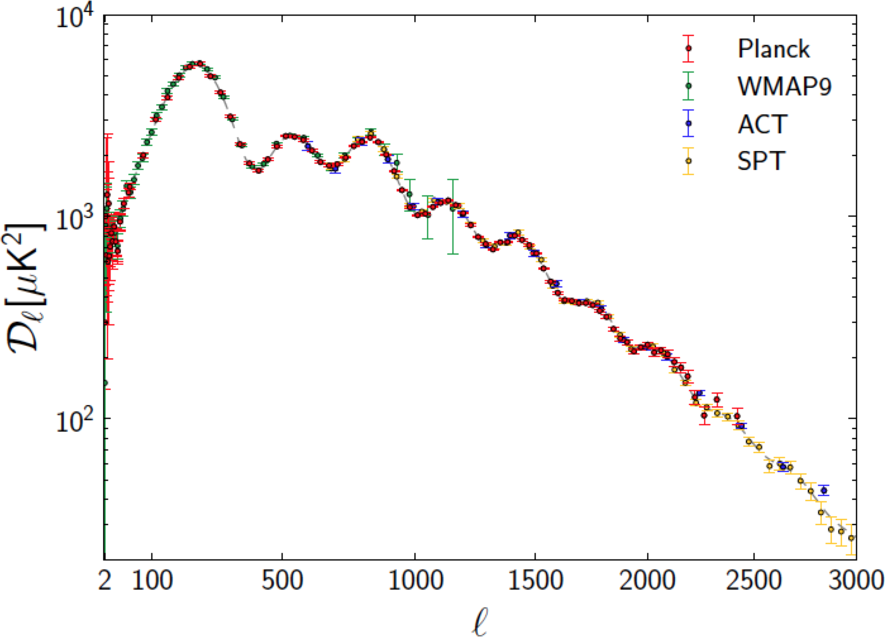
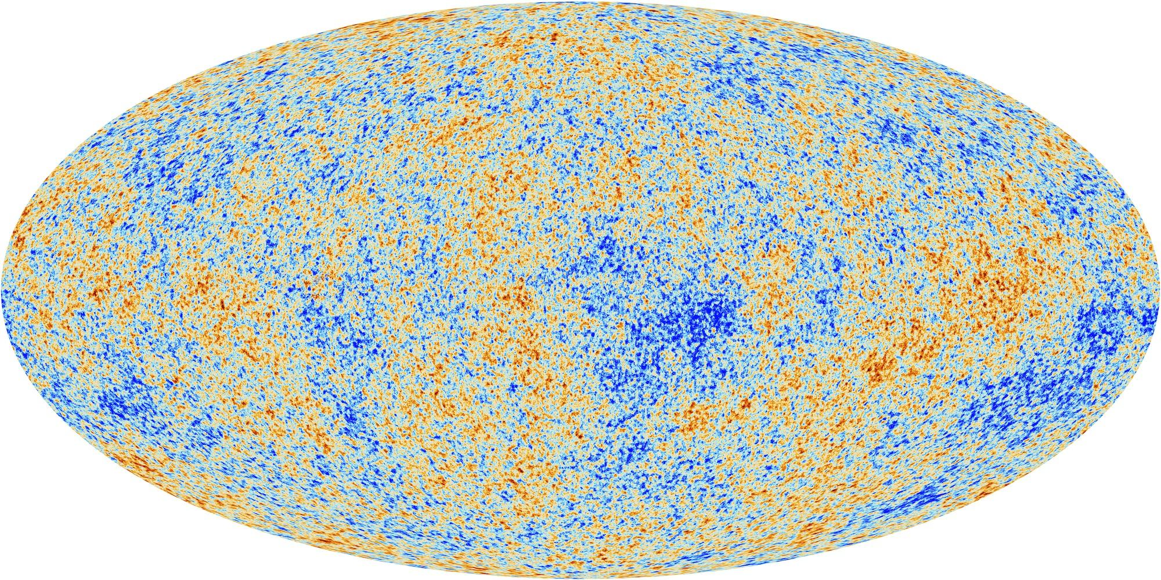
Baby Picture of the Universe at 379,000 Years
Cosmic Microwave Background (CMB)
The Cosmic Microwave Background as measured by the Planck Satellite
(±200 μK)
Spectrum of the brightness variations with fit by Cosmic Inflation (line)
Notes:
Inflation turned quantum fluctuations into the brightness variations in this picture (false color)
First evidence of this in early ‘90s by COBE satellite (G. Smoot)
Multipole expansion
These fit of theory to measurements shows that Omega = 1.001+-.0065
The density fluctuations of galaxies agrees with the same theory
Although highly successful, the inflationary paradigm represents a vast extrapolation from well-tested regimes in physics. It invokes quantum effects in highly curved spacetime at energies near 10^16 GeV and timescales less than 10^−32 s.
Furthermore, we don’t know what 96%of the mas-energy of the universe is

Slide 21
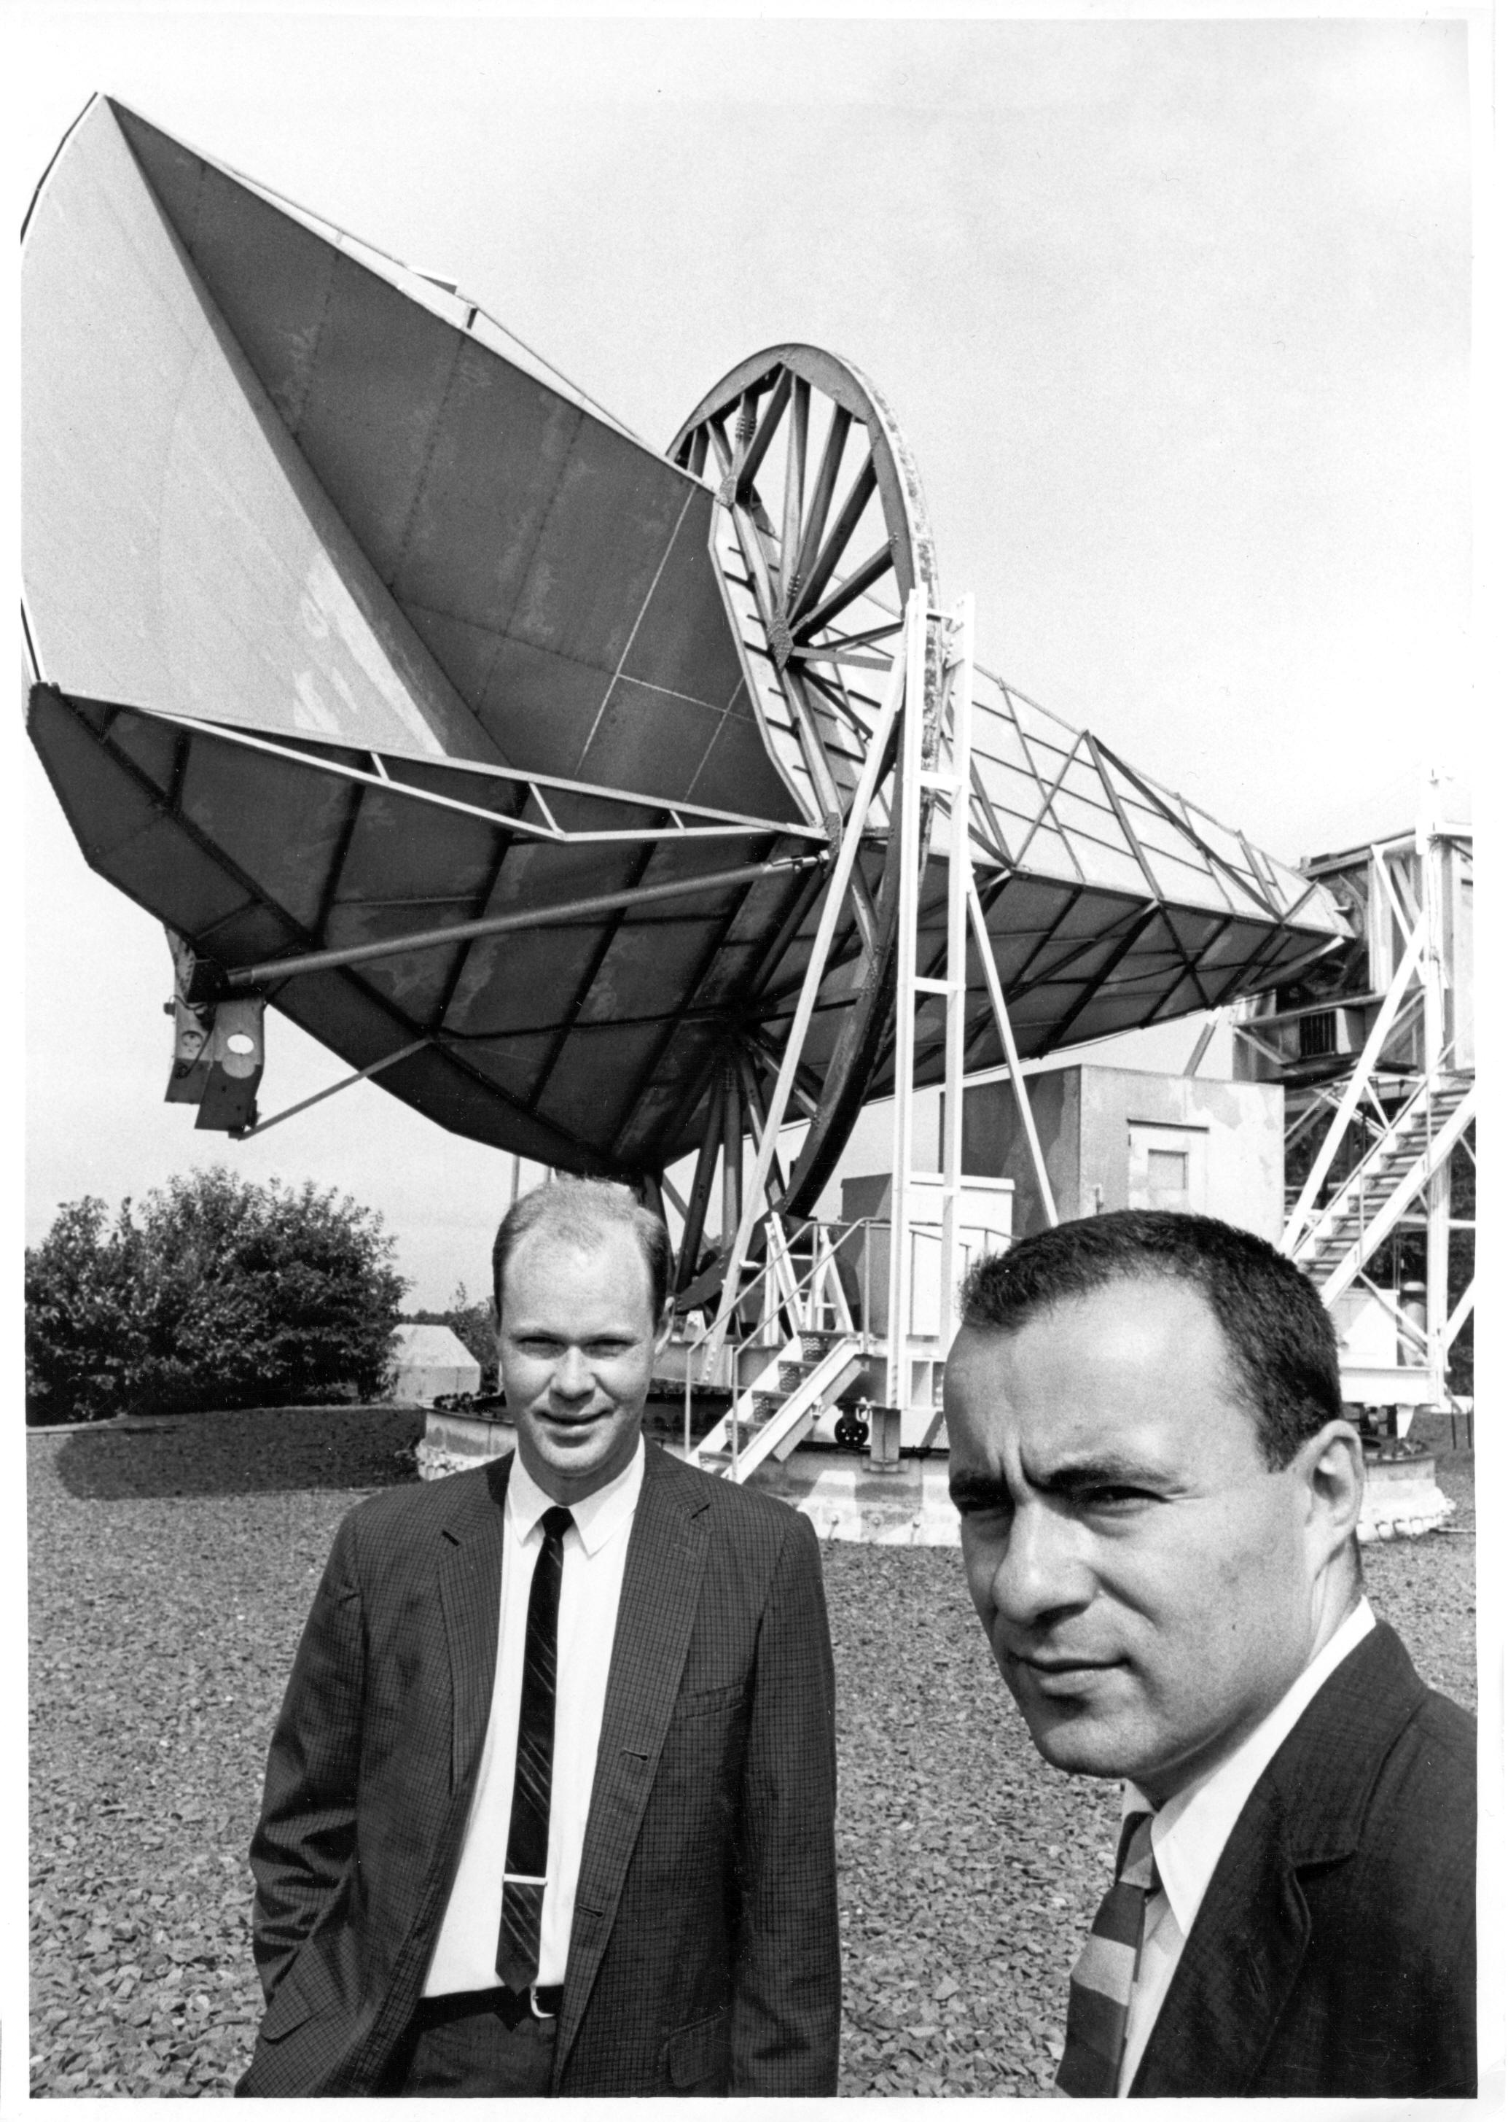
Notes:
21
I am here to tell you that those guys in 1965 did not know how important the CMB would be
Looking back on this, I feel very lucky:
I had a job at Bell Labs and was supported to apply technologies Bell Labs developed for communications to astrophysics. There were many experts who were happy to help
I started my career when Radio Astronomy and cosmology were relatively new sciences but poised to blossom as technology developed.
When I entered the work force, the nation, perhaps shocked by Sputnik, and remembering the contribution of science to winning WW2, understood the value of science for its future and was willing to spend the money to be the world leader in science and technology.
As you may have gathered from what I have said, there was no aha moment in discovering the CMB. Instead there was a long period of trying to identify the "problem" The importance of the CMB only became clear over the following years as theories and more sensitive receivers were developed. It is, however, very satisfying to look back and see that we did our job right and to see how much has been derived from the CMB.
It has been a great ride.

