Slide 1

Radio Recombination Lines
Sergei Gulyaev
Institute for Radio Astronomy and Space Research
Auckland University of Technology
New Zealand

Slide 2
Study of highly-excited atomic levels (transitions) started before Atomic Physics became a discipline:
J. Balmer, Annalen der Physik , 1885, 25, 80.
J. Rydberg, Zeitschrift für Physikalische Chemie, 1890, 5, 227.
and continued in the era of Quantum Mechanics:
E. Fermi, Zs. Phys., 1924, 26, 54.
E. Fermi, Nuovo Cimento, 1934, 11, 157.
J. Baker and D. Menzel, ApJ, 1938, 88, 52.
A. Unsold, Zs. Ap., 1948, 24, 355.

Slide 3
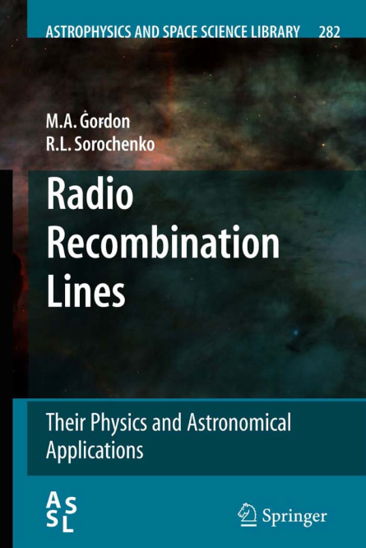

Slide 4
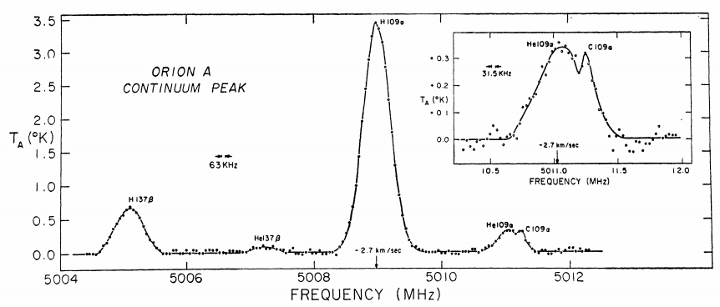
Webster's Dictionary defines an enfant terrible as an unusually successful person who is strikingly unorthodox, innovative, and/or avant-garde; a very difficult child to manage, but incredibly rewarding eventually.
from Dupree and Goldberg, 1970

Slide 5
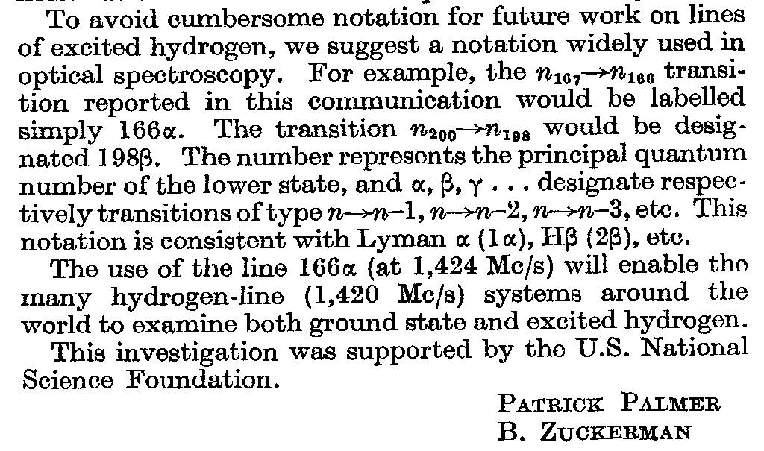
Nature, 1966

Slide 6
RRL in Physics:
How many atomic level can exist?
An amazing proof of quantum mechanics: it works beautifully to a unbelievable extreme: n = 1000, the state when the simplest quantum system, H atom, becomes 1 million times greater in size than ordinary atoms -- as big as 0.1 mm in size – thickness of a piece of paper. The simpliest quantum system of a classical size!
Spectral line broadening theory was significantly reconsidered and refined (Hans Griem, 1967; Minaeva, Sobel’man, Sorochenko, 1967). Very important for diagnostics of plasmas, e.g. thermonuclear plasma in nuclear reactors (broadening of spectral lines of multi-charged ions of heavy elements)
First natural atomic (not molecular) masers (Goldberg, 1966) and lasers (Strelnitski et al., 1996).

Slide 7
RRL in astronomy:
Diagnostics of regions of ionized H (HII regions -- star formation areas, planetary nebulae, ultra-compact, hyper-compact HII) – their physics, dynamics, geometry, gradients, abundance of He, etc.
Radio wavelengths – it means that dust and gas are transparent, therefore study of the areas of the MW Galaxy where optical photons can’t penetrate (e.g. tracers of the spiral structure)
Discovery of photodissociation regions (PDR); “CII – HI” regions
Direct measurements of the CR ionization rate in the MW Galaxy
Most accurate estimate of He abundance
Properties of star-forming galaxies

Slide 8
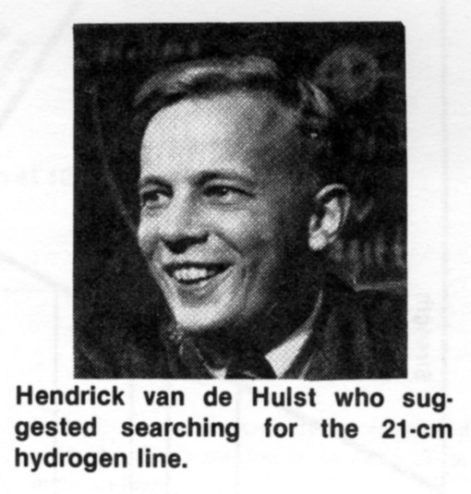

Slide 9
Very low frequencies.
Very large quantum numbers. These lines are indeed unobservable for a number of reasons. Kardashev considered much lower n
David Inglis and Ed Teller 1939
Indeed, it had to be 5/3, not 3/5 – but for the quasi-static Stark. If correctly followed Inglis and Teller, the impact broadening had to be used, that is 7/3. And again, he uses a very long 100m wavelength (?)

Slide 10
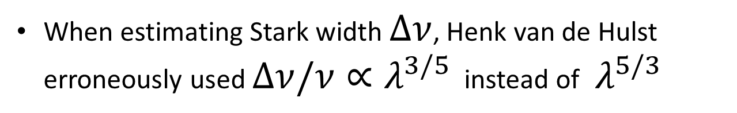
When estimating Stark width $∆ν$, Henk van de Hulst erroneously used $∆ν/ν∝λ^{3/5}$ instead of ${ λ}^{5/3}$
TRUE
FALSE

Slide 11
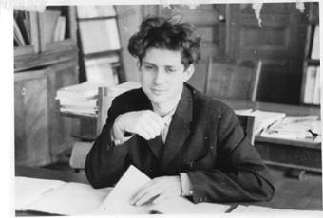
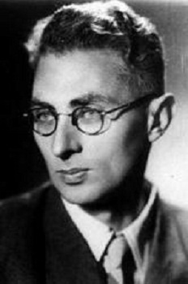
Nicolai Kardashev, 25,
PhD student of I. Shklovski,
Moscow State, GAISh Library, 1958
Iosif Shklovski
Solomon Pikel’ner
Both ~40 years old in 1958

Slide 12
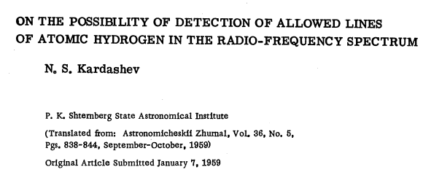
Kardashev’s paper was informally presented in 1958 to a group of radio astronomers who attended the Xth General Assembly in Moscow (Erickson, Field, Goldberg, Haddock, Hagen, Heeschen, Menon, Muller, Weaver, Westerhout, Shklovski, Pikel’ner and Yu Parijskij)
Submitted on 7 January 1959

Slide 13
A great paper!
It starts from the reference to the work of Paul Wild (1952), where Wild just quotes negative conclusion of van de Hulst (1945)
Did Kardashev, Shklovski and Pikel’ner know about the work of van de Hulst?

Slide 14
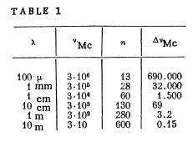
A great paper!
Kardashev considers all range of RRLs observed in the next 50 years:

Slide 15
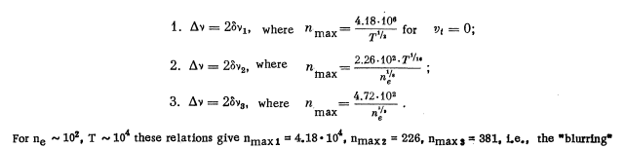
A great paper!
Correctly estimates line widths:
Doppler
Impact
Quasi-static

Slide 16
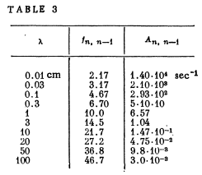
A great paper!
Calculates oscillator strengths and transition probabilities:

Slide 17
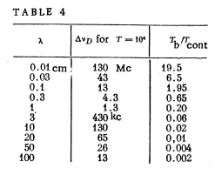
A great paper!
Calculates line widths and line intensities:

Slide 18
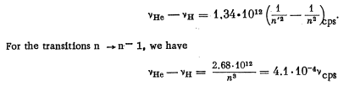
A great paper!
Suggests observation of lines of He and other atoms:

Slide 19
A great paper!
Suggests which objects are most suitable and can be observed first

Slide 20
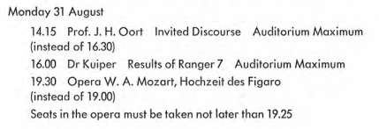
The XIIth General Assembly, Hamburg, Germany.
Joint session of Commissions 33, 34 and 40 (organised by Westerhout)

Slide 21
The XIIth General Assembly, Hamburg, Germany.
Joint session of Commissions 33, 34 and 40 (organised by Westerhout)
Chair: Alan Barrett
…
23. Detection of excited Hydrogen line n=91→90 in Omega Nebula --- R.Sorochenko and E.Borodzich (presented by V.Vitkevich)
24. Detection of excited Hydrogen line n=105→104 --- A.Dravskikh et al. (presented by Yu.Parijskij)

Slide 22
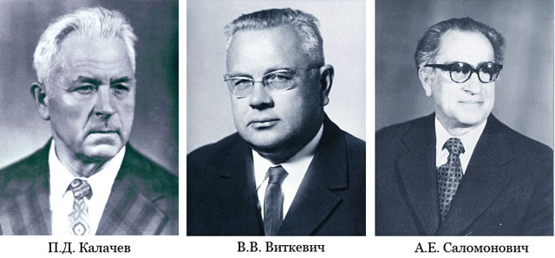
Viktor Vitkevich Yu. Parijskij
The XIIth General Assembly, Hamburg, Germany.

Slide 24
The XIIth General Assembly, Hamburg, Germany.
Joint session of Commissions 33, 34 and 40 (organised by Westerhout)
Barrett: Are you saying that you detected the excited Hydrogen line n=105→104 ?
Parijskij: Yes.
Barrett: Let me repeat my question. Are you saying that these lines can exist ?
Parijskij: Yes.

Slide 25
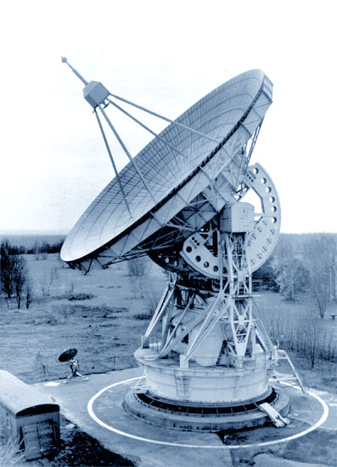

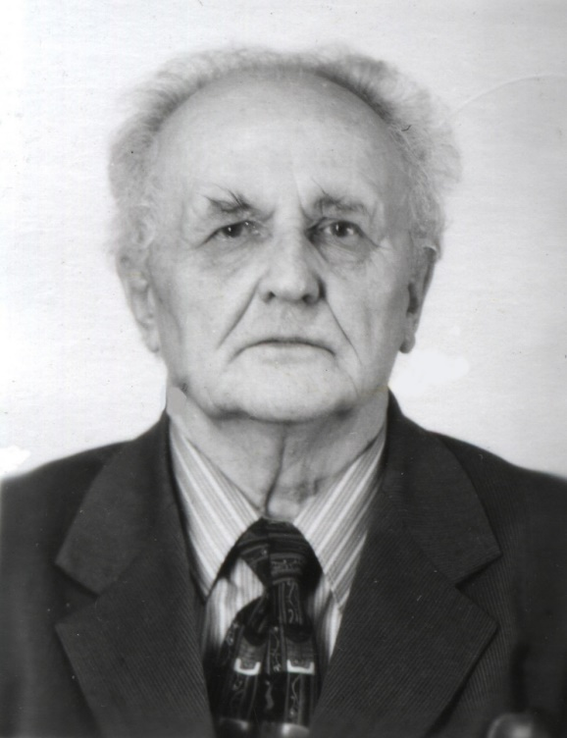
Roman Sorochenko,
1942
Roman Sorochenko,
2012
Lebedev Physical Institute (FIAN), Pushchino, RT-22

Slide 26
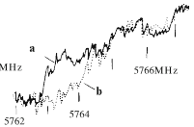
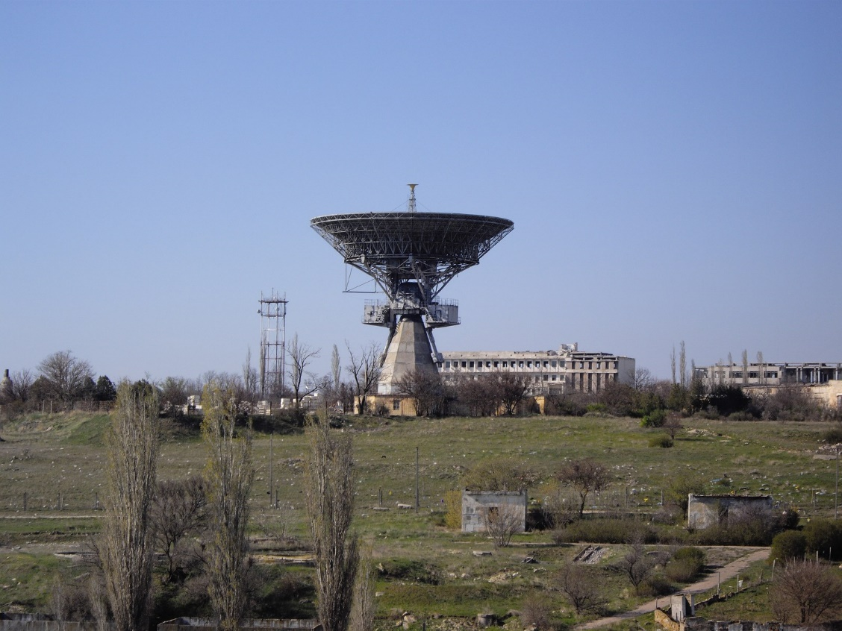

32m RT in Crimea https://ru.wikivoyage.org/wiki/%D0%A1%D0%B8%D0%BC%D1%84%D0%B5%D1%80%D0%BE%D0%BF%D0%BE%D0%BB%D1%8C#/media/File:TNA-400.jpg

Slide 28
Early attempts
Pulkovo group started search of RRLs in 1958
Australian radio astronomers (John Bolton, Frank Gardner and Brian Robinson) tried to observe RRLs on 64m Parkes in 1963, but failed because they used an approximate formula for line frequency instead of the accurate one.

Slide 29
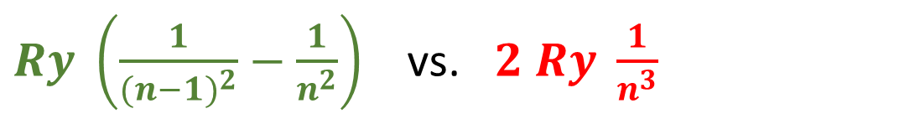
Rydberg Formula for Frequency:
Accurate vs. Approximate
$Ry \left(\frac{1}{{(n−1)}^{2}}−\frac{1}{n^{2}}\right)$ vs. $2 Ry \frac{1}{n^{3}}$

Slide 30
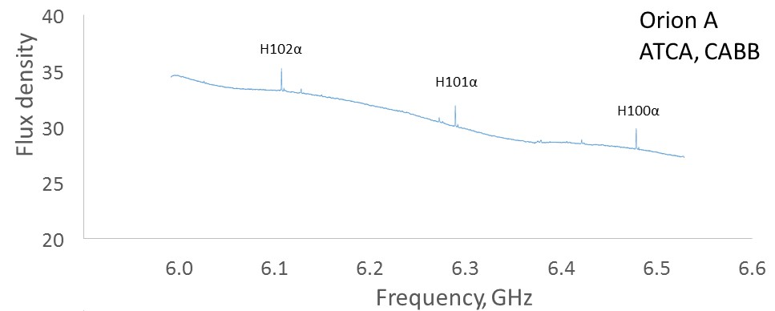

Slide 32
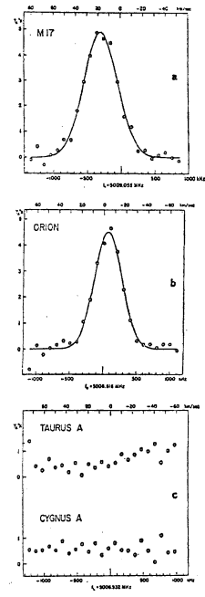
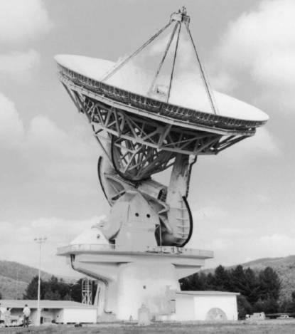
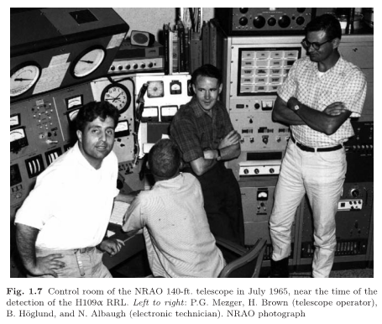
140ft NRAO RT in Green Bank, WV
Höglund and Mezger, 1965

Slide 33
32m RT in Crimea https://ru.wikivoyage.org/wiki/%D0%A1%D0%B8%D0%BC%D1%84%D0%B5%D1%80%D0%BE%D0%BF%D0%BE%D0%BB%D1%8C#/media/File:TNA-400.jpg

Slide 34
Carbon?
Helium abundance
Huge 21 hour integration

Slide 35
Carbon?
Huge 21 hour integration

Slide 36
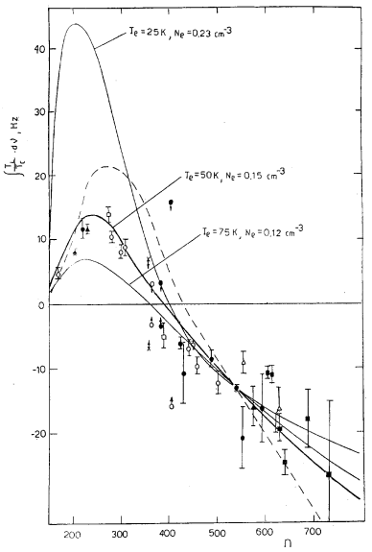
First Carbon RRLs were detected in HII regions in NRAO in 1966-67 by Palmer, Zuckerman, Penfield, Lilley and Mezger (Nature, 1967);
Leo Goldberg and Andrea Dupree (Nature, 1967)
explained these observations
pointed at the importance of dielectronic recombination as one of population mechanisms.
This was the beginning of the era of research of the ionized Carbon. It continued with observations of cold/warm CII clouds in direction of Cas A
The first decametre RRL (C631a) was detected by Konovalenko and Sodin 1980. They looked for a hyperfine structure line of Nitrogen at 26.1 MHz.
From Gordon and Sorochenko, 2009

Slide 37
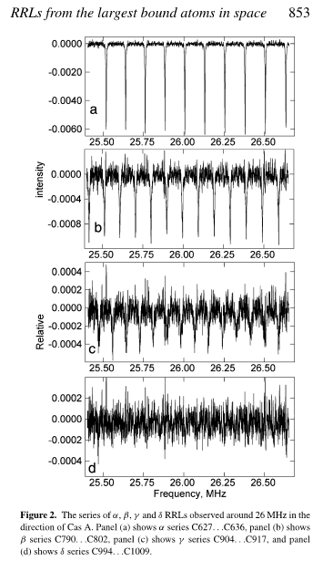
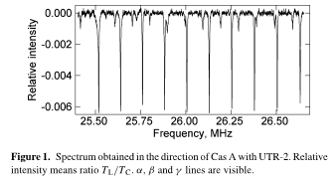
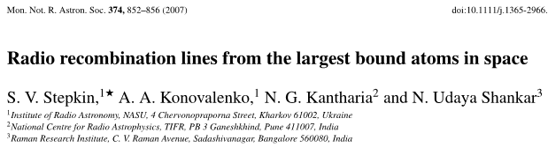

Slide 38
Leo Goldberg, 1966
Identifying the problem
Here it is !!!

Slide 41
(NLTE)
(LTE)
And significant enhancement of line intensities can take place depending on the physical conditions.

Slide 42
It followed from Goldberg’s work that depending on the balance between dlnb_{n}/dn and hv/kT_{e} one can get either positive or negative absorption coefficient.
Goldberg considered the option of negative k_{L}, but still positive sum k_{L} + k_{C}. He called it a partial maser effect. Full (pure) maser/laser effect takes place when the net absorption coefficient k_{L} + k_{C} in the media is negative.
The first natural atomic laser on RRL was discovered by Strelnitski and Townes (1995).

Slide 43
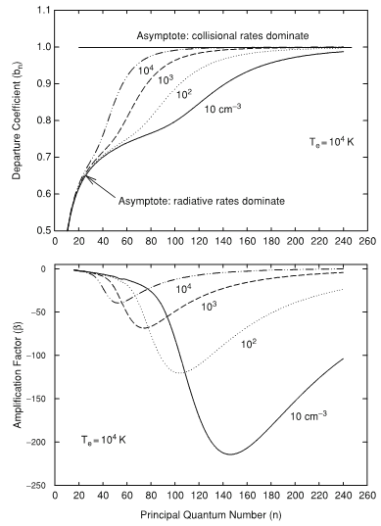
Another result of Goldberg’s work was emergence of an important area of research, such as computing the departure coefficients b_{n} and dlnb_{n}/dn with as high accuracy as possible and with all possible population/ depopulation mechanisms taken into account.

Slide 45
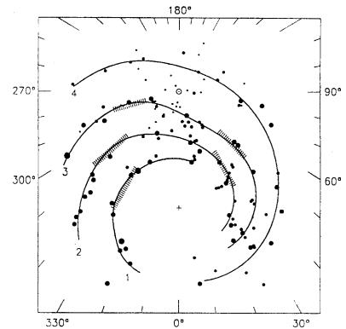
Taylor and Cordes, 1993

Slide 46
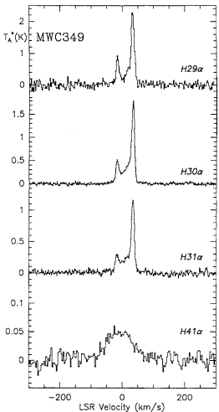
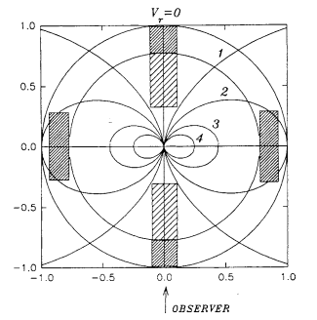
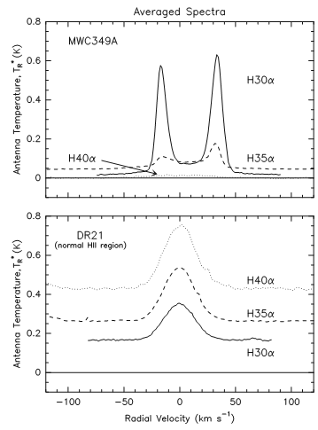
A model of differentially rotating circumstellar disc (Ponomarev et al., 1994)
Gordon et al., 2001

Slide 47
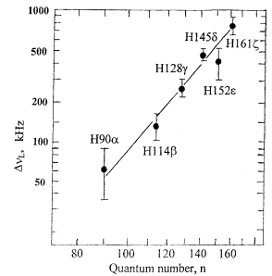
Smirnov, Sorochenko, Pankonin, 1984

Slide 48
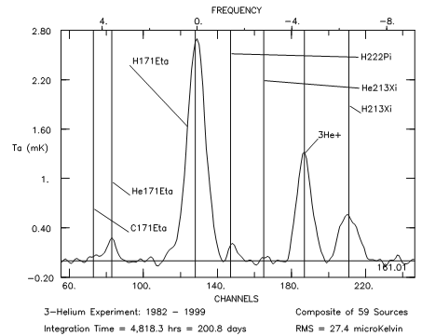
Bania, 2001

Slide 49
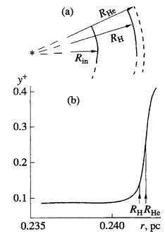
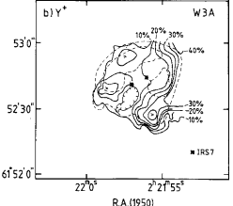
HeII region Paradox
Roelfsema, Goss, et al., 1992
Gulyaev et al., 1997

Slide 50
Roberts & Goss, 1993

Slide 51
THANK YOU !

