Slide 1
Radio Source Variability: a tale of 1965
Leonid Gurvits Ken Kellermann
JIVE and TU Delft NRAO
The Netherlands USA
with contributions by Mikhail Larionov and
Alexander Midler

Slide 2
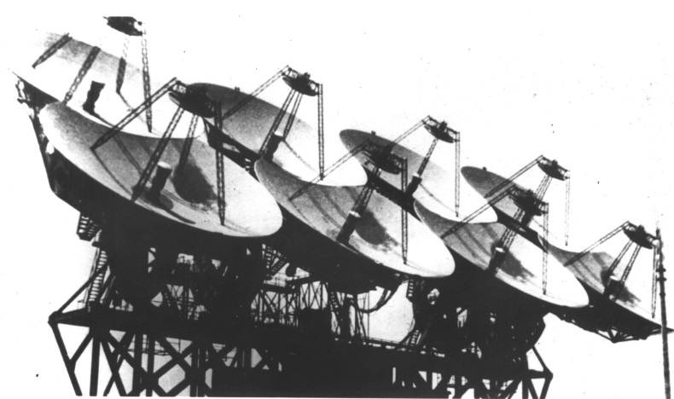
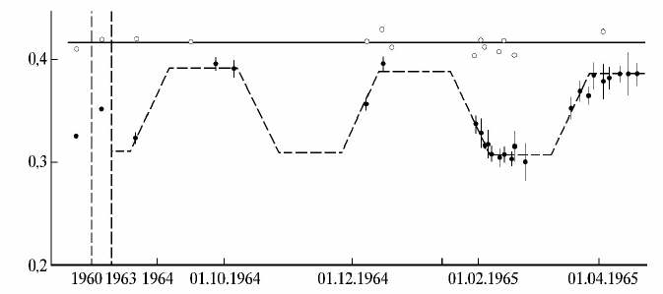
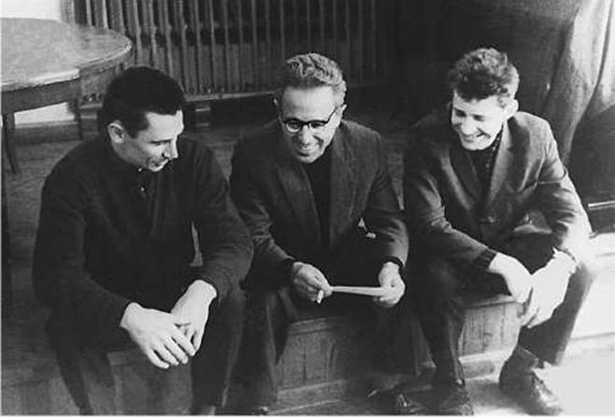
The view from the West
G. Sholomitskii, CTA 102 Variability – IB 83
It’s Wrong!
Unknown antenna
No discussion of techniques
Not confirmed at OVRO, Arecibo
Theoretically Impossible
No credibility - 100 Day period - ETI
April 14, 1965
Notes:
No experimental details
Plot published in Izvestia – Interest by Western intelligence circles

Slide 3
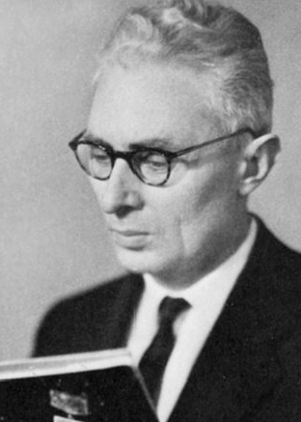
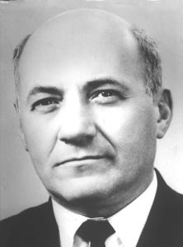
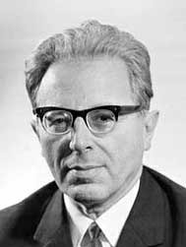
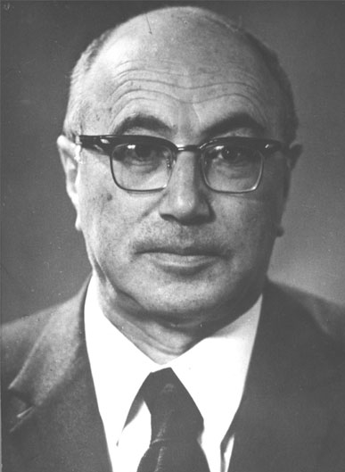
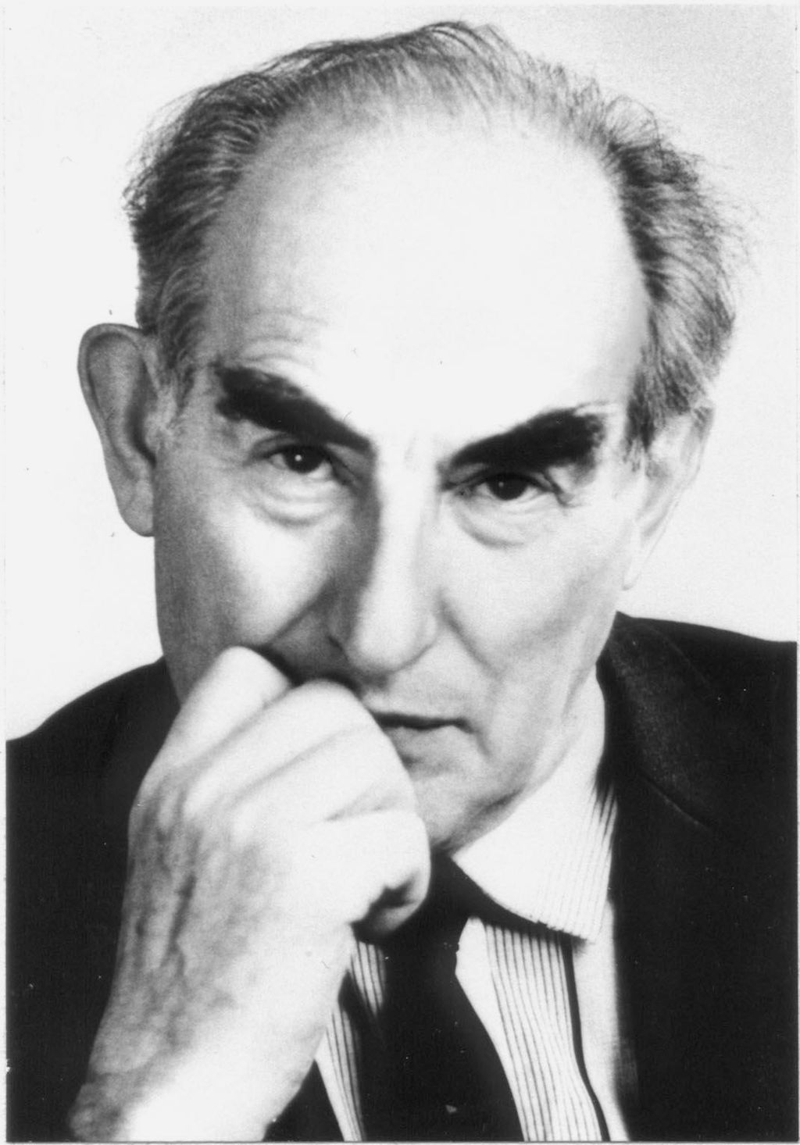
1960s: Golden decade of Moscow astrophysics
Solomon Pikelner
1921–1975
Samuil Kaplan
1921–1978
Iosif Shklovsky
1916–1985
Yakov Zeldovich
1914–1988
Vitaly Ginzburg
1916–2009
Notes:
All – theoreticians/intepreters. The Big Five of Moscow astrophysics. No major observing facilities, but some exceptions…

Slide 4
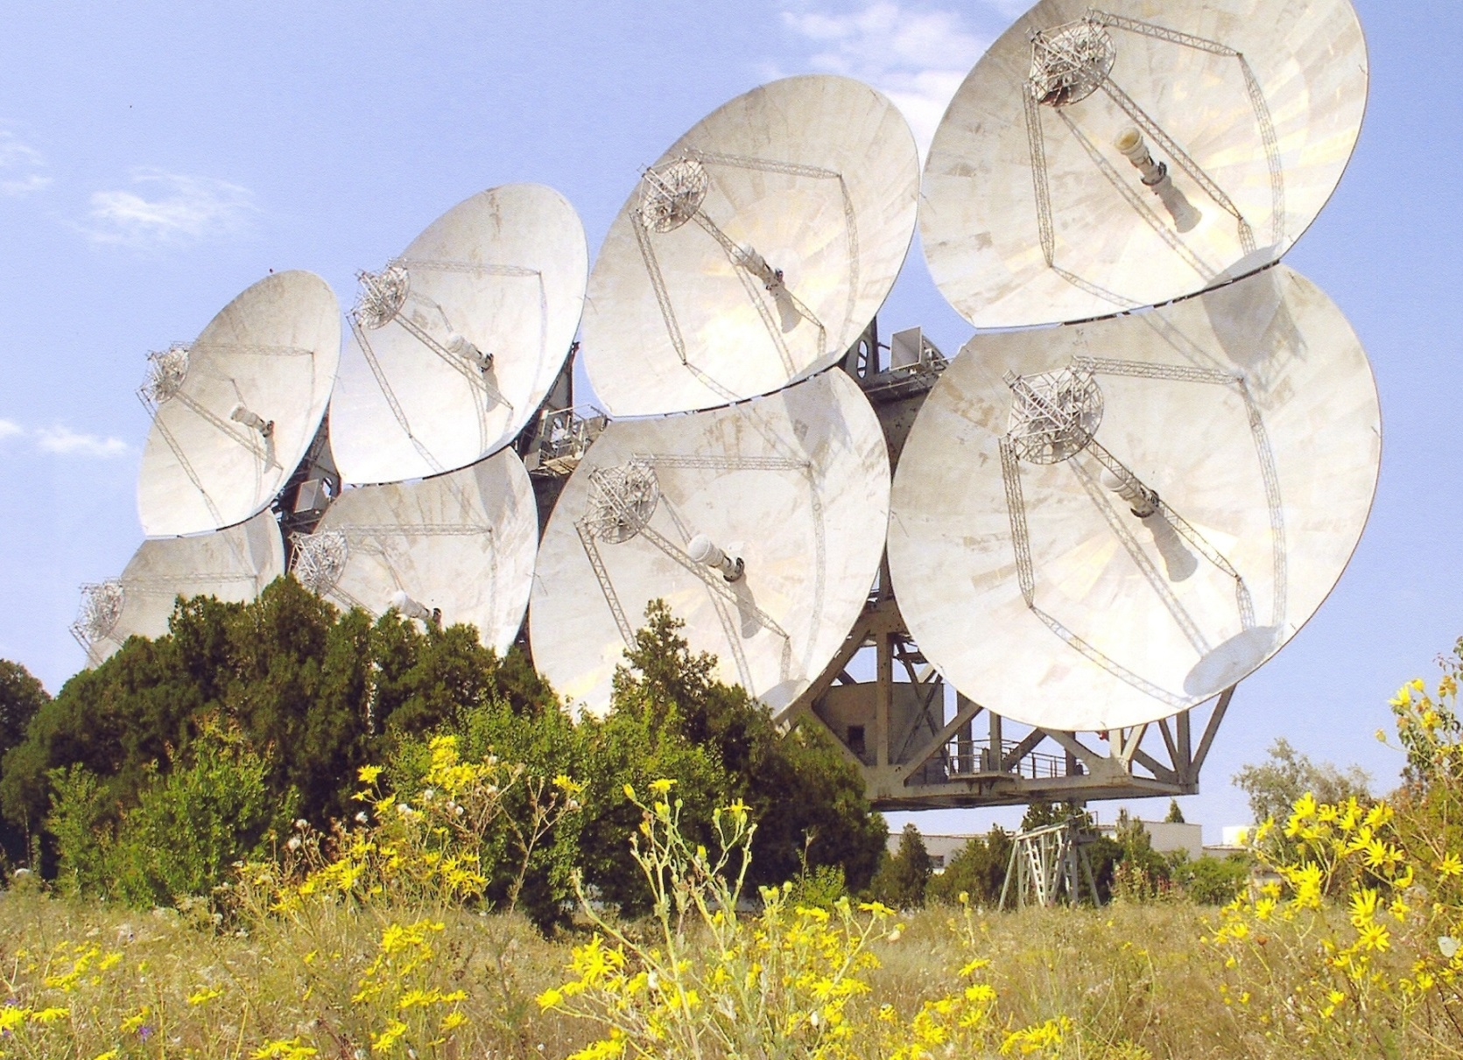
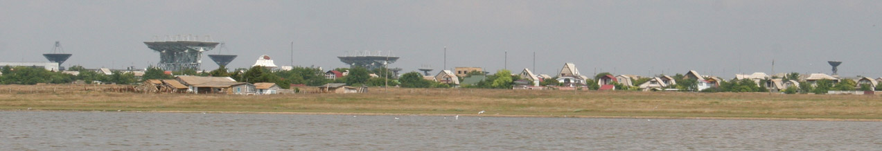
1960: Somewhere, at undisclosed location…
Eight 16-m parabolas
900 m² effective area
NIP-16, Vitino, near Yevpatoria, Crimea
Notes:
An exception of the beginning of 1960s, ADU 1000

Slide 5
ADU-1000, Solar system intercom
Purpose: 2-way comm for planetary missions (Mars, Venus)
  Command up-link
  Data downlink
    Ability to support manned missions too (voice comm)
  Nominal operational distance – 2 AU (but code name “Pluton”)
Decision to build – mid 1959 (M. Keldysh, S. Korolev)
Construction starts – January 1960
Three installations operational – December 1960
  Two facilities for reception, ~1 km apart
  One transmitting, 8.5 km apart
Efrеm Korenberg proposed an 8-element interferometer
  Maximum utilisation of available structures/design
  Minimum automation (a regiment per installation anyway)

Slide 6
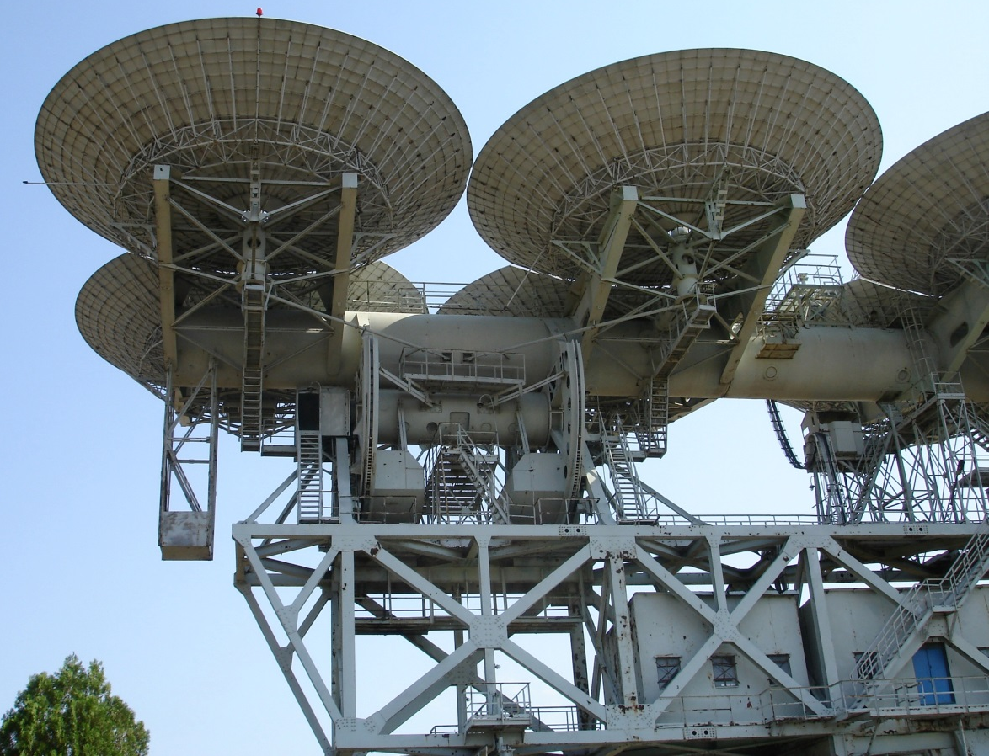
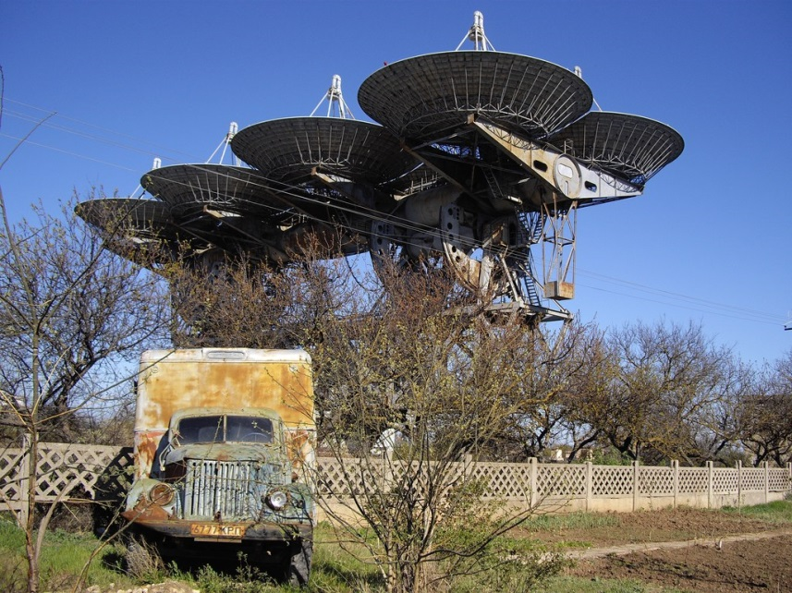
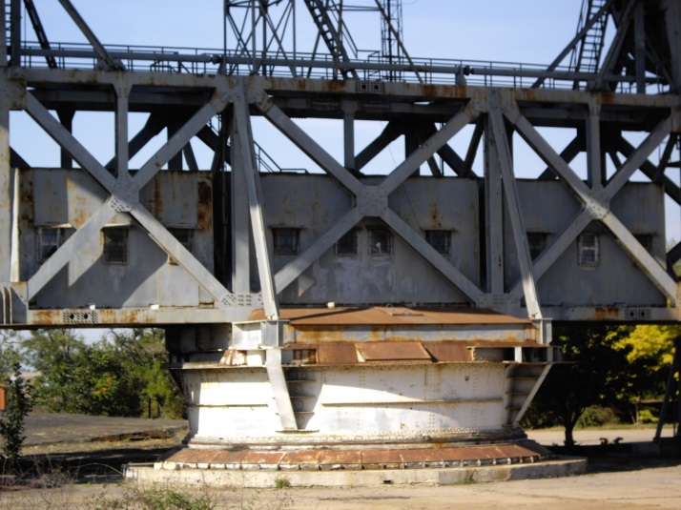
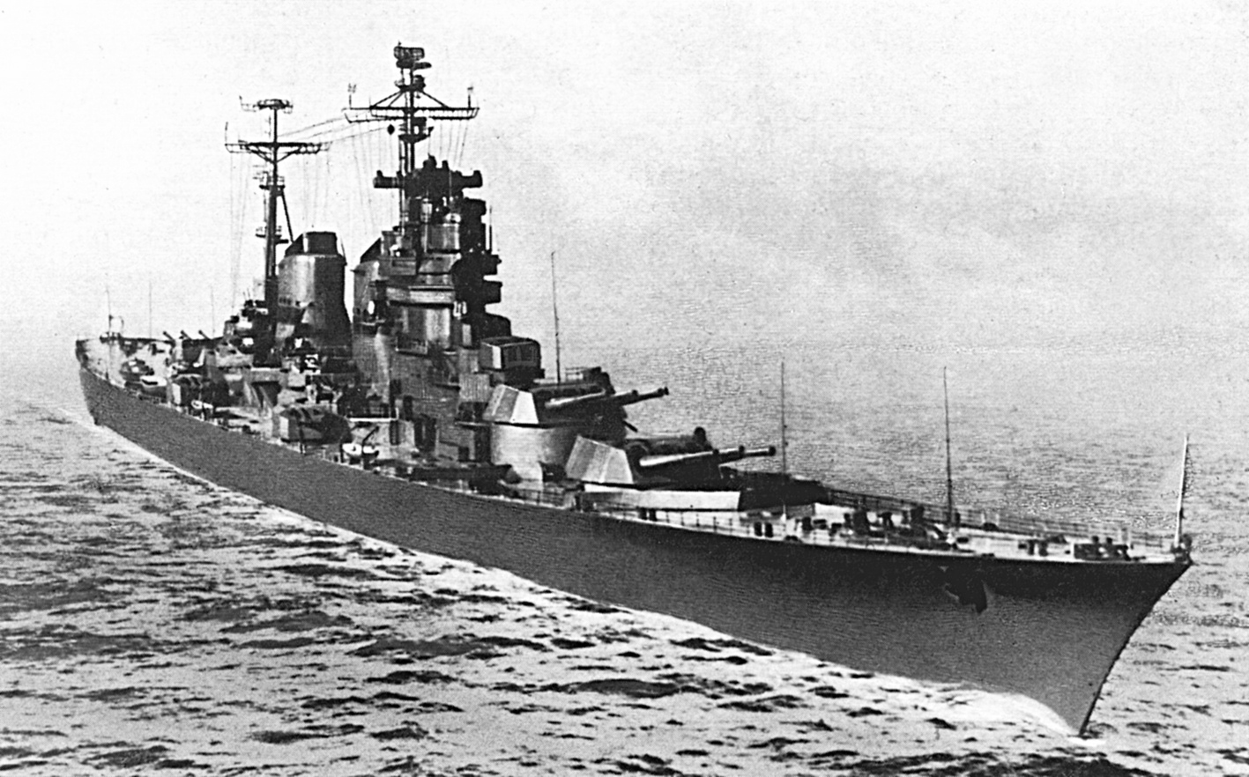
ADU-1000, the discovery machine
Two (Italian) submarine hulls
for elevation axis
Trapezoid military railway bridge
(upside-down)
Rotator of main cruiser canon
for azimuth pointing
Transmitter installation, 2007

Slide 7
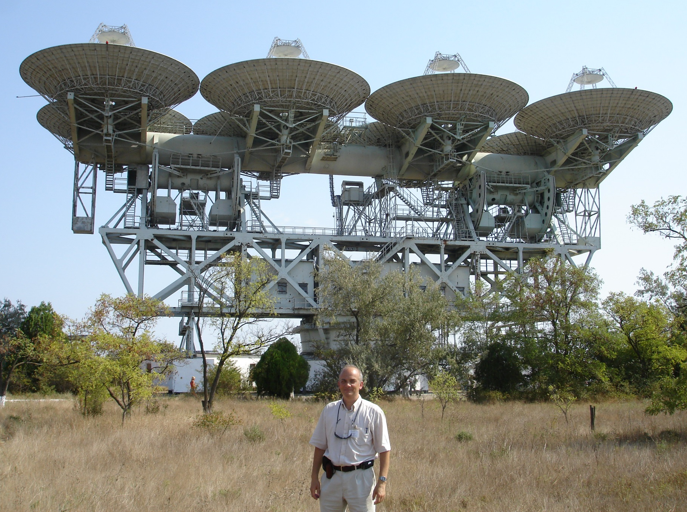
Forgotten artefact
The speaker, 2007

Slide 8
Sternberg institute in Yevpatoria
Access to Yevpatoria – a recognition of GAISh by space programme leadership
  Not least – because of the ”artificial comet” success in 1959:
Observing projects by
  V. Kurilchik
  L. Matveenko
  G. Khromov
  G. Sholomitsky
Receiver:
  921 MHz (telemetry, voice)
  Parametric
Gennady Sholomitsky assisted by a student M. Larionov
V. Moroz, V. Esipov, I. Shklovsky,
V. Kurt, P. Shcheglov, 1959

Slide 9
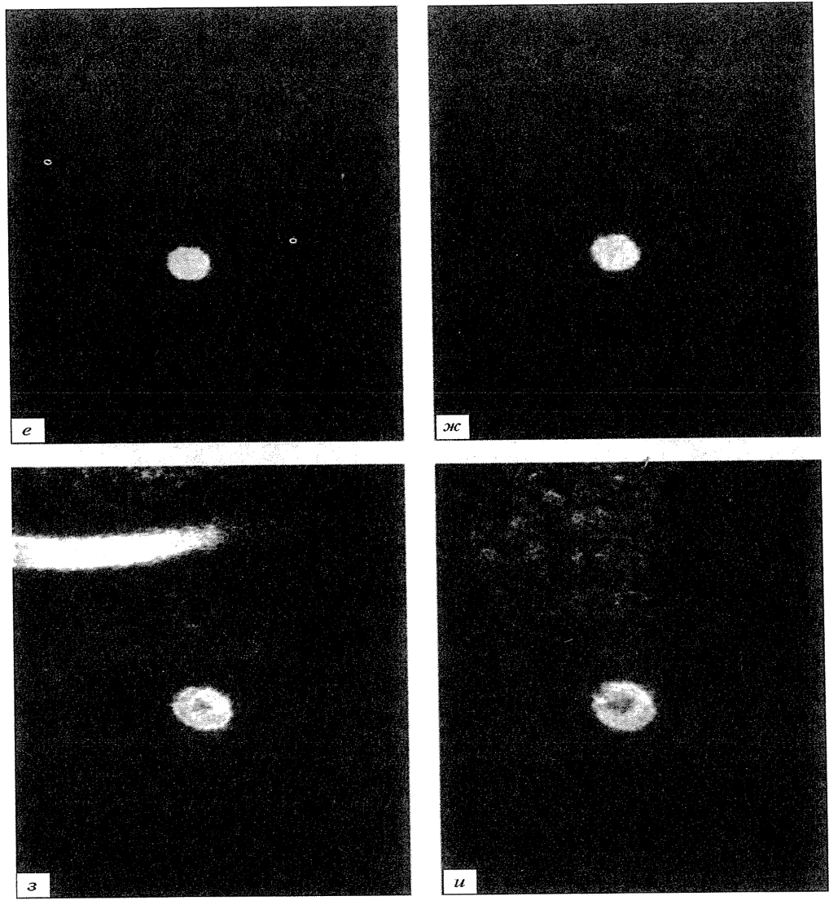
Astronomy for deep space navigation: a bit of side history…
Shklovsky I.S., 1960,
“Artificial comet as a method of observations of spacecraft in optics”,
in “Artificial satellites of Earth”, v. 4, 195-204
Artificial sodium (Na) comet onboard the 2nd “space rocket”, 12 Sept 1959:
m_{v} = 4.5
R = 156,000 km
σ_{Dec,RA} ≈ 0.5”

Slide 10
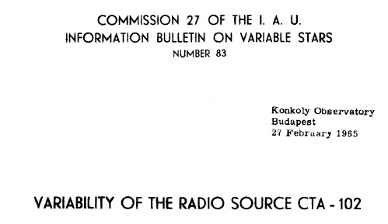
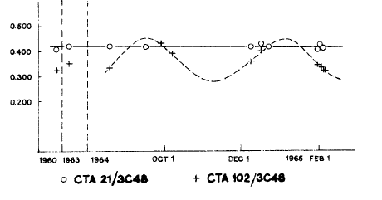
Variability published - I
G. Sholomitsky
Submitted 27 Feb 1965
One page, no technical details
Periodic variability, T ≈100 days
CTA 102 size by Slish 1963 (10 mas)
Interpretation: galactic source, closer than 2 Mpc

Slide 11
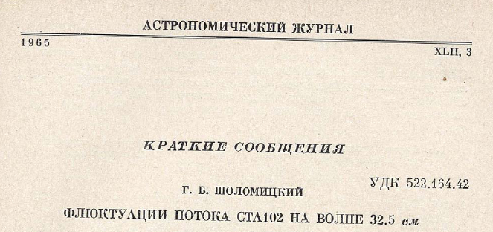
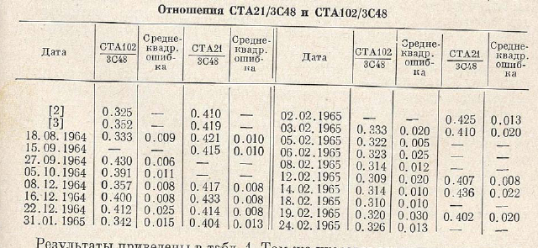
Variability published - II
G. Sholomitsky
Submitted 17 Nov 1964 !!!
Data from 1964.08.18 to 1965.02.24
One page, no plot
Technical details - Sholomitsky et al. 1964

Slide 12
Press-conference @ Sternberg, 12 Apr 1965
Alexander Midler, correspondent of TASS, covers science
  Commonly attends colloquia at Sternberg Institute
  On 12 April 1965, overhears semi-formal discussion by I. Shklovsky and N. Kardashev on possible ETI explanation of CTA 102 variability
  At 16:40 MSK, 12 April 1962, TASS issues a “telegram” on discovery by Soviet scientists of a cosmic artificial signal
The day after: a huge press-conference at Sternberg
Careful statements by Shklovsky and Kardashev
The news reproduced around the world (all major agencies)
“Pravda” article on 14 Apr 1965
April 1965, a very special time…

Slide 13
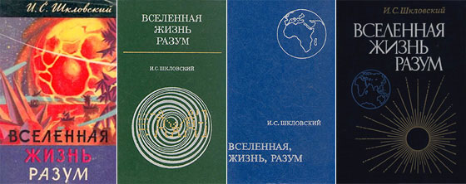
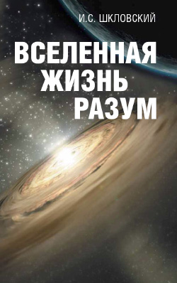
1960s: SETI background [in Moscow]
I. Shklovsky, 1960, Priroda
  Is communication to intelligent creatures on other planets possible?
I. Shklovsky, 1962, “The Universe, live, and mind”
N. Kardashev 1964, Soviet Astronomy 8, 217
  Broadcast of information by extraterrestrial civilisations
  3 types of civilizations
The impact: “SETI” is on the agenda of science discussions
  support (moral and otherwise) by I. Tamm, Ya. Zeldovich, V. Kotel’nikov,
  S. Khaikin, V. Siforov, V. Troitsky, S. Sobolev, V. Ambartsumian, S. Pikel’ner et al.
“Project Au” [“Hey, is there anybody?”]
  not implemented, but played its role

Slide 14
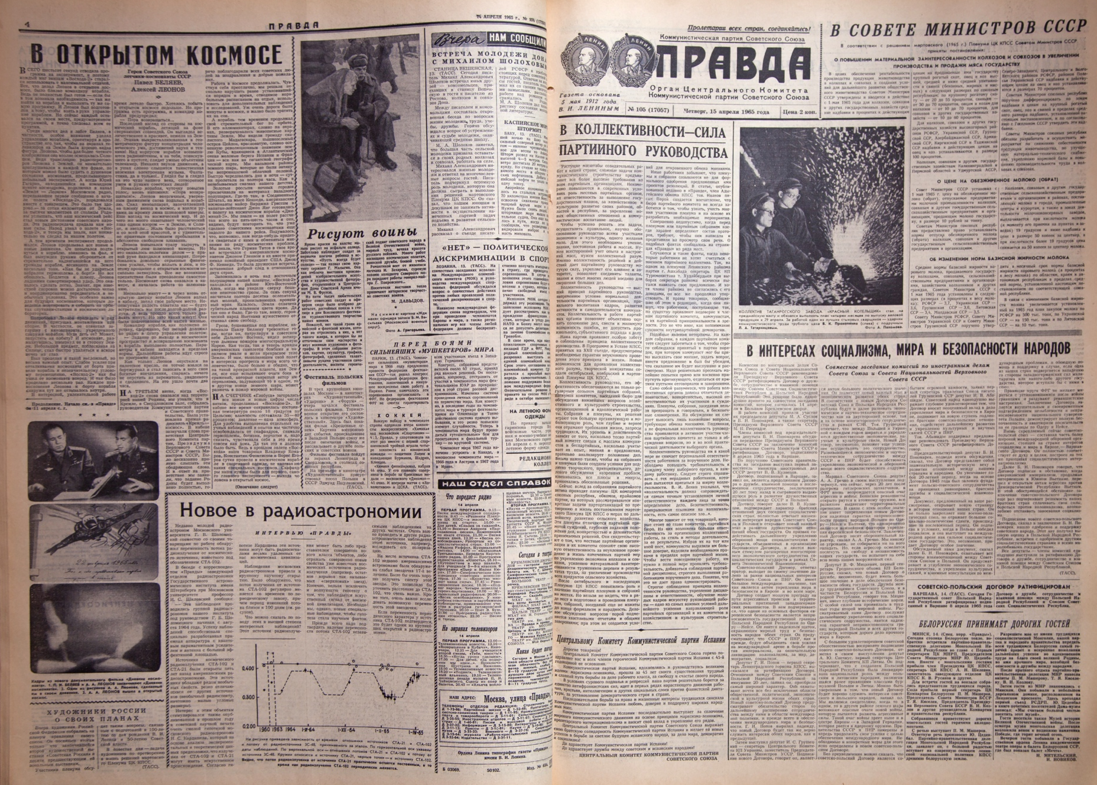
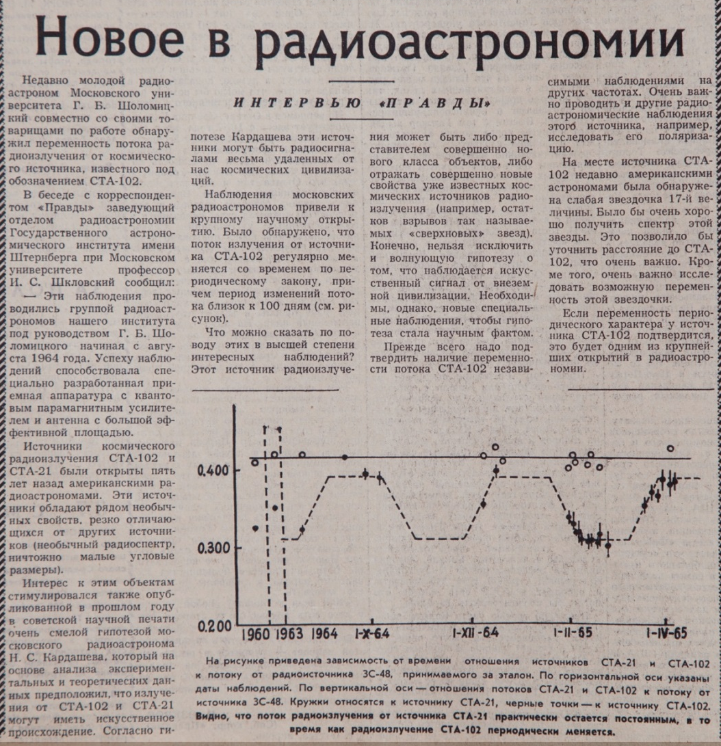
….published and publicized, 14 April 1965

Slide 15
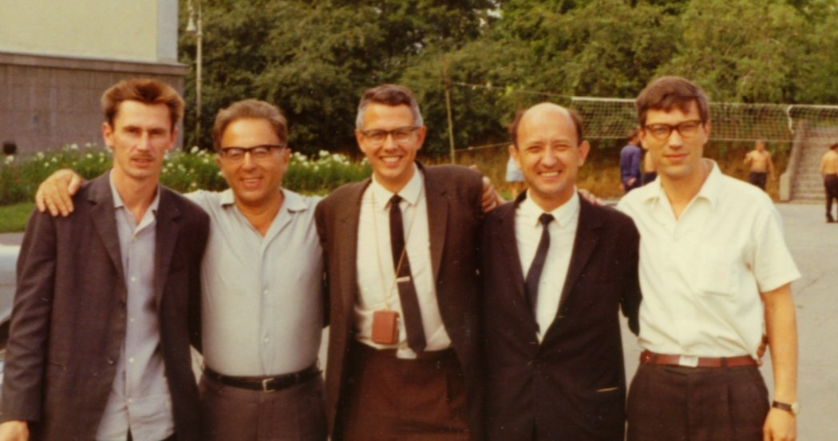
Aftermath…
Gennady Sholomisky switched to sub-mm & IR astronomy
Studies of ISM and IPM scintillations become a “speciality” in Moscow
  Some 20 PhD defended in the period 1971 – 1990
RadioAstron conceived on the fringes of the “variability saga”…
Gennady Sholomitsky, Iosif Shklovsky, Bill Howard, Leonid Matveenko, Slava Slysh, GAISh, 1967?

Slide 16
Acknowledgements
Nikolay Kardashev
Nadezhda Sleptsova
Vladimir Andreyanov
Tatiana Lozinskaya
Valentin Esipov
Ekaterina Borovikova

