Slide 1
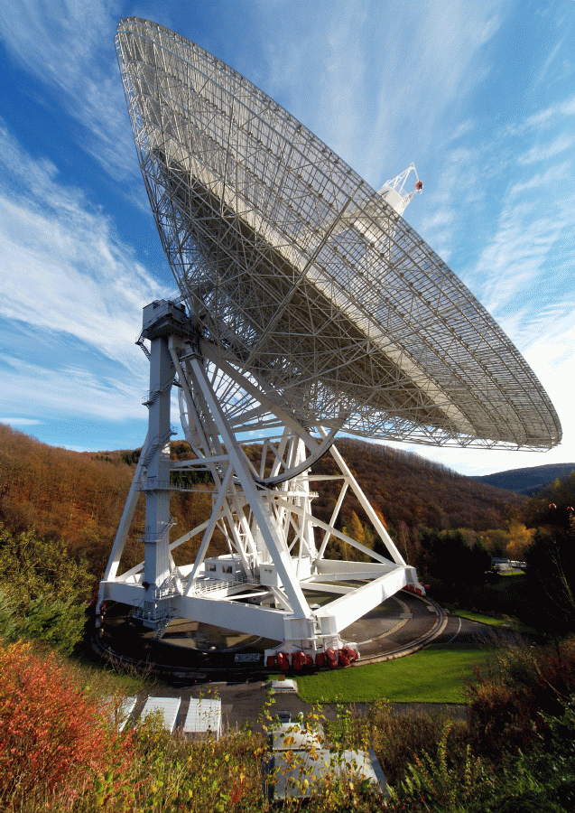
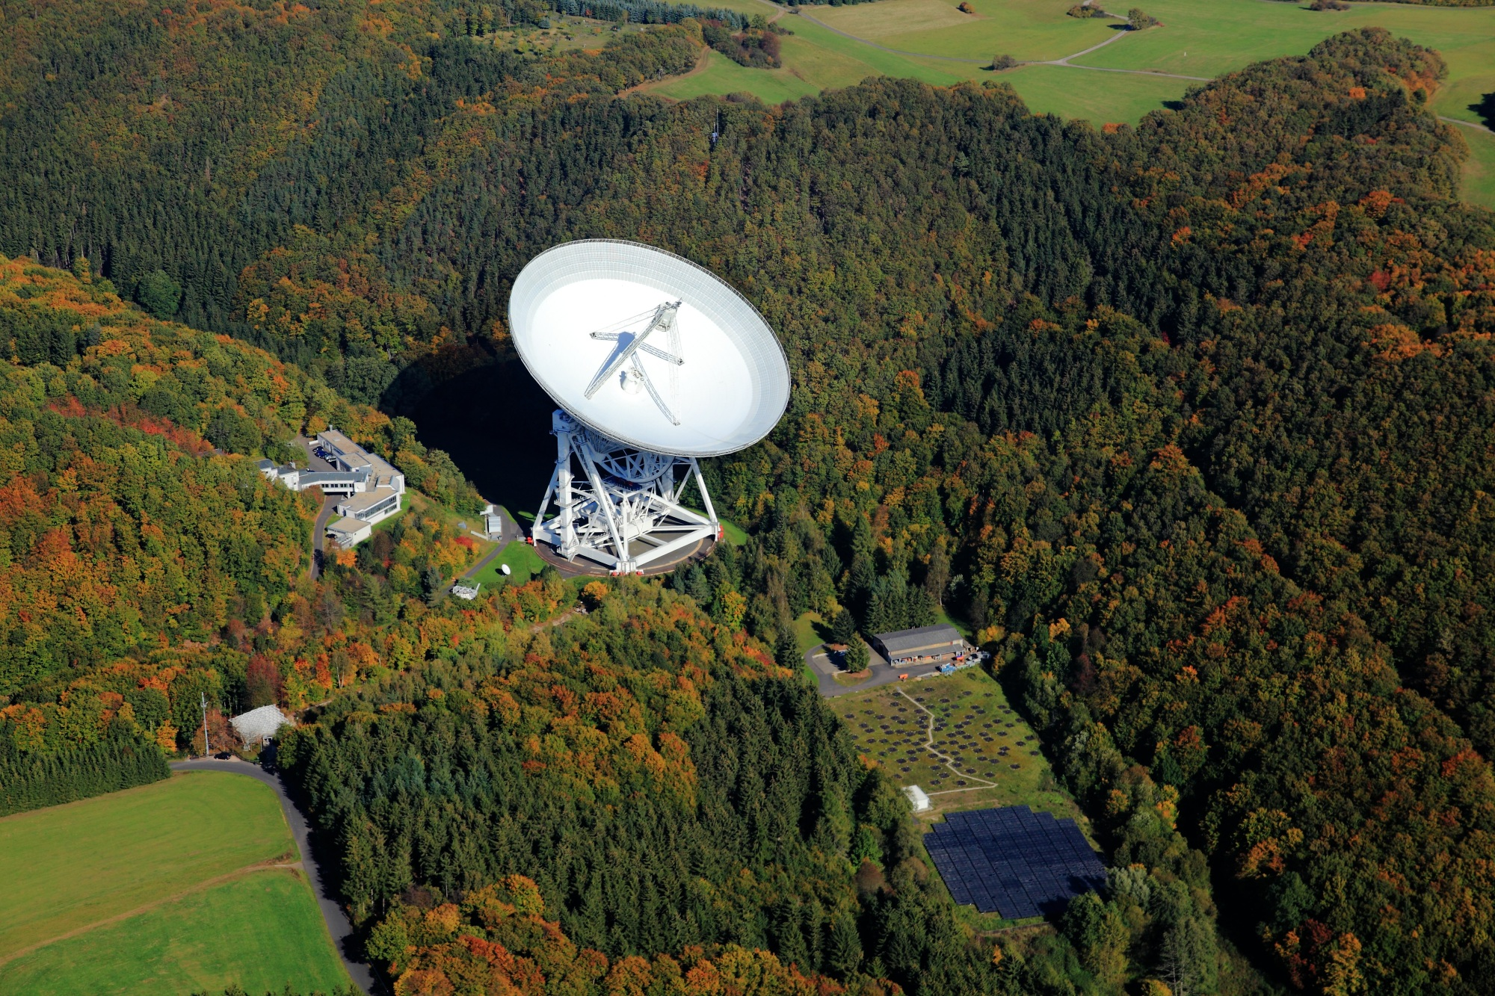


The Effelsberg 100-m dish – the first homologous radio telescope
Alex Kraus, MPIfR
IAU GA Vienna
Aug 27, 2018

Slide 2
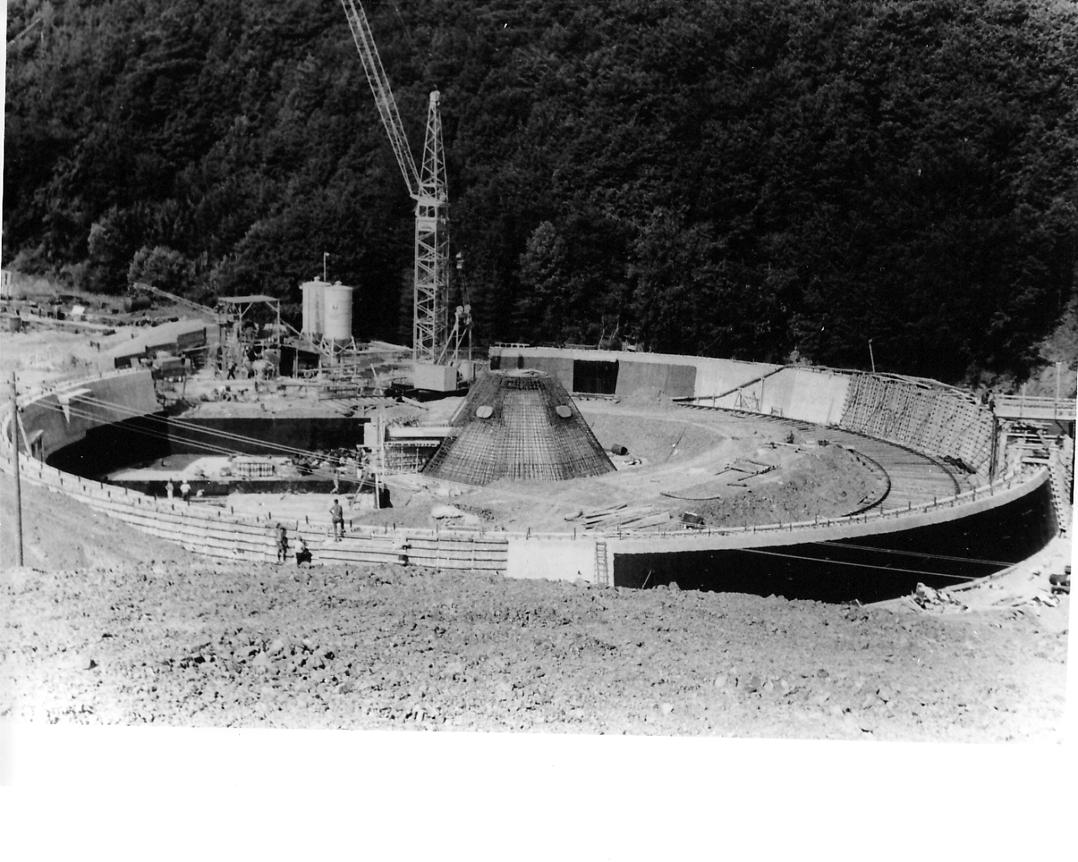
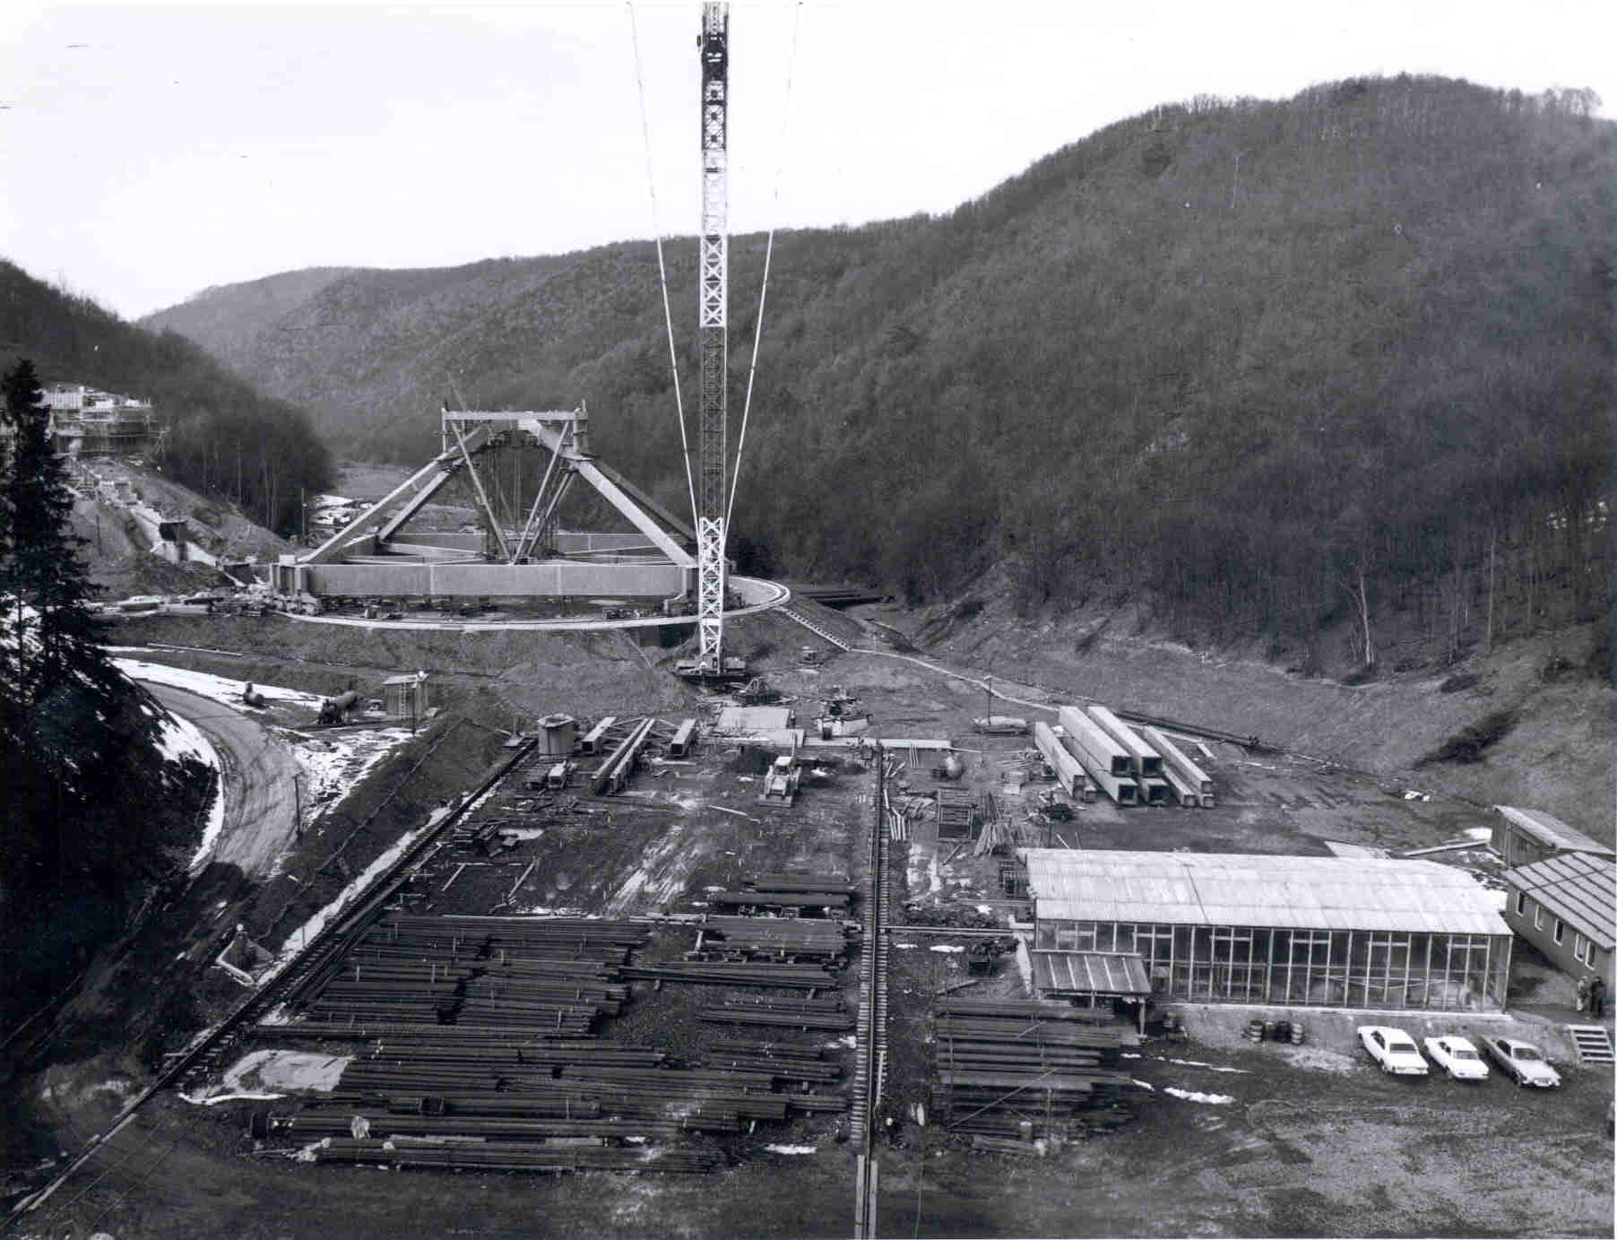
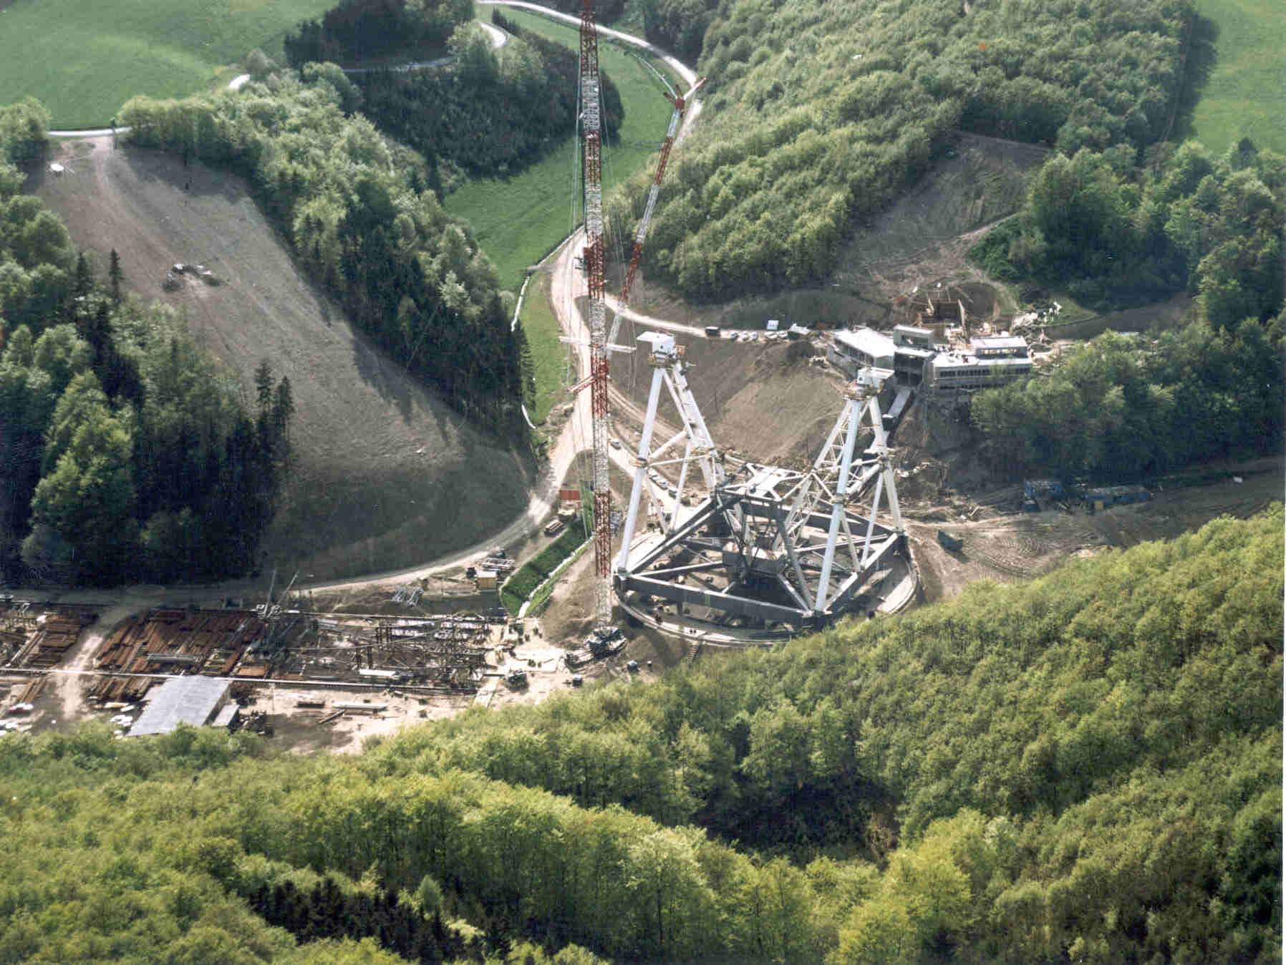
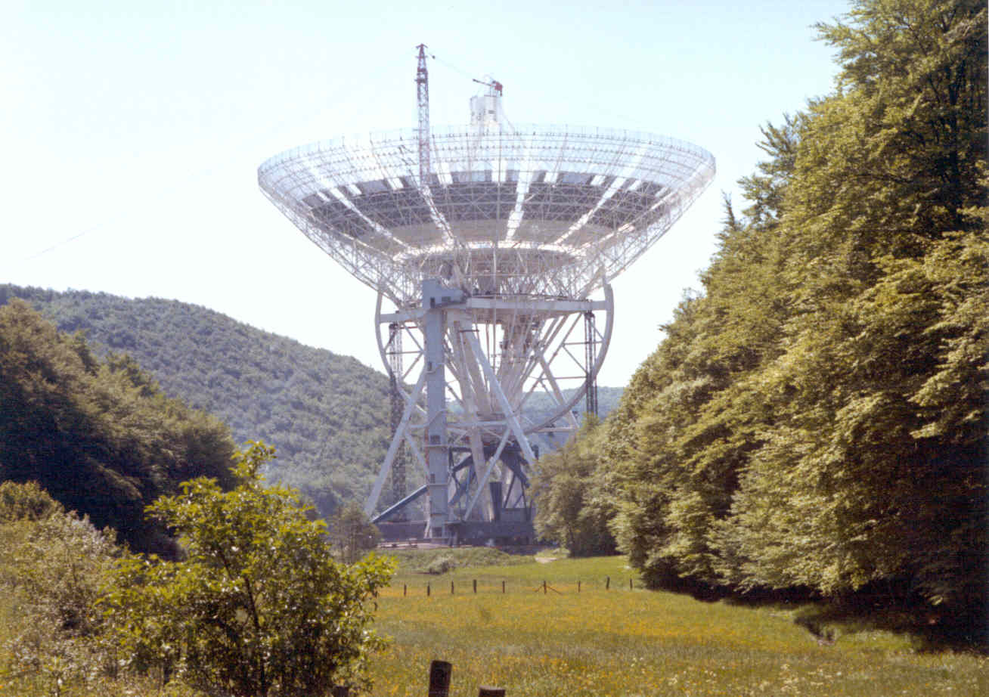
Construction between 1967-1971
Pictures by Hans Kärcher
(MT Mechatronics /MAN)

Slide 3
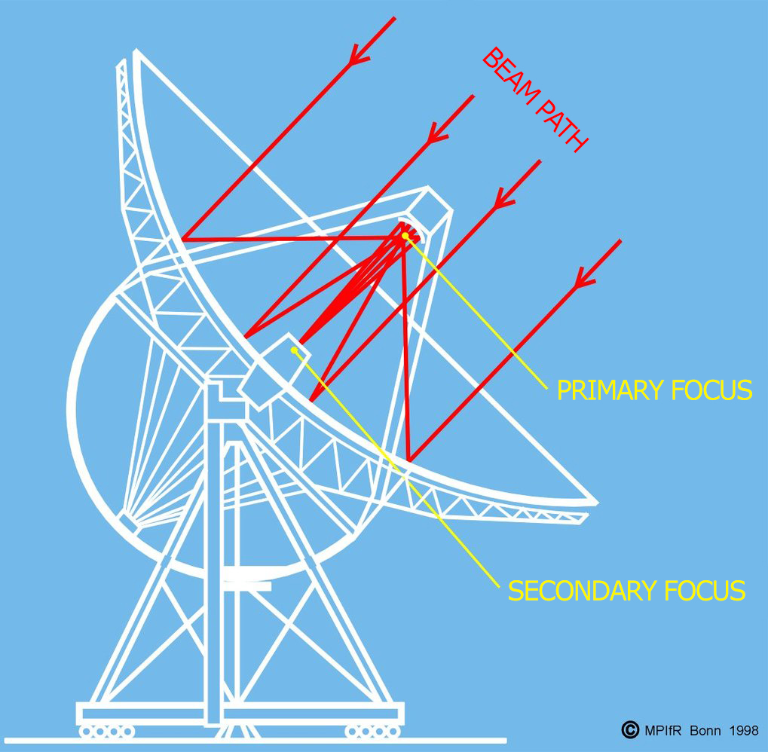
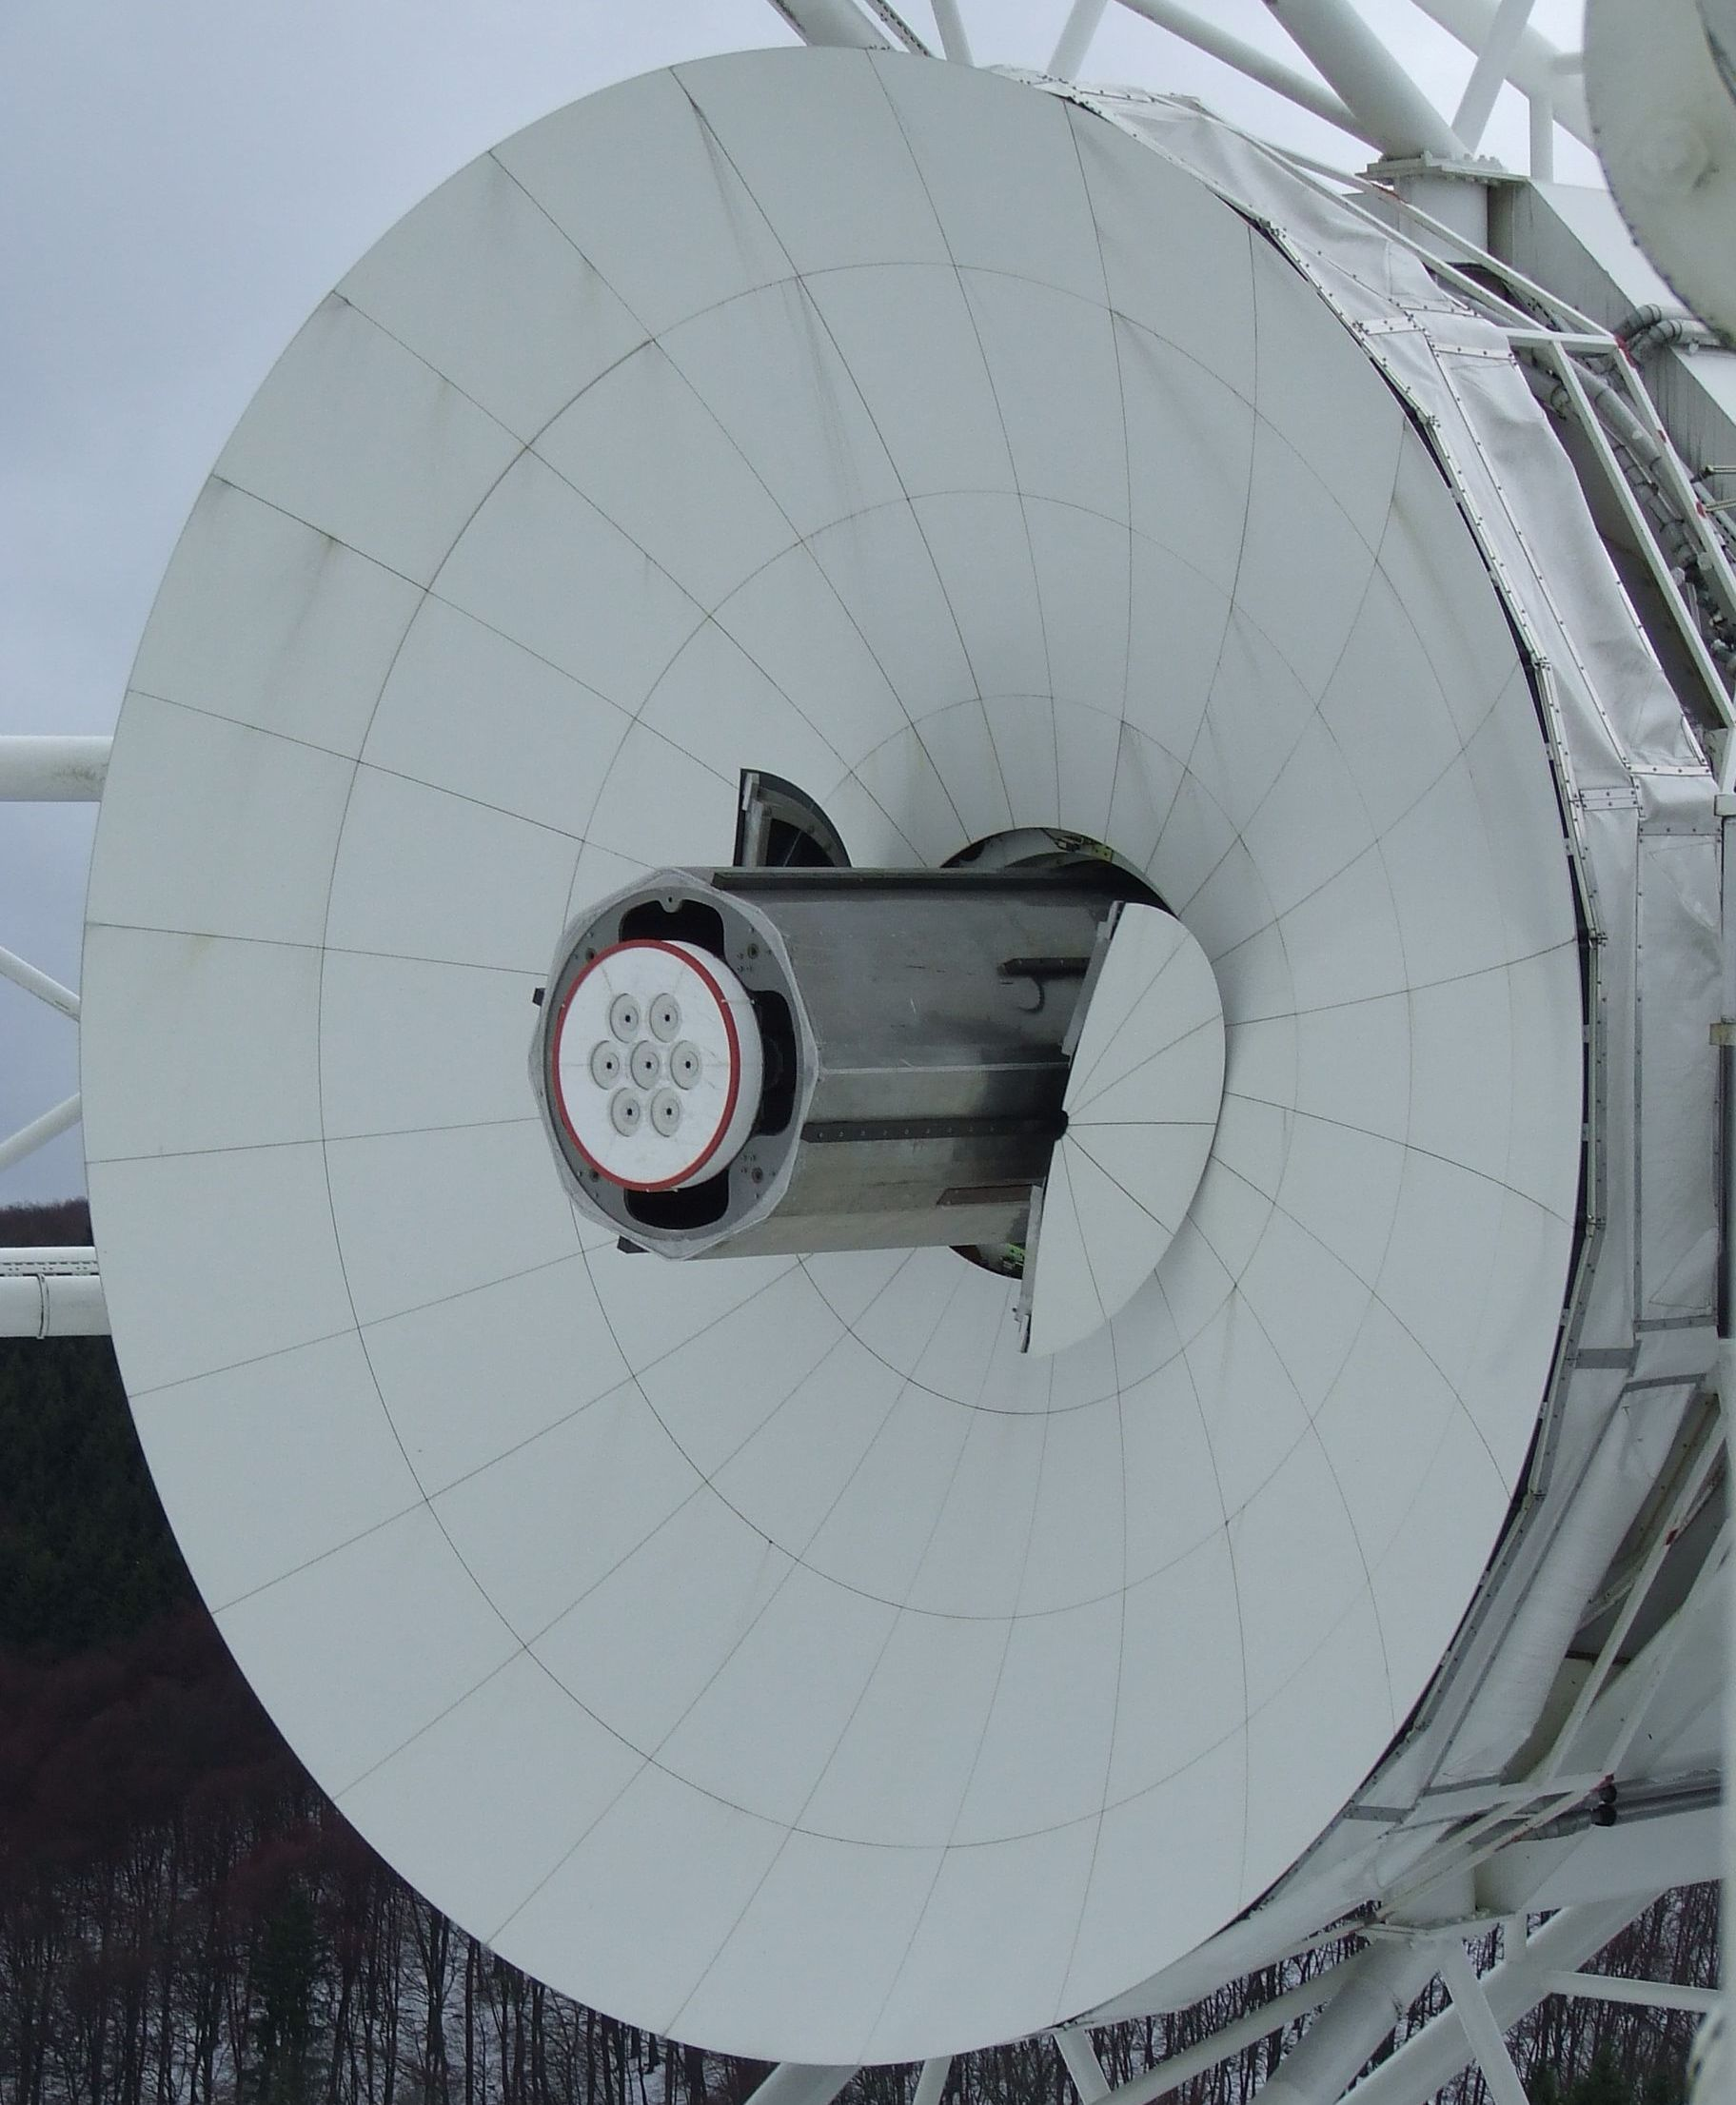
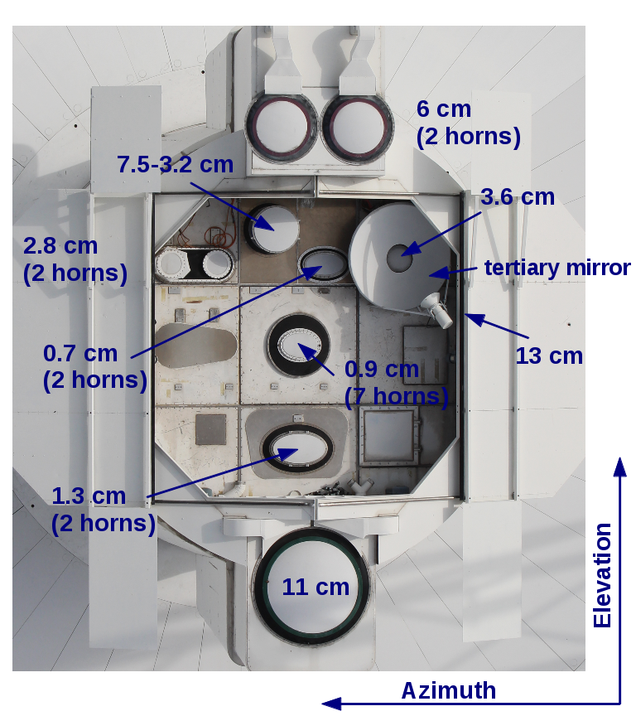
The 100-m telescope: factsheet
Inauguration: May 12, 1971
Regular operations started on August 1, 1972
Aperture: 7854 m², Sensitivity > 1 K/Jy (≤ 20 GHz), Gain 60-85 dB
Surface accuracy: σ_{min} = ~0.5 mm
Frequency coverage: 300 MHz – 90 GHz
Optics: Gregorian
Resolution: 9’ @ 1.4 GHz, 10” @ 86 GHz
21cm-7 Beam-
receiver in the
prime focus
Secondary focus
with 9 receivers

Slide 4
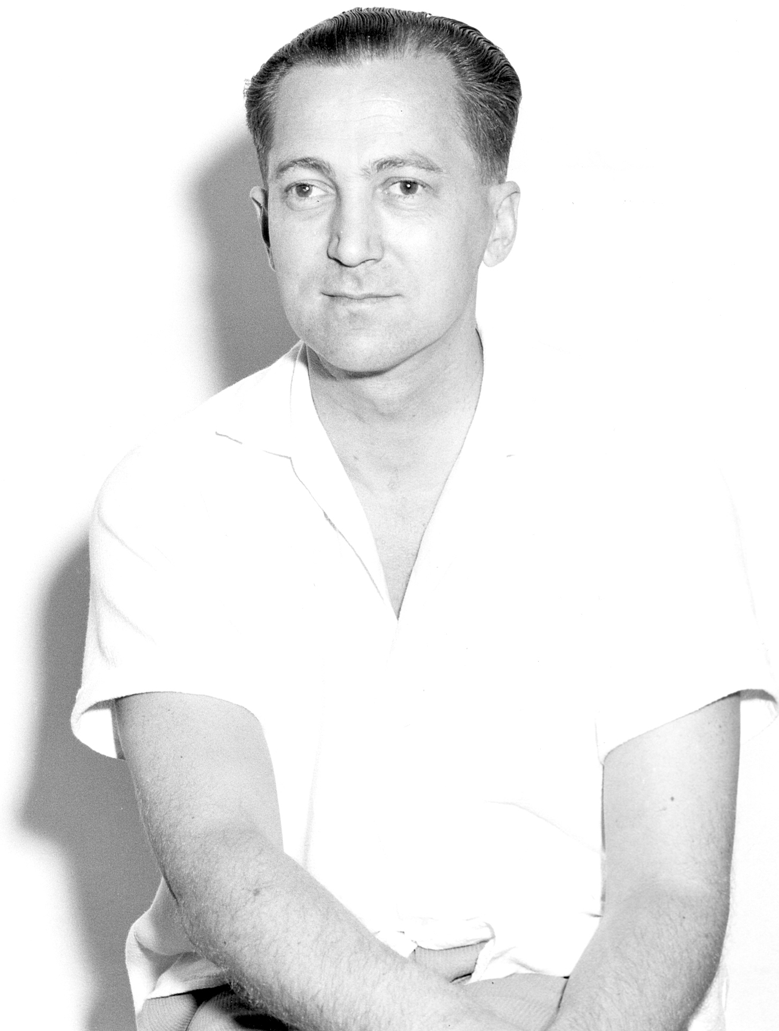
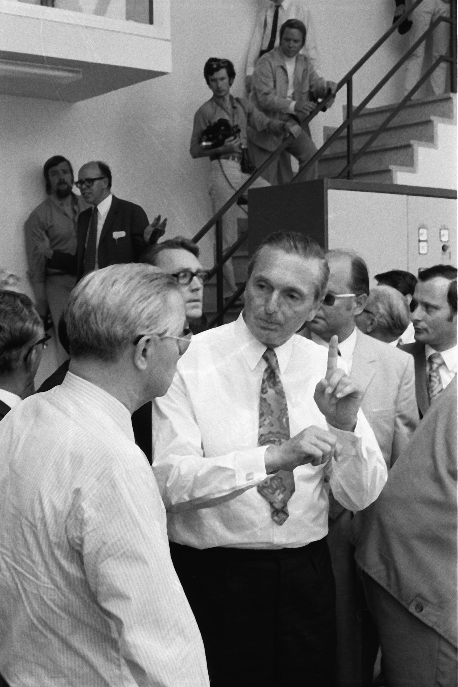
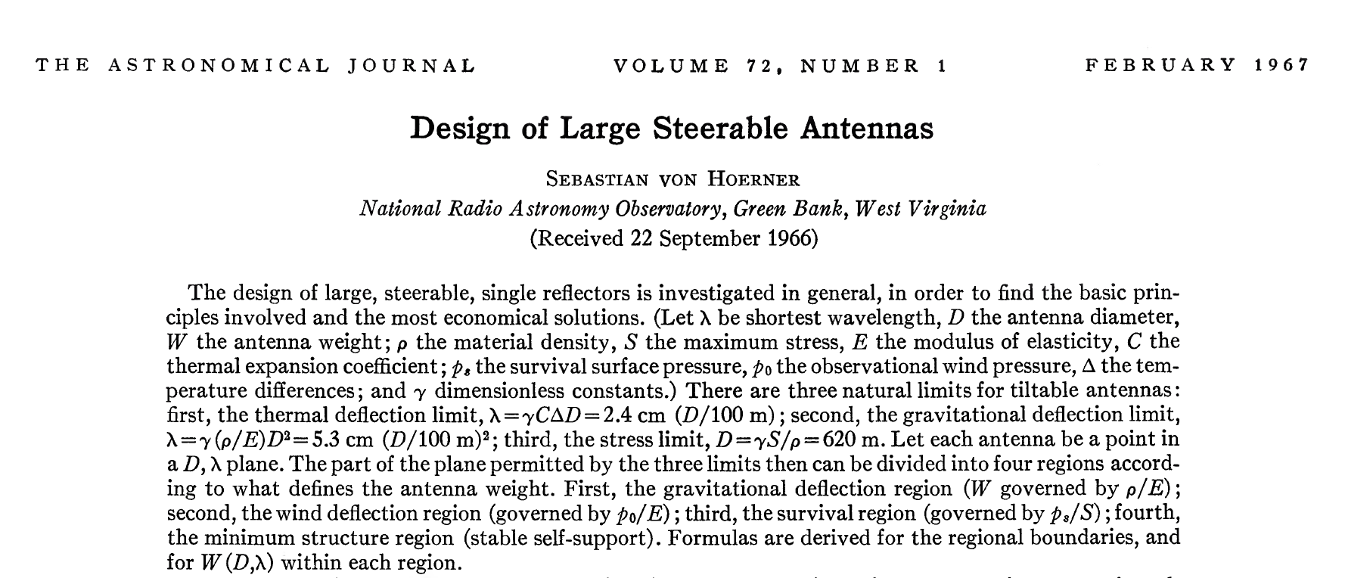
History
Problem: How to build a large radio telescope that could observe up to low cm-wavelengths?
Large structures deform when tilted (due to gravity)
  reflector does not have a well-defined shape
  beam deforms, strong decrease of sensitivity
Ideas by S. von Hoerner and O. Hachenberg
NRAO
MPIfR

Slide 5
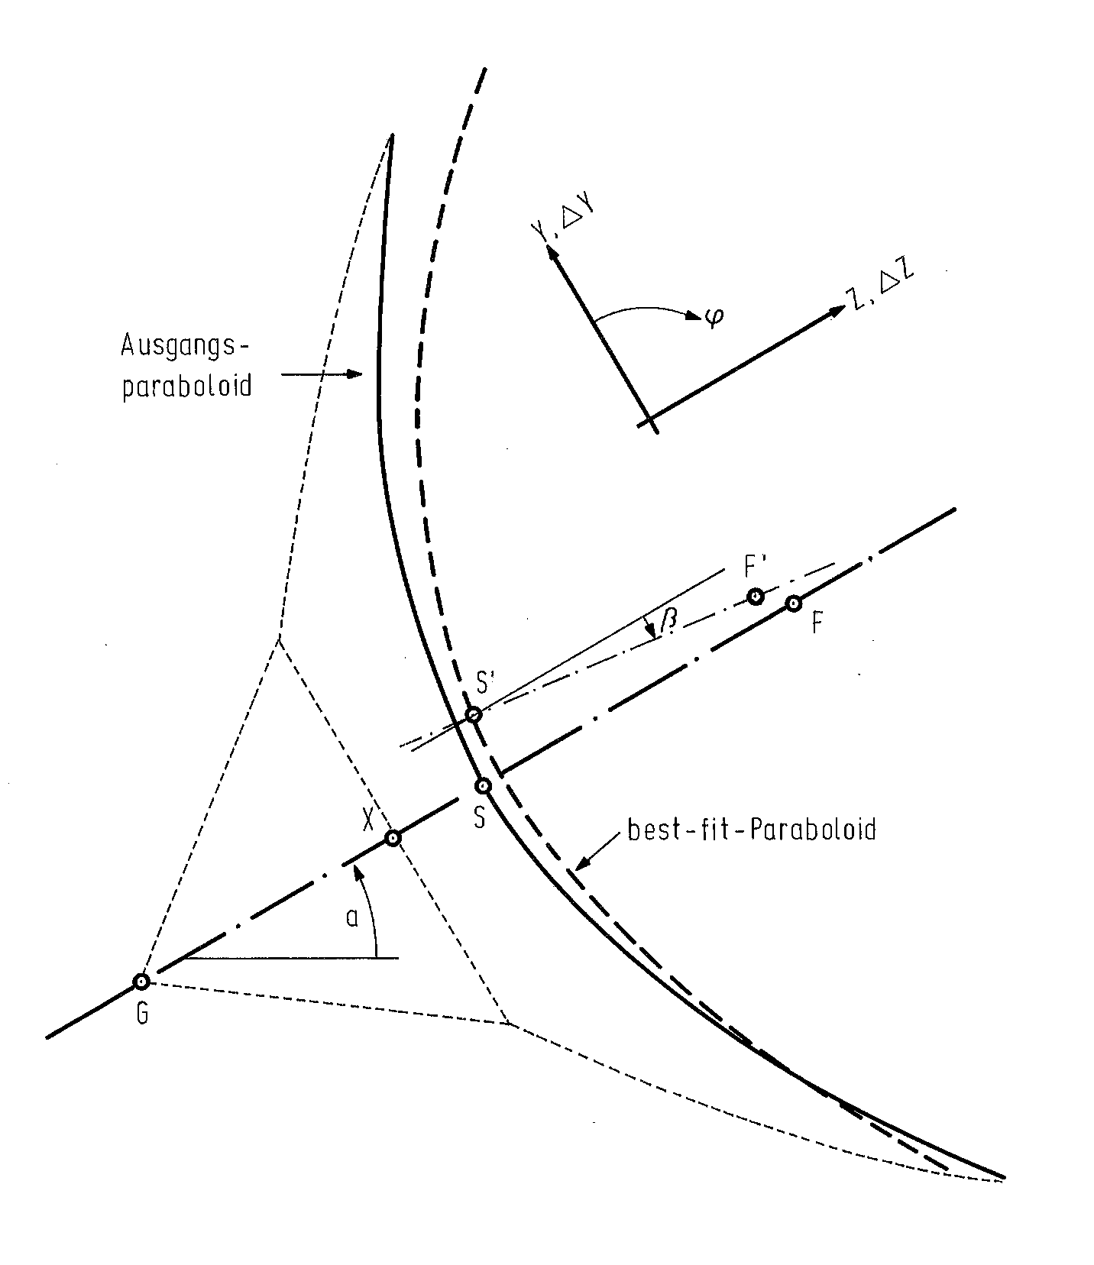
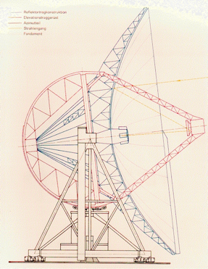
Homology
Solution: special construction leads to a
well-defined parabolic form at all elevations!
Focal point changes by about 10cm
between zenith and horizon
→ Receiver adjustment necessary

Slide 6
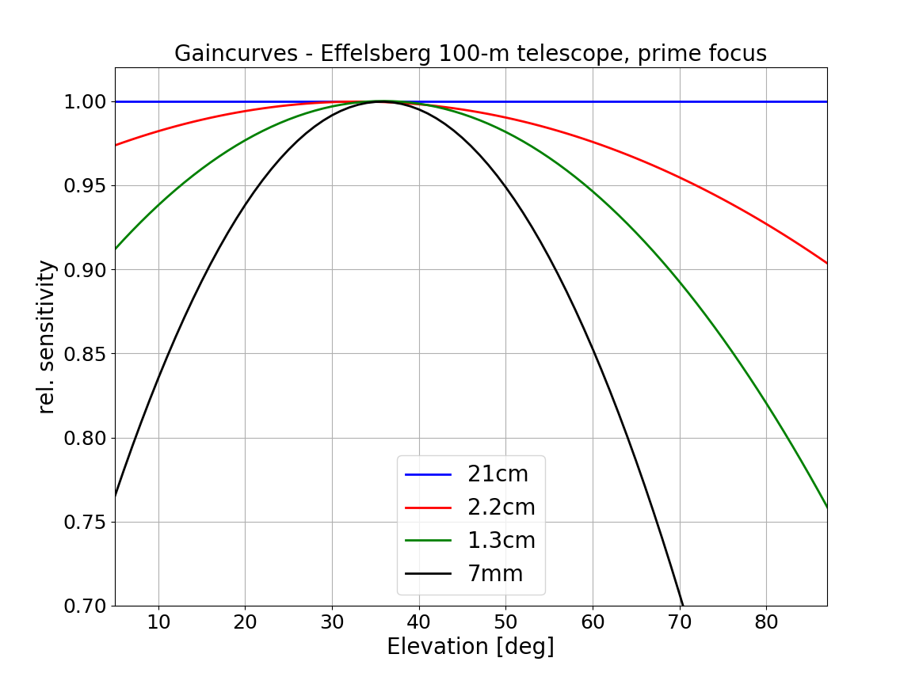
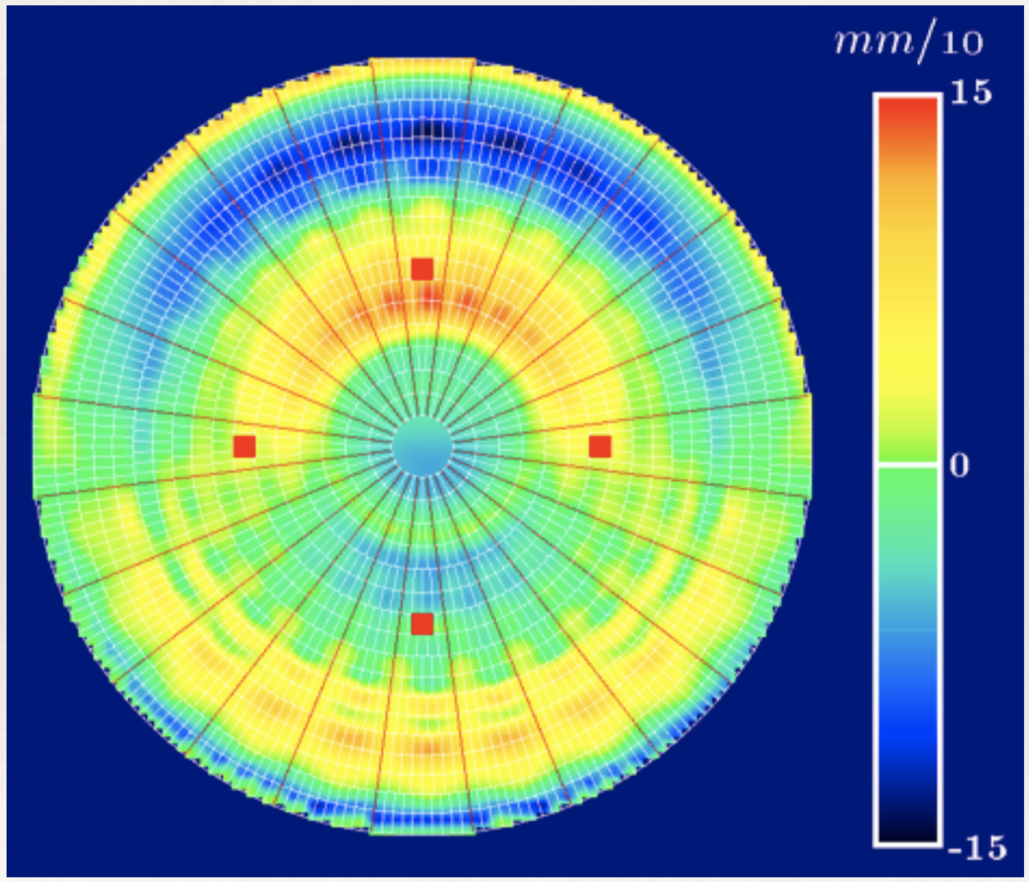
Homology is incomplete
Surface of the dish is measured (holography) and adjusted at an elevation of 32°.
Remaining deformations lead to an elevation-dependent sensitivity (Ruze‘s formula)
Finite element model for 90° elevation
FE-model recently confirmed by laser-scanner measurements.

Slide 7
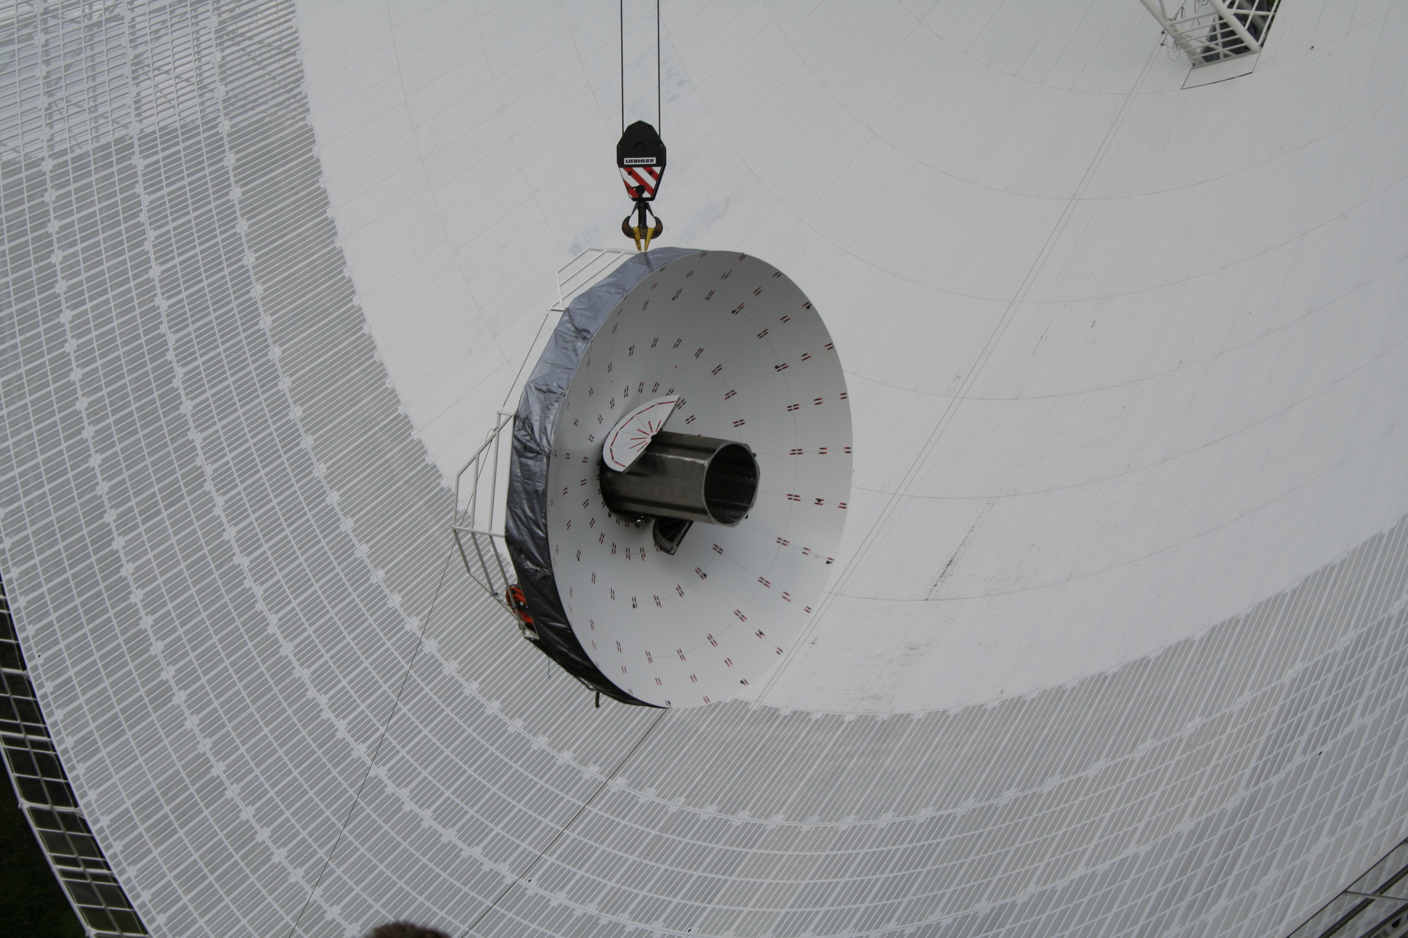
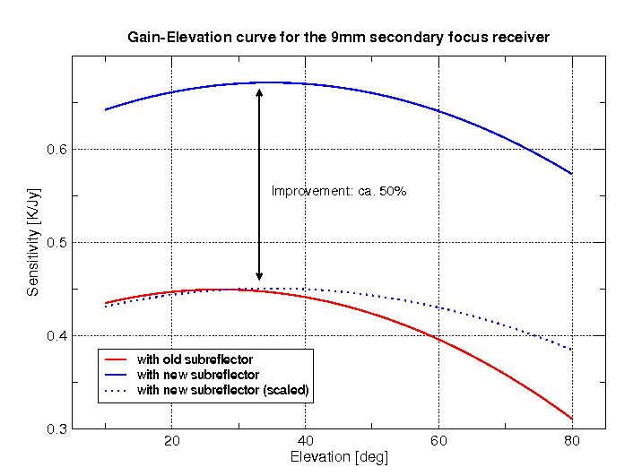
New subreflector
Exchange of the elliptically shaped subreflector in 2006:
σ_{subr} < 60 μm!
Active surface compensates for incomplete homology
→ flatter gain curves (secondary focus)
Increase of sensitivity:
λ [cm] | Γ_{old} [K/Jy] | Γ_{new} [K/Jy]
6 | 1.52 | 1.55
2.8 | 1.25 | 1.40
1.3 | 0.77 | 1.00
0.9 | 0.45 | 0.68

Slide 8
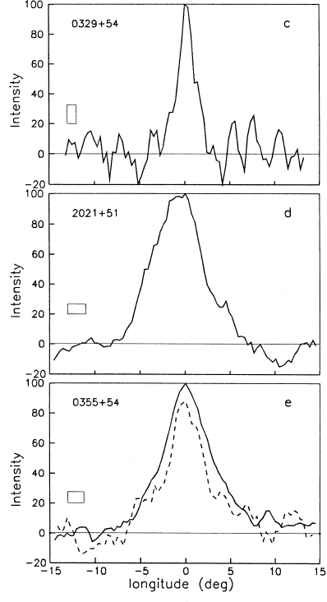
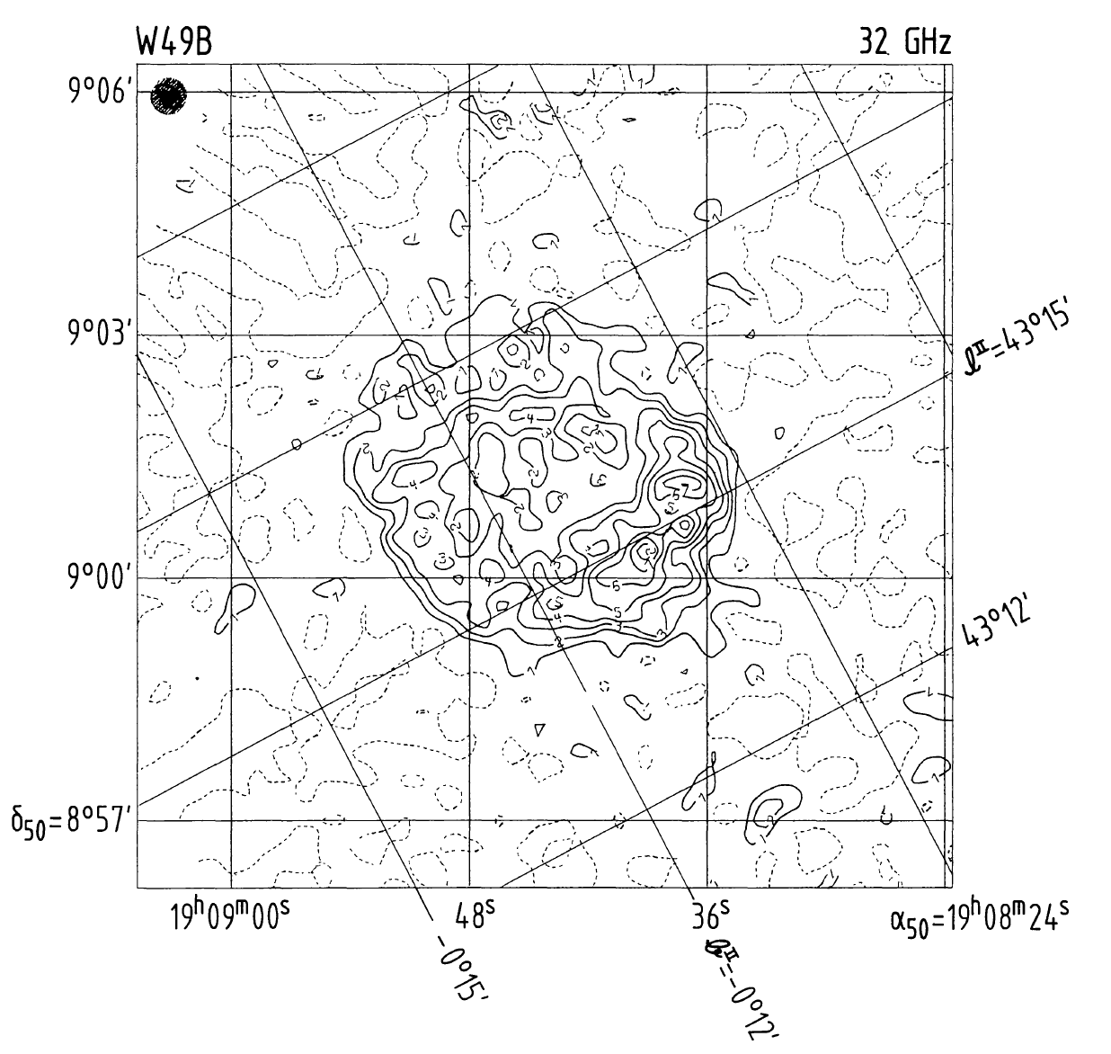
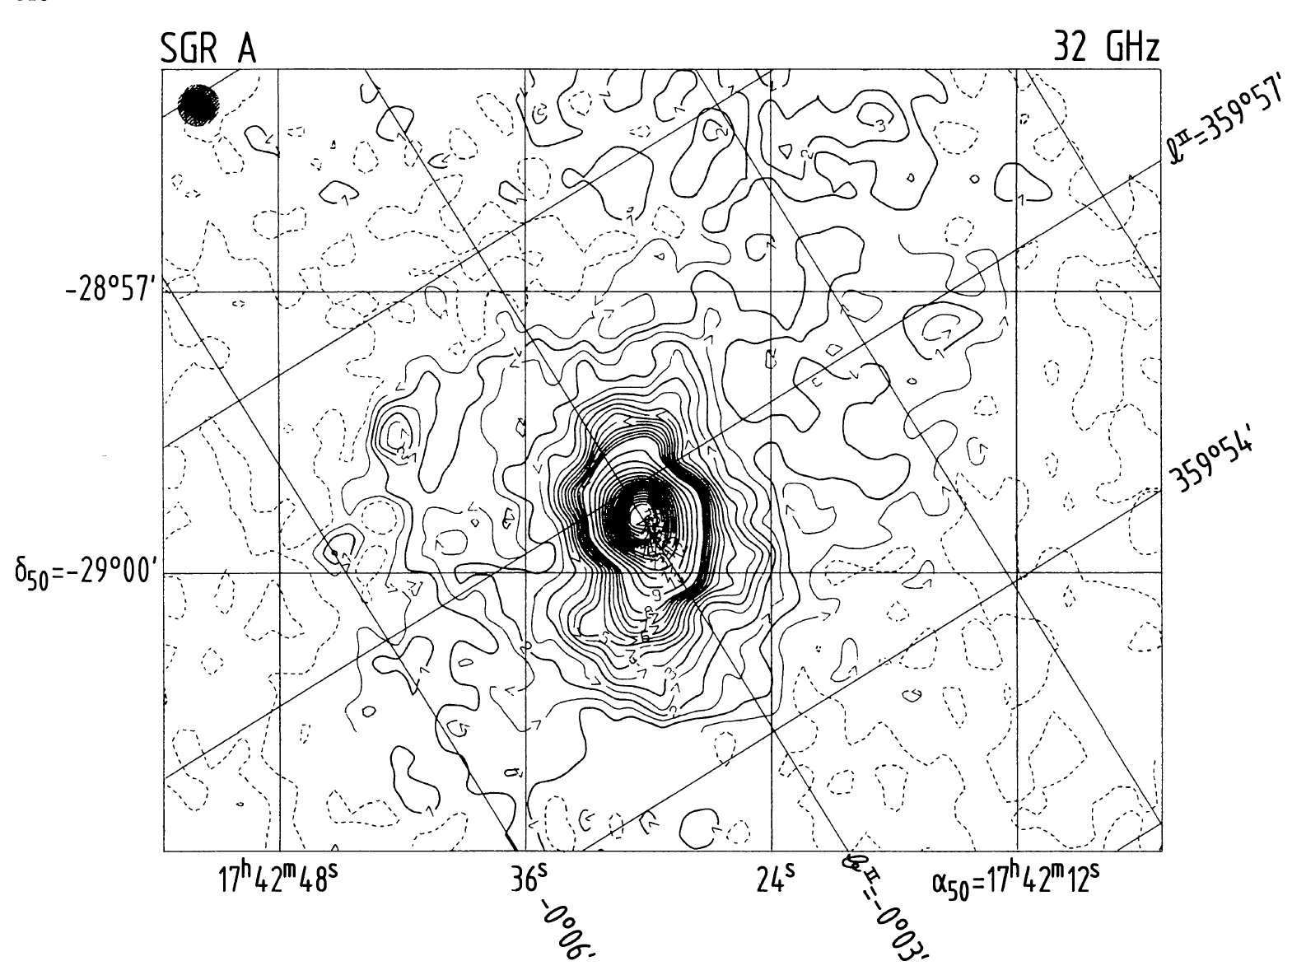
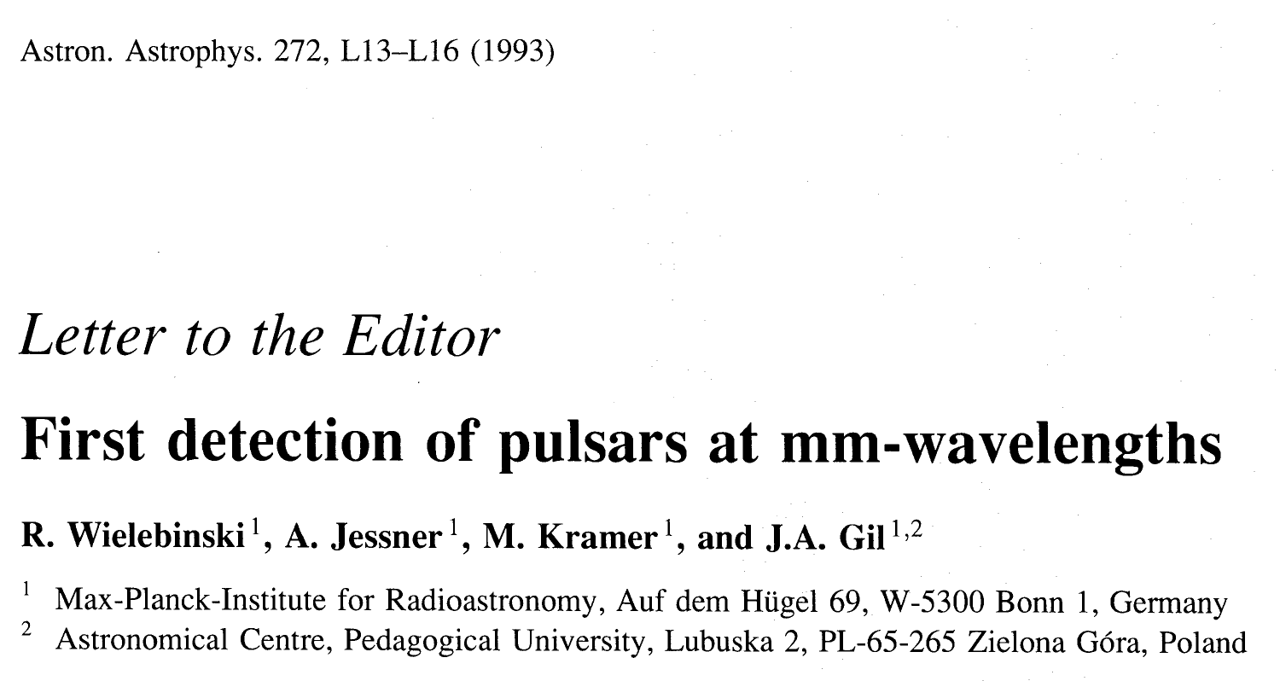
Homology works!
Design Goal: limiting wavelength ~3cm,
with degradations observations should be possible up to K-band.
→ Goal was met and exceeded!
34 GHz
Morsi & Reich, 1986

Slide 9
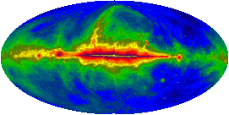
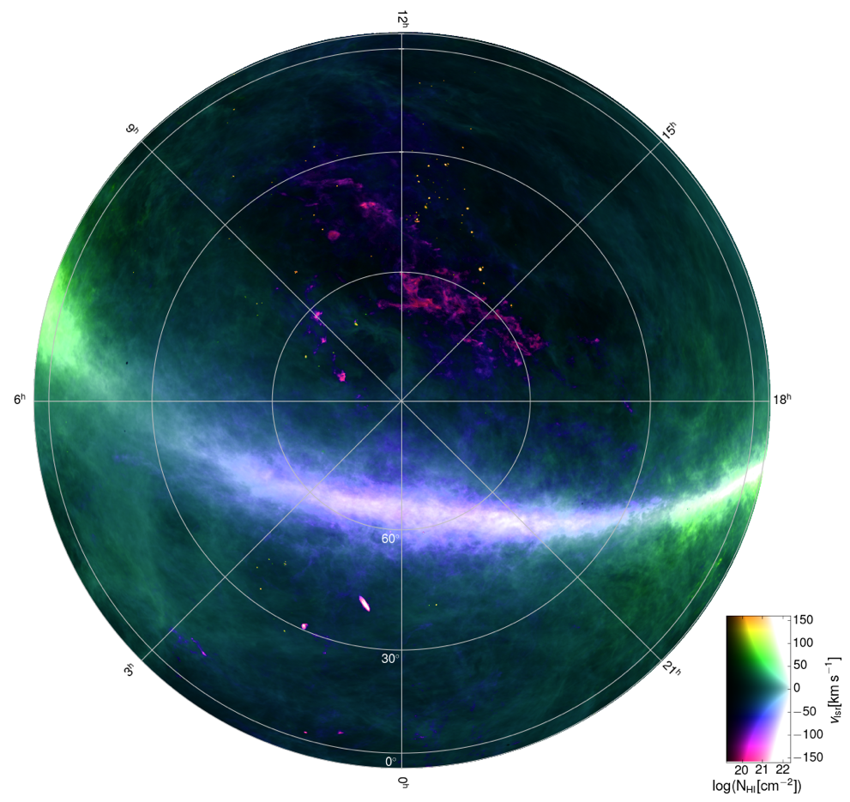
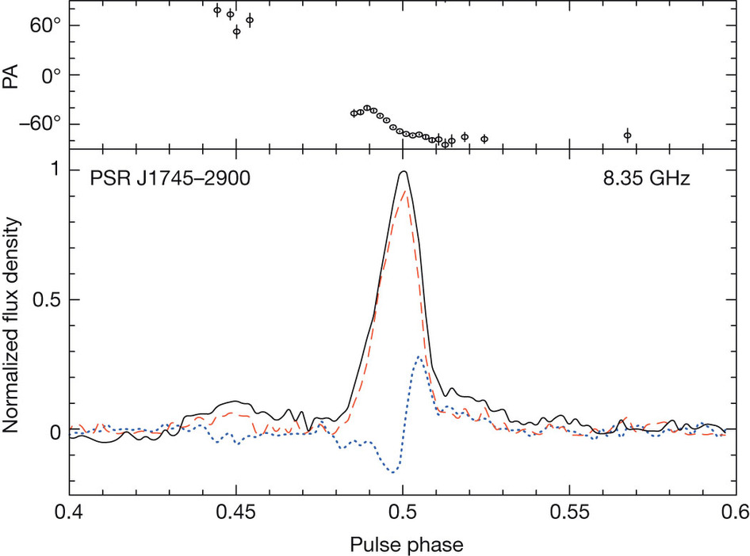
Science
(Haslam et al., 1982)
Continuum observations:
Surveys (e.g. 408 MHz), Galaxies,
Variability studies, Polarimetry
Spectroscopy:
HI, Line Surveys, Maser emission,
Fundamental Physics (e.g., e-p mass ratio in the early universe)
Pulsars:
Pulsar search (> 30 pulsars newly discovered),
Timing (EPTA / LEAP), Transients / FRBs
VLBI:
EVN, GMVA, HSA (VLBA, GBT, Arecibo, EB),
with RadioAstron and in geodetic mode
(Winkel et al., 2016)
(Eatough et al., 2013)

Slide 10
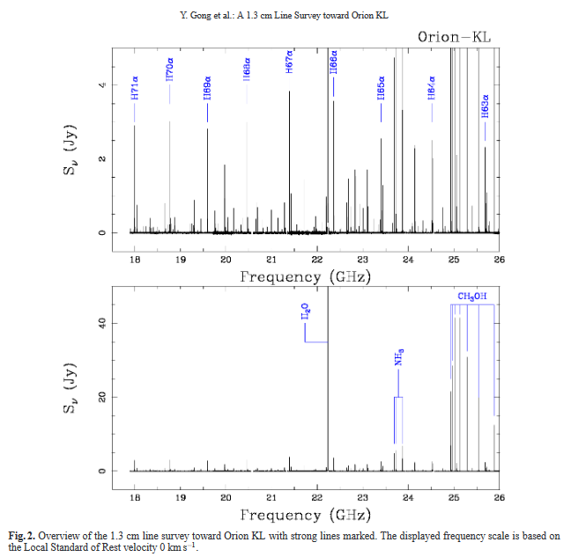
K-Band Line Surveys
Gong et al., 2015:
Survey on Orion-KL (18-26.5 GHz)
261 lines detected
Now:
Use the 8 GHz-mode of the new K-band receiver together with 28 FFT spectrometers:
1.8 * 10⁶ channels,
4.5 kHz resolution,
Δv ~ 0.08 km/s
Instantaneously!

Slide 11
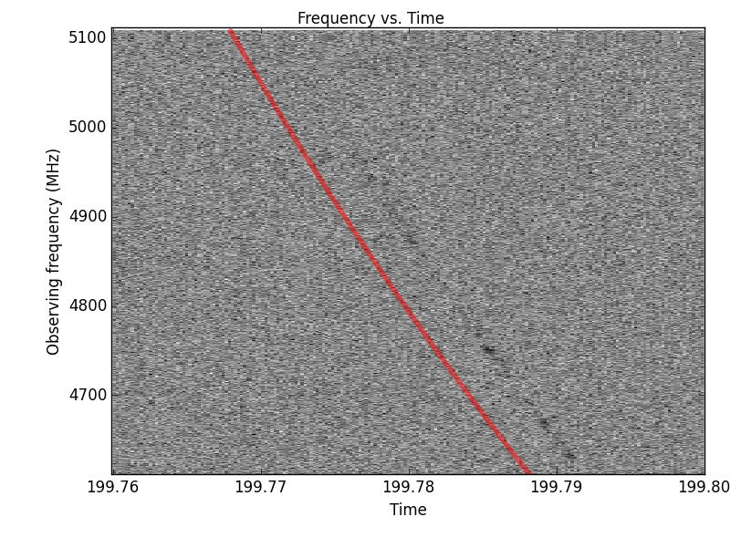
Pulsar Observations
~30% of observing time for pulsar observations
Goals:
Gravitational wave detection in the nHz regime.
Testing GR and alternative theories.
Measure neutron star masses.
Probing the interior of neutron stars.
Study orbital parameters in binary systems.
Searching for new pulsars / binary systems.
…
Large European Array for Pulsars (LEAP):
Coherent addition of the pulsar signals from
EB, JB, SRT, WSRT, Nancay (~ a single-dish with D = 194m).
Fast Radio Burst 121102
First detection at 5 GHz (EB, Aug 20, 2016)
DM = 560 pc cm⁻³ → extragalactic (Spitler et al., in prep.)
→ Trigger LOFAR observations (low freqs. come later)

Slide 12
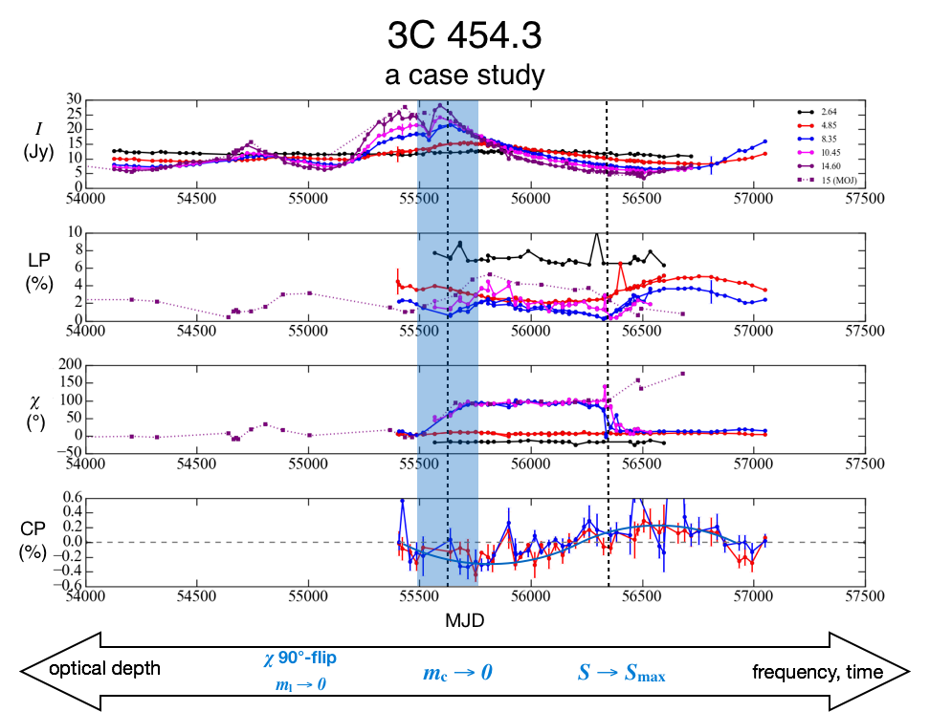
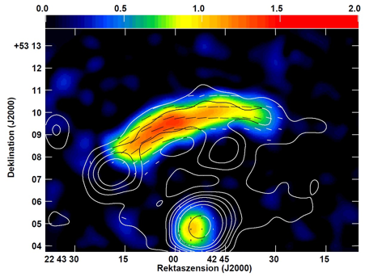
Radio continuum and Polarimetry
The 100-m telescope is well-suited for sensitive and broad-band continuum observations:
Secondary Focus: Good frequency coverage (2.6-43 GHz), high agility (30 secs switching time)
Excellent polarization properties (instrumental pol. ~0.3 % at 6cm)
Polarimeters available for several receivers
New Spectro-Polarimeter under test: 2 GHz BW, 1024 channels
Used for OTF mappings, AGN monitoring, Variability studies
New software for OTF analysis available → Nod3 (Müller et al., 2017)
Magnetic fields in the Galaxy Cluster Relic CIZA J2242+53, „sausage“, λ = 3.6cm
p_{max} ≈ 55% (Kierdorf et al., 2017)
Contours: Stokes I
Colors: polarized emssion
(Myserlis et al., in preparation)

Slide 13
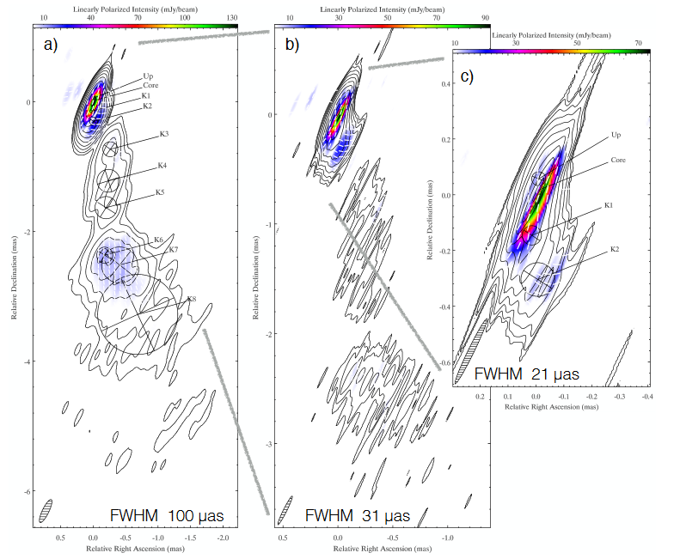
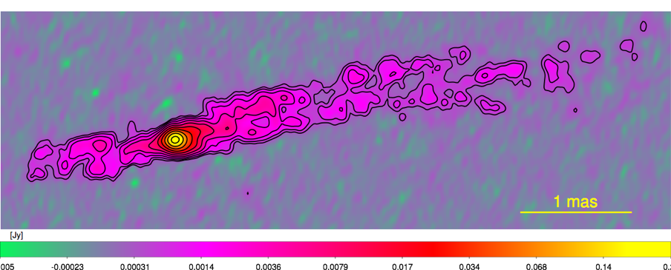
VLBI
Effelsberg is an important element in VLBI networks, e.g. RadioAstron observations of
3C273 → Ө = 26 µas → T_{B} > 10¹³ K
(Kovalev et al., 2016)
BL Lac → polarimetry with Ө = 21 µas!
(Gomez et al., 2017)
Effelsberg as part of the GMVA, e.g.
Cygnus A at 86 GHz (GMVA, Boccardi et al., 2016)
Spatial resolution ~50 µas (~200 Schwarzschild radii).
Recent News: 3mm Fringes
Effelsberg – ALMA !!
OJ287, SNR = 223

Slide 14
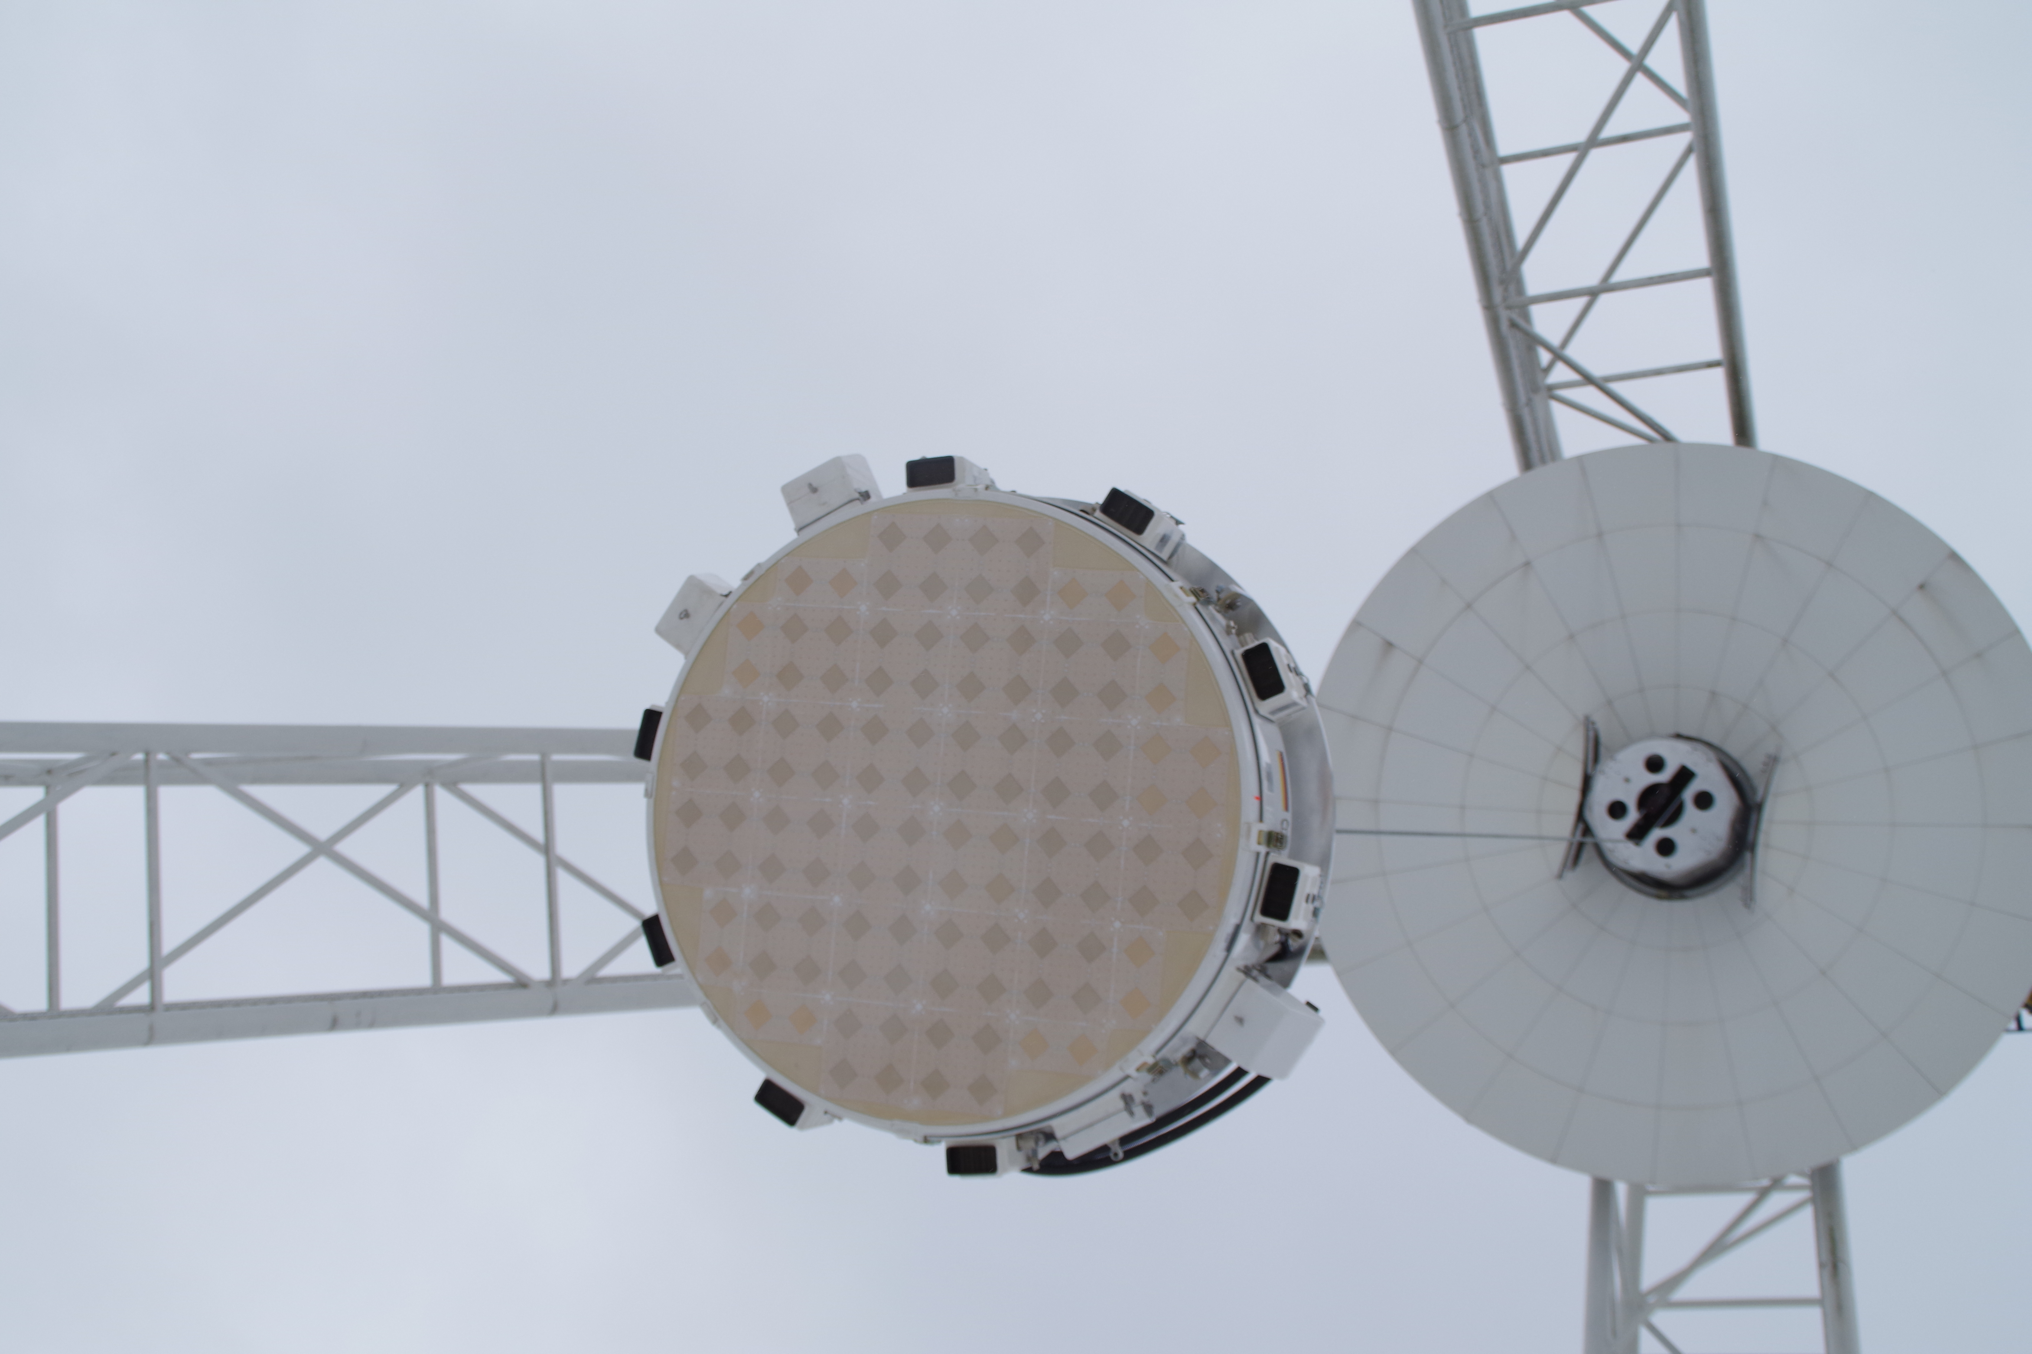
Hardware developments
CX-band system (4-9 GHz, multi-purpose)
➔ working, will be used e.g. for a continuum and spectroscopic Galactic Plane survey
K-band (18-26.5 GHz, double-horn, multi-purpose)
➔ working
Phased-Array-Feed (1.2-1.7 GHz, pulsars / HI)
➔ currently being commissioned
Q-band (38-50 GHz, double-horn, multi-purpose)
➔ working
Ku-band (12-18 GHz, double-horn, multi-purpose)
➔ to be installed in fall
Spectropolarimeter: full Stokes, 1024 channels, 2 GHz bandwidth
Develop new backend systems (FPGA-/GPU-based)
➔ already being done for PAF / Pulsar work
➔ together with digitization of the RF signal in the focus cabin (proper shielding!)

Slide 15
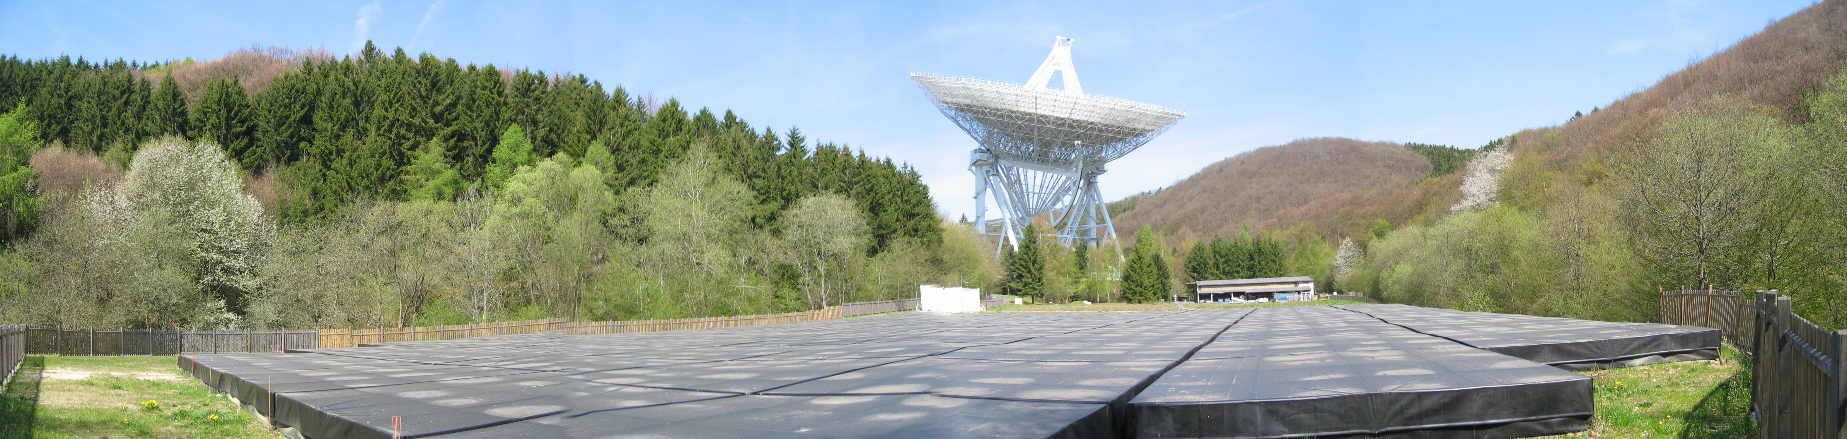
Lessons learned
The homologous design of the 100-m telescope works very well and allows observations up to 90 GHz.
Even 47 years after its inauguration, the telescope is still in very good shape!!
Frequency agility and flexibility has been a key feature for the success!
A renewal of the receivers, IF and backends is needed and has started, together with the upgrade of the software.
100 meter seems to be some natural limit for fully-steerable radio telescopes.
Thank you very much!

