Slide 1
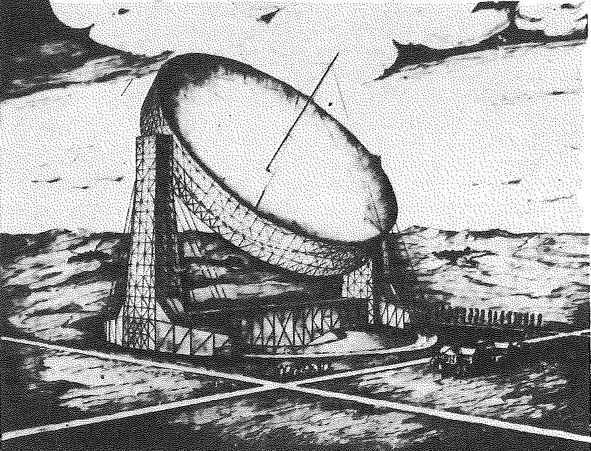
The Largest Feasible Steerable Telescope
Ken Kellermann
NRAO
IAU Vienna, August 2018
Notes:
When NRAO was first established in the mid 1950s, the goal was to build a very large radio telescope – of the order of 600 feet in diameter.
At the time NRAO didn’t have any staff or a director, so all planning and decisions were made two advisory committees, one reporting to the NSF in Washington, and one reporting to AUI in new York. The two committees had partially overlapping membership, but unfortunately, their advice wasn’t always consistent.

Slide 2
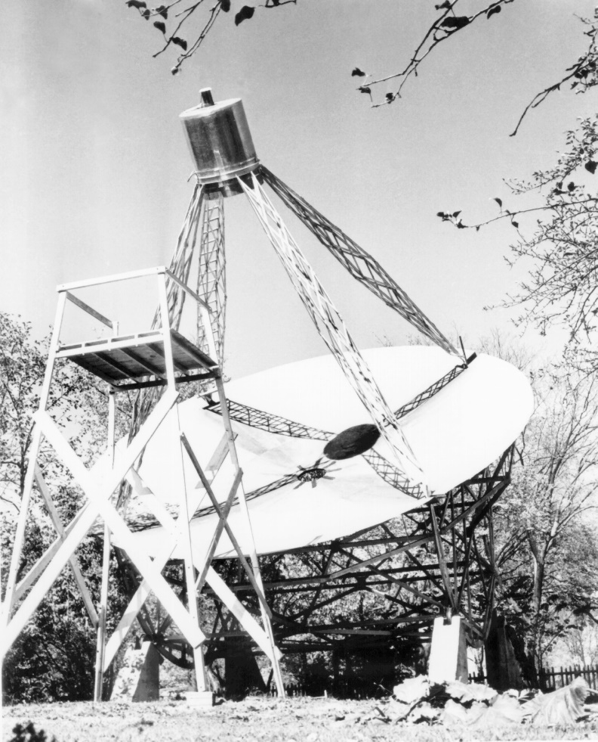
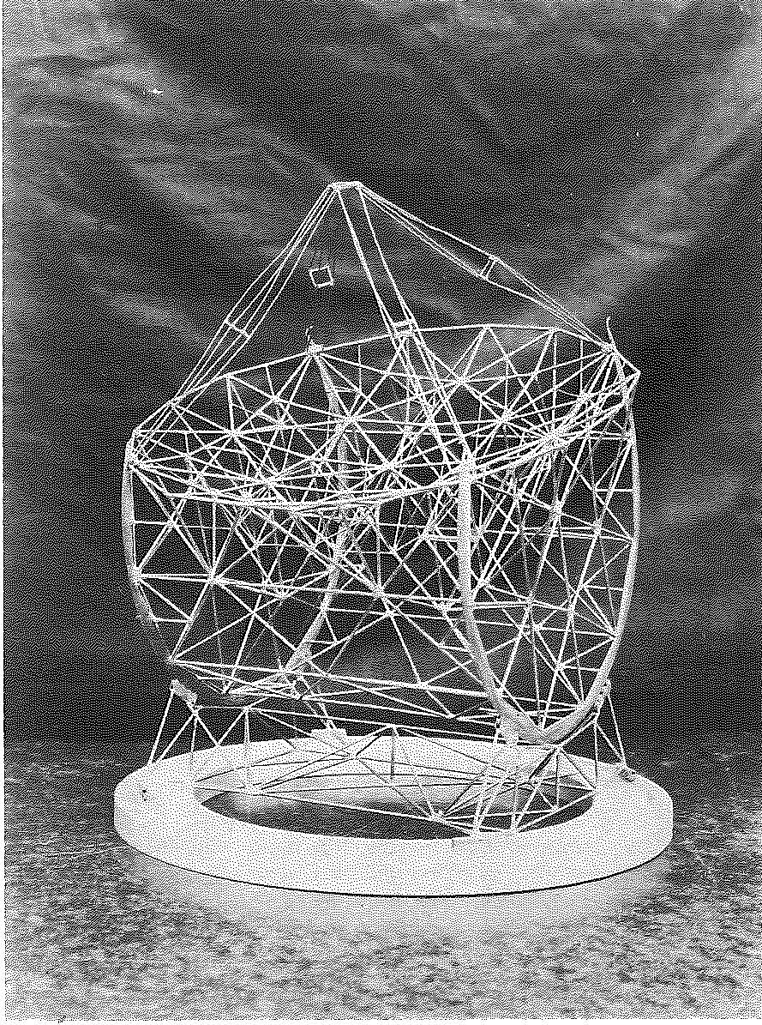
Grote Reber Antennas
1937 Wheaton, IL
32-ft antenna
1946 220-ft design
Notes:
When Grote Reber built this 32ft radio telescope in his backyard in 1937, it was the largest parabolic dish ever built.
After WW II
Reber designed a 220-ft antenna and tried to get funding from the NSF
Design was basically the same as his 1937 transit telescope
Except it was fully steerable and was made out of steel rather than wood.
Tried to find money to build it, but he was ahead of his time, and no one took him seriously.

Slide 3
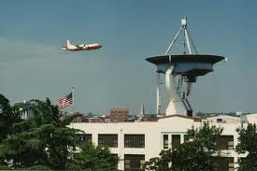
NRL 50-ft radio telescope
Notes:
It was almost 15 years before anyone built a larger dish than Reber’s Wheaton radio telescope.
This is the NRL 50-ft antenna which was built in 1951 on top of a building overlooking the Potomac River.
It is still there and you can see it when flying into National Airport.

Slide 4
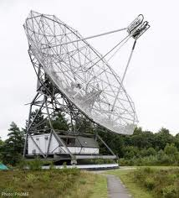
Dwingeloo, 1959

Slide 5
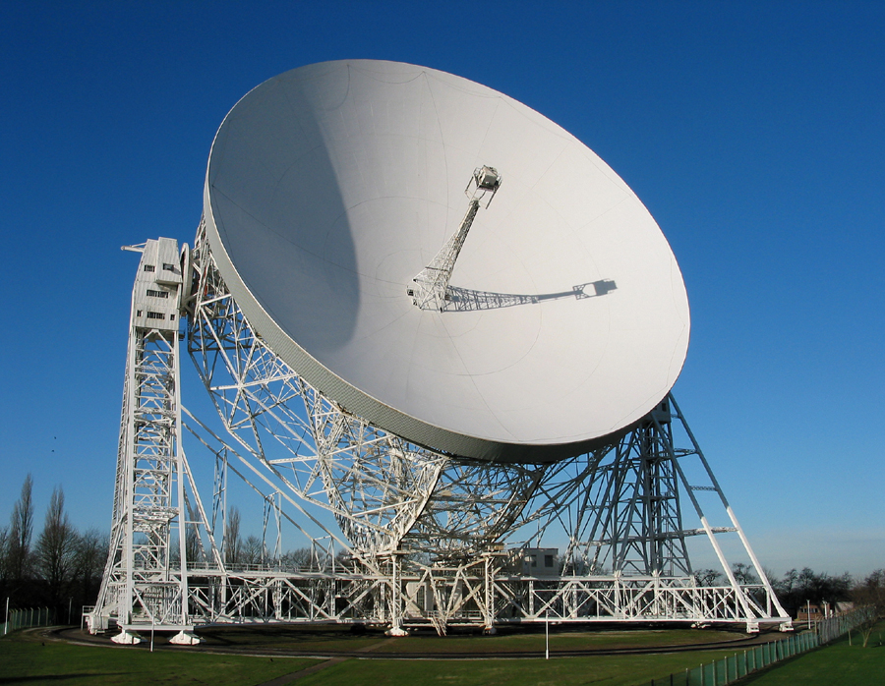
Jodrell Bank, 1959

Slide 6
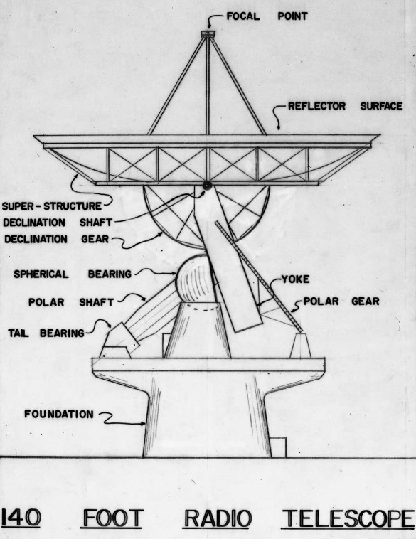
The 140 foot Telescope
Argued over size/wavelength limit
  No reason to go shorter than 10 cm
Start with 40 meters (λ > 3 cm)
  rounded up to 140 feet
Polar or Alt-Az Mount
  Astronomers didn’t trust computers – polar mount
  Donald Menzel: Must be able to observe Sun any time
  “NRAO’s worst decision ever”
Conceptual design by Ned Ashton (NRL 50-ft)
Bids ranged from $4 million to $12 million
June 1958 AUI signed contract with Bliss Corp.
  Cost: $4.75 million
  Completion: Summer 1960 (24 months)
Notes:
In order to complete the job within two years, the contractor stared fabricating components and building the foundation before the engineering design was complete. Design deficiencies – design was changed after construction began. - Arguments about who was responsible for the design, Ashton or Bliss or NRAO went on for years.
Complex structure – No one thought about how it was going to be assembled. - parts transported to GB. Numerous delays – cost increases – NRAO had to keep going back for more money
Yoke and polar axis were made from Type A -373 steel. After they had been delivered to GB, some one realized that (A-373) steel was subject to brittle fracture in cold weather.

Slide 7

Notes:
During WW2, ships had sunk in the North Atlantic winters

Slide 8
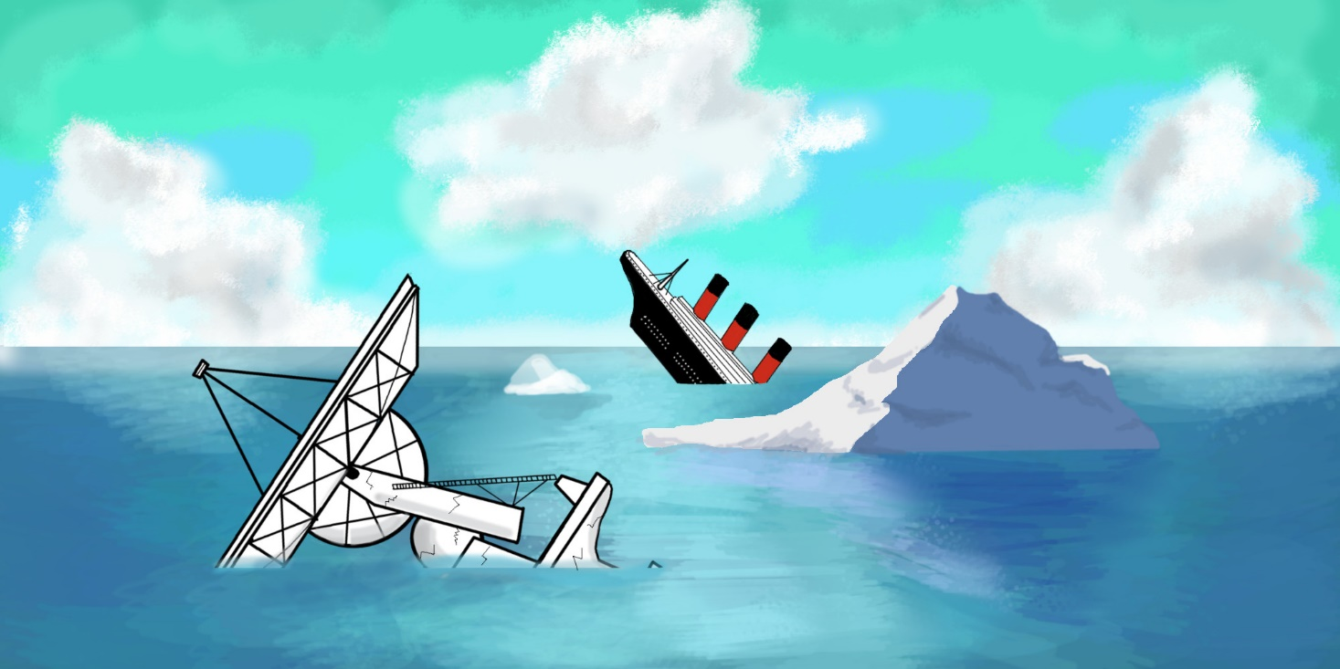
Notes:
It gets pretty cold in GB during the winter
Everything that had been fabricated was scrapped. Some of it was sent to Brookhaven to shield reactors
Rest was buried in Green Bank and is still there.

Slide 9
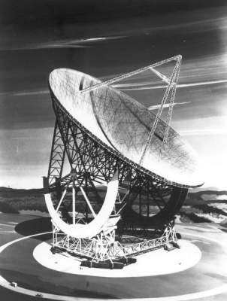
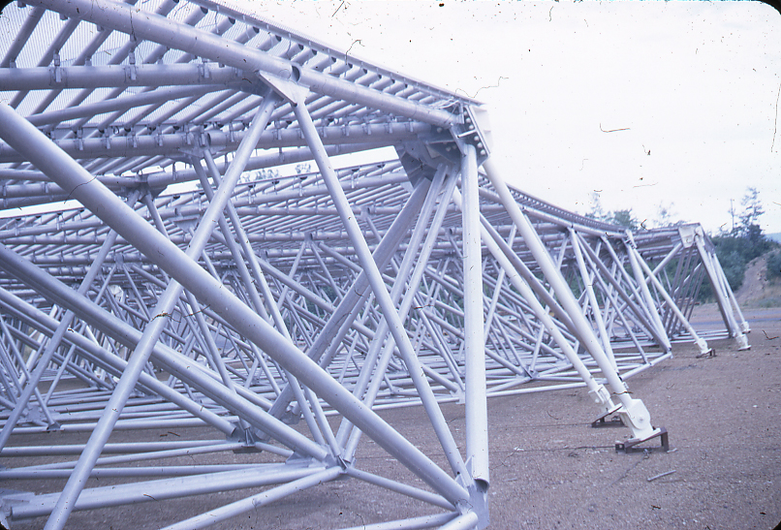
Sugar Grove 600-ft antenna
Notes:
Meanwhile only 30 miles away at Sugar Grove WV, the Navy was actually starting to build a 600-ft antenna- reflections of Soviet missile telemetry of the Moon --VLBI
Due to perceived military need and typical military overconfidence construction started in 1956 even before design was complete. KIK there in 1965, they had built a foundation and a number of surface panels
Project highly classified – but not secret - everyone knew about it. telemetry delibetaly- leaked -- Never clear what real purpose was. When ran into trouble – Navy started to refer to Sugar Grove as a radio telescope. By 1962 price had gone from $20 million to $130 million – Sec Defense shut project down
Confusion between 140-ft and Sugar Grove
I think the failure of the Sugar Grove project coupled with the Green Bank problems were probably the low point of US radio astronomy.

Slide 10
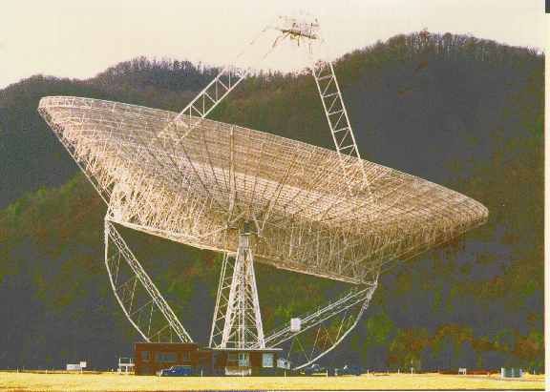
Green Bank 300–ft
Transit telescope
Notes:
Meanwhile all NRAO had was a commercial 85 foot antenna
Budget > all rest of US Radio astronomy.
In a crash program, John Findlay led the design and construction to build a 300 foot transit antenna
Total cost < $1 million
Two years from conception to completion
Temporary until the fully steerable telescope was built

Slide 11
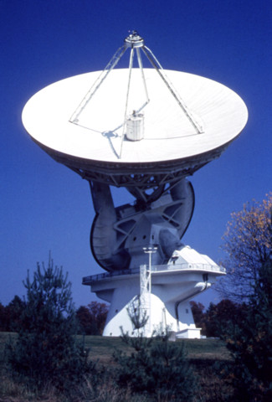
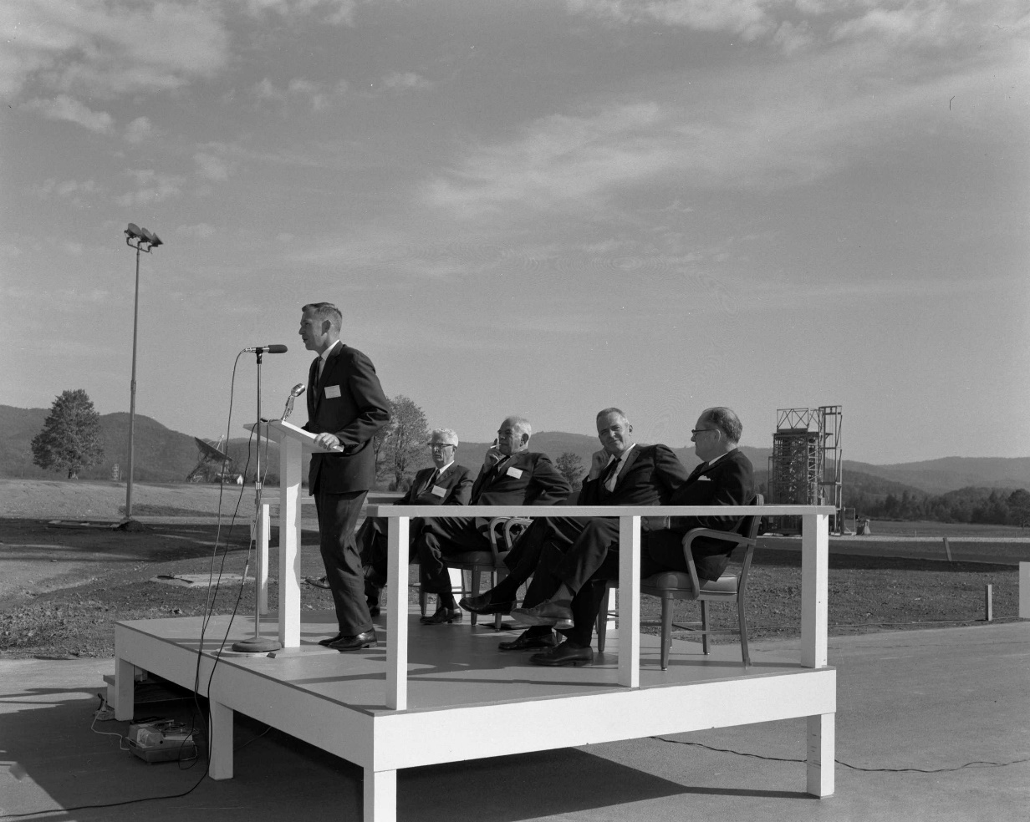
This isn’t the largest radio telescope in the world.
But it is the largest equatorially mounted telescope in WV. Dave Heeschen
Dedication of 140-ft radio telescope
Green Bank, WV
Oct 13, 1965
Notes:
Meanwhile 140 ft problems continued-- AUI fired the manufacturer,
Dave Heeschen had become Director of NRAO
Project management shifted from a New York Committee to Green Bank
Telescope finally finished in 1965, 5 years late - 3 x budgeted cost.
I had just come to NRAO from a post-doc in Australia – remember Heeschen’s speech at the dedication.

Slide 12
Decade Review Priorities
Year | Chair | Recommendation
1961 | Pierce | Large Array
1964 | Whitford | Large Array
1970 | Greenstein | VLA
1981 | Field | VLBA
1991 | Bahcall | MMA
Notes:
Over the following decades, Every review of radio astronomy, mentioned the need for a large fully steerable radio telescope, as a high priority, but never as the first priority, so none were ever built.

Slide 13
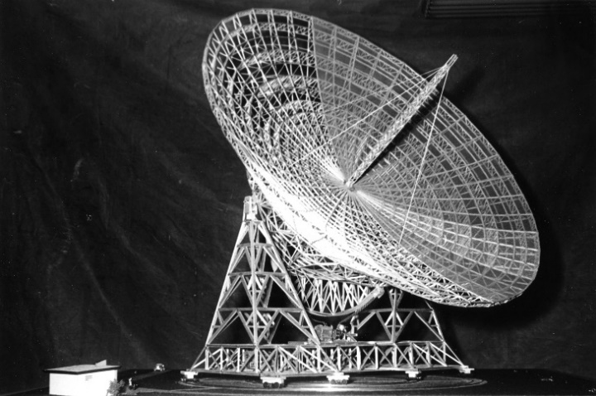
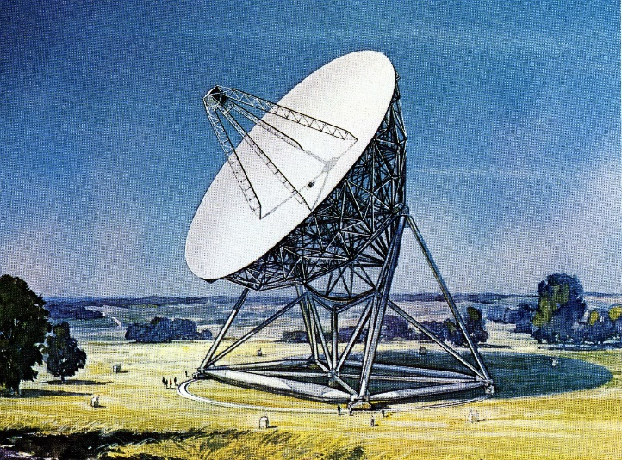
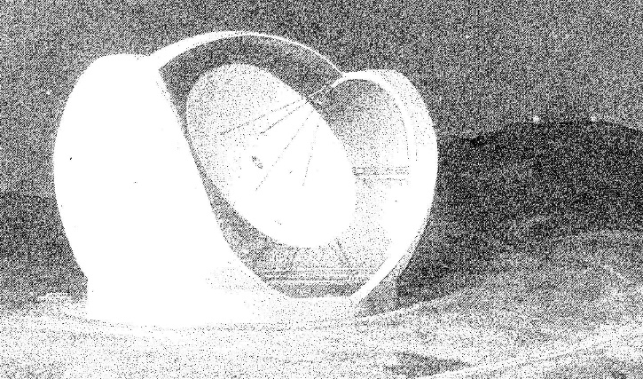
Largest Feasible Steerable Telescope
Year | Size | λ(min) | Cost ($)
1969 | 300 foot | 1.3 cm | 8.3M
1972 | 65-m | 3mm | 9.4 M
1977 | 25-m | 1 mm | 30 M
Notes:
As early as 1965, even before the 140 was finished NRAO established the Largest Feasible Steerable Telescope Project – John Findlay. They considered a number different designs, some very exotic, for antennas up to 1000 feet in diameter.
They finally settled on a fully steerable 300 ft dish -- 1 cm –
65-m good to 3 mm; proposed to NSF, got in the NSF budget proposal , but didn’t make it though government budget office.
But, again science had made the 65 m obsolete; mm community wanted a telescope that would work to 1 mm. They designed a 25m dish that actually did get into the President Carter’s budget, but was cut out by Congress.
Following year the at a meeting of the NSF Astronomy Advisory committee, 25 m lost out to the VLBA as the top priority for astronomy. – Nobeyama 50 m, IRAM 30 m Pico Veleta
Some of my former millimeter astronomer friends have never forgotten or forgiven me for what happened at that meeting.

Slide 14
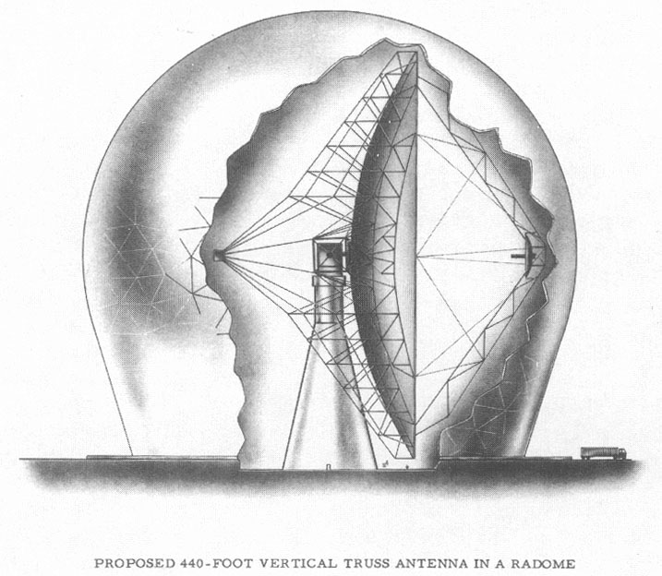
NEROC 440-foot Radome Enclosed Telescope
Notes:
Also, During the 1960s MIT/Harvard group developed plans for a 440-ft radome enclosed antenna.
Up against the VLA in the 1970s Decade Review lost to VLA
By 1980 -- None of these large antennas were ever built.

Slide 15
NSF Langenberg Committee - June 1988
Group A
Considered Absolutely Essential
VLA, VLBA, BIMA, OVRO, CSO
Class B
Highly Recommended
NRAO140-ft, NRAO-12m, Five Colleges, Arecibo
Class C
Less Competitive
Haystack, NRAO 300-ft, OVRO 40-m
Notes:
Things got worse
Much of American radio astronomy had been supported by DoD
Caltech, Michigan, Illinois, Arecibo
Congress decided that military research confined to things that won wars
NSF didn’t have enough money to operate all of the US radio astronomy facilities
The NSF subsequently cutoff funding for Haystack and the OVRO antenna
Most likely so would have been the 300-ft dish except for an unexpected event happened a few months later

Slide 16
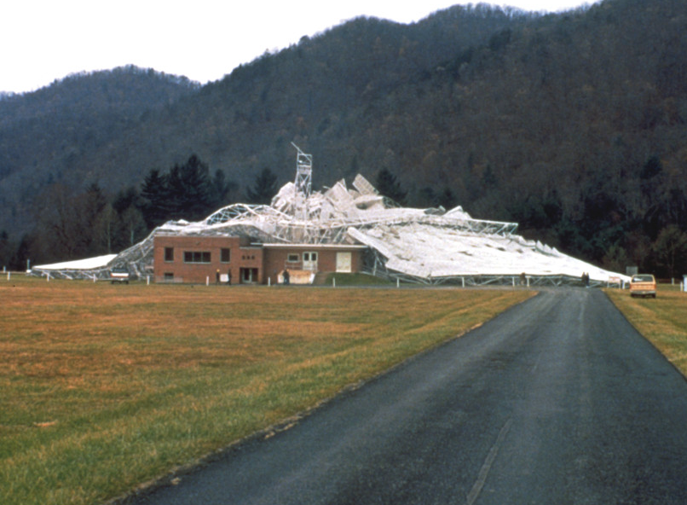
NRAO 300-ft transient telescope
November 14, 1988
November 15, 1988
Notes:
Picture by Richard Porcas on Nov 14, 1988
Since NRAO was never able to build any large steerable telescope. The 300 foot had been upgraded several times with a new surface; traveling feed – 1 hour tracking
Built as a stopgap measure in the early 1960s, it was still in use after 25 years
At the time it was being used for an all sky 6 cm survey -- observers were scanning in elevation at 20 degrees per minute.
Gusset plate failed
Porcas claims he had nothing to do with the collapse

Slide 17
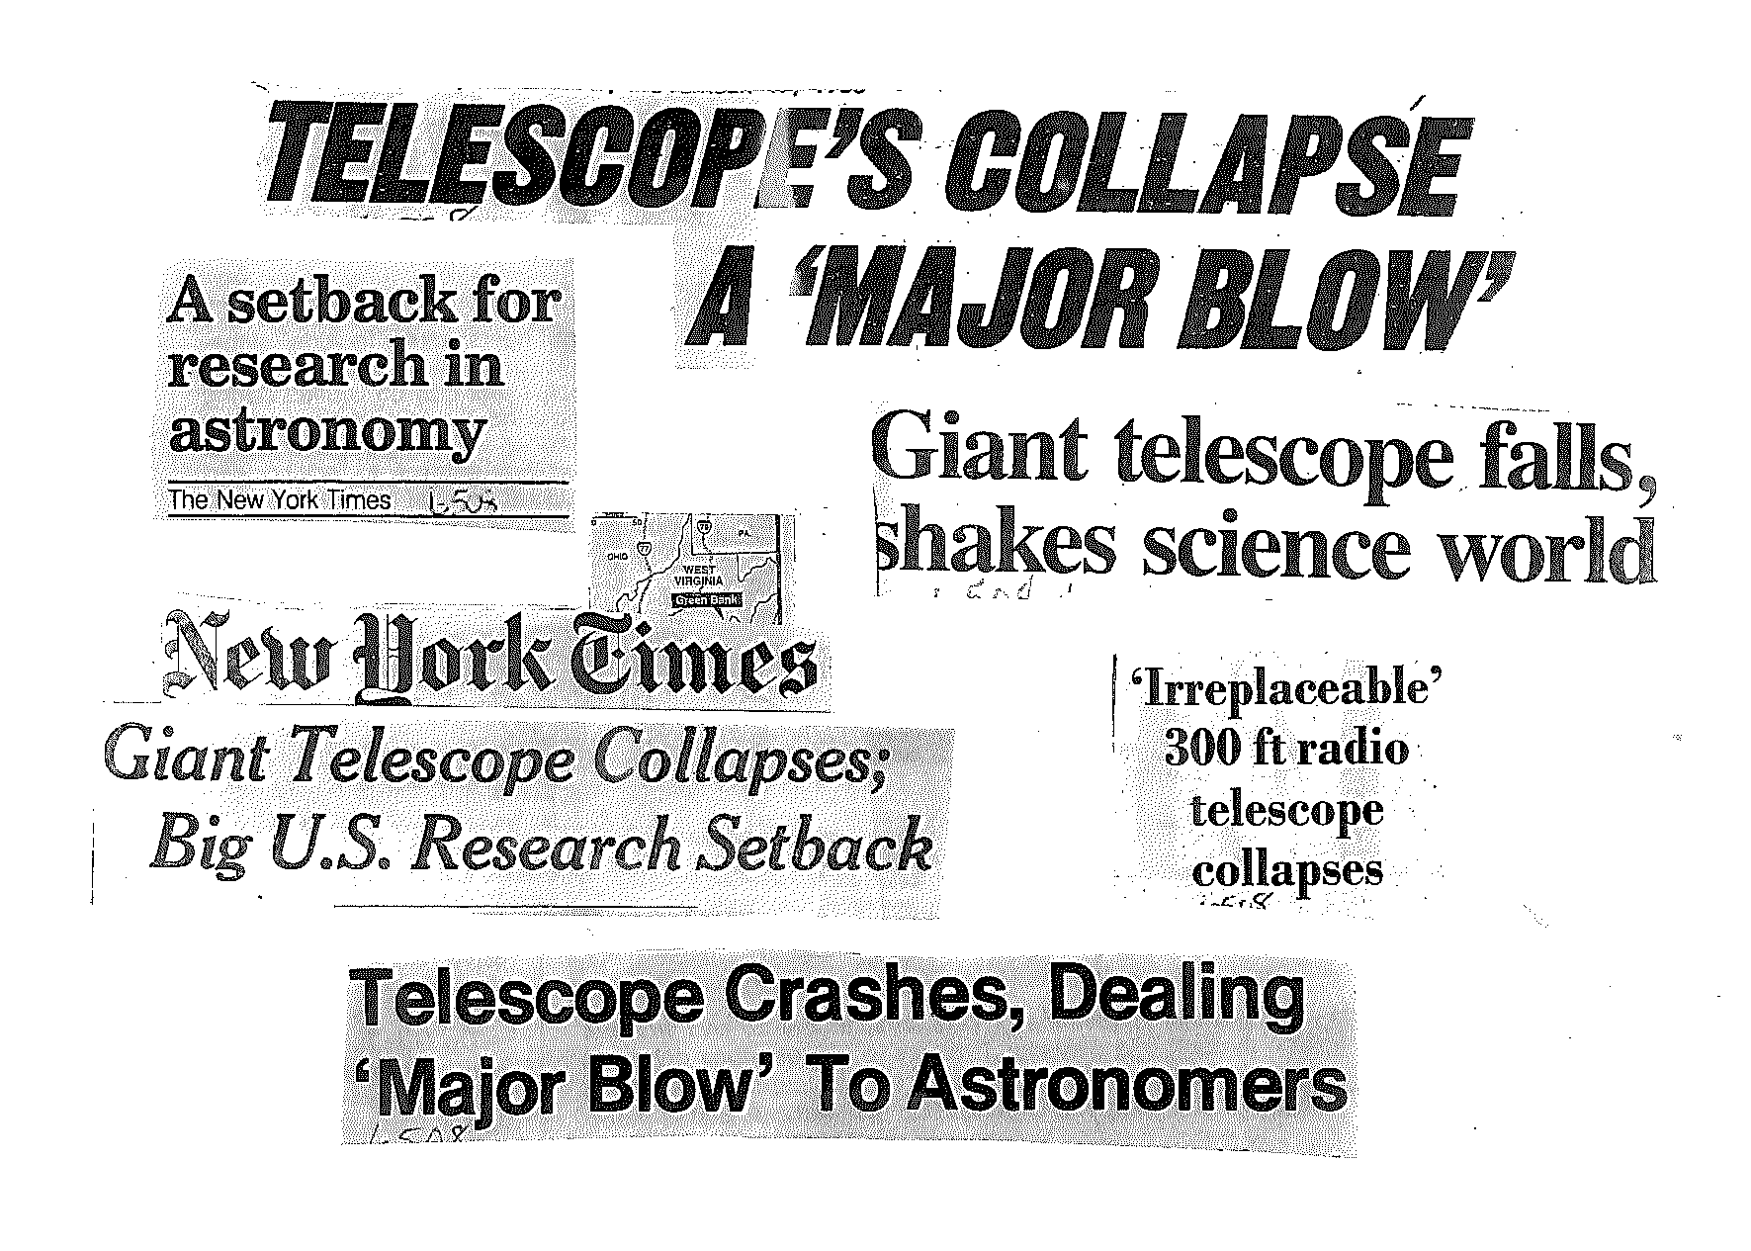
Notes:
300-ft probably would have been shut down, but when word got out about the collapse – the media converged on Green Bank, -- sent reporters, Washington TV --helicopters – very exciting..
New media from around the world reported the loss of the 300-ft as a national disaster and a set back for astronomical research.

Slide 18
A National Disaster
The collapse Tuesday night of one of the world's largest radio telescopes will hinder astronomy over the long term and hamper an experiment planned for a space shuttle mission, experts said. Washington Post
In a mysterious accident that may have set back astronomical research by years, a 300-foot radio telescope collapsed Tuesday night in a tangle of twisted metal girders. New York Times
In a devastating setback to the international search for extraterrestrial life, a giant radio telescope being used to probe the stars has been destroyed. Philadelphia Inquirer
Notes:
Seemed that everyone, except NSF had forgotten the telescope was about to be closed

Slide 19
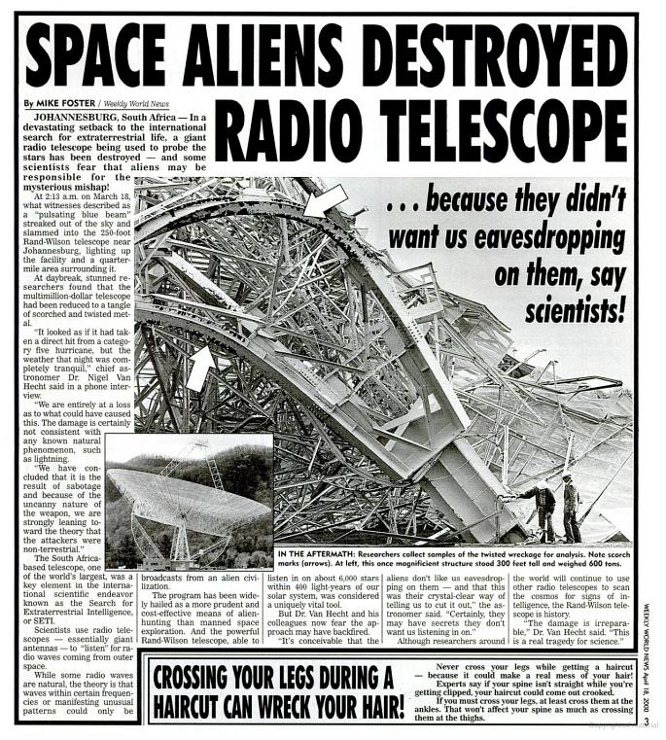
Notes:
A Newspaper in south Africa pinned the blame on extraterrestials.

Slide 20
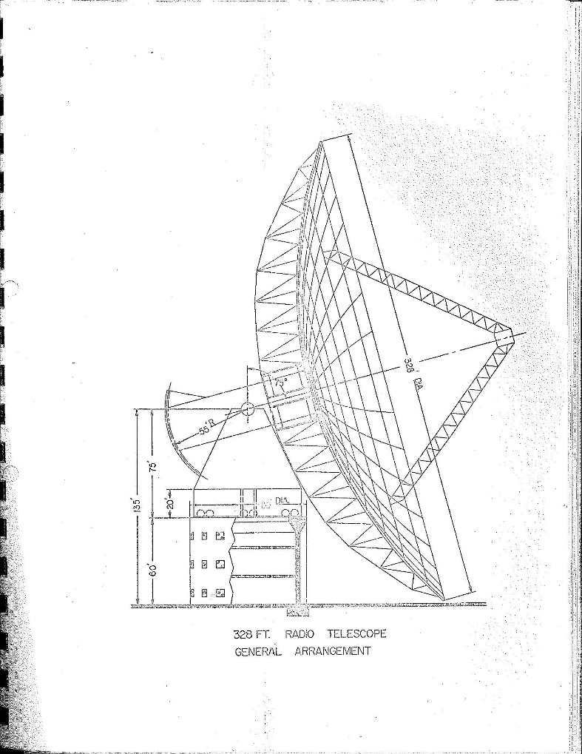
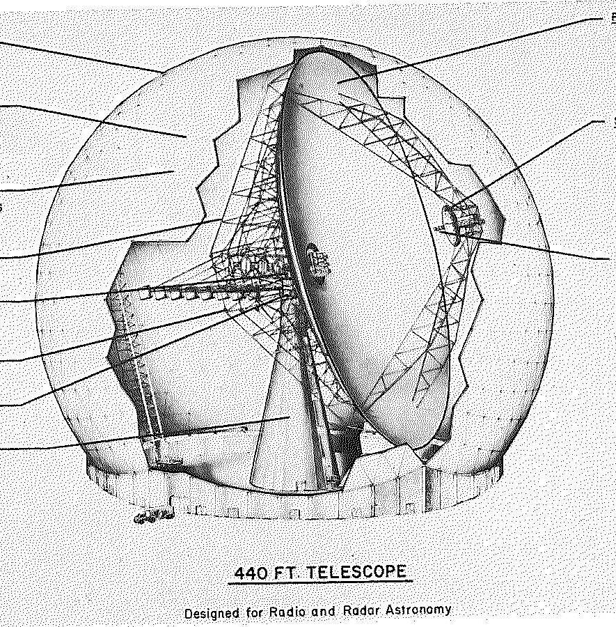
Other Large Antenna Initiatives
Association for Research in Astronomy
Caltech, Berkley, Stanford
100-m fully steerable telescope
NEROC 440-ft Telescope
Notes:
Meanwhile, there were also other initiatives in the US
New England Radio Astronomers proposed a 440 radome enclosed dish
Caltech, Berkely, and Michigan jointly proposed a more or less conventional 100-m dish.
Neither one was ever funded.

Slide 21
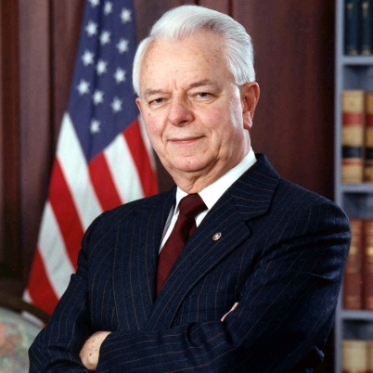
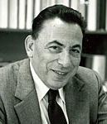
Senator Robert C. Byrd, D-WV
Chair of Senate Appr. Committee
Eric Bloch
NSF Director
Notes:
Especially Senator Byrd from WVA summoned the NSF Director to his office to explain how the NSF would replace the 300 ft antenna.
Richard Byrd was the longest serving member of US Congress-wielded a lot of power
Long history of bring federal money to WV for projects of questionable merit.
Used to getting his way - About to become Chair of the Senate appropriations Committee
Erich Block first NSF Director no PhD
Previously been at IBM – In change of development series of IBM 360 computers
Bloch tried to explain not planning to replace 300 ft
Langenberg Committee and that 300 foot was obsolete

Slide 22

SS
we
Senator Byrd
will have his finger on every dime of the federal budget. Now will you let us
help you?
We have
a peer review process.
No telescope proposal
Our next big NSF
project will be
LIGO
In all my years in Washington I have never encountered such an uncooperative agency head
Erich Bloch
Senator Byrd
Senator
Rockefeller
Notes:
Bloch suggested that maybe they could build LIGO in Green Bank

Slide 23
Fast Track Funding
17 Feb, 1989 ‒ CRS: Radio telescope best for WV
June 23 ‒ 1989 Dire Emergency Supplemental Appropriations Act
  $74.5 million spread over two years to replace 300 foot telescope
June 30 – President G. H. W. Bush signs NSF bill
June 30 – AUI/NRAO submits proposal to NSF ($74.5 M)
July 31– NSF Panel Review (All Excellent)
August 15– NSF funding to NRAO for design work ($500 K)
Notes:
LIGO will be buried
Telescope bring in more visitors – better for WV
6 weeks proposal to funding

Slide 24
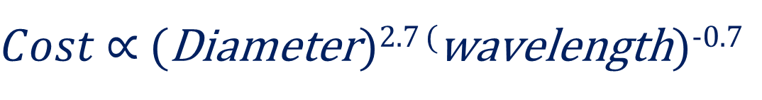
NRAO had $74.5 million but
No design
No community consensus
Senator Byrd wanted action
NSF wanted action
$Cost$ ∝ (Diameter)^{2.7 (}wavelength)^{-0.7}
Wide range of views on what to build
  Large collecting area - 100m diameter
  Short mm wavelengths – λ > 3.5 mm
  Radome or open air
  Active surface
  Symmetrical or unblocked
Notes:
For fixed cost – tradeoffs
Largest unblocked antenna 7 m Bell Labs dish + 10%
Site was not open for discussion

Slide 25
June 1, 1990 – Request For Proposals
Bids
  Radiations Systems Inc. (RSI) - $57 million
  Brown and Root (TIW/Vertex) - $83 M
  Fru-Con (MAN/Krupp) - $103 M
  Dec 19, 1990 - Contract Awarded to RSI
    $55 million
    Completion August, 1993
Notes:
Took nearly a year

Slide 26
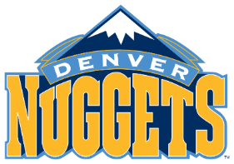
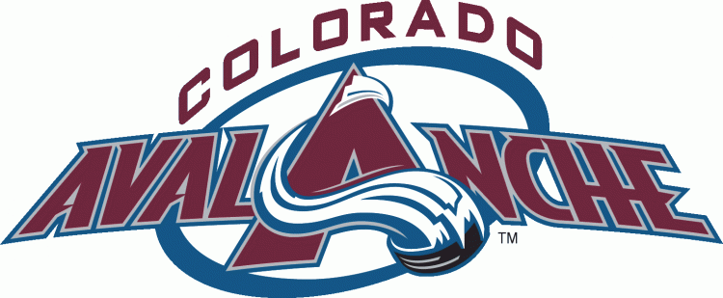
RSI/NRAO/NSF all anxious to get the job finished fast
RSI Implementation – before design completed
  Built foundation
  Fabricated members
Design weight – 12 million pounds
  Design faulty
    Moving structure would collide with mount
    Not able to sustain large number of cycles
NRAO provided optimized design
Final weight - 17 million pounds = $$$$$
RSI loosing money
RSI sold to COMSAT
COMSAT sold to Lockheed Martin
Notes:
RSI bid compliant – proposal
Build antenna 2 ½ years
Denver Nuggets basketball
Denver Avalanche Hockey Team

Slide 27
Completion delayed 1994, 1996, 1997, 1998, 1999, 2000
COMSAT sued NRAO for $29 million
  NRAO design changes
NRAO counter-sued for $3.8 million
  Poor project management
  Additional Administrative costs
  Seven Years of Lost Astronomy Data
  Impact to NRAO reputation
Arbitration
  $6.6 million awarded to COMSAT
  $2.5 million awarded to NRAO
    Claim for lost data not accepted
Net $4 million + $5 million for legal fees:
NRAO faced = $9 million bill
Notes:
With delays were cost increases
NRAO did not have that kind of money
NSF astronomy did not have funds
NRAO on Calendar year budget
Federal Gov FY Oct to Oct.
FY 2002 began in Oct 2001
2001 NRAO 5 quarters of funding

Slide 28
Summary
RSI bid overly optimistic
  Proposed price too low
  Schedule unrealistic
  RSI wanted the job/knew how much money NRAO had
NRAO should have recognized RSI bid unrealistic
  RSI lowest bidder
  RSI bid responsive to RFP
  NRAO forced to accept RSI bid
6 years behind schedule
Cost to COMSAT-RSI $120 million
Final cost to NRAO/NSF $78,560,000
$4 M (4.7%) over budget
Notes:
120 million- more than 2 x original contract

Slide 29
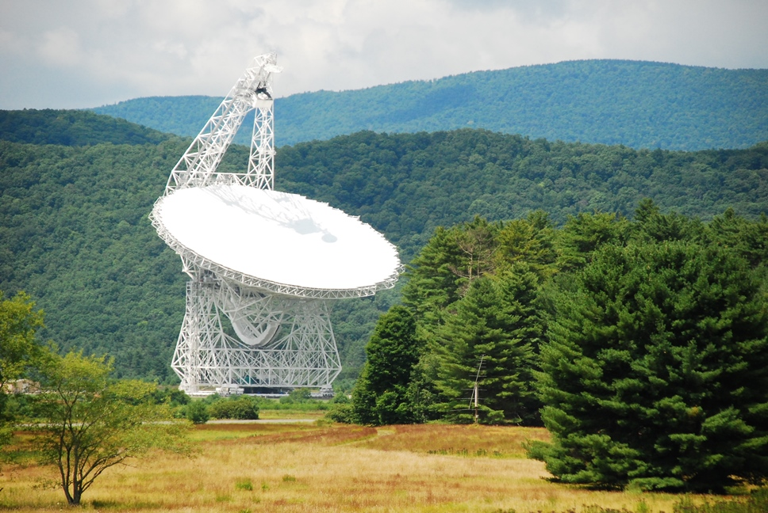
GBT finally completed in 2000
  Largest moving structure on land
  Meets or exceeds all design specifications
    Pointing good to a few arcseconds
    η_{3.6 mm} ~ 30% (night, low wind)
  Work continues to improve daytime performance
Notes:
Size of football field

Slide 30
Largest Feasible Steerable Telescope
It took nearly half a century of discussion and debate, and numerous NSF and Academy committees. But in the end it was a freak accident coupled with the ambitions of a powerful Senator to finally build a large US fully steerable radio telescope.

Slide 31
Lessons (re)Learned
Beware the lowest bidder
Have a strong leader (or patron)
Don’t take committee advice too seriously
Have good in-house expertise to generate costed design
Have veto power over sub-contractors
Control risk
Measure twice – cut once (Finish design before building)
Have clear points of contact, authority, and responsibility
Have a firm schedule with penalties and bonuses
Learn from mistakes and mistakes of others
Be careful what you ask for
Notes:
Lessons Learned, but relearned
Many of the same problems with the 140 ft, also occurred with the Sugar Grove antenna, and resurfaced 25 years later with the GBT
Penalties for not meeting milestones.

Slide 32
Open Skies: The National Radio Astronomy Observatory and its Impact to US Radio Astronomy
by
Ken Kellermann, Ellen Bouton, & Sierra Smith Brandt
Springer, 2019

