Slide 1
VLBI for Geodesy, Astrometry, and Navigation
Megan Johnson and Bryan Dorland
United States Naval Observatory

Slide 2
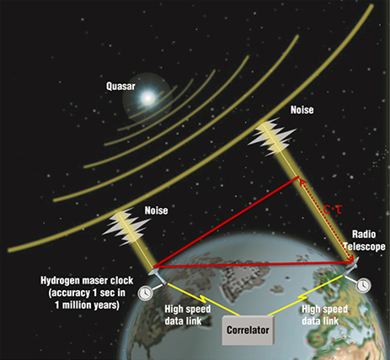
Very Long Baseline Interferometry (VLBI)
Radio telescopes spread over large distances work together to observe astrophysical sources
  Source positions are determined to very high accuracy
  In turn, station positions are determined to high accuracy
VLBI can be used to measure the precise position of the Earth relative to an inertial frame of reference → the International Celestial Reference Frame (ICRF)

Slide 3
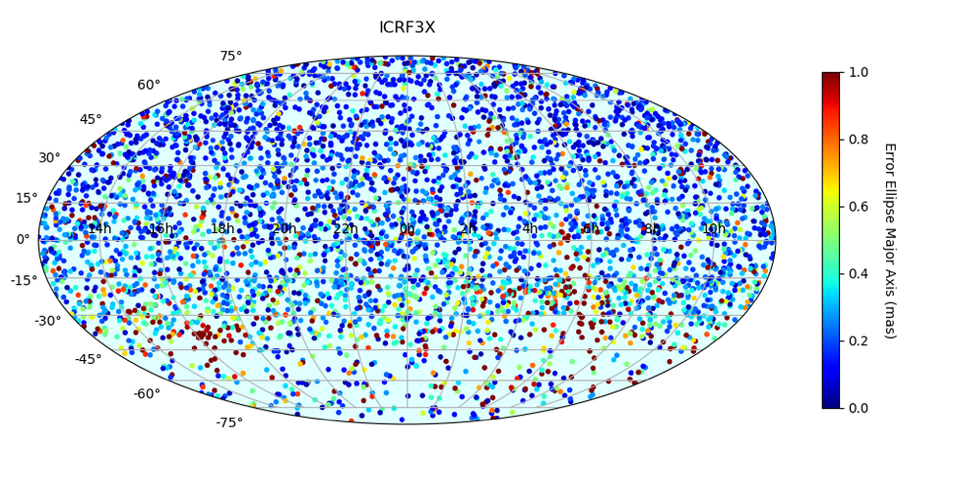
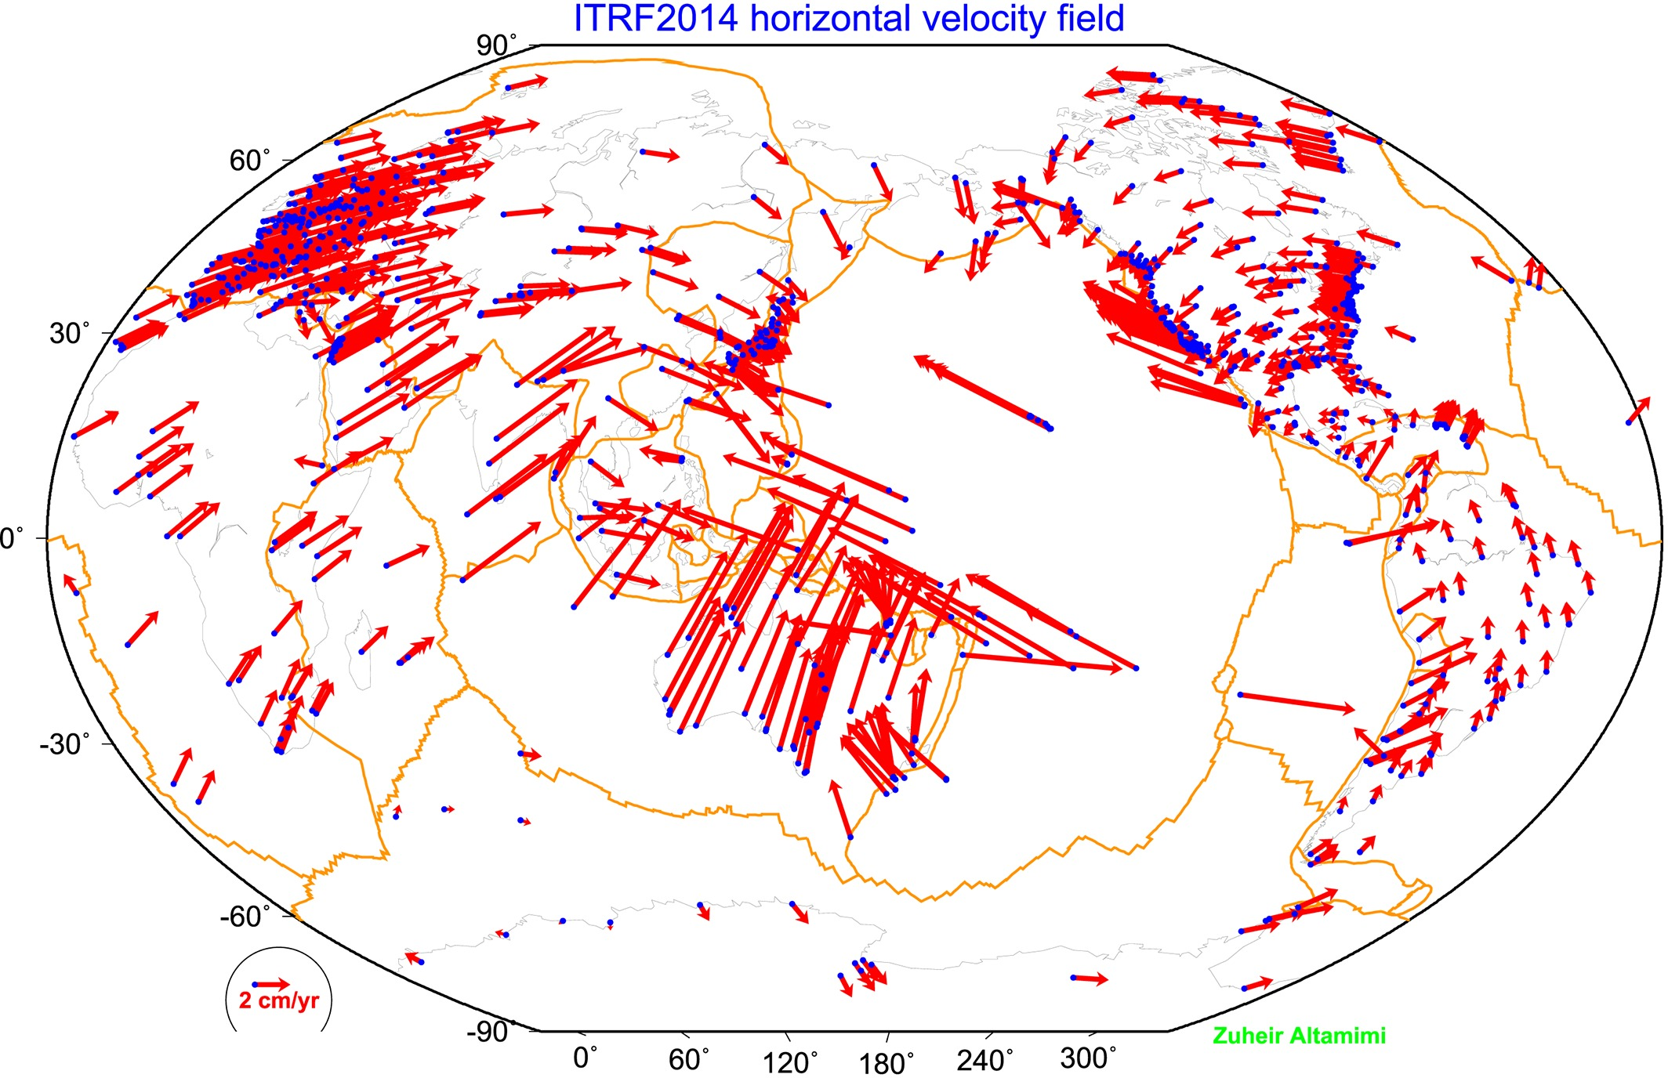
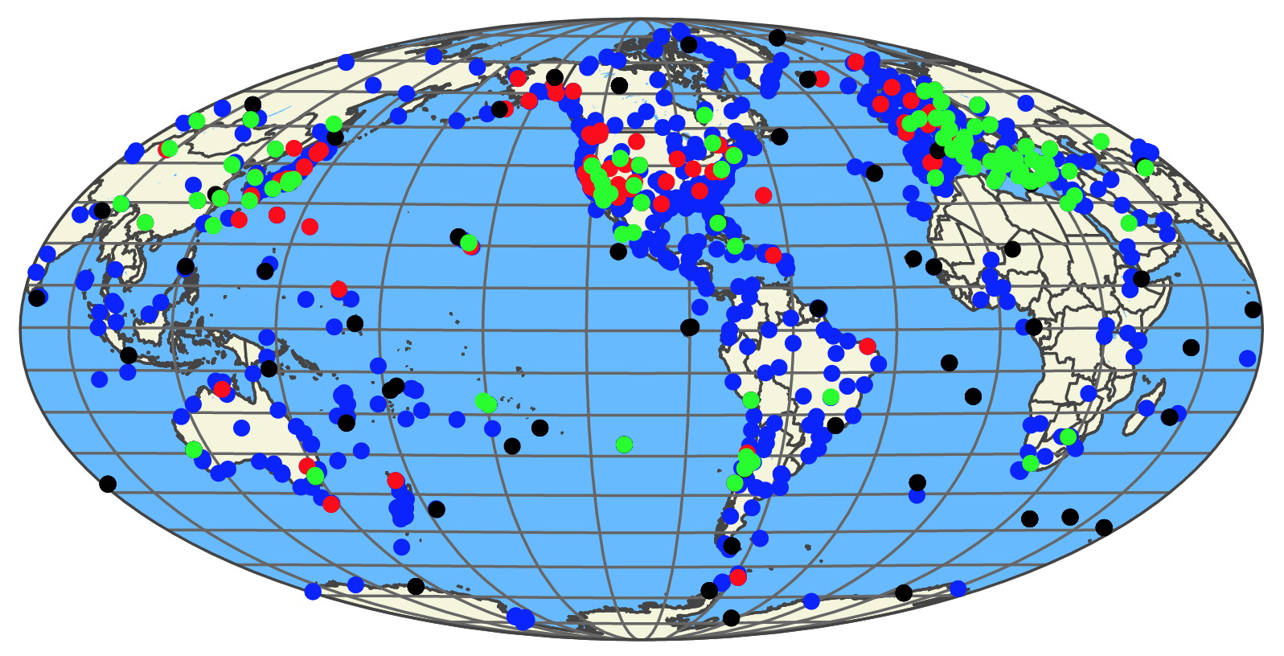
VLBI for Geodesy and Astrometry
Celestial Reference Frame
Terrestrial Reference Frame
Earth Orientation Parameters
EOPs

Slide 4
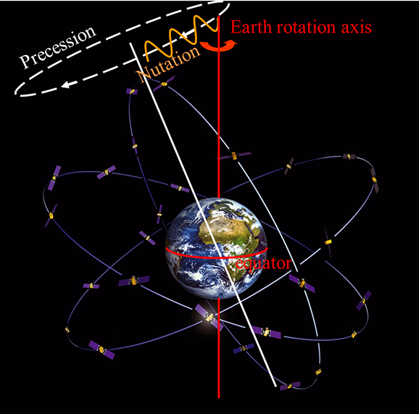
VLBI for Geodesy and Astrometry
Legacy system over 40 years old
20-meter class telescopes
Simultaneous S-/X-band observations to determine group delays
VLBI produces 5 EOPs:
  UT1-UTC
  X_{pole}, Y_{pole}
  Precession
  Nutation

Slide 5
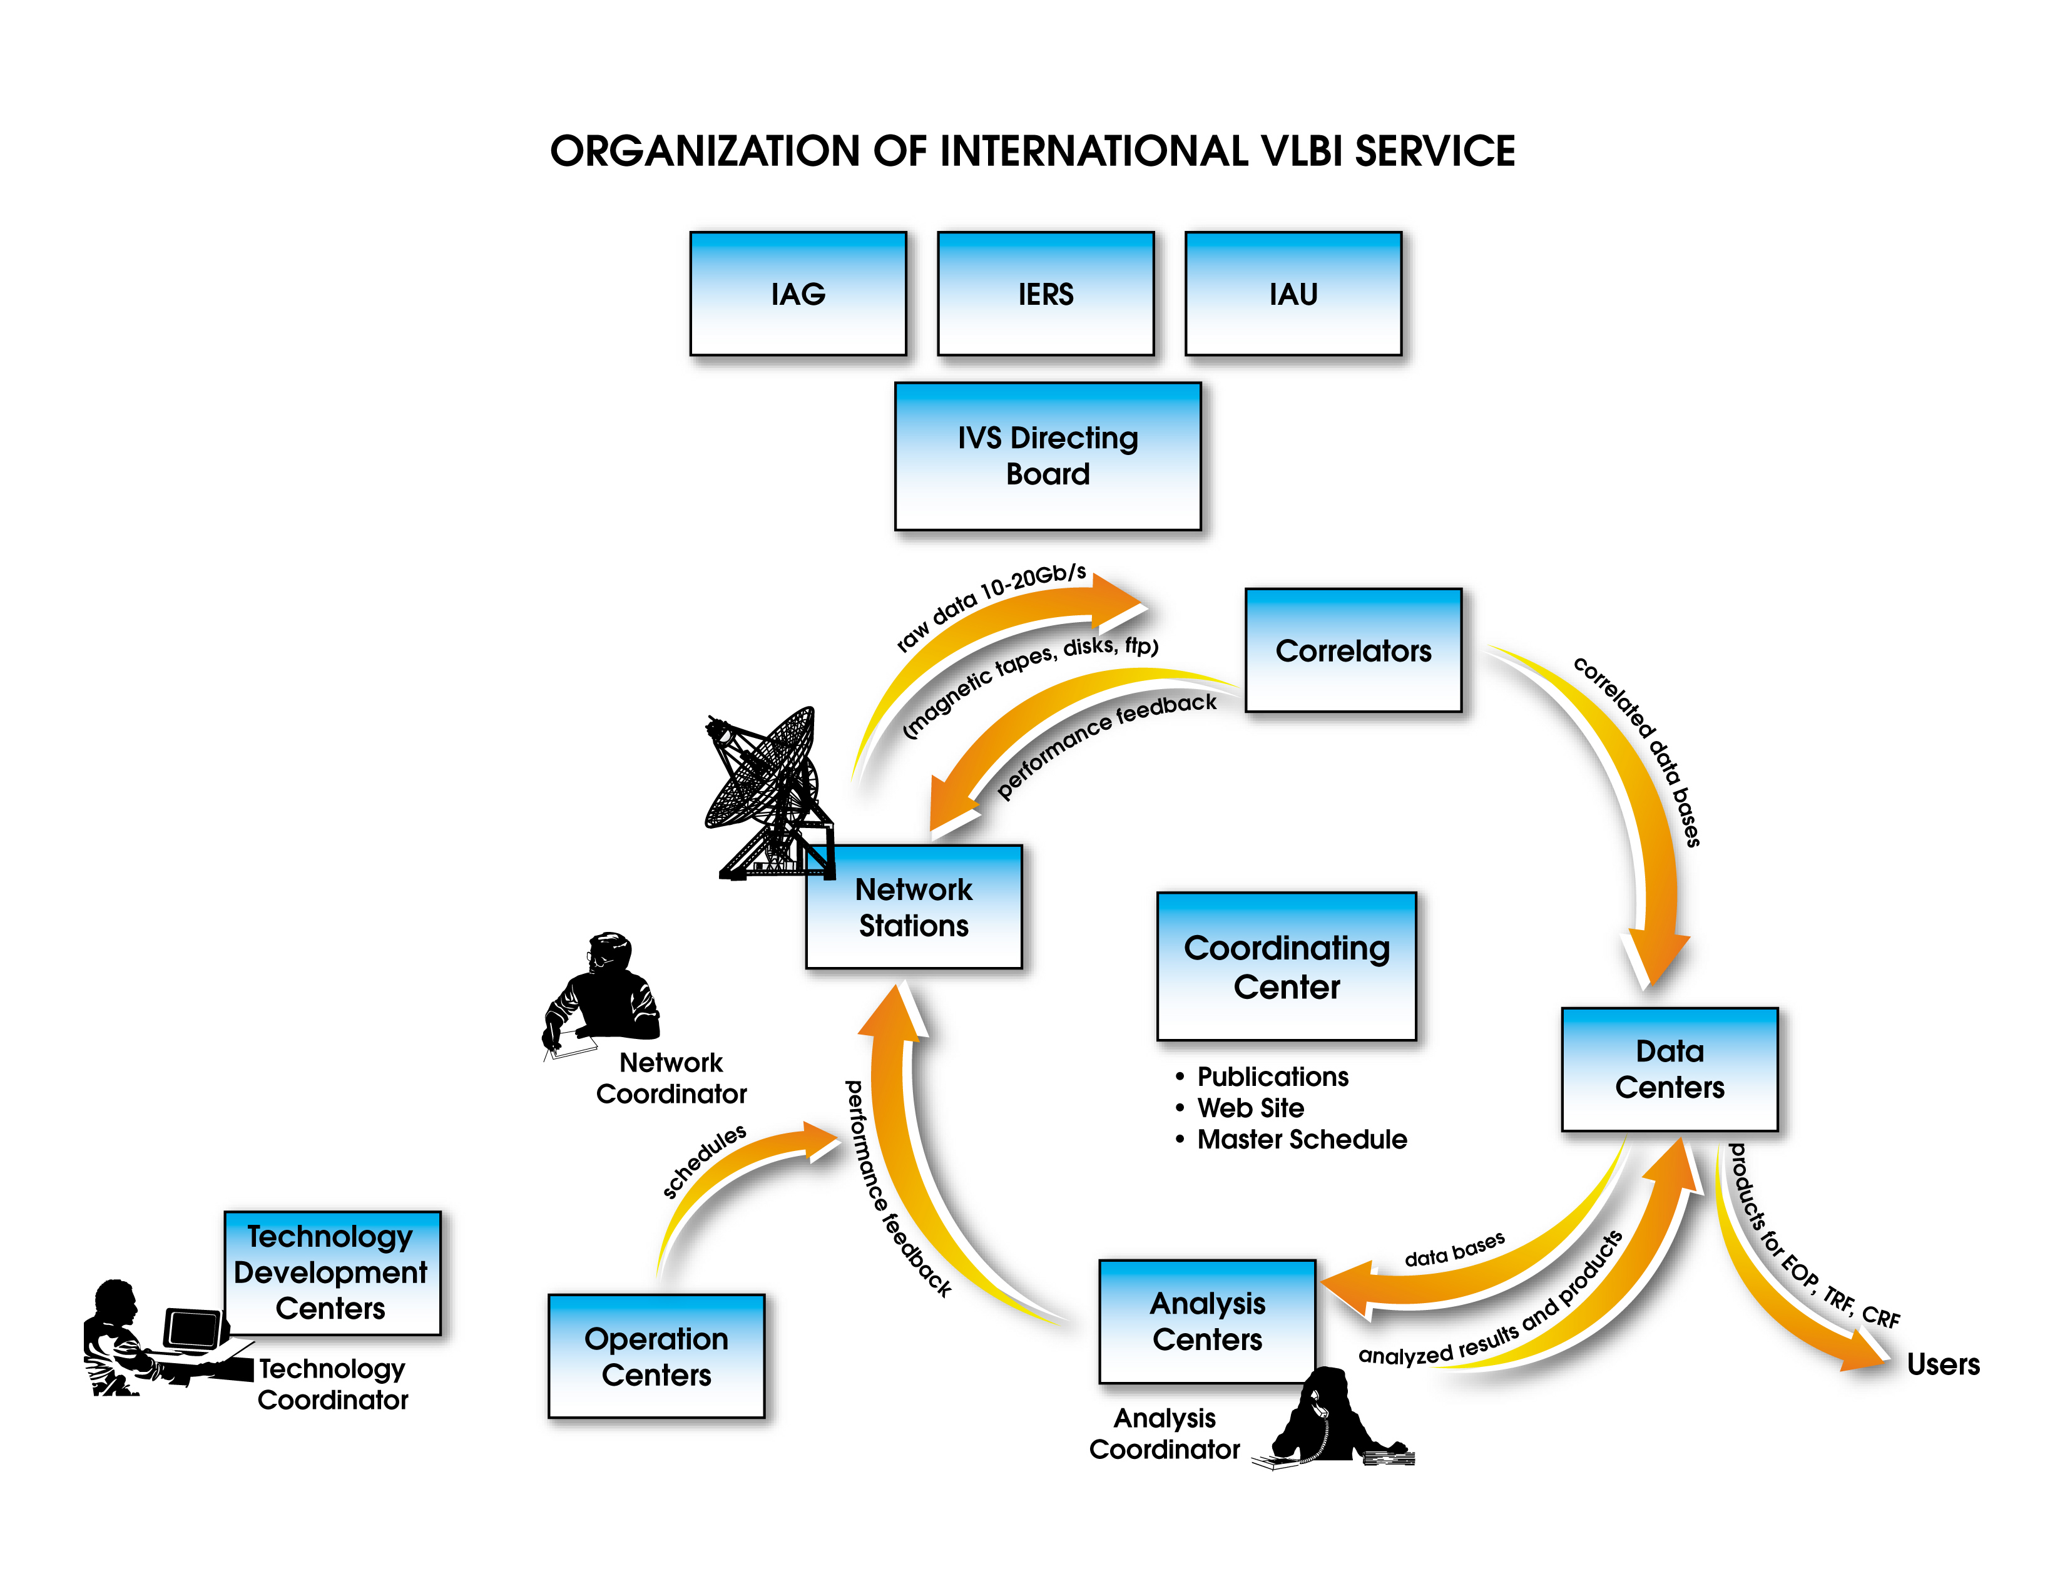
VLBI for Geodesy and Astrometry
The international VLBI network is managed by the International VLBI Service for Geodesy and Astrometry (IVS)
  More than 20 partner countries participate in the IVS
  IVS products include:
    A terrestrial reference frame (TRF)
    An International Celestial Reference Frame (ICRF)
    Earth Orientation Parameters (EOPs)

Slide 6
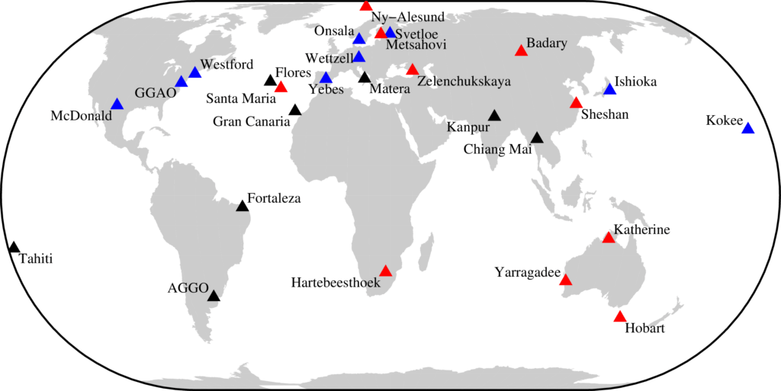
Next generation global VLBI network
VLBI Global Observing System (VGOS)
https://ggos.org/item/ivs/

Slide 7
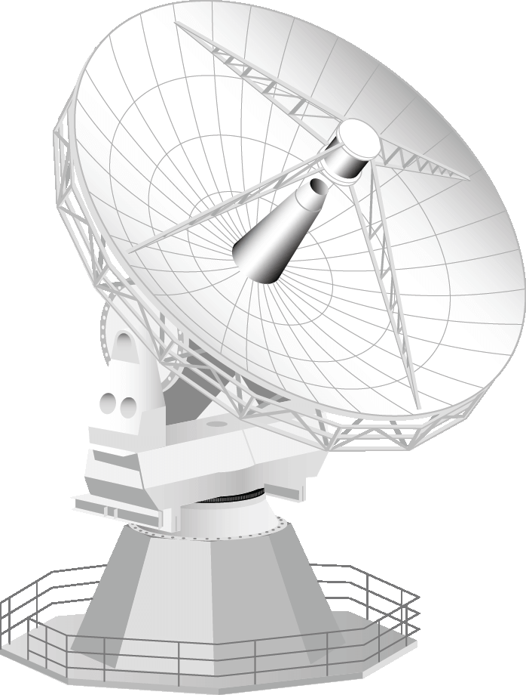
VGOS
12-meter class telescopes
Wide bandwidth, 4 x 1 GHz bands across 2.5 to 14 GHz
Fast slew capabilities, >360 deg/min
Increase in sensitivity over Legacy system, 8, 16, 32 Gbps recording rate and <2500 Jy SEFD
Current Status: Fledging network of ~8 stations online and observing!
https://ggos.org/item/ivs/

Slide 8
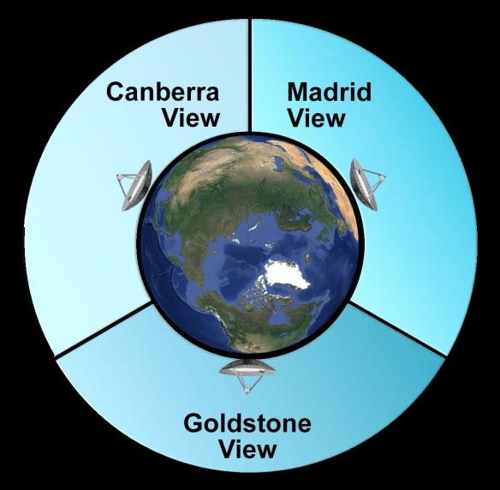
NASA Deep Space Network (DSN)
34-meter and 70-meter class radio telescopes separated by ~120°
Primary Objective: support spacecraft operations and research in deep space
Inception: 1960’s
Discrete frequency bands from 1.6 – 26 GHz
34-meter antennas used for S-/X-band CRF observations

Slide 9
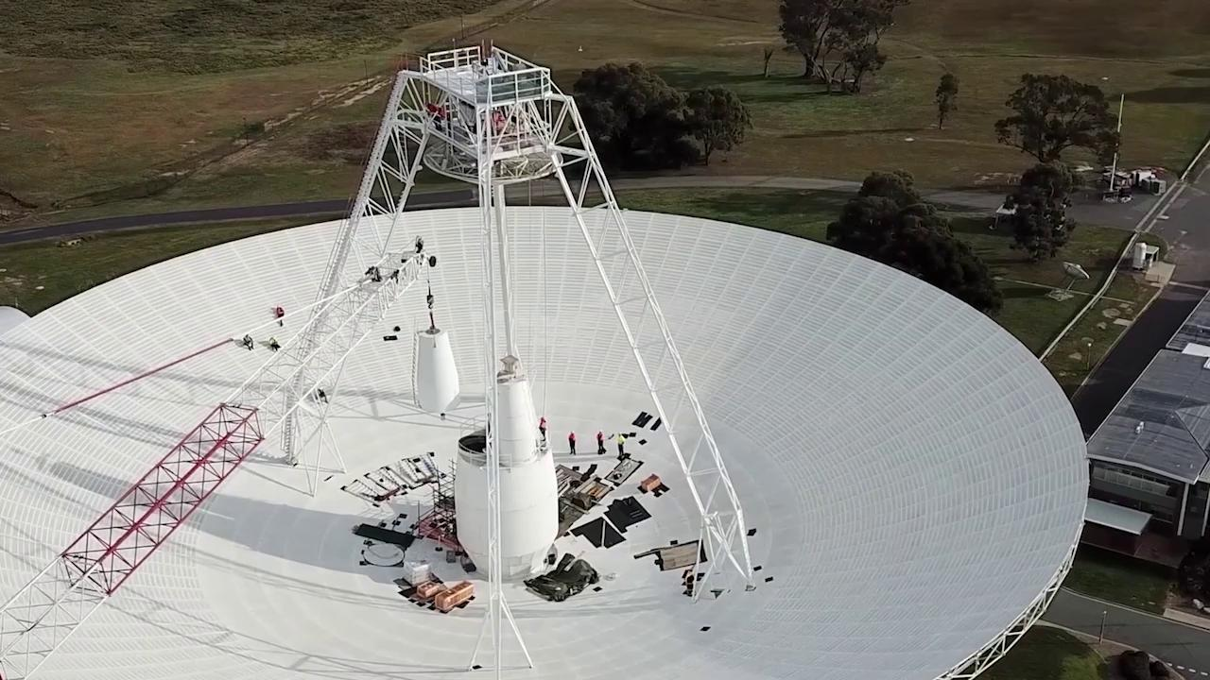
DSN and Voyager Spacecrafts
Tidbinbilla gets an upgrade!
Only radio telescope able to send commands to Voyager 2
Voyager 2 is now more than 11.8 billion miles, 127.27 AU from Earth
Notes:
Lost communication with Voyager 2 for 8 months due to upgrade; back online and receiving data from spacecraft.

Slide 10
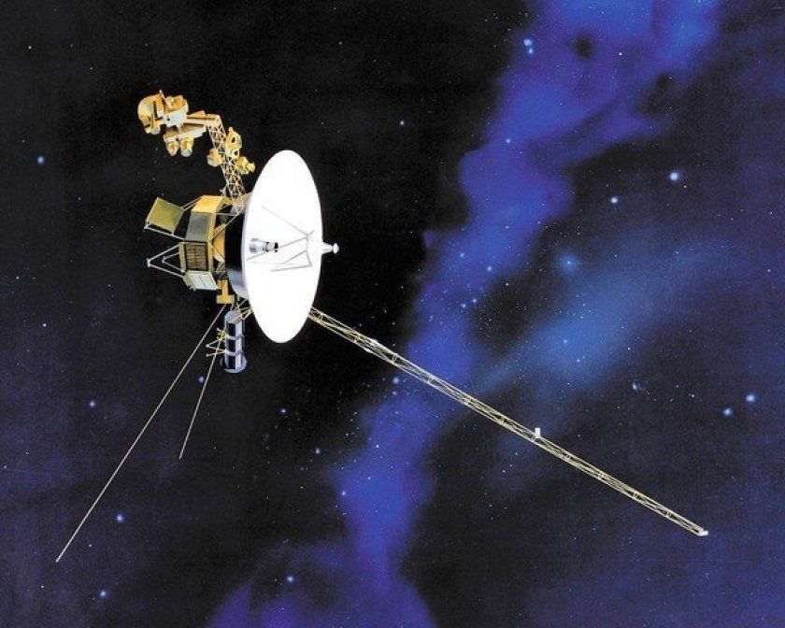
Voyager 1 & 2
Launched in 1977
Two different trajectories with different missions
Voyager 1: sent on trajectory to go to Jupiter and Saturn first, then sent on trajectory out of the solar system
Voyager 2: only mission to flyby all 4 gaseous planets in close range Jupiter, Saturn, Uranus, and Neptune

Slide 11
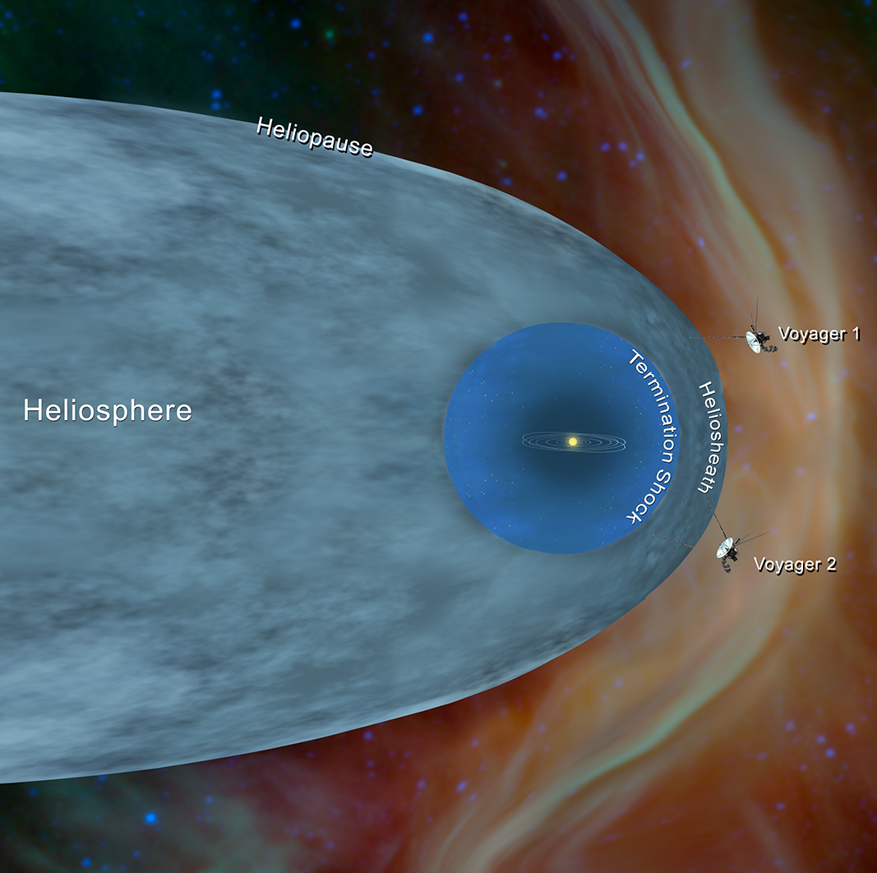
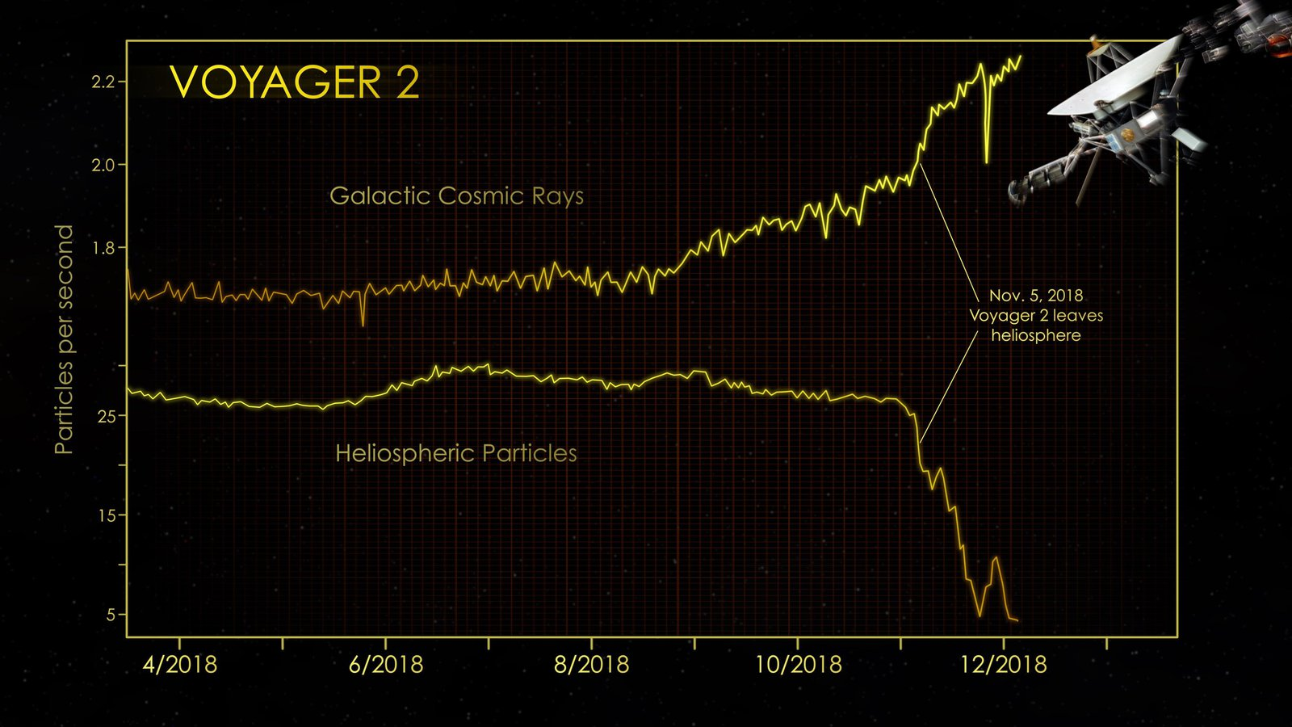
DSN and Voyager Spacecrafts
Notes:
An observation by Voyager 2's magnetic field instrument confirms a surprising result from Voyager 1: The magnetic field in the region just beyond the heliopause is parallel to the magnetic field inside the heliosphere.

Slide 12
Summary
VLBI used for supporting Celestial Reference Frame, Terrestrial Reference Frame and Earth Orientation Parameters
Legacy S-/X-band system aging and entire world working together on upgraded, next generation network, VGOS
VGOS system in fledging stage, but coming online and taking data!
NASA’s DSN is used for both radio astrometry and geodesy AND support of spacecraft operations
Voyager 2 still transmits data after 44 years and is now outside the solar system!

