Slide 1
The Role of IRAM in Millimeter Astronomy: An Historical Perspective
Pierre Cox
(ESO/ALMA)
XXXII International Union of Radio Science
August 19-26, 2017
Montreal, Canada

Slide 2
Early Days in 1970’s
In Germany, the MPIfR was created in 1966 primarily to build the Effelsberg 100-meter telescope, which was successfully commissioned in 1972. Peter Mezger came back from NRAO to become one of the MPIfR directors in 1970 to create the division of Millimeter Technology, and proposed to build a 30-meter telescope working at high frequencies (up to 1mm) to be located at a favorable site in Europe.
In France, parallel discussions lead by J.-E. Blum, J. Lequeux and P. Encrenaz to explore the possibilities of an interferometer operating at millimeter wavelengths continuing the experience gained at the Nançay observatory (working at cm wavelengths) and the strong interest in millimeter astronomy (Caltech & Bell Labs). Leading to the POM 1 & 2 antennas with the ‘Bordeaux interferometer’ and then POM2 on the Plateau de Bure

Slide 3
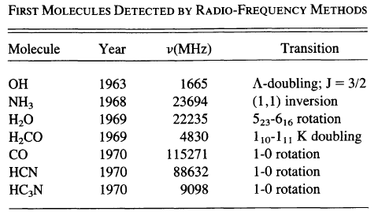
Context in the1970’s
Discussions and studies were triggered by natural technical developments based on successful, complementary facilities, progress in detection of mm-wave signals as well as on-going scientific results that demonstrated the need to explore the millimeter wavelength windows.
In particular, detection of molecules at radio frequencies, study of compact HII regions and radio emission of quasars/galaxies.

Slide 4
Towards the Creation of IRAM
In 1973, a joint proposal written by P. Mezger, D. Downes, J.-E. Blum and J. Lequeux, lead to the creation of ‘SAGMA’ suggesting the establishment of a French-German astronomy observatory with a single-dish of 30-meter diameter and an interferometer of 5x10-m dishes
Search for sites suitable for high frequency (1mm) observations: Pico Veleta (Spain) and Plateau de Bure (France) were considered.
Contacts with the Spanish IGN and authorities.
Discussions with the UK failed, who went along to build the JCMT.
Difficulties emerged on agreeing on the site selection.
International Committee (P. Wild, B. Burke, and K. Kellerman) in 1975
The Pico Veleta site is too unique not to build the single antenna there, but it restricts the array to an unacceptable small size; the Plateau de Bure provides an ideal location for the array and should be chosen for this instrument.
We propose to establish an independent Joint Institute with scientific, technical and administrative divisions in Grenoble, which is at a relatively short distance from the array.

Slide 5
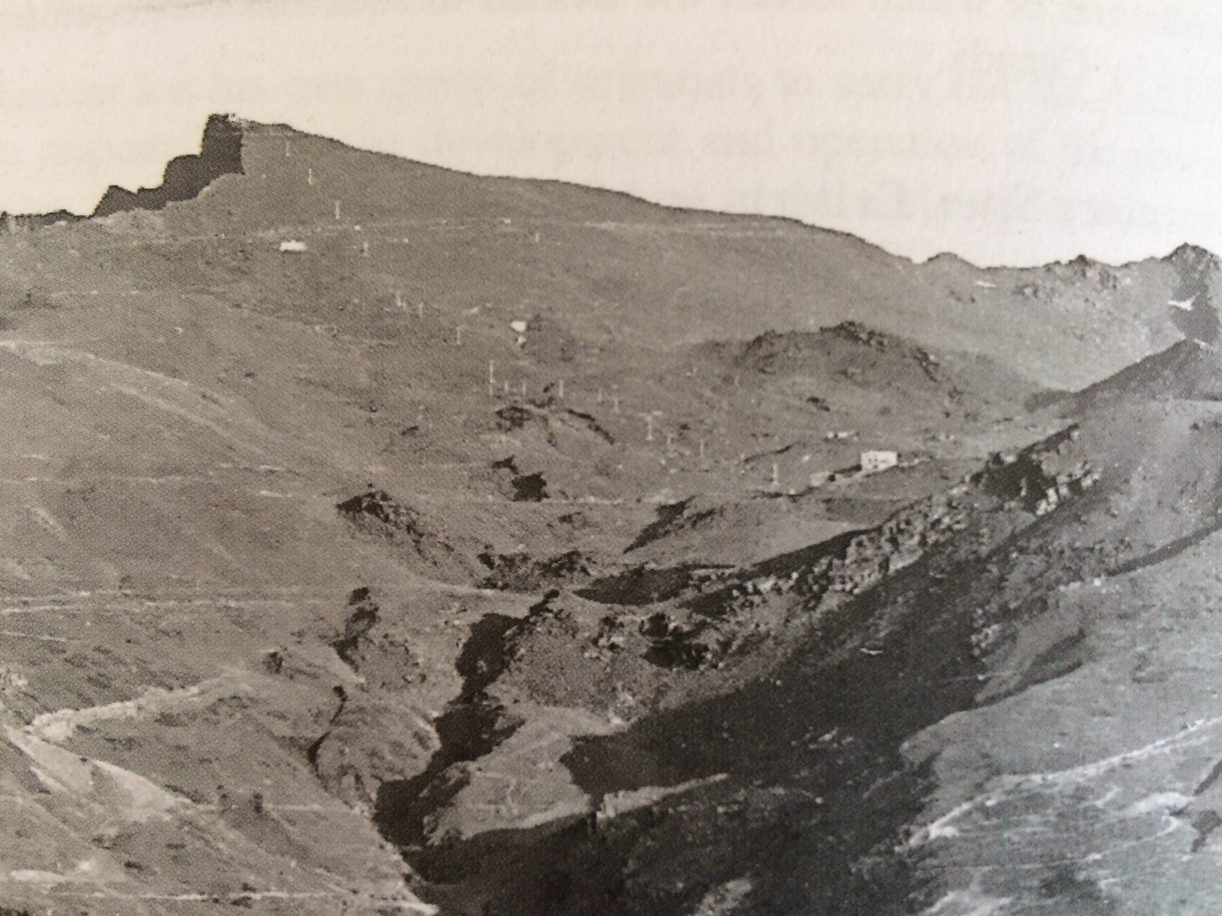
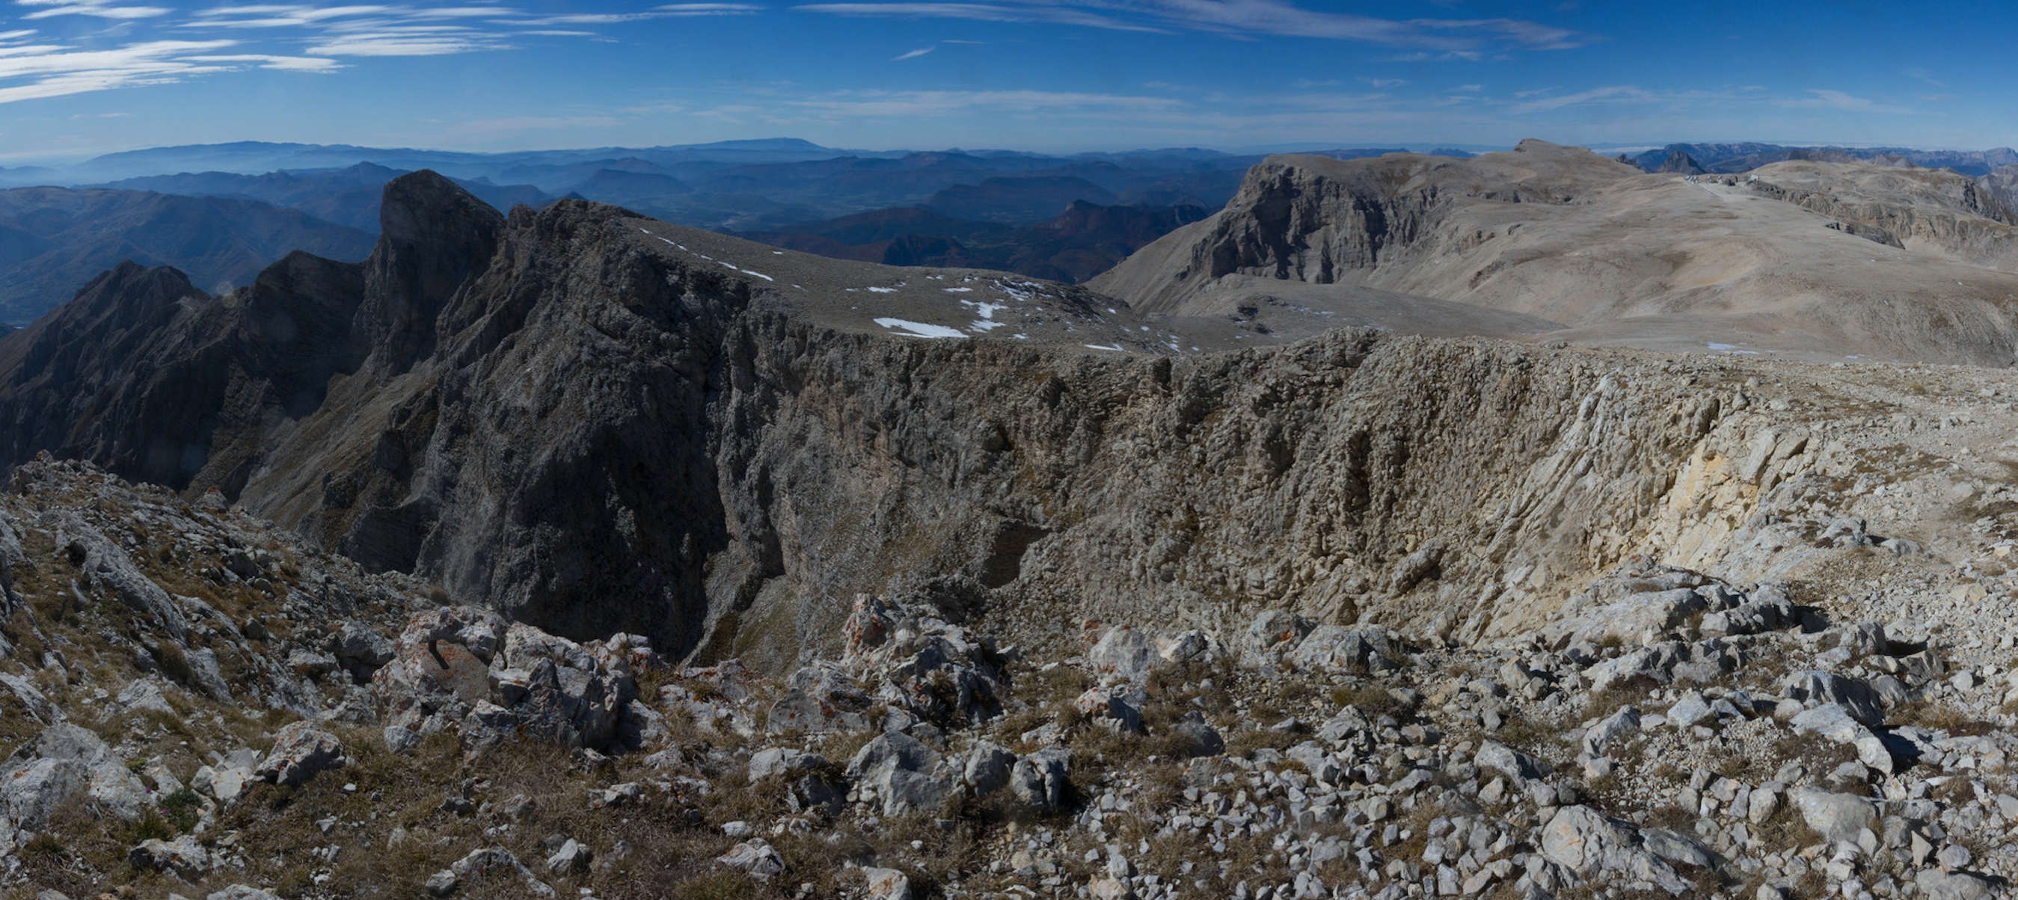
The Two Sites
Pico Veleta (Spain)
1975 @J. W.M. Baars
Plateau de Bure (France)

Slide 6
The Creation of IRAM
Further discussions to produce an organizational plan and budget estimate as well as with the Spanish authorities and IGN to build the 30-meter near Pico Veleta
Proposal for the Joint Institute for Millimeter Astronomy (JIMA) was issued on June 8, 1977 with recommendations regarding “the willingness of the MPG and CNRS to realize the project, nominate a provisional Administrative Council, set up a project office with an experienced project manager, continue preparatory activities, intensify contacts with Spanish authorities for Spanish participation and building at Pico Veleta and secure needed support for the development of the Plateau de Bure”.
The agreement between France, Germany was finally signed on April 2, 1979 and the name IRAM chosen.
Spain joined and signed the agreement in the fall of 1990. → go-ahead for the construction of the 4th PdBI antenna.
Since then four decades of continuous success.
It is interesting to remember that 20 years ago there was still much discussion if there would be small enough structures to resolve with a 1 km interferometer of if large dishes were better suited to study the ISM. This finally resulted in the creation of IRAM, a sort of forced marriage of a dish and an interferometer which has been remarkably successful. (L. Woltjer, 1996)

Slide 7
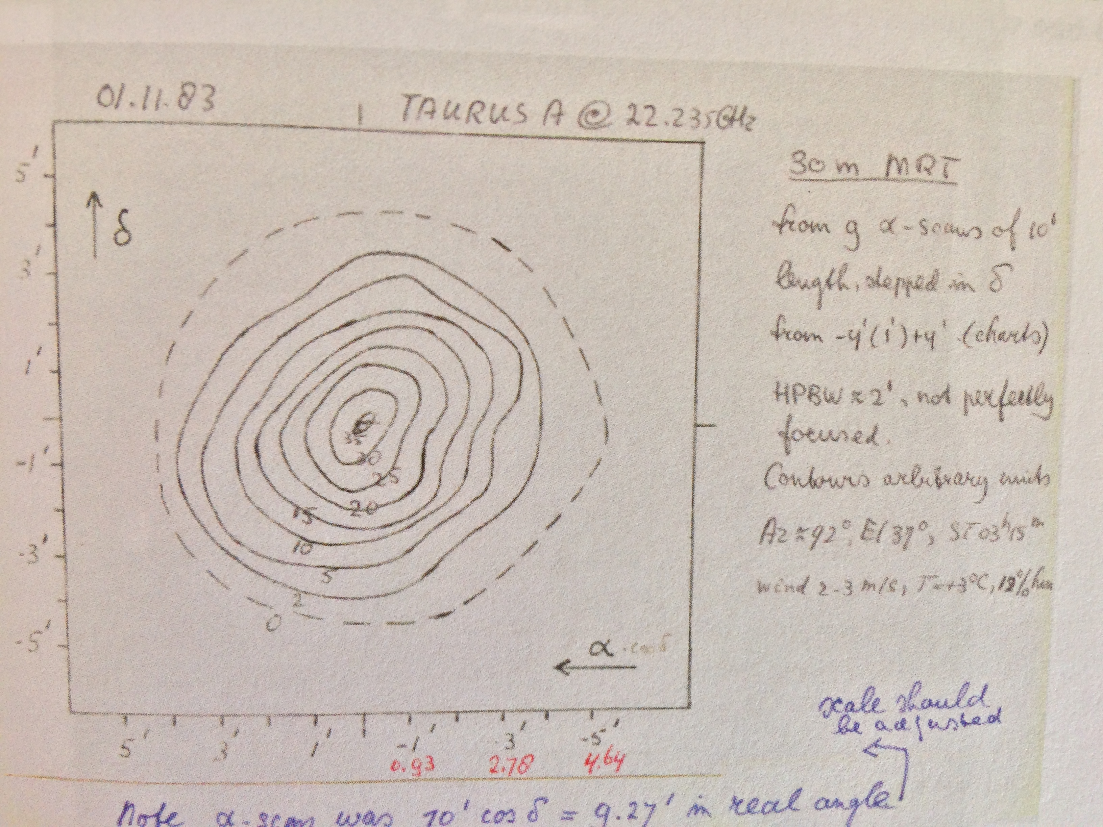
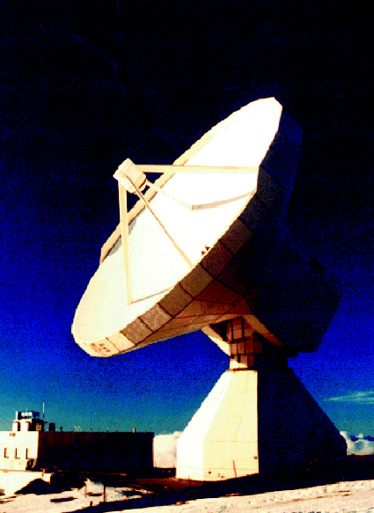
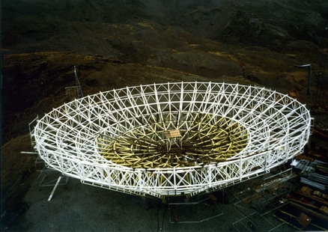
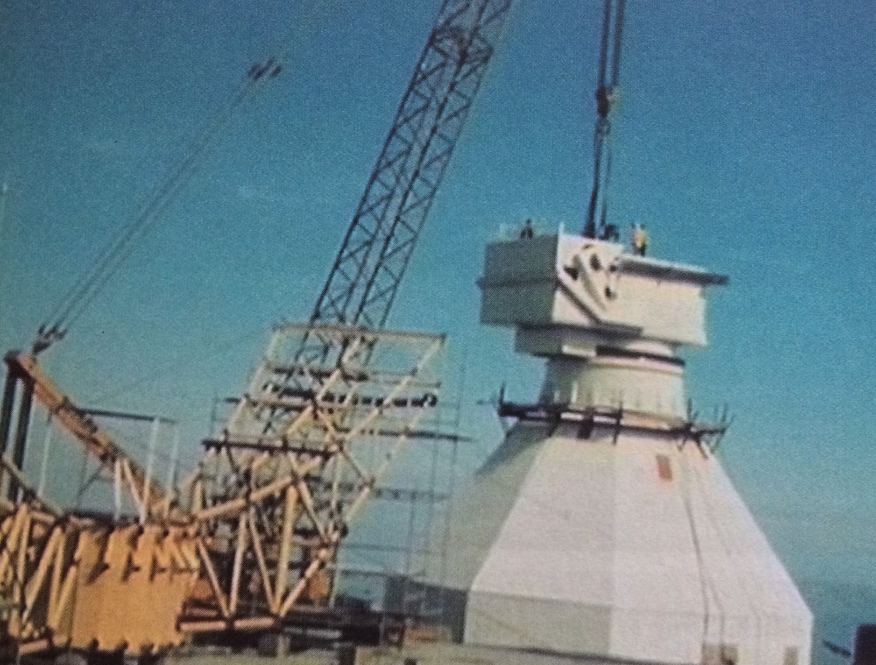
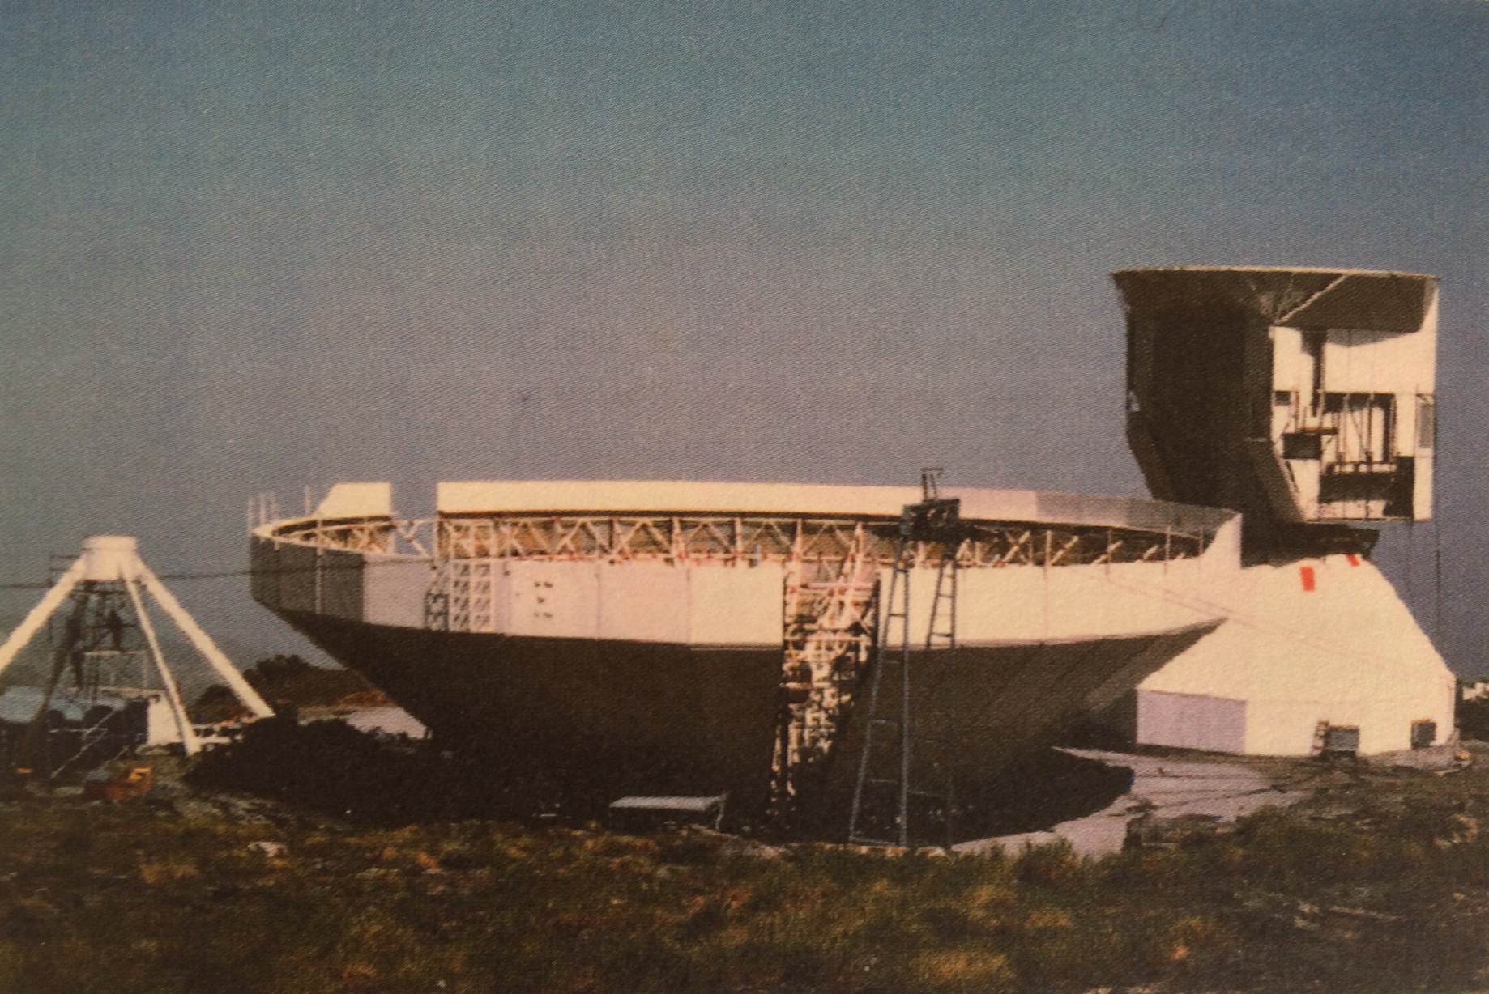
Construction and First Observations: 30-meter
Construction timeline:
Construction contract (MAN & Krupp) April 1979
Mid-1981: all parts at the site
Assembly completed on Nov. 19 1982
First astronomical observations in Nov. 1983
Final acceptance on Sep. 20, 1985
Picture credits: J. Baars, MPIfR, D. Downes

Slide 8
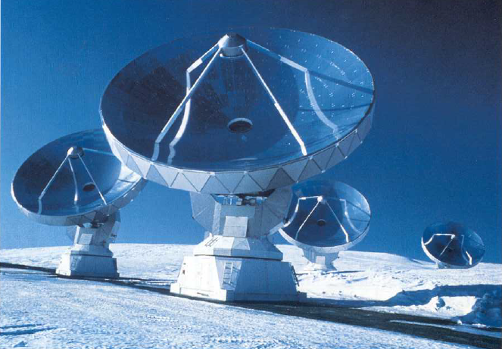
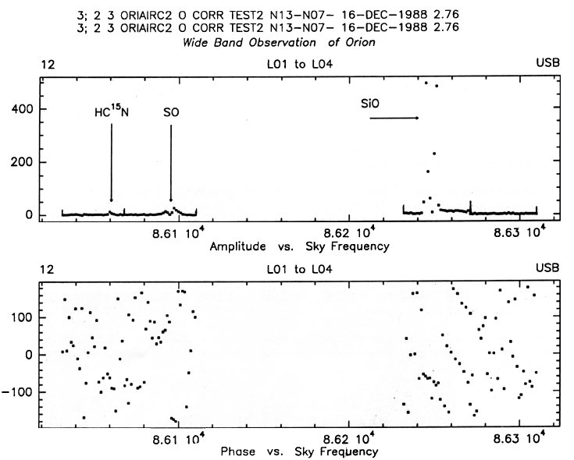
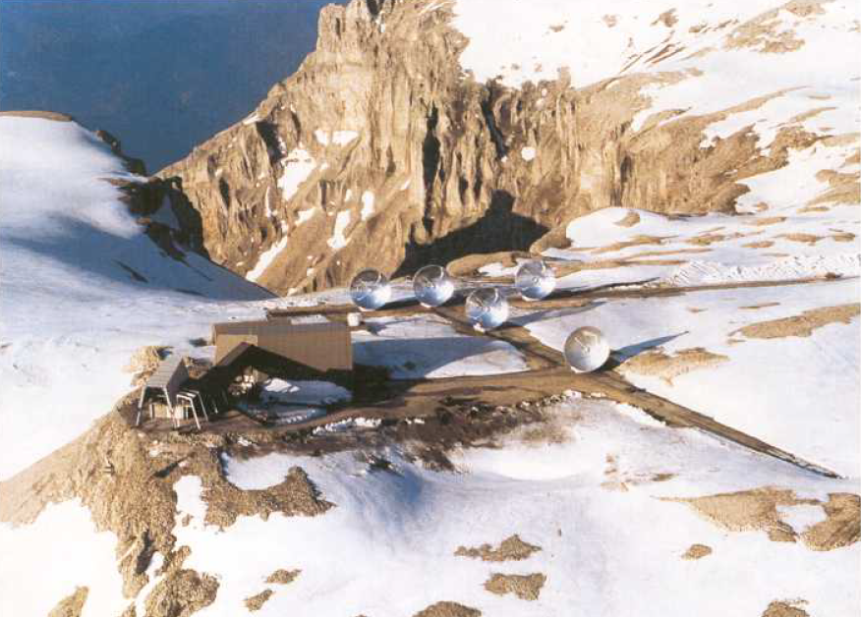
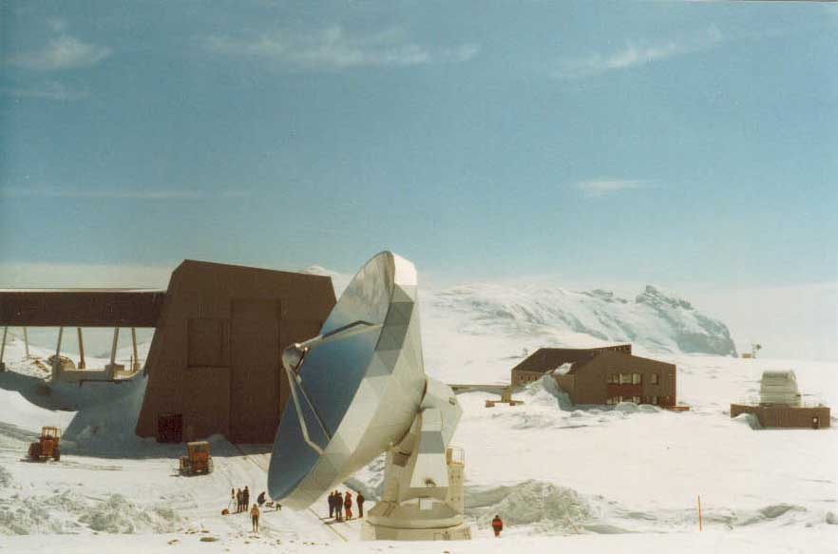
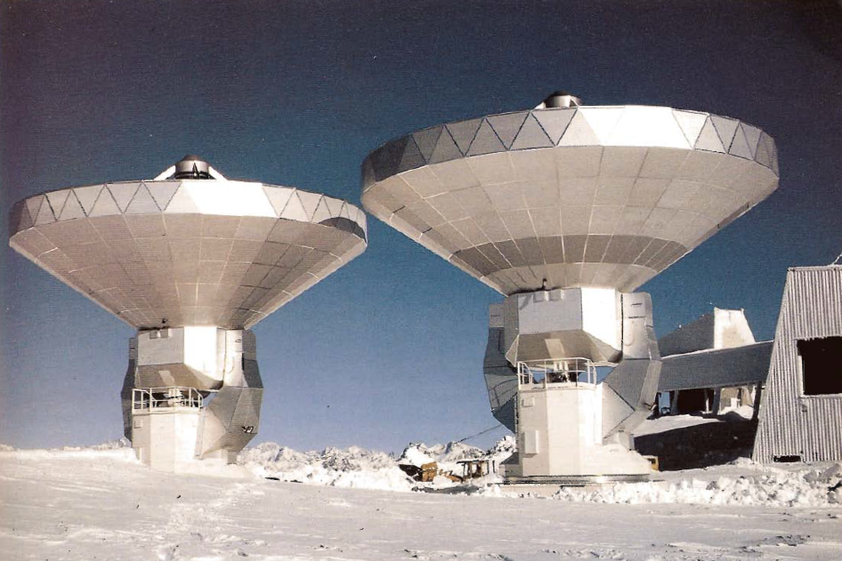
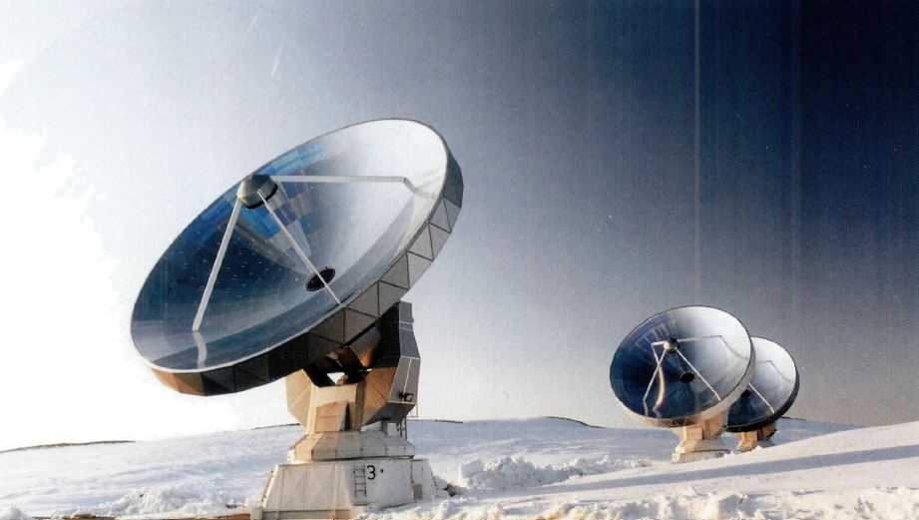
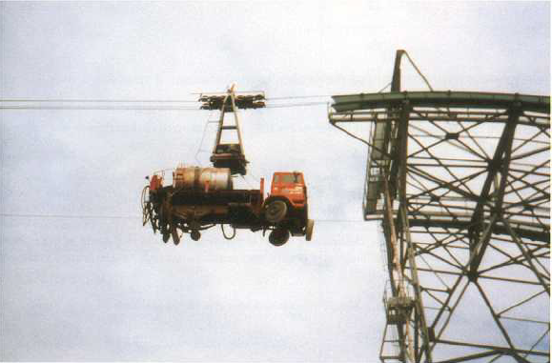
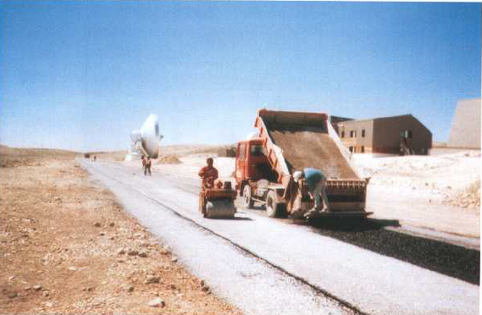
Construction and First Observations: Plateau de Bure Interferometer
Timeline: Design work started in 1979; after the completion of the cable car (only access to the Plateau de Bure), construction began in 1983 and by the fall of 1985 the tracks and hall were completed.
The first antenna was assembled by October 1986 (MAN & Neyrtec)
First fringes with 2 antennas were obtained in Dec. 1988 (48-m); 3 antennas in June 1989
In 1990, both the 30-meter and the PdBI are offered together to the community
Fourth and Fifth antennas 1992 & 1995 / Sixth antenna (Dec. 2001)

Slide 9
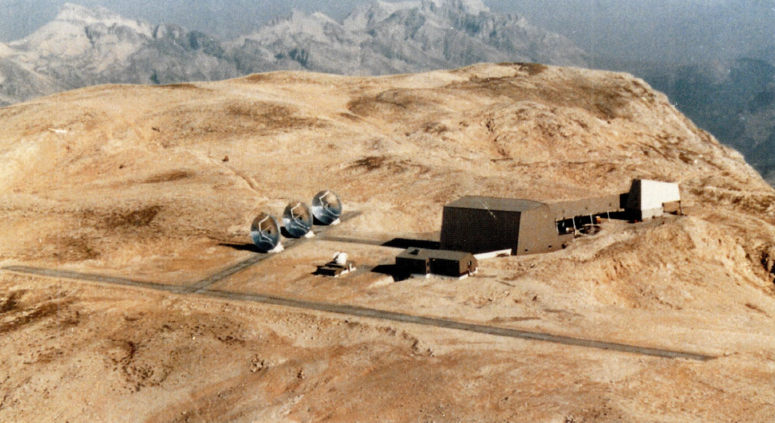
Plateau de Bure Baselines
N
W
160 m
288 m
E
Original Tracks: 160-m NS & 288-m EW

Slide 10
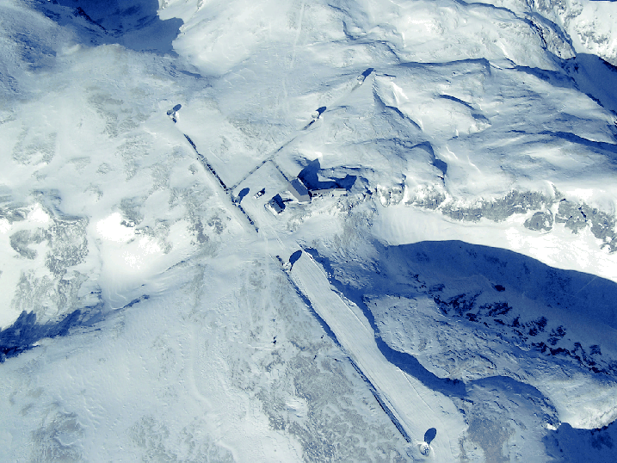
Plateau de Bure Baselines
N46
W27
730 m
760 m
E68
Original Tracks: 160-m NS & 288-m EW
Extension in fall of 2005: 368-m NS (+59%) & 760-m EW (+86%)

Slide 11
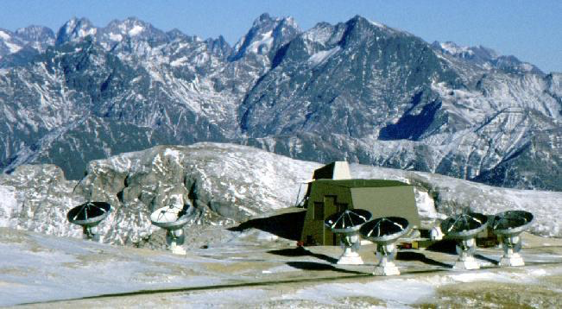
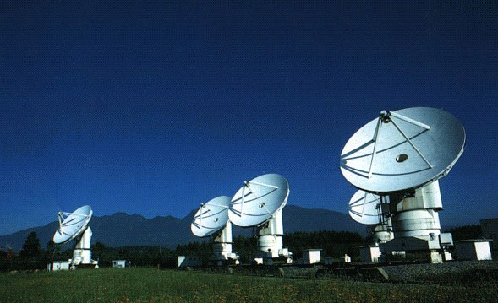
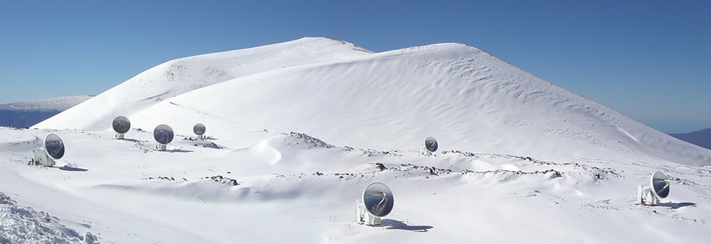
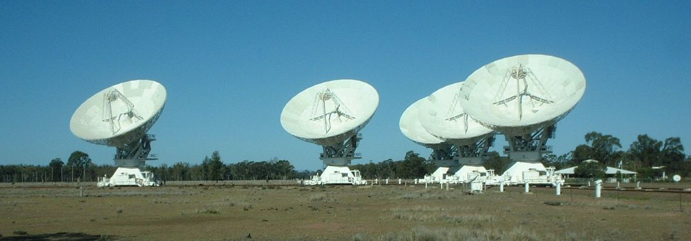
Millimeter/submm Interferometers
PdBI 6 x 15-m
Nobeyama 6 x 10-m
CARMA BIMA + OVRO & 8 x 3.5-m
SMA 8 x 6-m
ATCA 6 x 22-m

Slide 12
Scientific Impact of IRAM Facilities
The scientific results based on IRAM data are very rich, encompassing nearly all the major topics of modern astronomy.
In many cases, pioneering work was performed at both the 30-meter and the PdBI where, at the beginning, ‘proof of concept’ work was done, leading to discovery paths.
Major advances were achieved in the fields of star formation, protostellar disks, astrochemistry, evolved stars, galaxies and high-z objects.
The relatively late, though very successful, introduction of Large Programs in the late 2000’s lead to major projects that have had lasting legacy value (e.g., ‘Galaxy Formation History’ or ‘M51’)

Slide 13
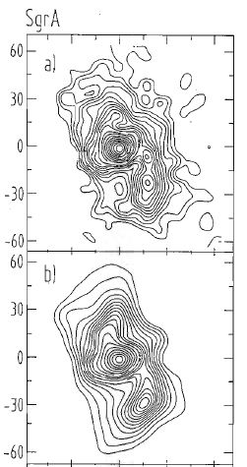
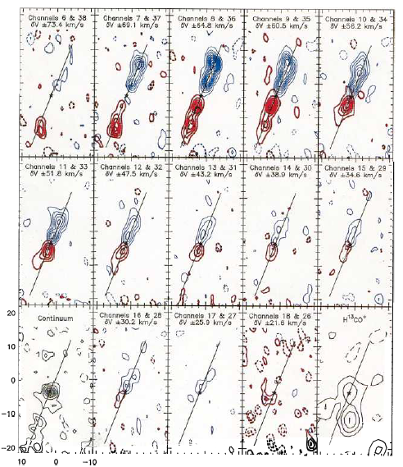
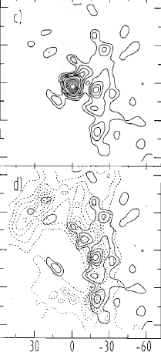
Scientific Results Using IRAM Facilities
L1448 in SiO and H¹³CO⁺
1.3 mm
(a-b)
2 cm
HCN(1-0)
Mezger et al. 1987
Guilloteau et al. 1990

Slide 14
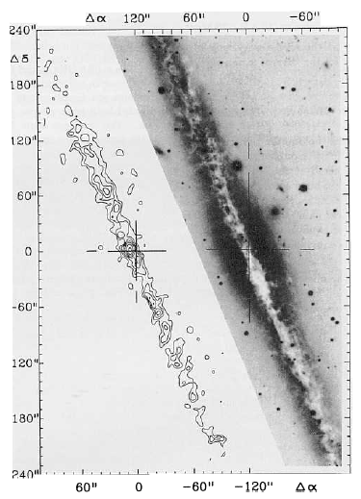
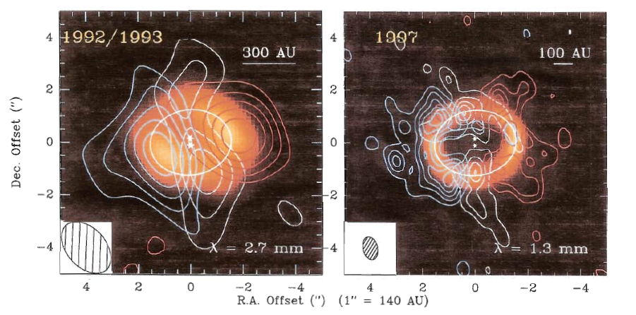
NGC891 in the 1.3 continuum
GGTau
Dutrey et al. 1998
Guélin et al. 1993

Slide 15
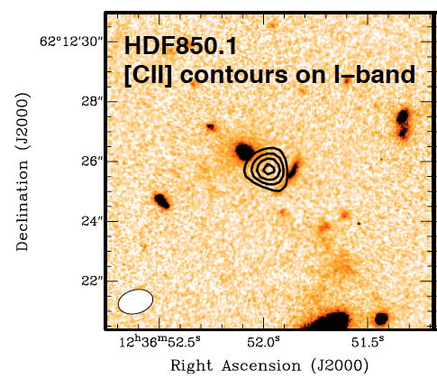
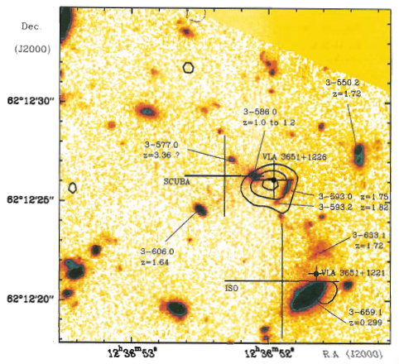
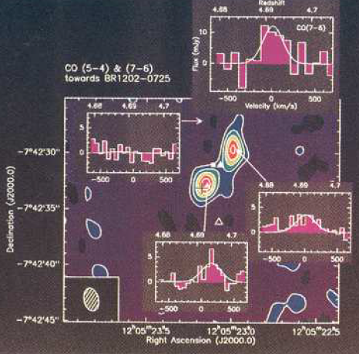
HDF850.1 at 1.3 continuum with PdBI
Identification: z=5.2 galaxy
BR1202-0725 at z=4.7
Downes et al. 1999 / Walter et al. 2012
Omont et al. 1995

Slide 16
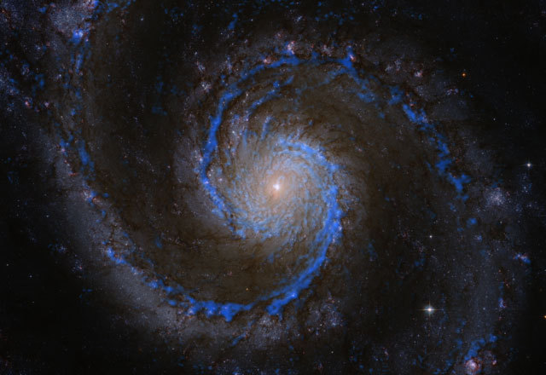

Slide 17
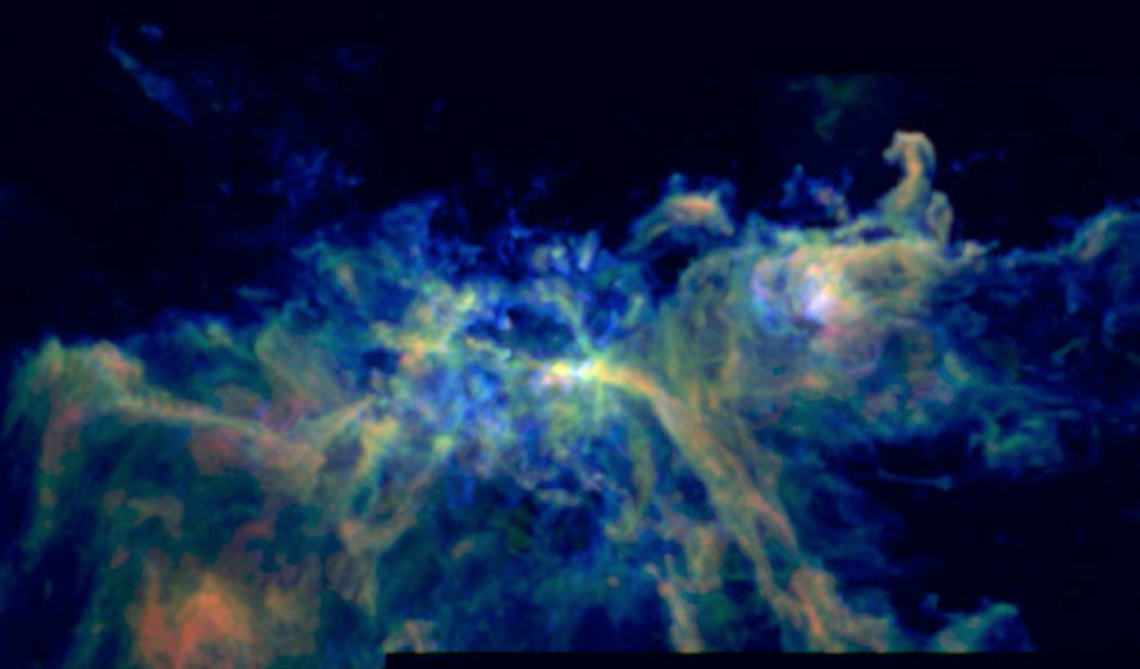

Slide 18
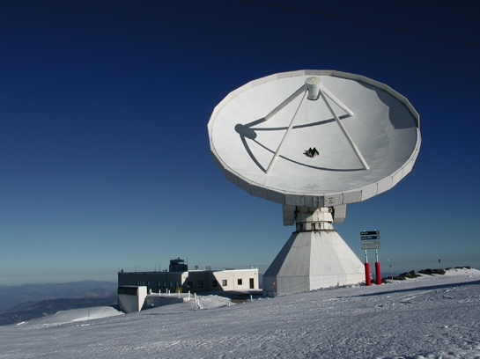
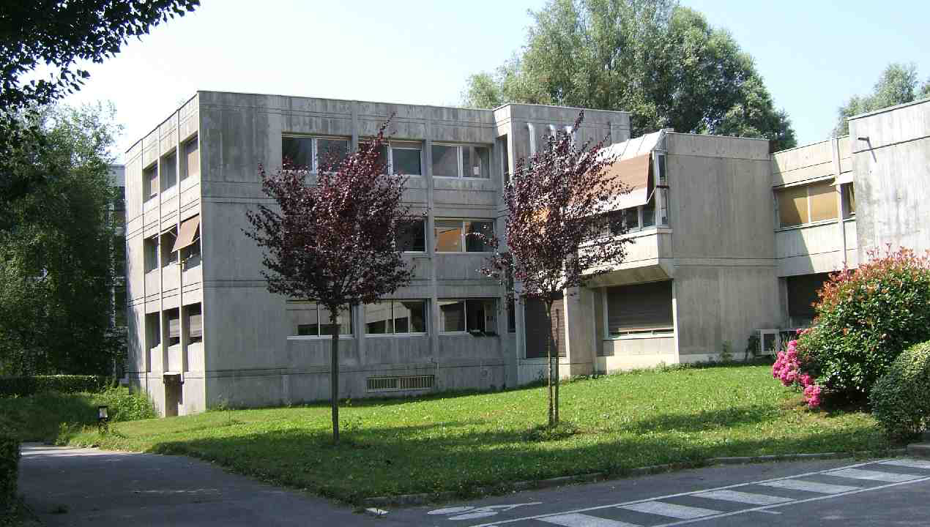
Comments on the IRAM Organization
Plateau de Bure
Grenoble
Granada/Pico Veleta
Unique synergy between single-dish (30-m) and interferometer (15-m)
Center of technological expertise in mm-wavelengths: receivers (junctions), correlators, and software
Top-level staff covering all aspects from technology to science
Strong partnership between MPG, CNRS & IGN
Clarity in governance: IRAM is a legal (French) entity; the Director has both authority and responsibility; decision-making process is well-defined
Stability, e.g., since creation four directors (Peter de Jonge, Michael Grewing, Pierre Cox and Karl-Friedrich Schuster)
Multi-year budget covering yearly operations as well as in-house developments; forward-looking planning resulting, since the beginning of IRAM, in gradual and sustained increases of the facilities’ capabilities (efficiency, sensitivity…)

Slide 19
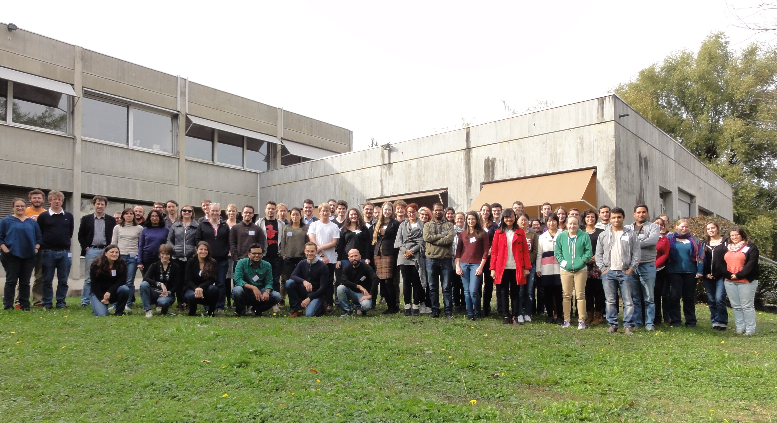
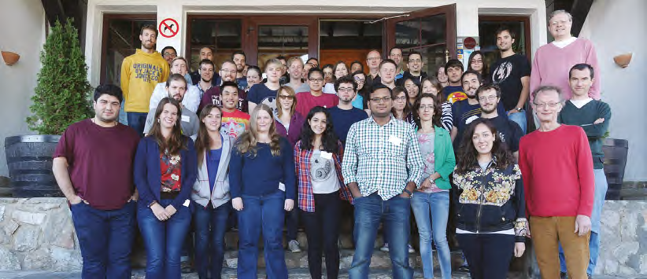
Impact of IRAM on the Community
Since the beginning strong synergy with and support from the science community, e.g., creation of the ‘Groupe d’Astrophysique’ at the Grenoble University → Observatoire des Sciences de l’Univers
Building of the Spanish radio-astronomy community
Structured a strong millimeter-astronomy community within Europe (Italy, Sweden, The Netherlands, UK) and major role in RadioNet (cf. Horizon 2020)
Interaction with the users at the telescopes and, for the interferometer, for data reduction in Grenoble
Through regular schools, alternating single-dish & interferometry, IRAM contributed to form and stimulate the interest of generations of new radio-astronomers worldwide
Open-sky policy (15%) leading to many successful international collaborations over the years
Preparedness of the European community for using ALMA and synergies with other key facilities
IRAM 8th 30-meter summer school (2015)
IRAM 9th interferometer summer school (2016)

Slide 20
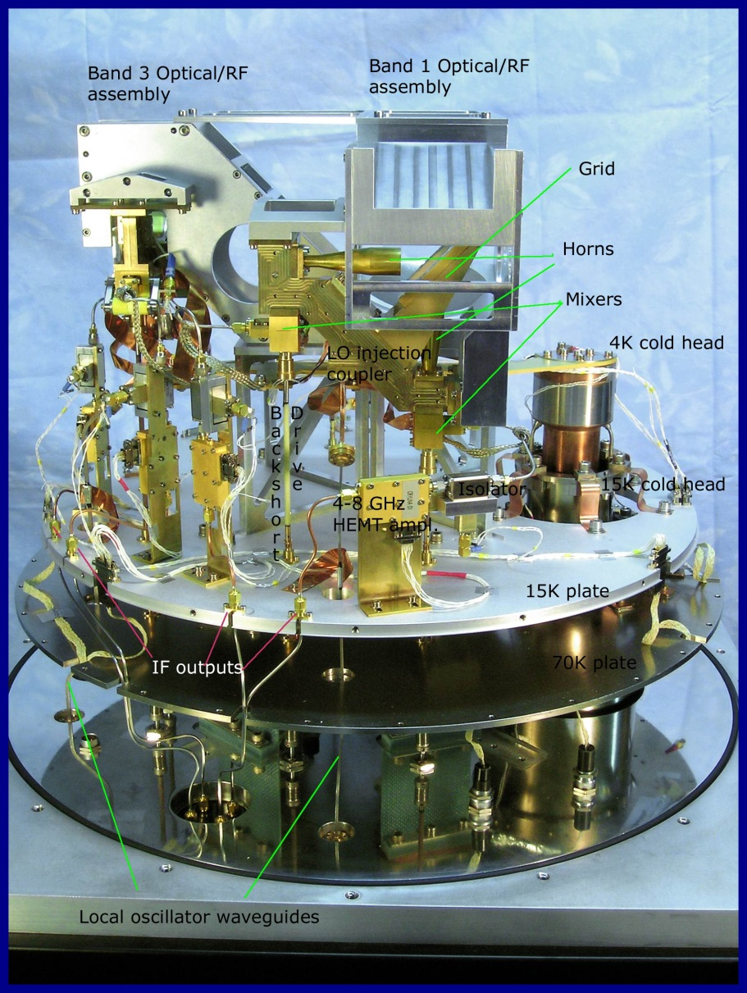
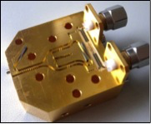
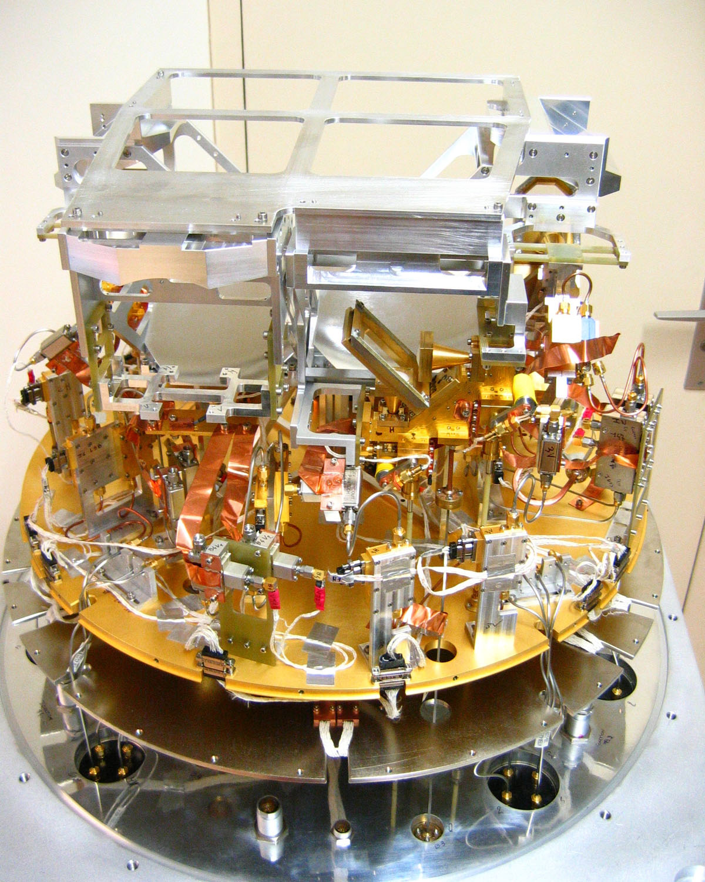
Technological Developments at IRAM
30-meter EMIR (Eight Mixer Receiver)
Dual-pol 4GHz mixers @3, 2, 1.3 & 0.9 mm
NOEMA Band 2 SIS mixer
NOEMA Front-End
Frontend Group has developed and maintained cryogenic superconducting mm heterodyne receivers covering today g ~70 to 270 GHz for the IRAM facilities.
All aspects of mm-technology from design to manufacturing are covered:
Optics; SIS waveguide mixers and couplers
Cryostats, LO system and distribution, IF amplification and filtering; Monitoring and control electronics
Successful record in the development of low-noise wideband receivers (multi-band and multi-beam)
Backend Group has conceived and developed state-of-the-art correlators and electronic devices for both IRAM’s telescopes, continually providing faster and more powerful equipment.
Mechanical Workshop and Computer Group
Environment where a strong coupling exists between technological R&D, response to new technical possibilities and relatively quick implementation on the facilities

Slide 21
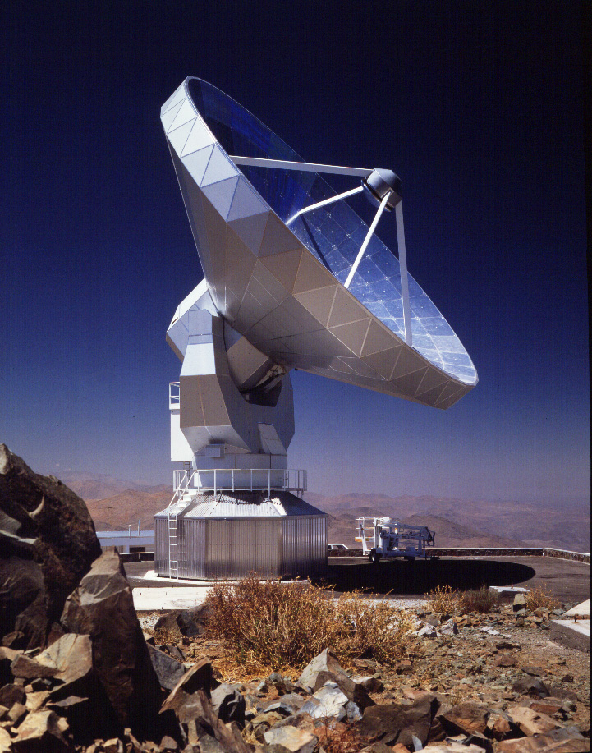
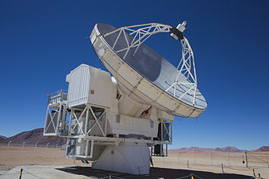
Role of IRAM in New Sub/mm Facilities (1)
With expertise & experience gained at Onsala 20-m telescope, initiative taken by R. Booth in 1984 to build a southern sub/millimeter telescope.
Taking advantage of the on-going construction of the six 15-m dishes at PdBI, most effective to build a modified extra one. This lead to the Swedish ESO Submm Telescope (SEST) located on La Silla (1987) as well as the first steps of ESO into radio-astronomy.
“Initially there was some concerns in the ESO Council about ESO going into radio astronomy. But after I pointed out that radio waves below 1 mm could be considered part of the infrared, there was no further problems.” (L. Woltjer)
SEST 15-m
APEX 12-m

Slide 22
Role of IRAM in New Sub/mm Facilities (2)
In the early 1990’s, the PdBI, amongst others, had shown the power of millimeter interferometry and time was appropriate to reflect on next step.
Many structures observable at millimeter wavelengths were found to be quite small in angular size (<1”). Also progress in the study of (x10 amplified) high-z galaxies indicated that to observe ‘normal’ galaxies in the early universe higher sensitivities were critical.
A larger collecting area and longer baselines (sub-arc) were therefore needed.
It became also clear that a southern site was preferred because of the greater richness of the southern galaxy and skies, and, for the fact that suitable, dry and extended sites are present in the northern Chile
This lead in Europe to the proposal of a Large Southern Millimeter Array or LSA (D. Downes), a millimeter array optimized for maximum sensitivity at 3 & 1 mm and ultimately covering 7 to 0.3 mm. The collecting area was to be 10,000 m² to ensure the required sensitivity at an angular resolution of 0.01”. The optimal array would consist of 50 x 16-meter (or 100 x 11-meter) antennas.
In parallel, on-going discussions of sub/mm projects in the US (MMA) and Japan (LMA), which lead to the creation of the ALMA project

Slide 23
From PdBI to NOEMA (1)
The tragic cable-car and helicopter accidents in 1999 deeply impacted the community and IRAM with many reverberations in the years to follow
IRAM went through very difficult times and, despite the somber mood, managed to continue operations albeit at a reduced pace and with many delays
Discussions between IRAM & Partners about future & next steps. Possible developments included multi-beam receivers and increasing the number of antennas
Meanwhile the construction of ALMA had started with IRAM actively participating
Many failed attempts to find a stable replacement solution to access the Plateau de Bure, which resulted in growing frustration within the Partners.
One option that was considered was to move the PdBI antennas to the CARMA site (hard-merging) or explore a ‘soft-merging’. My first IRAM Council in 2005!!
Commitment to MPG to rebuild a new cable-car. In return, promise of the Partners to extend the 1979 Agreement, which was expiring in 2009.
Rebuilding the new cable-car took 10 years (inauguration in Oct. 2015)

Slide 24
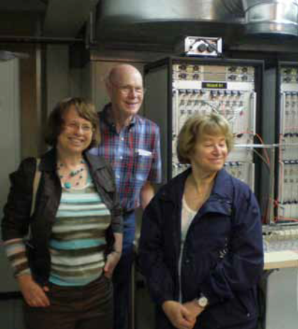
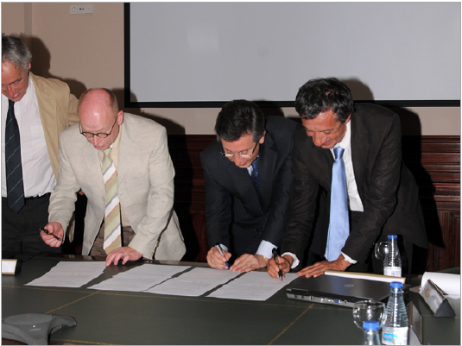
From PdBI to NOEMA (2)
New discussions about future development in consultation with the community and Partners.
Gradually the NOrthern Extended Millimeter Array (NOEMA) project took shape, receiving broader support from the community.
In 2010, a Visiting Committee (chaired by R.W. Wilson with R. Kennicutt, C. McKee, E. van Dishoeck, and C. Cesarsky) endorsed NOEMA and made a strong recommendation to the presidents of the MPG, CNRS and IGN.
In June 2011, a memorandum of understanding was signed between the Partners.
The NOEMA project could start.
Created the framework for increased science capability, enabled to maintain & develop the technical expertise within IRAM and provided the long-term stability for the institute.
Three members of the Visiting Committee at Bure in July 2009: E. van Dishoeck, R. Wilson and C. Cesarsky
IRAM and its Partner organizations sign the
Memorandum of Understanding, June 2011

Slide 25
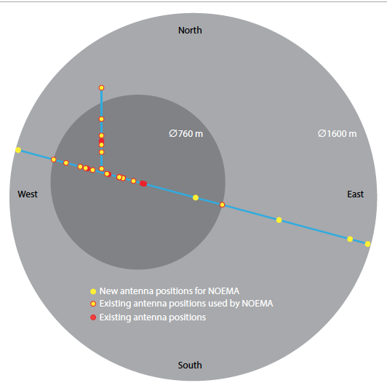
The NOEMA Project
Double the number of 15-m antennas from 6 to 12
New receivers: increase of IF bandwidth from 8 to 16 GHz
New flexible correlator
Extension of the baselines from 0.8 to 1.6 km

Slide 26
pictures of noema 7,8,9
Feb 2015
May 2016
May 2017

Slide 27
New Receivers for NOEMA
Band 1
~ 4-6 hν/k
+4 GHz
+4 GHz
SSB T_{rec} (K) vs Sky Freq (GHz)
Band 2
~ 3-4 hν/k
+4 GHz
+4 GHz
SSB Trec (K) vs Sky Freq (GHz)

Slide 28
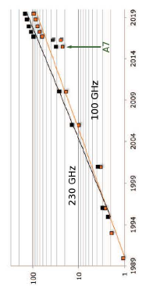
Increase in Sensitivity at IRAM Interferometer
Plateau de Bure
NOEMA
Continuum
Increase in Sensitivity
Year

Slide 29
IRAM Synergies & Future
Provided equipment for other facilities including HIFI on Herschel, SMA, GBT, APEX or the Sardinia Radio Telescope
Prototype and construction of the highly successful ALMA Band 7 cartridges – also positive impact on the internal IRAM organization
Data reduction package (GILDAS) is now used in many observatories
Starting in 1991, IRAM has been part of the mm-VLBI network (first at 3, then at 1-mm), most recently in the Event Horizon Project including ALMA
The outstanding performance of the IRAM facilities also lead to the installation of instruments built elsewhere and with internal participation, in particular, the bolometers at the 30-meter (MAMBO 1 &2, NIKA)
Expertise center in mm-technology, providing a healthy coupling with on-going in-house developments and growth (e.g., NOEMA & 30-meter).
Natural frame for playing a role in future developments at other facilities, including ALMA (e.g., increasing the receivers’ throughput).

Slide 30
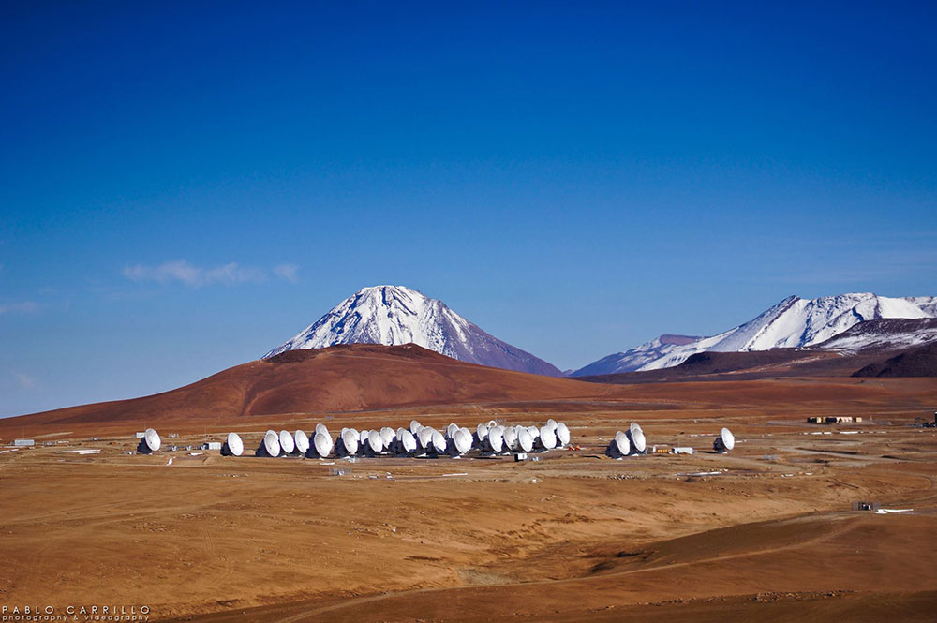
Millimeter/submm Interferometers
NOEMA 9 x 15-m
SMA 8 x 6-m
ATCA 6 x 22-m
ALMA

