Slide 1
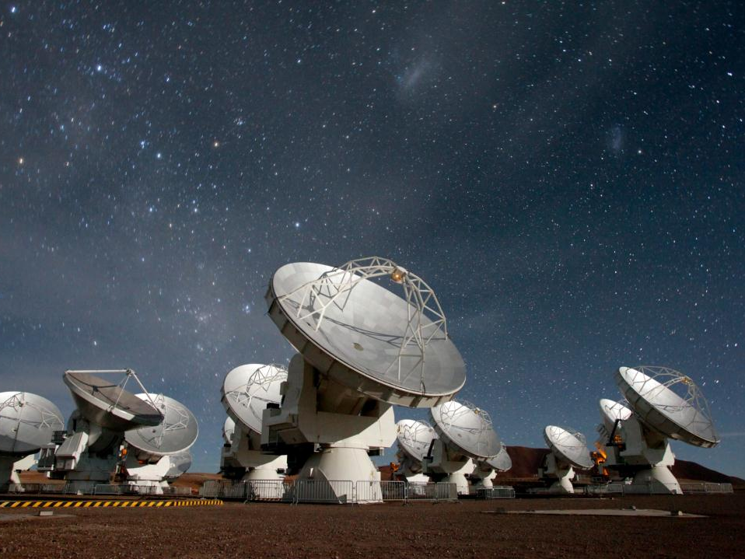
Lessons From ALMA Construction
Tony Beasley/NRAO
Notes:
Good afternoon. My name is Tony Beasley, I’m the director of the US National Radio Astronomy Observatory, N-R-A-O. With funding from the National Science Foundation and support from Associated Universities Incorporated, we build and operate radio telescopes here in the US and around the world for use by researchers. Our headquarters is here in Charlottesville, on campus at the University of Virginia.

Slide 2
This Talk
History of ALMA construction project, reviewing issues & lessons….
Me: VLBA, VLA Ops, MMA/ALMA, CARMA, ALMA, NEON, NRAO. 20 yrs - 75+ reviews astronomy/physics/ocean/ecology, Advisory Boards, etc.
Several other ALMA participants here (with different opinions..).

Slide 3
ALMA
International project to build & operate a large (66-antenna) millimeter/submm (λ ~0.85-3mm) array at high altitude site (5000m) in northern Chile.
Timeline: Project construction began in 2002; first quant. baseline 2003; Japan rejoined in 2004; the global project was redefined/rebaselined in 2005/2006; hardware/software production lines operated for a decade; Operations began 2006; early science ~2010; end of construction project Sept 2015; Full Science Operations ~2016.

Slide 4
ALMA – Major Elements
Partners: US (NSF) & Canada (NRC) – ESO & Spain – Chile – Japan – Taiwan – Korea…
Sites: Array Operations Site – AOS – telescope
Operations Support Facility – OSF – support
Santiago Central Offices – SCO – administration
ALMA Regional Centers – ARCs + ARClets – science
More than $2B spent over ~20 years.

Slide 5
Operations Support Facility (OSF)
Notes:
The OSF is the place where a lot of the day to day maintenance and operation of the array is done, and the international partners have created a joint ALMA observatory organization led by Dr. Pierre Cox to manage the day to day chilean operations of ALMA

Slide 6
Array Operations Site (AOS)
Notes:
Here we see the array operations site.

Slide 7
Array Operations Site (AOS)

Slide 8
In The Beginning…
1970/80s … several mm arrays built; science promise established. National efforts (MMA/LSA)
Late 90’s - growth of ALMA collaboration, joint planning for technical prototype developments.
Separate conceptual designs combined into a preiminary joint reference design. High-level committees set up, funding agencies wheeling and dealing… by a peer group.
Partners: D&D money (~$60M) for design work at ATF, antenna prototypes contracted, site acquisition … all efforts managed separately.

Slide 9
Early 2000s: Science requirements, tech requirements (80% flowdown), WBS, management, antenna prototype efforts underway…
Feb 2003 – Bilateral (without Japan) project defined/signed – Y2000$562M.
Antenna Dev process – build to print, or build to spec? Shootout designs? Process weakly defined for a highly political process. Ultimately: four antenna types (3 x 12m design + 7m design).
Difficulties balancing Intellectual Property & Risk; generated concept of “Value” ~observing time. Much “Hidden scope” – incomplete bottoms-up scope, budget, schedule estimate, system design. Tech reviews below PDR level.

Slide 10
Large cultural differences between the organizations; reflected in people, interactions. Different strengths in the orgs, hard to combine effectively sometimes.
Prototype developments (many subsystems) were complex, delayed… antennas: attempting very large step beyond state of the art; vendors performed slowly.
ALMA technical mgt issues were emerging…

Slide 11
Parties
Parties
Executives
Executives
Joint ALMA Office
ALMA
Governance
Integrated Product Teams
(lead/deputy Execs)

Slide 12
Joint ALMA Observatory
Management: strong desire of partners to retain independent management control… but agreed to necessary creation of a central project office to handle Chilean activities (JAO).
Not a legal entity – overlay on top of Executive staff. Joint positions possible (NDAs, etc.).
JAO does not control budgets – Executives do.
JAO controlled project configuration, provides technical leadership, controls PMCS & CCB, reports to ALMA Board.

Slide 13
Complex interactions with Executives at all layers – governance, engineering, admin.
Procurement & Recruitment carried out via standard NRAO, NAOJ & ESO systems... Timing, coordination issues.
Local staff: one partner (AUI) cover – pros/cons.
Lead by influence, not line authority.
Problem: Decision time within a complex responsibility matrix; inadequate alignment.
JAO: Observatory or Site?

Slide 14
ALMA Rebaselining
2004… major issues apparent (no PMCS, contingency depleting, communications poor).
World economy changing (oil, steel); Chile $$ ↑
Japan – initially in, then out, reappeared: more complex international collaboration model, technical definition.
Staffing issues: no JAO project manager, project scientist, project engineer... ~mid 2004.
Late 2004: rebaselining: restoring morale & confidence, process: change control, risk. Descope array science/technical goals (50 antennas). Add: Japan ACA, other contributions.

Slide 15
Bring PMCS online (budget, integrated schedule, preliminary reporting).
Complete exploration of scope, followed by bottoms-up cost/schedule estimates. Strong linkage of scope to technical definition, system framework.
Evaluate costs-to-date + define ownership of deliverables.
Follow formal project management techniques (CCB, risk, EV). (mixed success…)
Address antenna test issues at ATF – Near Death Experience. Solved these to enable contracts.

Slide 16
20 people ~1 year; additional 40% funding needed; Y2K$562M → $786M.
Currency fluctuations: large impacts.
Reviewed several times; $$ awarded.
Generated Value/Risk Imbalance which drove another year of analysis ☹
Eventually: Budget: ok. Schedule missed by ~two years (mainly: antennas).

Slide 17
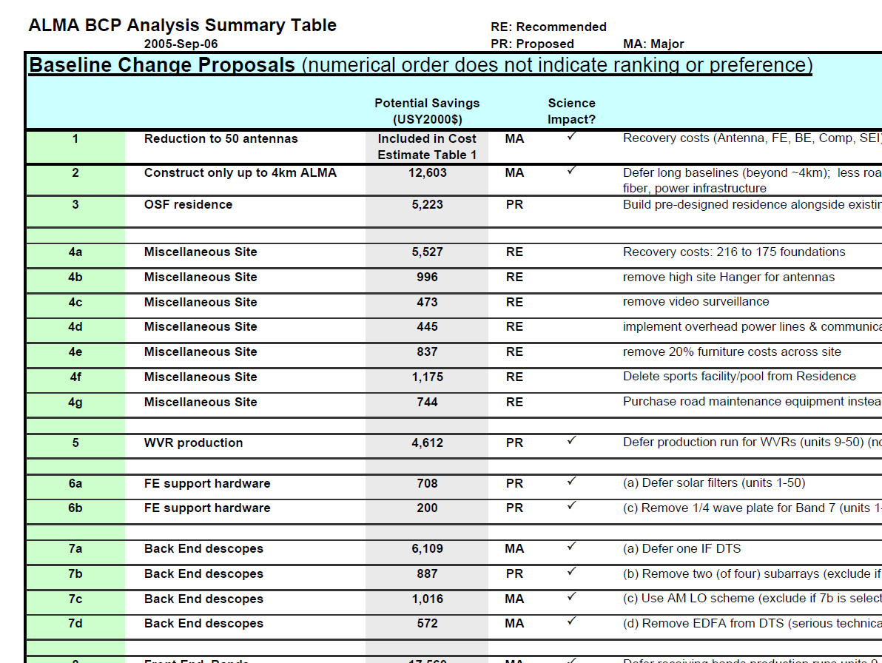

Slide 18
Late Construction
Antenna vendors ran late (lesson: antenna vendors run late). Difficult to guide/impact large companies.
Site development was expensive. Ouch!
Electronics development eventually accelerated.
Errors in original Operations thinking were understood and compensated for (OSF; AOSTB; AIV; offsite; etc. etc. Need more $$$).
Technical definition was proved; rebaselining budget was enough; and the right people were in place.
One antenna, then two… now 50. Five cycles of science in 2017.

Slide 19
Stock in Warehouse – New Plan Antenna arrival discounts stock

Slide 20
Cultural Differences - wtf
Major differences between ALMA Execs.
Inter-site differences within Execs...
Personalities, communication styles & social skills critical. “Explain to X what Y means…”
ALMA 2004: Near-death realism, new staff, revised management styles critical to overcome the cultural & historical issues.
Obvious: Face-to-face time: important. Email & timezones make communications difficult.
Differences still quite apparent at times.

Slide 21
Echoes from Construction
Ops Mgt/Governance remains overcomplex.
Late deliverables: Residencia,Pipelines.
Const. people different to Ops. People. Things inevitably change, staffing evolves… painful.
Partners are more linear orgs now; ALMA partnership is effective, capable. Major upgrade anticipated in 10-15 years.
Global economy is a factor; regional economies are x10 worse impact to ALMA.
Balancing risk/resources – hard. $$, observing time, development funding, etc.

Slide 22
Changes? (TB)
Initial Operation ideas flawed– AOS TB; OSF design; offsite/onsite maintenance balance.
Power generation – situation functional, but long-term concerns. Grid power ultimate soln.
IP balancing across regions – better solns?
(NA) Continued US URO program.
Multiple Antennas types – YES.
Residencia – up-front… living conditions.

Slide 23
Some Lessons from ALMA
Buy as much formal PM/PE/SE/QC as can afford.
People (not physics) are your enemy and savior.
There is no substitute for experience.
Decisions: make them. Do best you can with data available. Focus on big decisions, watch risks.
Effective & professional personnel management is critical (no brilliant jerks).

Slide 24
Centralized technical/budget control, decision-making also critical. Strong JAO.
Information volume ~too high for good external review, and project reporting can be difficult.
Cultural issues: always tough. Amplify personality effects, organizational differences. Regular face-time important.

Slide 25
Scale & complexity of endeavor critical, and their impacts on decision-making and culture often underappreciated. LCD decision-making.
Political considerations make some decisions.
Science projects: make extraordinary requests of unique individuals ⇒ complex workforce.
As a discipline - we do not retain/transmit lessons learned well.

Slide 26
Large projects – not a sprint or a marathon, they are a relay race – plan for this. Large projects have multiple generations of management.
Stop imagining your problem and organization are special… there are few new & unique problems in the project world. Seek knowledge elsewhere.
Don’t accept madness somewhere in your project, then demand widespread sanity.

Slide 27
Summary
ALMA Construction Project was an immense success, thanks to the efforts of the incredible people involved and the inspiration/guidance of the community.

Slide 28
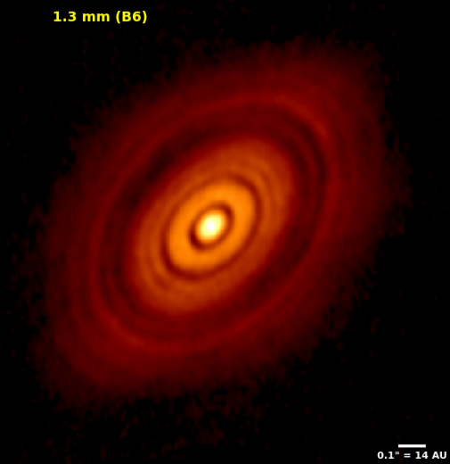
HL Tau

Slide 29
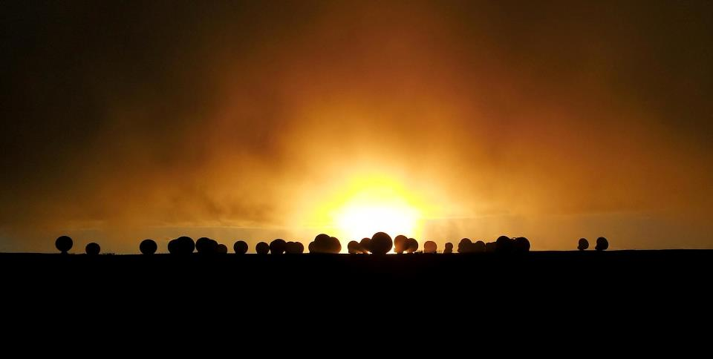

Slide 30
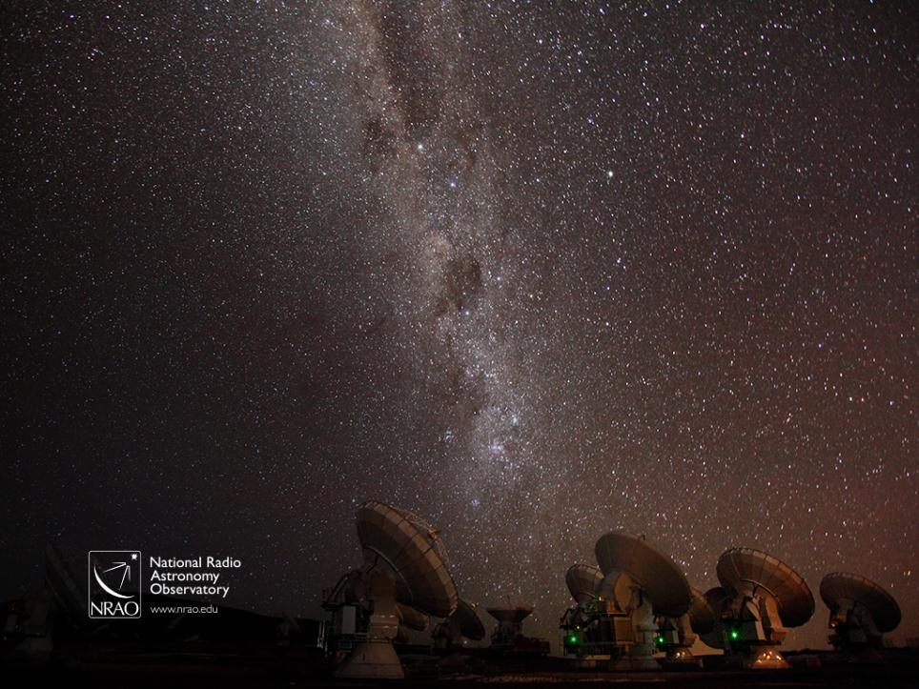
The Atacama Large Millimeter/submillimeter Array (ALMA) is an international partnership of the European Southern Observatory (ESO), the U.S. National Science Foundation (NSF) and the National Institutes of Natural Sciences (NINS) of Japan, together with NRC (Canada), NSC and ASIAA (Taiwan), and KASI (Republic of Korea), in cooperation with the Republic of Chile.
ALMA construction and operations are led on behalf of Europe by ESO, on behalf of North America by the National Radio Astronomy Observatory (NRAO), which is managed by Associated Universities, Inc. (AUI) and on behalf of East Asia by the National Astronomical Observatory of Japan (NAOJ). The Joint ALMA Observatory (JAO) provides the unified leadership and management of the construction, commissioning and operation of ALMA.
Many thanks to Jeff Hellerman, Bill Saxton, Alex Angelich, the NRAO EPO team, the Joint ALMA Office and our EPO/outreach colleagues from our European and Japanese partners, NASA/ESA and the US National Science Foundation for the graphics and animations shown.
Notes:
In summary: there are at least four good reasons to do astronomy – seek our place in the universe; access a cosmic laboratory; create new technologies; and inspire STEM outcomes - and ALMA has a role to play in all of them. The different view of the universe ALMA delivers is already making incredible and important contributions to astronomy, and while we may or may not eventually better understand better our origin, place and role in the universe in future, I strongly believe that the broad interest and inspiration that science in general, and astronomy in particular, can trigger in students and in people like all of you, will be the difference that makes a difference across many lives and in our future.
Thanks for your time.

