Slide 1

Impact of New Generation of User Oriented Radio Telescopes
The Golden Anniversary of the 1960’s:
The Golden Years of Radio Astronomy
HRA - IAU GA Hawaii
5 Aug 2015
Ron Ekers
CSIRO
Australia

Slide 2
Overview
The discovery process
Specialized ➔ general purpose
Discoveries with the first general purpose telescopes
Impact of the 1960’s technology revolution
The concept of User Facilities & Open Access

Slide 3
The discovery process
At the inception of a new field
  Discoveries will be made with any simple instruments which open up new parameter space
  Specialised instruments will dominate
  Sir Richard Wooley (Astronomer Royal 1955-75):
    Took the view that radio people were unreasonably lucky
After the inception of a new field
  A transition occurs with more discoveries being made with general purpose telescopes
  For radio astronomy this transition occurred during the 1960s
Notes:
Woolley statement from William McCrea Woolley memoir
http://www.asap.unimelb.edu.au/bsparcs/aasmemoirs/woolley.htm

Slide 4
Key Discoveries in cm Radio Astronomy#
Discovery | Date
Cosmic radio emission | 1933
Non-thermal cosmic radiation | 1940
Solar radio bursts | 1942
Extragalactic radio sources | 1949
21cm line of atomic hydrogen | 1951
Mercury & Venus spin rates | 1962, 5
Quasars | 1962
Cosmic Microwave Background | 1963
Confirmation of General Relativity (time delay + light bending) | 1964, 70
Discovery | Date
Cosmic masers | 1965
Pulsars | 1967
Superluminal motions in AGN | 1970
Interstellar molecules and GMCs | 1970s
Binary neutron star / gravitational radiation | 1974
Gravitational lenses | 1979
First extra-solar planetary system | 1991
Size of GRB Fireball | 1997
# This is a short list covering only metre and centimetre wavelengths.
Wilkinson, Kellermann, Ekers, Cordes & Lazio (2004)
Notes:
Table 1: Taken from “Exploration of the unknown”
NB this is a very exclusive list (all 5 co-authors had to agree). It doesn’t include double pulsar or Deuterium
# This is a short list covering only metre and centimetre wavelengths.
Serendipity removed from this version

Slide 5
Key Discoveries :
Type of instrument
The number of discoveries made with special purpose instruments has declined
Notes:
Table 1: Taken from “Exploration of the unknown”
the number of discoveries made with special purpose instruments
has declined. Cf Harwitt
Possible reasons:
- Its easier to use existing general purpose instruments
- The people who can build special purpose instruments have gone
- the discoveries which can be made without the big science
instruments (sensitivity...) have all been made.

Slide 6
Transition from specialised to general purpose instruments
During the 1960s the first of the General Purpose Radio Telescopes were in use
  1958 OVRO 2x90’ dishes
  1960 Parkes 210’ dish
  1962 Cambridge One-mile Telescope
  1963 Arecibo 1000’ fixed spherical reflector
  1964 Haystack 120’ dish
  1965 Greenbank 140’ dish
  1965 VLA proposal submitted
  1966 Goldstone 210’ Deep Space Network
  1967 Culgoora Solar Heliograph
  1970 WSRT
Notes:
Telescope data from “Radio Telescopes”

Slide 7
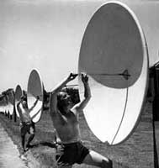
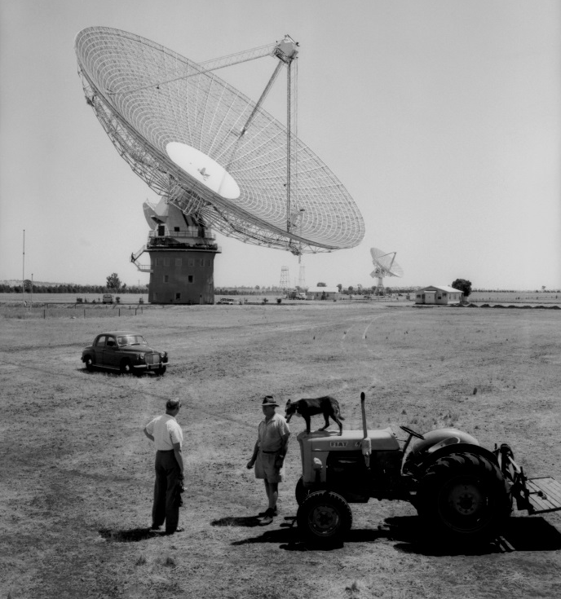
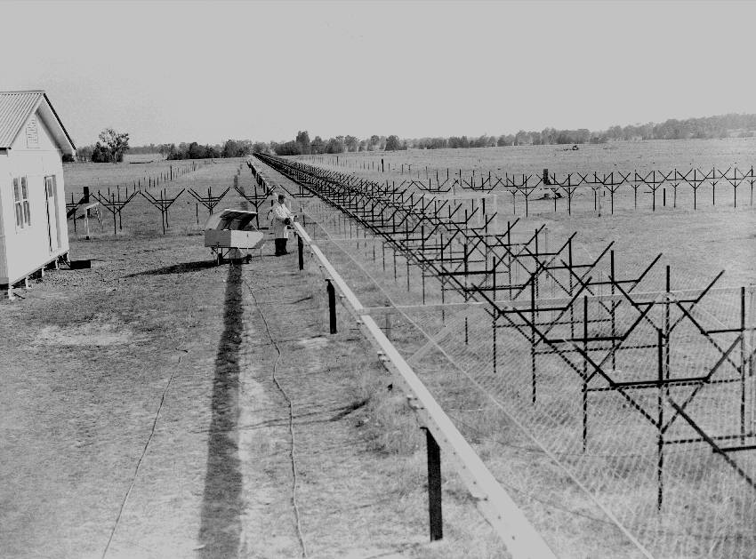
Early Australian Telescopes
Specialised
⇩
General Purpose
Christiansen
Potts Hill
  Mills Cross
7
Notes:
7

Slide 8
1960s Discoveries with General Purpose Instruments
Cambridge
  Ryle and Neville earth rotation synthesis image of the North pole
    MNRAS 125, 39
  FT done using EDSAC II
Parkes
  Quasars - Hazard as an example of an outside user
JPL/Arecibo
  Mercury/Venus spin rates
Culgoora Solar Heliograph
  2D dynamic spectra of solar bursts
VLA
  images of quasars (3C273)
Notes:
Removed WSRT
HI and dark matter (1978)
Dark matter – started in 1972 (Rogstad and Shostack) then Bosma WSRT 1978

Slide 9
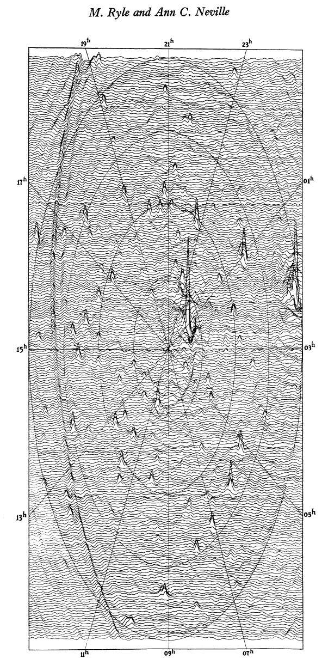
First Cambridge Earth Rotation Synthesis Image
Ryle & Neville, MNRAS 1962
North pole survey
178 MHz
200x200 pixels took a full night on EDSACII
9
Notes:
June 1961
4C aerials
7 years after Christiansen
Similar results now being obtained by LOFAR & MWA!
Removed: Now Moore’s law and the massive improvements in computing power give us LOFAR and MWA

Slide 10
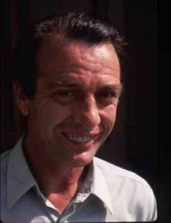
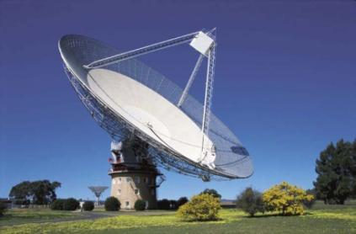
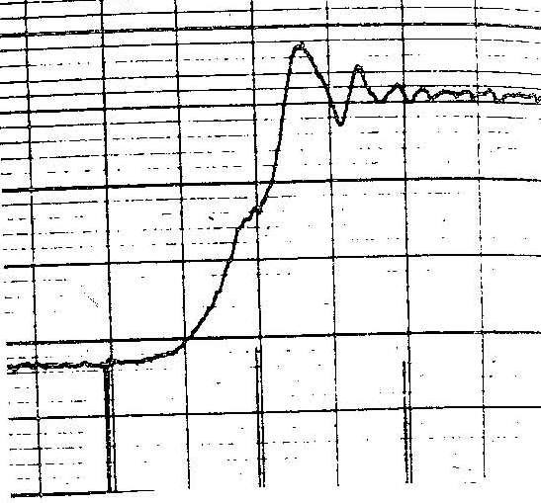
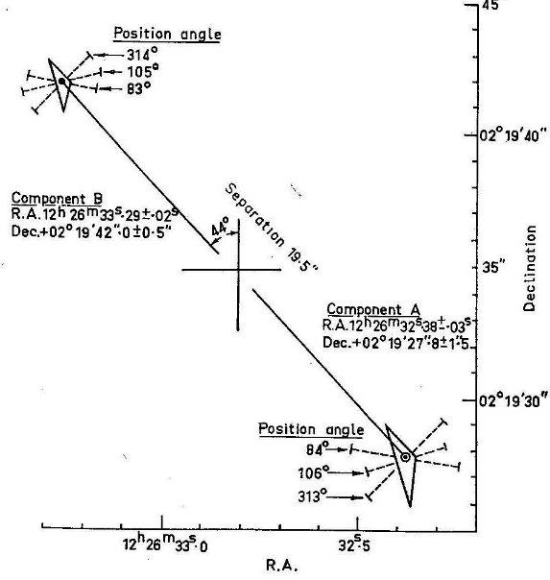
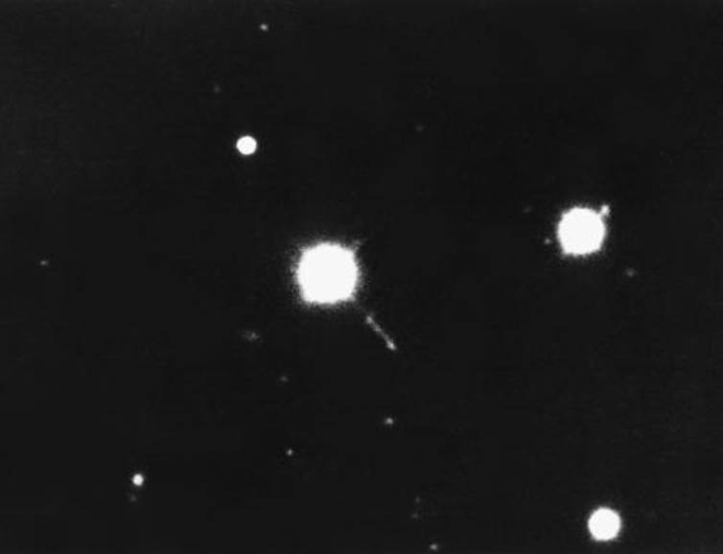
3C 273 identification (1963)
Cyril Hazard
Parkes lunar occultation
Notes:
Replace Cyril Hazard picture
Add 3C273 optical id

Slide 11
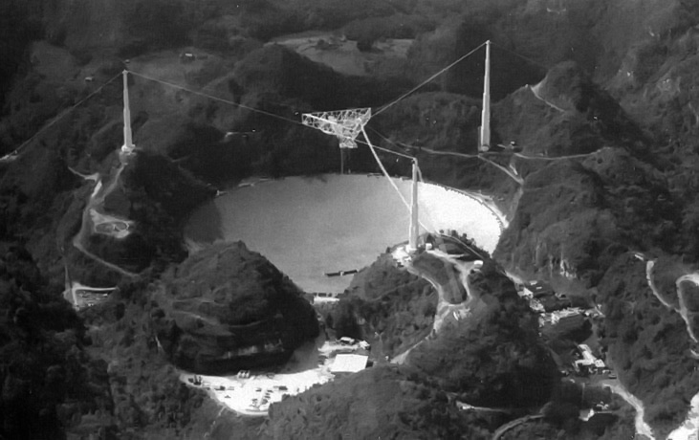
1962 JPL & 1965Arecibo radar Mercury/Venus rotation period
Dyce & Pettengill AJ 73, p351 (1967)
Notes:
Dyce & Pettengill AJ 73, p351 (1967)

Slide 12
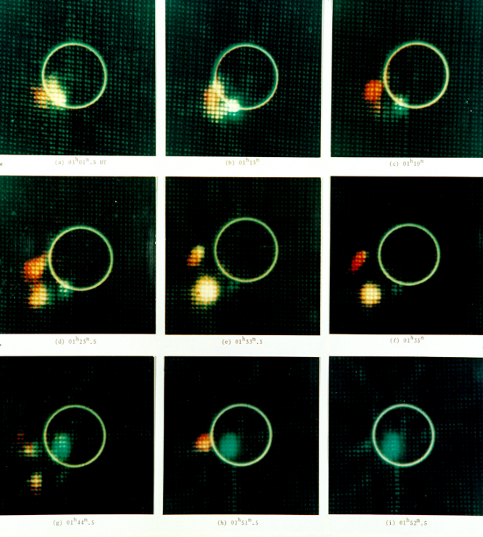
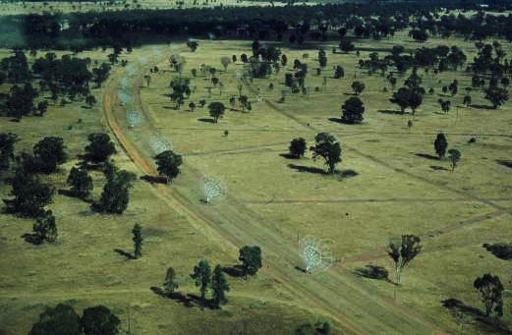
Culgoora Solar Heliograph
1968
2D dynamic images of solar bursts
  2sec/image
Type II & III bursts
  Evolution
Type IV bursts
  great loop structures
  giant magnetic fields
  circularly polarized

Slide 13
Technology leads scientific discoveries
De Solla Price (1963):
most scientific advances follow laboratory experiments
Martin Harwit (1981): “Cosmic Discovery”
most important discoveries (in astronomy) result from technical innovation
  Discoveries peak soon after new technology appears
  usually within 5 years of the technical capability
  Instruments used for discoveries are often built by the observer

Slide 14
Impact of the 1960’s technology revolution
receiver performance
  changed the balance between arrays and dishes
    needed big D small N
    OVRO
  changed the balance between high and low frequency
Impact of computers and digital signal processing

Slide 15
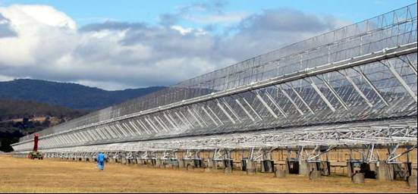
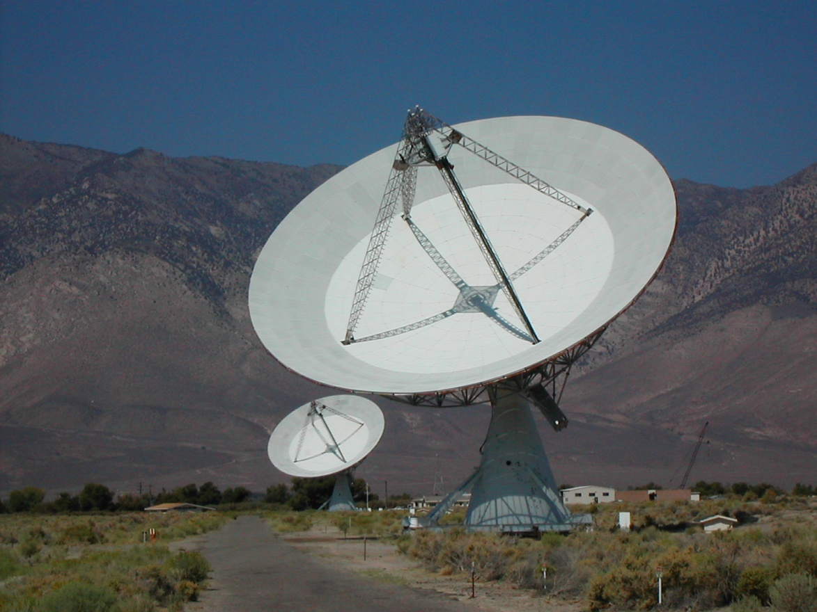
Dishes v Arrays circa 1957
Parkes 64m dish or a Super Mills Cross
Mills
  The dish will be confusion limited at low frequencies
  At high frequencies it will only see thermal emission which is boring
  The array has high resolution at low frequency and you can map the distant universe
Bolton – build an interferometer with large dishes
OVRO
15
Notes:
15
Added for RRI talk, copy back to URSI

Slide 16
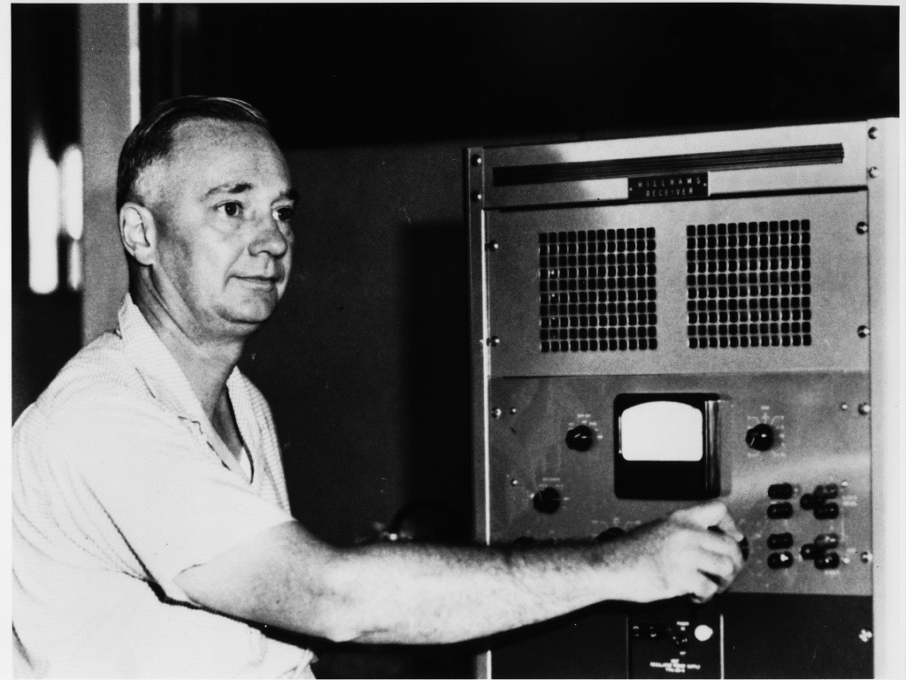
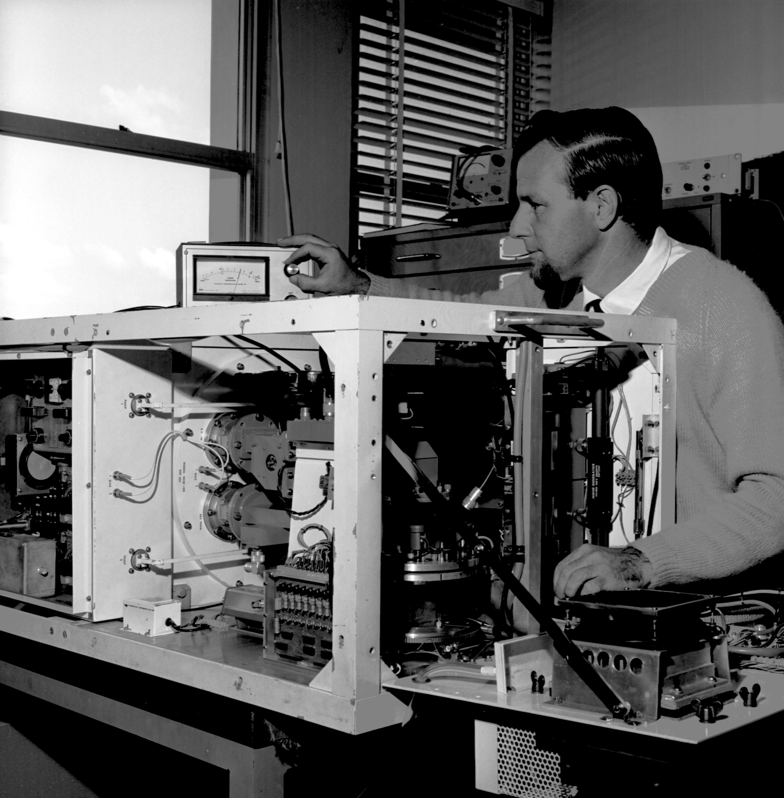
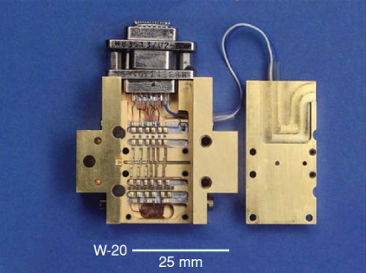
Receiver developments
(Radio Astronomy)
1940 Vacuum tubes (>1000K)
1950 Crystal mixers (300K)
1960 Parametric amplifiers (100K)
1960 Masers (65K)
1960 Diode mixers
1965 Cryogenically cooled transistors (50K)
1980 GaAs FETs (20K)
1987 Multi element receivers
1990 HEMT (10K)
2000 SIS (high frequency)
2020 Superconducting
paramp (0.3K)
Notes:
Information from Brian Cooper and Marian Pospieszalski
Maser discovered 1953 (Nobel prize Townes, Basov and Prokhorov 1964)
Updated after discussion with Sandy Weinreb Sep 2014
Maser for Radio Astronomy Giordmaine et al Proc IRE, 47 pp1062 (1959)
Multi-element: 1987 Greenbank, 1996 Parkes

Slide 17
Receiver Sensitivity exponentials again!
Notes:
Added July 2015

Slide 18
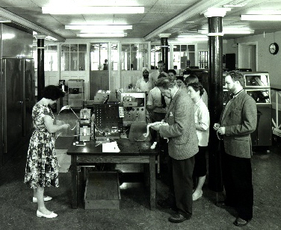
Computers and signal processing
1958
  EDSAC II completed and applied to Fourier inversion problems
  360 38-point 1D transforms took 15 hours (Blyth)
  Output was contours!
1961
  Jennison had acquired Ratcliffe's lecture notes on the Fourier transform and publishes a book on the Fourier Transform
  Sandy Weinreb builds the first digital autocorrelator
1965
  Cooley & Tukey publish a convenient implementation of the FFT algorithm
Cambridge 1960
user queue for programming the EDSAC 2
18
Notes:
FFT was known since Gauss 1805 and reinvented many times

Slide 19
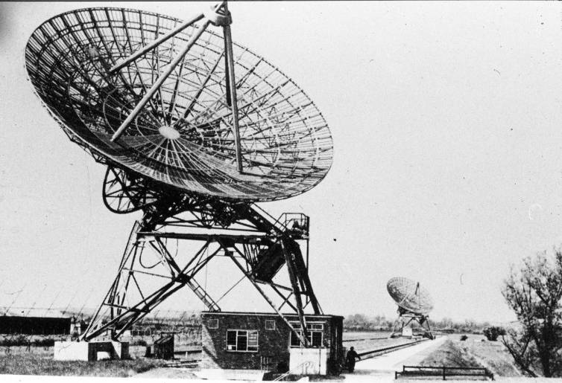
Cambridge One-Mile Telescope: 1962

Slide 20
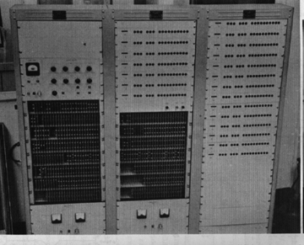
1960 – First Radio Astronomy Digital Correlator
21 lags 300kHz clock discrete transistors
$19,000
Sandy Weinreb
Notes:
From Dan Werthimer 2015

Slide 21
The concept of user facilities
NRAO and the concept of user facilities
  1961 Joe Pawsey appointed as NRAO director
    Died 1962 - what would have happened if Joe Pawsey had lived?
    Proposed astronomy program 1962
  beginning of VLA
what is a user
  astronomers are sophisticated end users - good for technology development and innovation
open skies concept needs user facilities

Slide 22
Pawsey 1962 "Promising Fields of Radio Astronomy”
HII regions in absorption at low frequencies
  20MHz observations
Magnetic fields in inter-stellar space
  linear polarization ☑
  Zeeman splitting ☑
    Weinreb digital correlator
High angular resolution of solar flares ☑
Counting sources
  resolve the violent disagreements ☑
Notes:
from Pawsey note July 19 1962

Slide 23
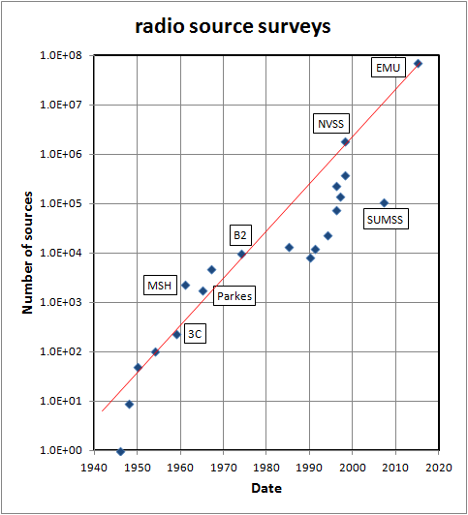
Source Counts
Resolved the disagreements
First reliable catalogues
  3C, 4C
  MSH
  Parkes
Establish the need for source evolution

Slide 24
Pawsey 1962 "Promising Fields of Radio Astronomy”
HII regions in absorption at low frequencies
  20MHz observations
Magnetic fields in inter-stellar space
  linear polarization ☑
  Zeeman splitting ☑
    Weinreb digital correlator
Counting sources
  resolve the violent disagreements ☑
High angular resolution of solar flares ☑
What was missed in just the next 10 years
  Quasars, CMB, Masers, Pulsars, ….
Notes:
from Pawsey note July 19 1962

Slide 25
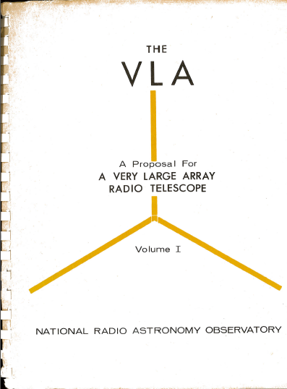
VLA performance goals 1965
“General consideration of the problems in radio astronomy, has led to the concept of a radio analog of the 200-inch optical telescope - a radio telescope which can produce a "picture" of a radio source with resolution and sensitivity comparable to that achieved with optical telescopes.
This is the basic performance goal of the VLA.
No such instrument exists at present. When a radio telescope with these capabilities does exist, it will revolutionize radio astronomy. “

Slide 26
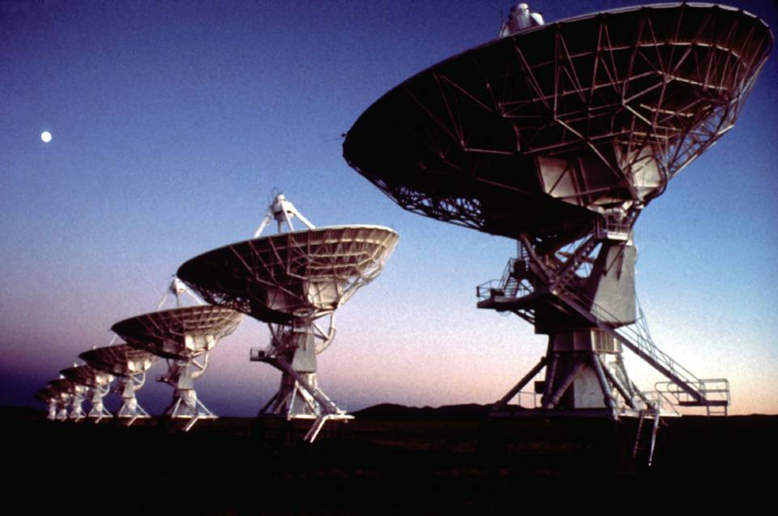
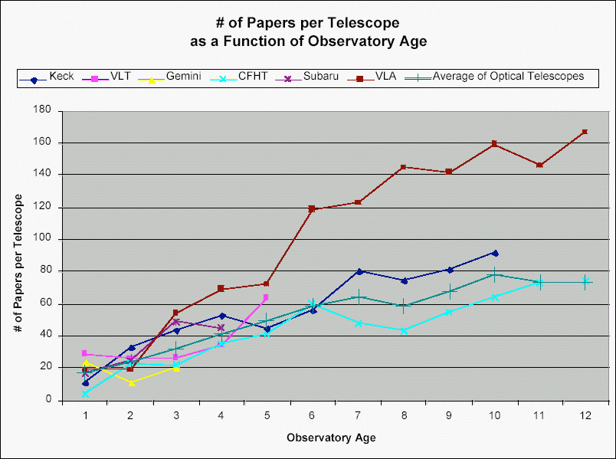
VLA
New Mexico
1980
Notes:
26

Slide 27
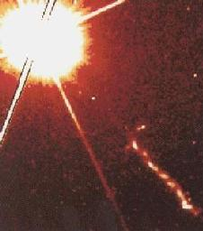
3C273
Optical HST

Slide 28
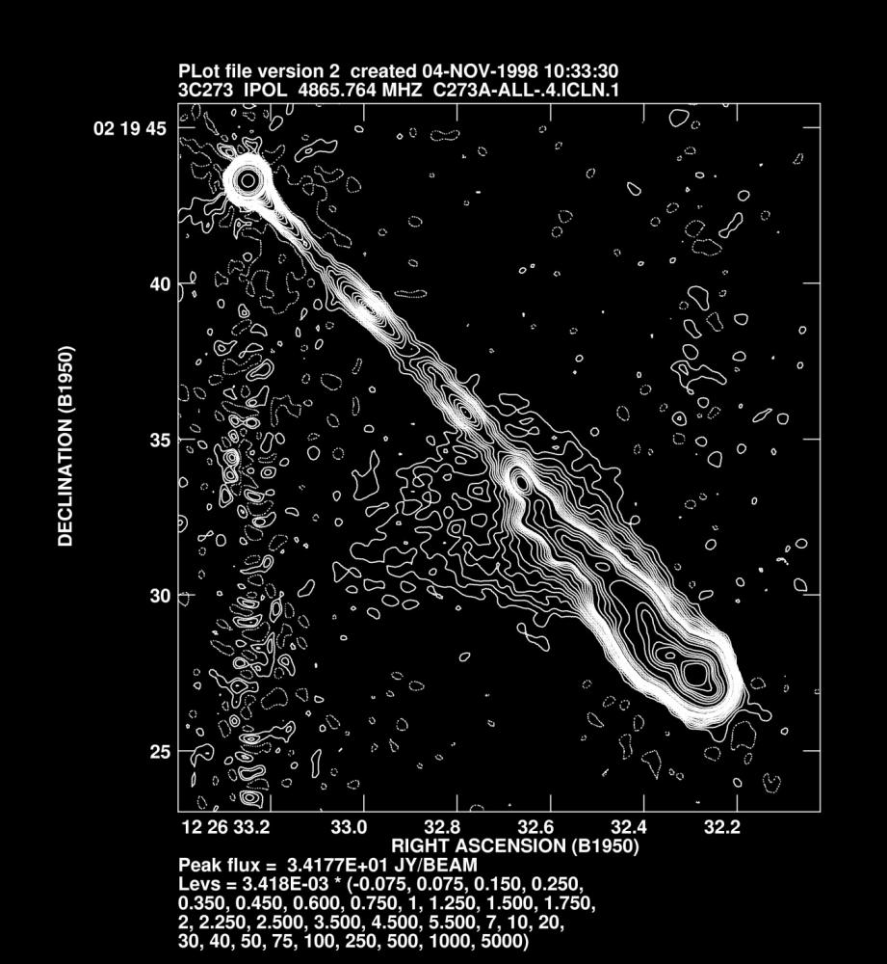
3C273
VLA 5GHz 1998

