Slide 1
Fred Hoyle - Source Counts - Steady State Cosmology
Historical Radio Astronomy
27 Aug 2012 IAU GA Beijing
Ron Ekers
CSIRO, Australia
Notes:
Title: How Fred Hoyle reconciled radio source counts and the Steady State Cosmology
Abstract: In 1969 Fred Hoyle invited me to his Institute of Theoretical Astronomy (IOTA) in Cambridge to work with him on the interpretation of the radio source counts. This was a period of extreme tension with Ryle using the steep slope of the radio source counts to argue that the radio source population was evolving and Hoyle maintaining
that the counts were consistant with the steady state cosmology. Both of these great men had made some correct deductions but they had also both made mistakes. The universe was evolving, but the source counts alone could tell us very little if anything about cosmology. I will try to give some indication of the atmosphere and the issues at the time and look at what we can learn from this saga.

Slide 2
Summary
My involvement with Hoyle & Ryle in 1969
The controversy
History of source counting
The radio luminosity function and how it can mess everything up
Evolution of radio surveys over time
Livingston curves
Notes:
IAUGA version

Slide 3
Early views on cosmology and radio sources
Steady State was the favored cosmology
Testable theory
Charismatic advocates (Gold, Hoyle ……
Big Bang
a popular term coined by Fred Hoyle
Hoyle and Burbidge were early supporters of the extra galactic radio source models
Super massive stars (not blackholes) in centres of galaxies
Opposed the radio star interpretation and already in conflict with Ryle
Notes:
Changed Big Bang a “derogatory term” to “popular”. Note that it is probably a myth that Fred intended it to be derogatory. See Hoyle’s biographer Simon Mitton who blames George Gamow for the Myth.

Slide 4
History of source counting
Ryle measures a cumulative source count slope steeper than S^{-1.5}
Concludes that the universe is evolving
Initially S ^{-2.5} and later revised to S^{-1.8}
Peter Scheuer understood the confusion issue
Mills obtains a slope less than S^{-1.5}
Measured S^{-1.8} and corrected it to S^{-1.5} (resolution bias)
Concludes that the universe is consistent with static Euclidean or steady state.
May have been misled by the number of bright extended SH sources
Hoyle argues that Ryle is wrong and that counting sources can’t say anything about cosmology
I worked with Hoyle between 1969 and 1970
All were wrong in different ways!
Source counting gets a bad reputation

Slide 5
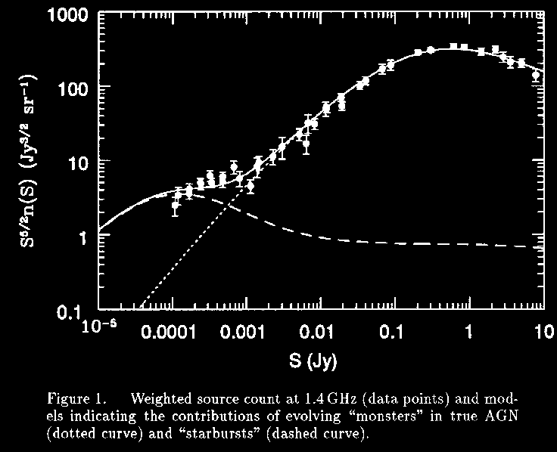
Radio Source Counts

Slide 6
Role of the Radio Luminosity Function
What is the relationship between flux density and distance?
Naively you expect weaker sources to be further away but …
The critical luminosity function
ρ(P) ∝ P^{-3/2} (Static Euclidean)
Applies for a large range in radio luminosity
Eg van Hoerner ApJ 186, 741 (1973)
Hubble relation, an inverse Hubble relation or no relation between flux density and distance

Slide 7
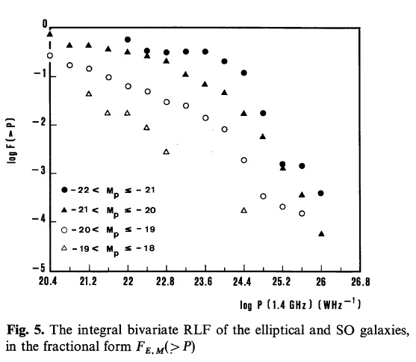
Radio Luminosity Function
Local Bivariate RLF
B2 radio survey
Auriemma et al A&A 57, 41-50 (1977)
Volume

Slide 8
Role of the Radio Luminosity Function (2)
What is the relationship between flux density and distance?
Naively you expect weaker sources to be further away but …
The critical luminosity function
ρ(P) ∝ P^{-3/2} (Static Euclidean)
Applies for a large range in radio luminosity
Eg van Hoerner ApJ 186, 741 (1973)
Hubble relation, an inverse Hubble relation or no relation between flux density and distance

Slide 9
The radio luminosity function
For a flux limit S_{min}
we see out to R=(P/S_{min})^{0.5}
ie in a Volume V∝ ((P/S_{min})^{1.5}
If the RLF ρ(P) ∝ P^{α}
Then the number of sources ∝ P^{α} . (P/S_{min})^{1.5}
Hence 3 possibilities:
α > -1.5 as P increases N increases
More sources at greater distance
α = -1.5 any P is equally probable
Flux density is independent of distance
α < -1.5 as P increases N decreases
More sources at smaller distance

Slide 10
Hoyle 1970
Hoyle & Burbidge, Nature 227 , 359- 361 (1970)
the data supports a differential luminosity function of the form dL/L^{5/2}
They then go on to show that there is no relation between flux density and redshift
Van Hoerner, ApJ 186, 741-765 (1973)
Introduces concept of a critical luminosity function
Discusses the evolution of the rlf
eg density v luminosity evolution

Slide 11
Fred’s Institute (IoTA) in 1969
Across Madingly Road from the Cavendish Laboratory
A few of us crossed the road
Foreigners
Peter Scheuer
Martin Rees
Atmosphere was very different
Fred’s circus – many visitors
Open v Closed
Fred supported my experiment at Algonquin Park to search for CMB fluctuations (1969)

Slide 12
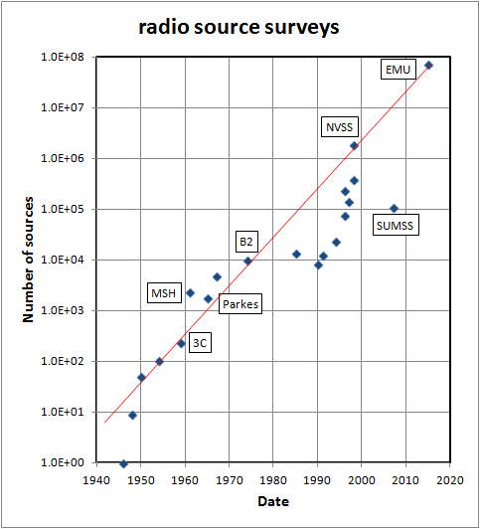
Evolution of radio surveys
Increase by 10⁵ in 60 yr
3 year doubling time for survey size
Exponential?
What happened from 1970 to 1990?
WSRT and VLA focus on individual objects
Tracks telescope sensitivity evolution
Notes:
Updated version

Slide 13
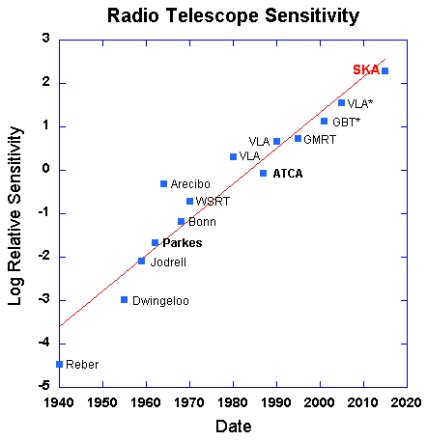
Radio Telescope Sensitivity
Exponential increase in sensitivity x 10⁵ since 1940 !
3 year doubling time for sensitivity
Follows the well known law of exponential growth in Science

Slide 14
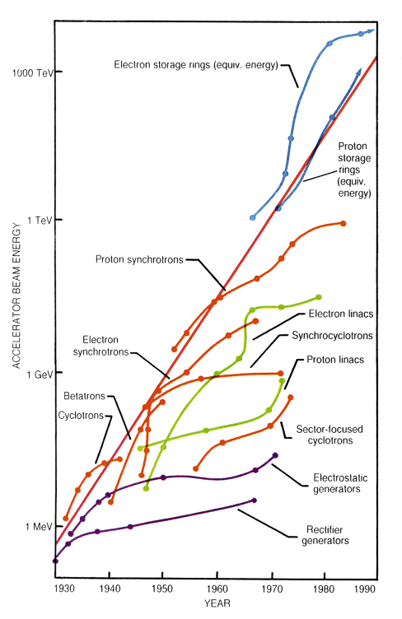
Exponential Growth
Livingstone Curve
Blewett, Brookhaven 1950
Fermi 1954
Livingstone 1962
De Solla Price 1963
exponential growth
Little science, big Science
Notes:
The figure shows the rate of increase of operating energy in particle accelerators (Livingston, M.S. and Blewett, J.P., "Particle Accelerators" McGraw Hill Book Co. 1962., updated by Sessler, A.M., Physics Today, Jan. 1988, pp 26-34). Starting in 1930, each particle accelerator technology provided exponential growth up to a ceiling when a new technology is introduced. The envelope of the set of curves is itself an exponential with an increase in energy of 10**10 in 60 years. This example, originally presented by Fermi, has become known as the "Livingston

